Slide 1

Intro

Slide 2
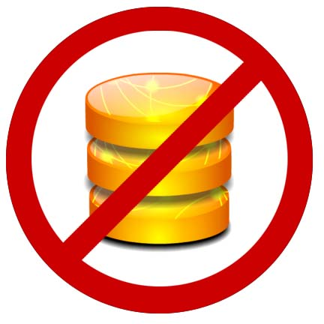
What Will NOT be Covered
DB Stuff -> Serializing your model into the document
DB Stuff->Upserting changes to restful endpoints
Unit Testing your Models
Using View templates to separate markup
Backbone Routers, History

Slide 3
What WILL be Covered: the foundations of client-side MV* frameworks
Models
Views
How to connect them

Slide 4
Spa-Query
Spaghetti-jquery
$(document).ready(function() {
$(‘#foo’).click(function() {
$.ajax(‘/url’,a, function(er) {
});
}):
});
function a() {
}

Slide 5
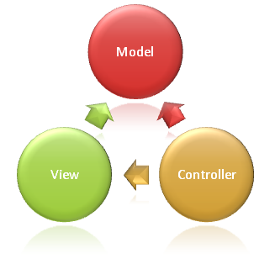
Server Side MVC Frameworks connect models and views with HTTP verbs: GET, POST, etc. over the Request/Response Cycle

Slide 6
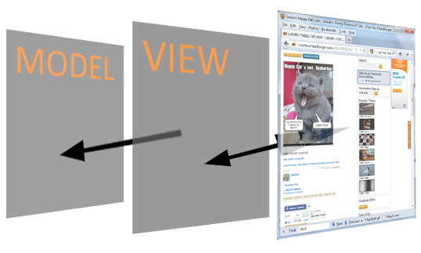
Client Frameworks connect models and views with DOM events onclick, etc. in the window.
No longer simulating a stateful a process

Slide 7
Some of the Players
Backbone -MVW railsy
Knockout – MVVM miscrosofty
Ember.js – MV railsy
Jquery UI widgets (not flexible enough)
A whole slew of others, but it is the first two that have the most momentum right now
Bb -> diy, happy path, strong,m & v, extensible
Ko -> no view class, declarative bindings,observable types,a supv. Class to glue everything up
Ember.js -> strong v&w, templating, weak events

Slide 8
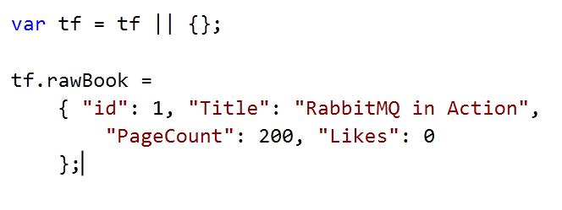
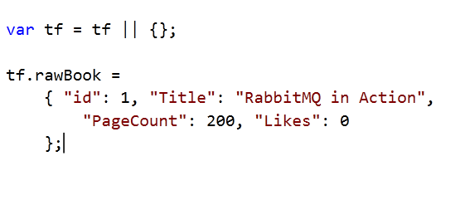
Consider this Book Data Model

Slide 9
BackBone.Model
Prototype for your JSON data object that adds:
Attribute Getters/Setters (properties)
The ability to add custom methods
Event model – publish/subscribe to attribute changes
Built-in plumbing for saving back to server (not covered)

Slide 10
Model Codeup
Quickly proto the incrementlikes
Cover getters and setters
Cover instantiating a model from the proto
Take 60s or less

Slide 11
Views are used to generate a DOM node with HTML content and events and references an underlying MODEL instance

Slide 12
View Codeup
60s or less
Subscribe to model change
To template or not?

Slide 13
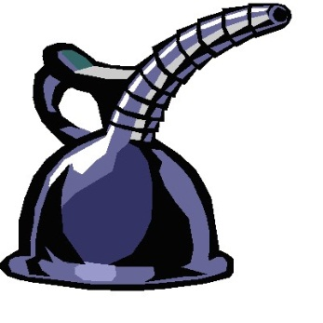
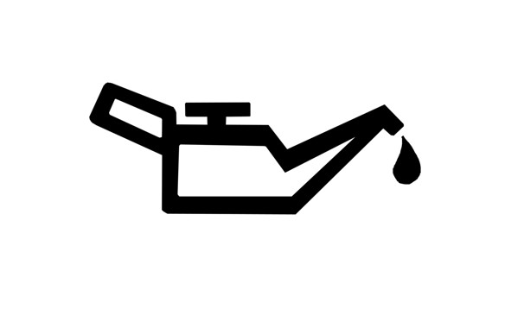

So what?? BFD, this looks like a LOT of code and all it does it increment click.
Maintainable
Maintainable
Maintainable

Slide 14
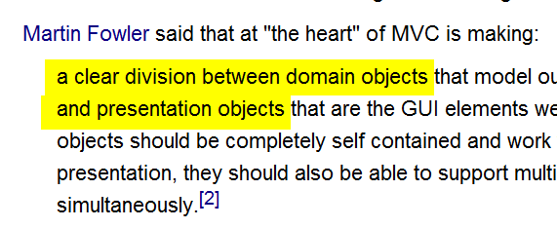

A Guru Speaks
Source: Wikipedia article on MVC

Slide 15
BackBone.Collection & More
Model Reuse
Array of Model with add/remove callbacks, array extensions

Slide 16
What Else?
Persistence -> Backbone.sync (model.save posts to server and only registers changes in attr collection after 200 -> saves A LOT of nested callbacks -> Build RESTful API's with ASP.NET Web API John V. Petersen at 1:45pm
Validation is built in, but best for mobile/quick hits
TDD -> JavaScript Testing John V. Petersen at 3:15pm today

Slide 17
Takeaways
The is a landscape of MV*
Intro to bb code (render is tricky and key)

Slide 18
Client Side Technology is already pretty mature – right now
The apps you know and love are using it
Clients/customer are going to start asking why doesn’t the app work more like gmail/facebook/twitter

