Slide 1

Intro

Slide 2
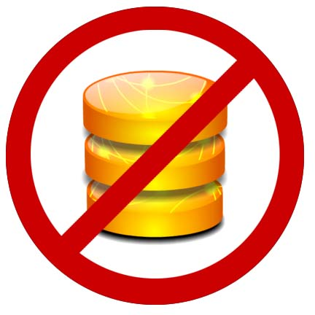
What Will NOT be Covered
DB Stuff -> Serializing your model into the document
DB Stuff->Upserting changes to restful endpoints
Unit Testing your Models
Using View templates to separate markup
Backbone Routers, History

Slide 3
What WILL be Covered: the foundations of client-side frameworks
Models
Views
And how to connect them

Slide 4
Spa-Query
Spaghetti-jquery
$(document).ready(function() {
$(‘#foo’).click(function() {
$.ajax(‘/url’,a, function(er) {
});
}):
});
function a() {
}

Slide 5
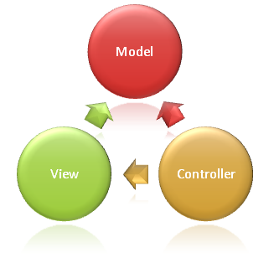
Server Side MVC Frameworks connect models and views with HTTP verbs: GET, POST, etc. over the Request/Response Cycle

Slide 6
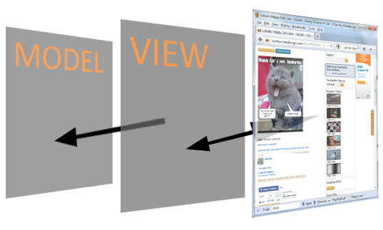
Client Frameworks connect models and views with DOM events onclick, etc. in the window.
No longer simulating a stateful a process

Slide 7
Some of the Players
Backbone - railsy
Knockout - miscrosofty
Ember.js - railsy
Jquery UI widgets (not flexible enough)
- A whole slew of others, but it is the first two that have the most momentum right now

Slide 8
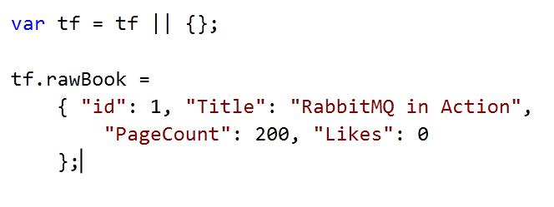
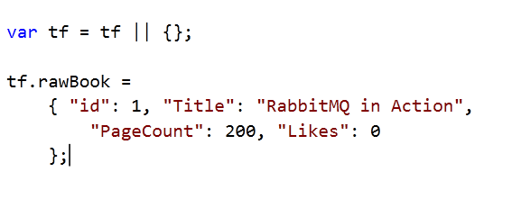
Consider this Book Data Model

Slide 9
BackBone.Model
Prototype for your JSON data object that adds:
Attribute Getters/Setters (properties)
The ability to add custom methods
Event model – publish/subscribe to attribute changes
Built-in plumbing for saving back to server (not covered)

Slide 10
Model Codeup
Quickly proto the incrementlikes
Cover getters and setters
Cover instantiating a model from the proto
Take 60s or less

Slide 11
Views are used to generate a DOM node with HTML content and events delegation, that references an underlying MODEL instance

Slide 12
View Codeup
60s or less
Subscribe to model change
To template or not?

Slide 13
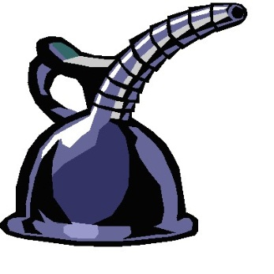
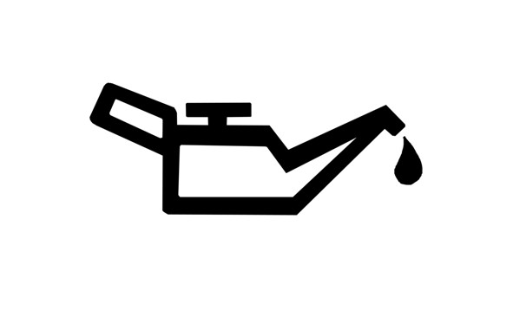

So what?? BFD, this looks like a LOT of code and all it does it increment click.
Maintainable
Maintainable
Maintainable

Slide 14
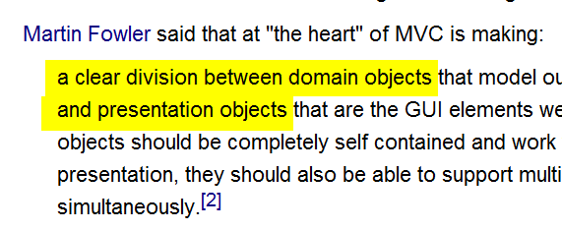

A Guru Speaks
Source: Wikipedia article on MVC

Slide 16
What Else?
Backbone.sync
Validation
Templating
TDD
Namespacing
Collections
routers

Slide 17
Takeaways
Backbone is Agnostic about:
Templating
When/how to re-render after the model changes:
Rerender in view stack
-subscribe to change events in the model

Slide 18
The Client Side is already pretty mature

