Slide 1
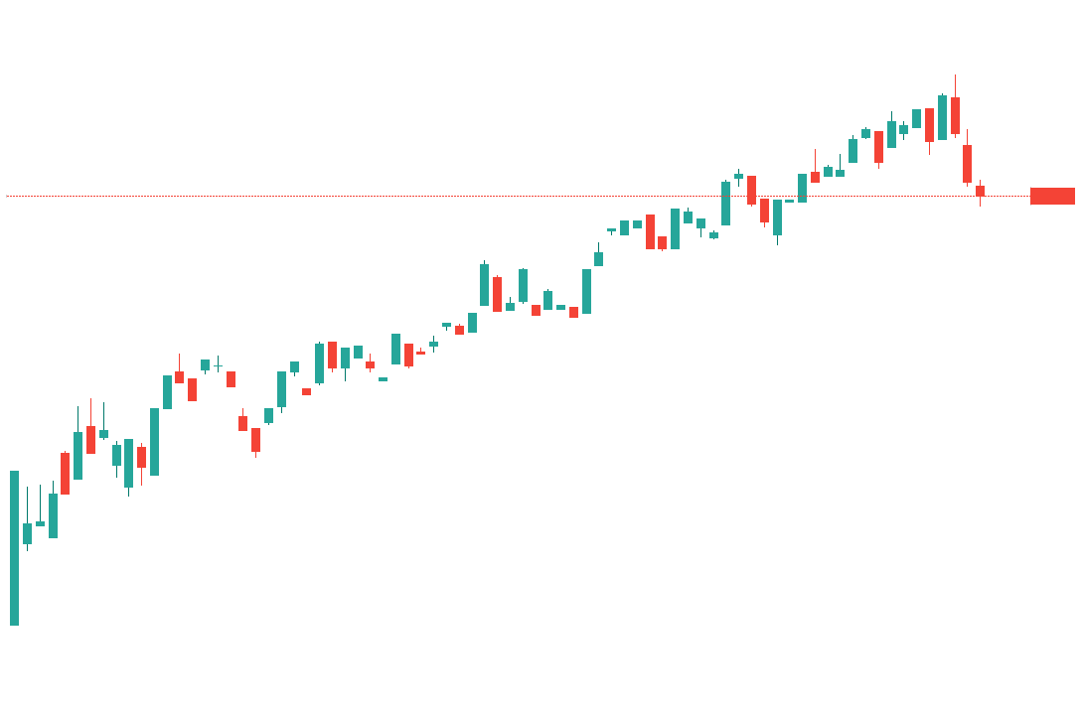
Predicting Bitcoin Prices
Project 2 - Machine Learning
Group 3 - Zach Cone, Richard Henderson, Jonathan Park

Slide 2
Overview: Predicting Bitcoin Prices
The project deploys a variety of machine learning models in order to determine their effectiveness in predicting bitcoin prices. The project utilizes the following historical stock, commodity and macroeconomic data from 1/1/2016 - 6/30/2020:
Dow Jones Industrial Average
NASDAQ Composite
S&P500
CBOE Volatility Index
Gold
Silver
US Dollar Index
WTI Crude Oil
10 YR Treasury Bond Yield
Bitcoin
Gross Domestic Product
Consumer Price Index
Industrial Production Index
Unemployment Rate
Non-Farm Payrolls
Initial Unemployment Claims
Federal Reserve Total Assets

Slide 3
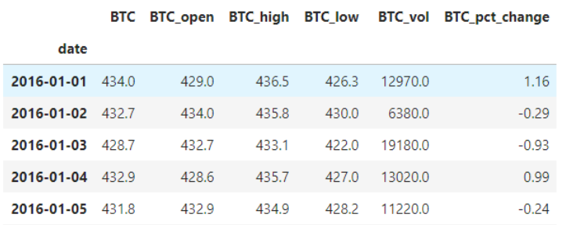
Data: Sample
Daily, historical data from investing.com provides close, open, high, low, volume and % change for each dataset:

Slide 4
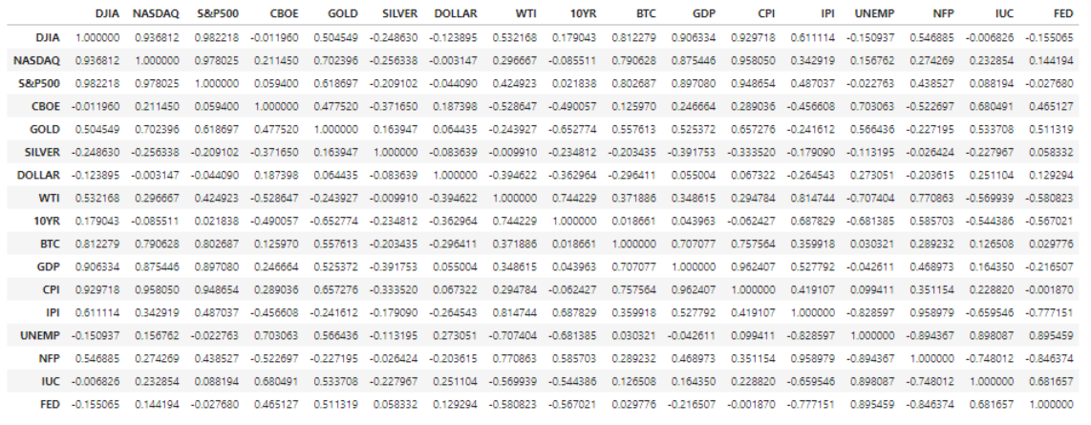
Data: Correlation

Slide 5
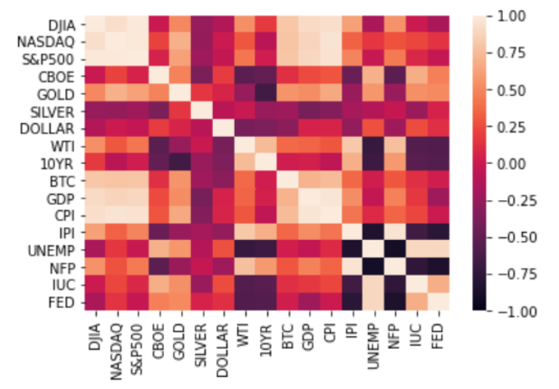
Data: Correlation Heatmap
Correlation analysis shows high correlation between Bitcoin, the stock market and some macroeconomic indicators:
DJIA - 0.81
NASDAQ - 0.79
S&P500 - 0.80
GDP - 0.71
CPI - 0.76

Slide 6
Models
The project deploys the following machine learning models:
Linear Regression
Gradient Boosting Regression
K-Fold Cross Validation Regression
Deep Neural Network
Long Short Term Memory Recurrent Neural Network

Slide 7
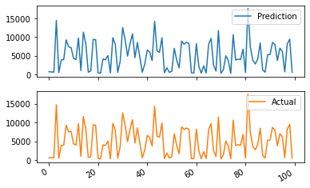
Models: Linear, Gradient Boosting & K-Fold
Testing Parameters:
All models used the same training & testing data
K-Fold used 200 splits & 40 Repeats
GBoosting used 100 estimators, max depth of 5
GBoosting used 61 max features and a learning rate of 0.1
Mean Squared Error used as performance indicator
Root Mean Squared Error used as performance indicator
Linear Regression had best performance indicators
Best Performer: Linear Regression
Linear Regression Mean Squared Error 12245.602
Linear Regression Root Mean Squared Error 95.947
Predictions vs. Actual

Slide 8
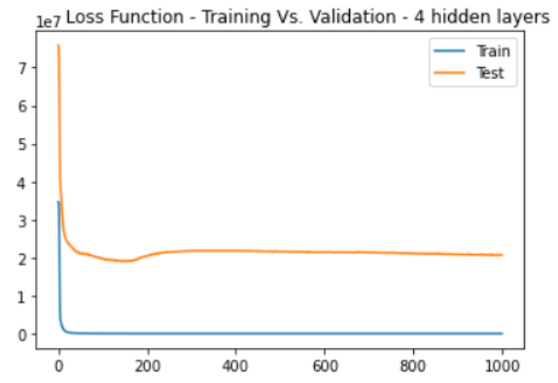
Models: Deep Neural Network
Hyperparameters: Loss Function:
Neural Network Model: Sequential
Number of Input Features: 63
Hidden Nodes Layer 1: 100
Hidden Nodes Layer 2: 50
Hidden Nodes Layer 3: 25
Hidden Nodes Layer 4: 12
Validation Split: 0.2
Epochs: 1,000
Loss: Mean Squared Error
Optimizer: Adam

Slide 9
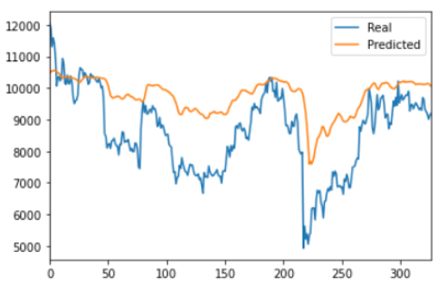
Models: Long Short Term Memory RNN
Hyperparameters: Prediction:
Neural Network Model: Sequential
Window Size: 5
Train - Test Split: 80 - 20%
Number of Units: 5
Dropout Fraction: 0.2
Epochs: 20
Loss: Mean Squared Error
Optimizer: Adam
Model Evaluation: 0.214

Slide 10
Conclusions
Findings:
Linear Regression, Gradient Boosting, & K-fold Cross Validation Regression
Performed the best out between Linear, Gradient Boosting, & K-fold Cross Validation Regression Models
Despite the high Mean Squared and Root Mean Squared error, the graph of the predictions vs the actual are almost identical
Looking at the actual data all three models where not that far off in their predictions
Due to the nature of Cryptocurrency still being relatively new, more data would need to be used to gain a better prediction.
More exploration would be needed to discover if any outliers are affecting the Mean Squared and Root Mean Squared Error results

Slide 11
Conclusions
Deep Neural Network
The loss function shows a significant gap between the training and testing loss curves
The training dataset is unrepresentative of the testing data
The model requires more features and historical data
Long Short Term Memory Recurrent Neural Network
At a train/test split of 80/20%, the model performs relatively well
The model does not predict volatility well
The model would benefit from more historical data
Due to Bitcoin being a relatively new asset, it does not have lengthy historical data. Therefore, it is not the most ideal candidate for machine learning applications as the greatest strength of machine learning is the ability to process large amounts of data.

