Slide 1
Three-stage bedload diffusion from aging and trapping random walks

Slide 2
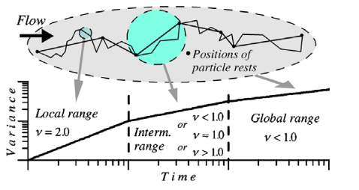
What is the problem?
Bedload shows anomalous diffusion
Three ranges, different diffusion
characteristics in each
Why is bedload diffusion this way? How do the three stages come about?

Slide 3
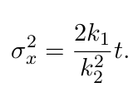
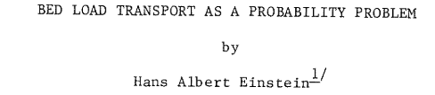
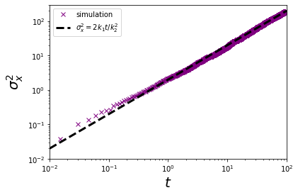
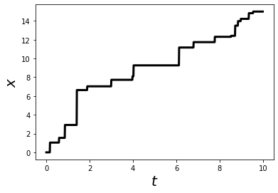
What do we know about it?
Einstein 1937
Einstein 1937 shows a single stage of normal diffusion

Slide 4
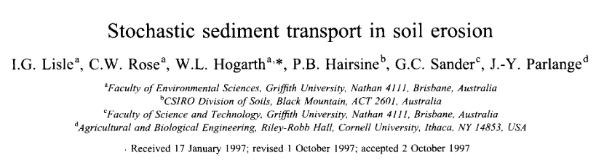
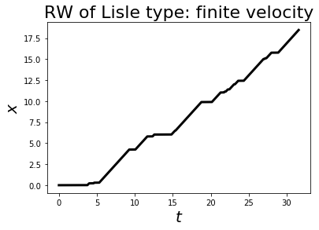
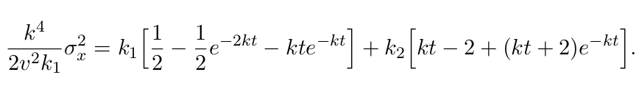
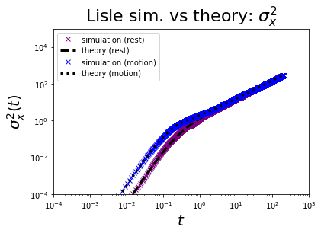
What do we know about it?
Lisle 1998 shows two stages of diffusion
finite motion periods imply local-range super-diffusion

Slide 5
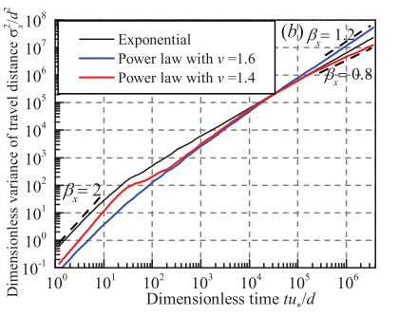
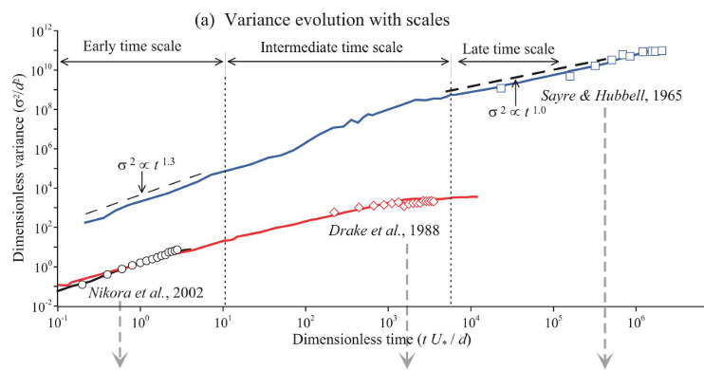
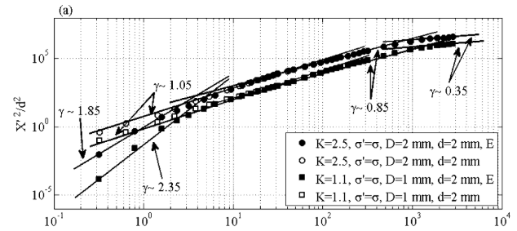
What do we know about it?
Fan 2016 (Niannian) did not obtain it in numerical
simulations
Bialik 2012 got it with numerical
Simulations of individual saltations
Zhang 2012 “TESTFADE”
- numerical simulation with faulty assumptions
- kind-of got it

Slide 6
What don’t we know about it?
Where does the 3rd range of diffusion come from?
What are its characteristics?
Comparing Einstein 1937 and Lisle 1998 shows us that incorporating more timescales
gives more ranges of diffusion ...
What is the time-scale giving the 3rd range of diffusion?

Slide 7
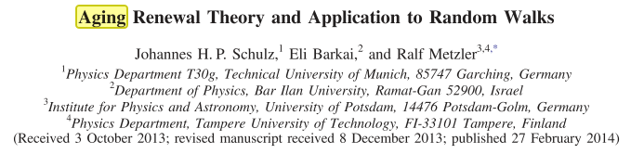
How to solve it?
Need to introduce a third timescale to the problem
Two options:
1) A “Trapping” time-scale
2) An “aging” time-scale

Slide 8
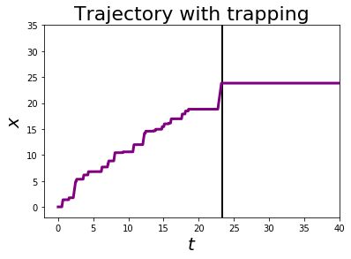
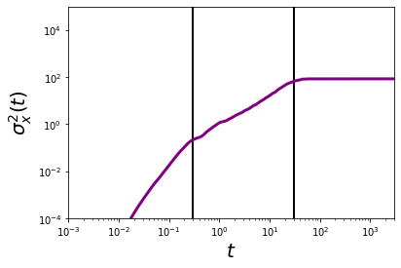
Trapping random walk
Tracers move like Lisle 1998 model until they randomly get stuck in the bed
This generates 3 stages of bedload diffusion.
1st cross-over -- characteristic motion time
2nd cross-over -- characteristic “trapping time”

Slide 9
Aging random walk
Heavy-tailed rest period
Light-tailed motion period
The more you sample resting periods, the larger the values get
The distribution “ages” from light-tailed to heavy-tailed
A Lisle-1998 type theory
With heavy-tailed rests
Should give 3 -stage diffusion

Slide 10
Conclusion
- 3 stage bedload diffusion results from aging or trapping processes
In an Einstein 1937 description
- for 3 stage diffusion, need (1) finite motion period, and (2) heavy-tailed rests
“aging random walk”
OR
- (1) finite motion period, and (2) a trapping process “trapping random walk”
Current stage of research
1) Have reproduced Einstein 1937 and Lisle 1998 from a physics framework
2) Have numerically simulated a trapping random walk. It provides 3 stage diffusion

