Slide 1
Exploring CMS Diversity
From 2008 - 2020
By
Chase Romano
Kirk Mason
Nityanand Kore

Slide 2
“Charlotte-Mecklenburg’s proudest achievement over the past 20 years is not the city’s impressive new skyline or its strong, growing economy. It’s proudest achievement is its fully integrated schools.”

Slide 3
“Charlotte-Mecklenburg’s proudest achievement over the past 20 years is not the city’s impressive new skyline or its strong, growing economy. It’s proudest achievement is its fully integrated schools.”
- Charlotte Observer, 1984

Slide 4
Charlotte’s Story of Diversity
1954 U.S. Supreme Court Brown v Board of Education
1964 Swan v Charlotte-Mecklenburg Board of Education
1971 Busing begins in Charlotte
1970s, 80s Charlotte’s school district is the nation’s model for how to achieve desegregation
1999 Capacchione v Charlotte-Mecklenburg Schools
2001 Busing ends

Slide 5
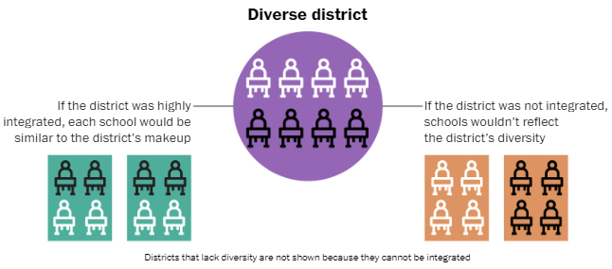
Diversity is a measure of the overall racial makeup of a school district. A district is considered diverse when no one race constitutes more than 75 percent of the school system’s student body overall.
Integration determines how well that diversity is reflected across the individual schools.
An integrated school leads to better academic performance for students of color without affecting white students’ performance, according to decades of research analyzing test scores and graduation rates.
The info and visual on this slide are from How the nation’s growing racial diversity is changing our schools by Kate Rabinowitz, Armand Emamdjomeh, & Laura Meckler, Washington Post, 2019. (Link to article)

Slide 6
Our Goal
To give policy makers and school leaders a tool by which they can assess the diversity changes occurring within the CMS district.
Shiny App

Slide 7
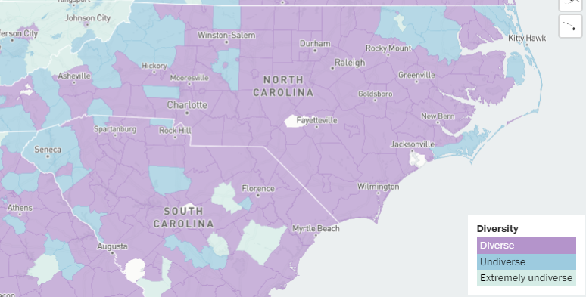
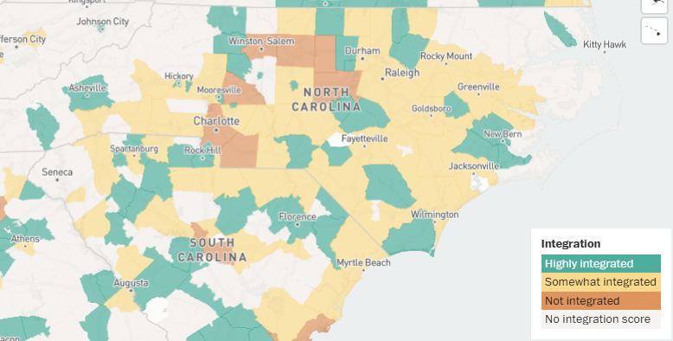
plots from the 2019 Washington Post article

Slide 8
We sent the Proof of Concept to many diﬀerent types of users. These Users included.. • Data Management and Communications Specialist from the Levine Museum of the New South • Assistant Principal in CMS • Parent of a CMS student • Director of Research, Evaluation, and Analytics for CMS Response from Cathy Doheny (Data Management and Communications Specialist) “We needed this very tool just last month when planning marketing for a program. We will deﬁnitely keep it handy to use in the future. I would think that other organizations, including CMS, would also ﬁnd it very helpful. I had a diﬃcult time ﬁnding current stats online last month. You have created such an easy-to-use tool that consolidates all the data into one place” Feedback from Lindsay Messinger, Ph.D. Director of Research, Evaluation, and Analytics Your visuals are very interesting. The only suggestion that I have is to create an option so that the user can select “All minority” or “All Students of color” or “Black/Hispanic”, rather than only being able to select one race at a time.

Slide 9
THANK YOU

