Slide 1
Exploring CMS Diversity
From 2008 - 2020
By
Chase Romano
Kirk Mason
Nityanand Kore

Slide 2
“Charlotte-Mecklenburg’s proudest achievement over the past 20 years is not the city’s impressive new skyline or its strong, growing economy. It’s proudest achievement is its fully integrated schools.”
- Charlotte Observer, 1984

Slide 3
Charlotte’s Story of Diversity
1954 U.S. Supreme Court Brown v Board of Education
1964 Swan v Charlotte-Mecklenburg Board of Education
1971 Busing begins in Charlotte
1970s, 80s Charlotte’s school district is the nation’s model for how to achieve desegregation
1999 Capacchione v Charlotte-Mecklenburg Schools
2001 Busing ends

Slide 4
Our Goal
To give policy makers and school leaders a tool by which they can assess the diversity changes occurring within the CMS district.

Slide 5
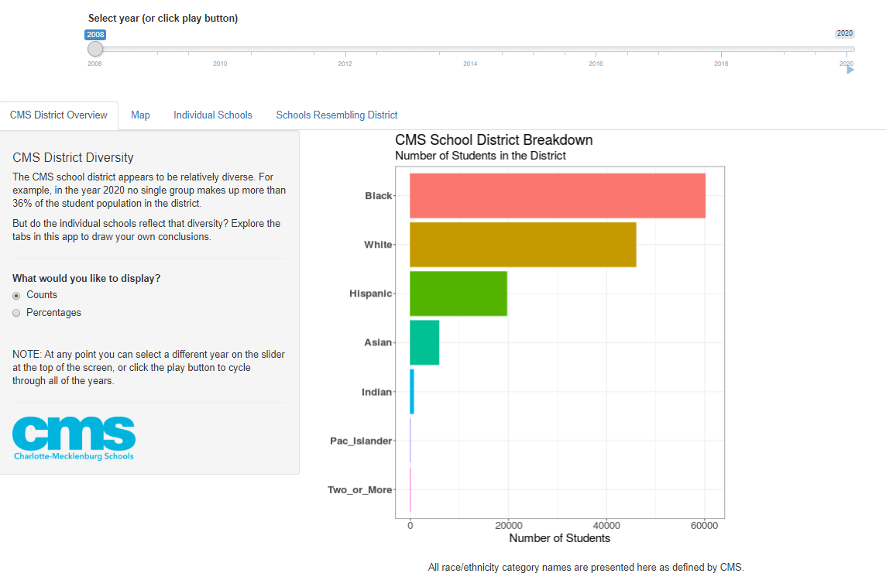
CMS District Overview Tab Panel
District in 2008

Slide 6
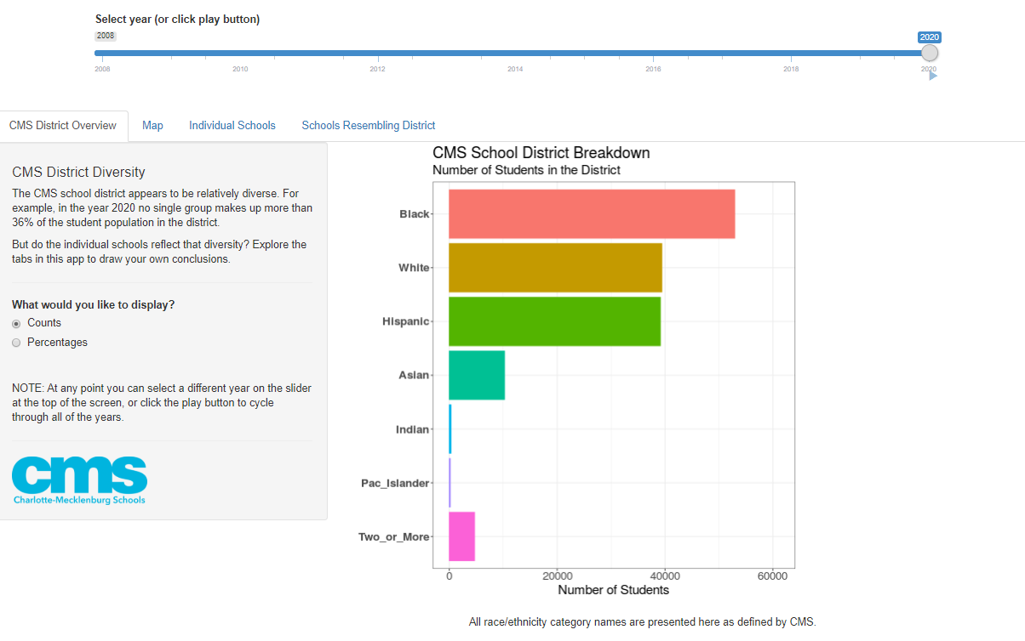
CMS District Overview Tab Panel
District in 2020

Slide 7
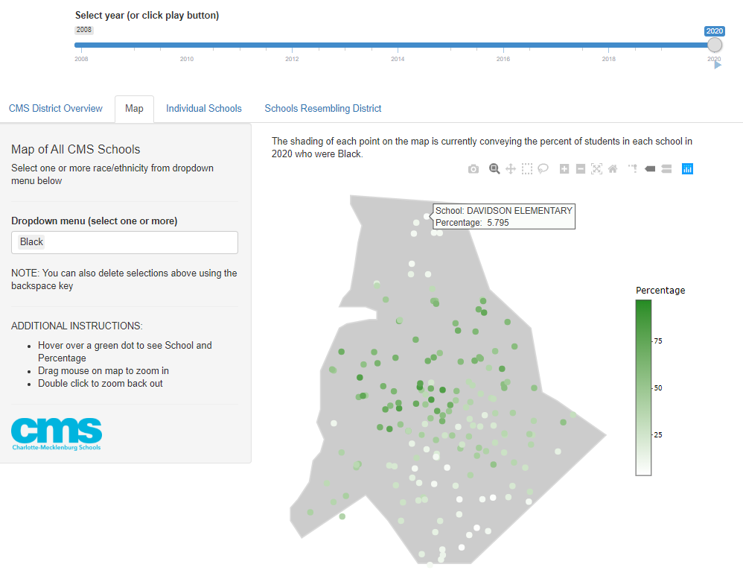
Map
Shaded by % Black

Slide 8
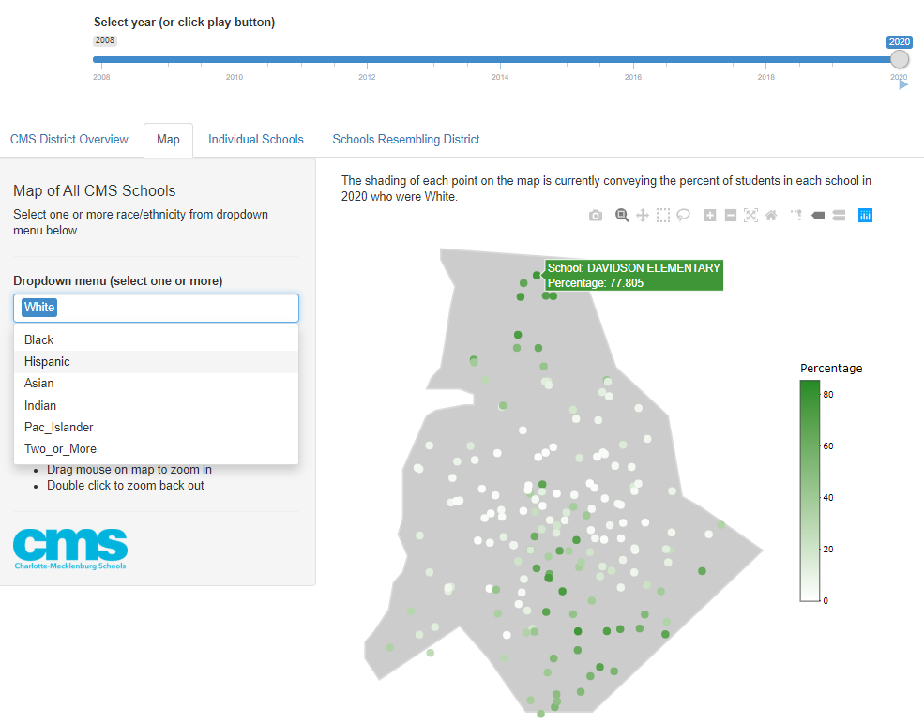
Map
Shaded by % White

Slide 9
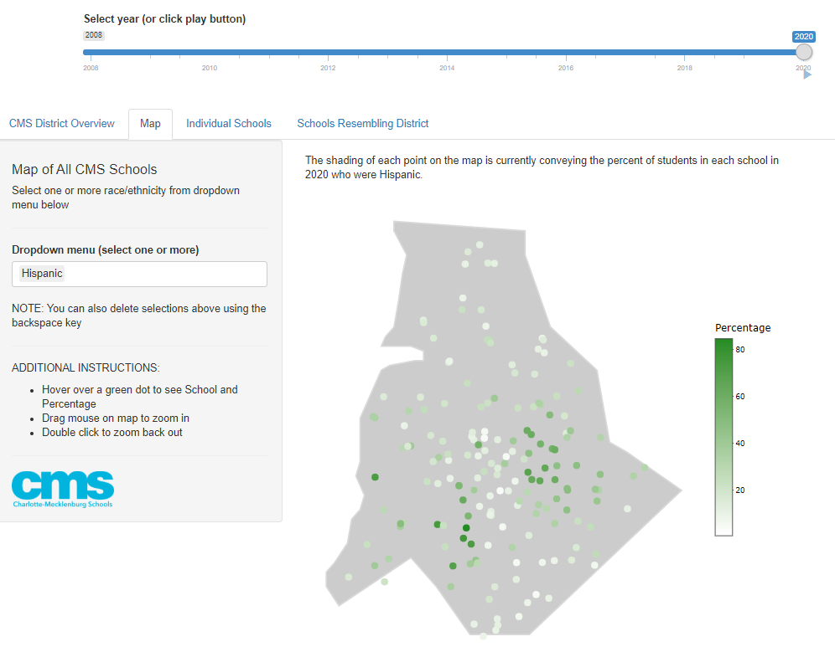
Map
Shaded by % Hispanic

Slide 10
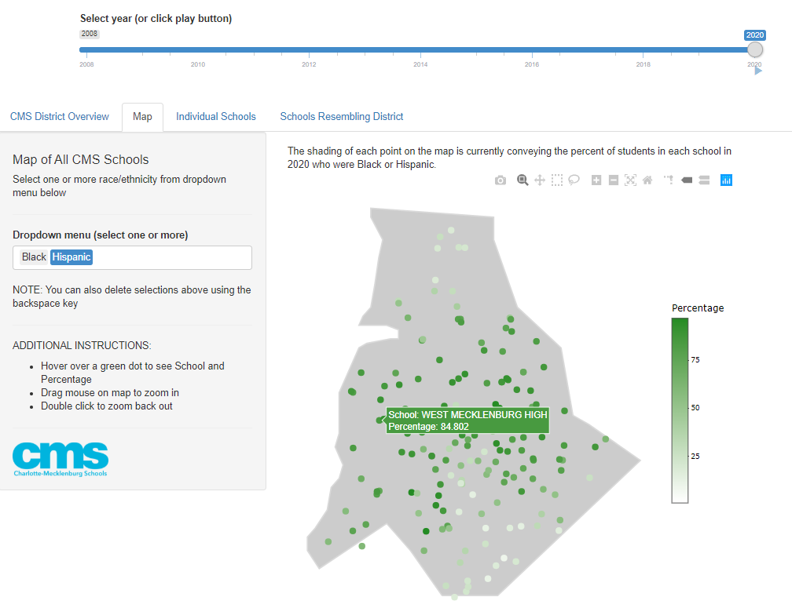
Map
Shaded by % Hispanic

Slide 11
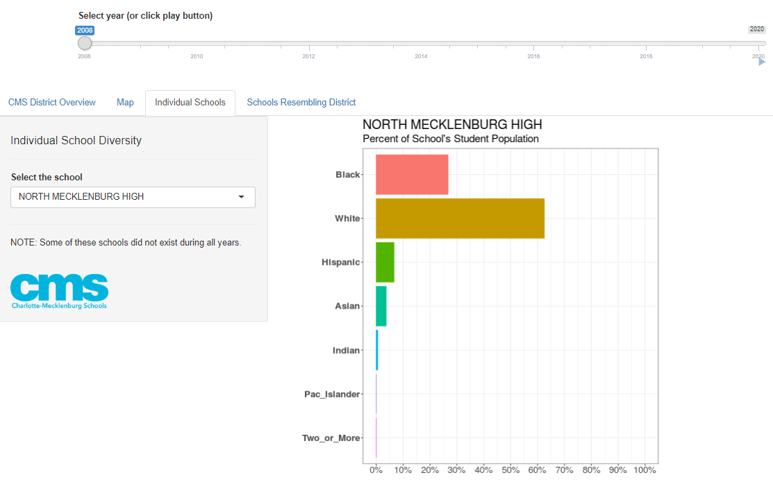
Individual Schools
2008

Slide 12
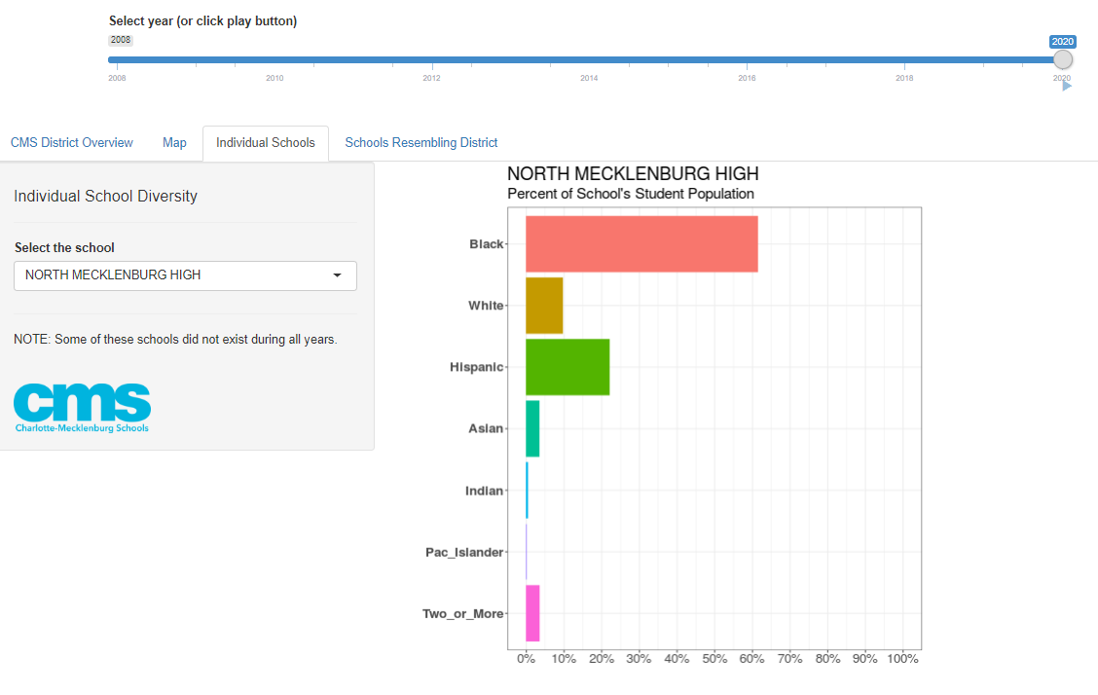
Individual Schools
2020

Slide 13
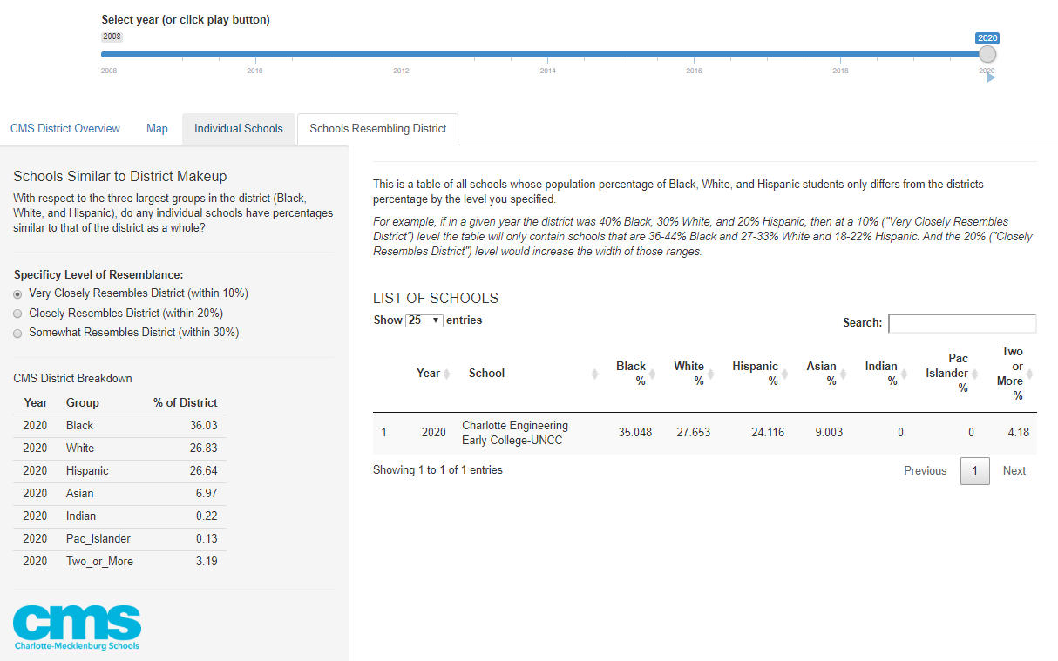
Schools Resembling District
At 10% Resemblance level

Slide 14
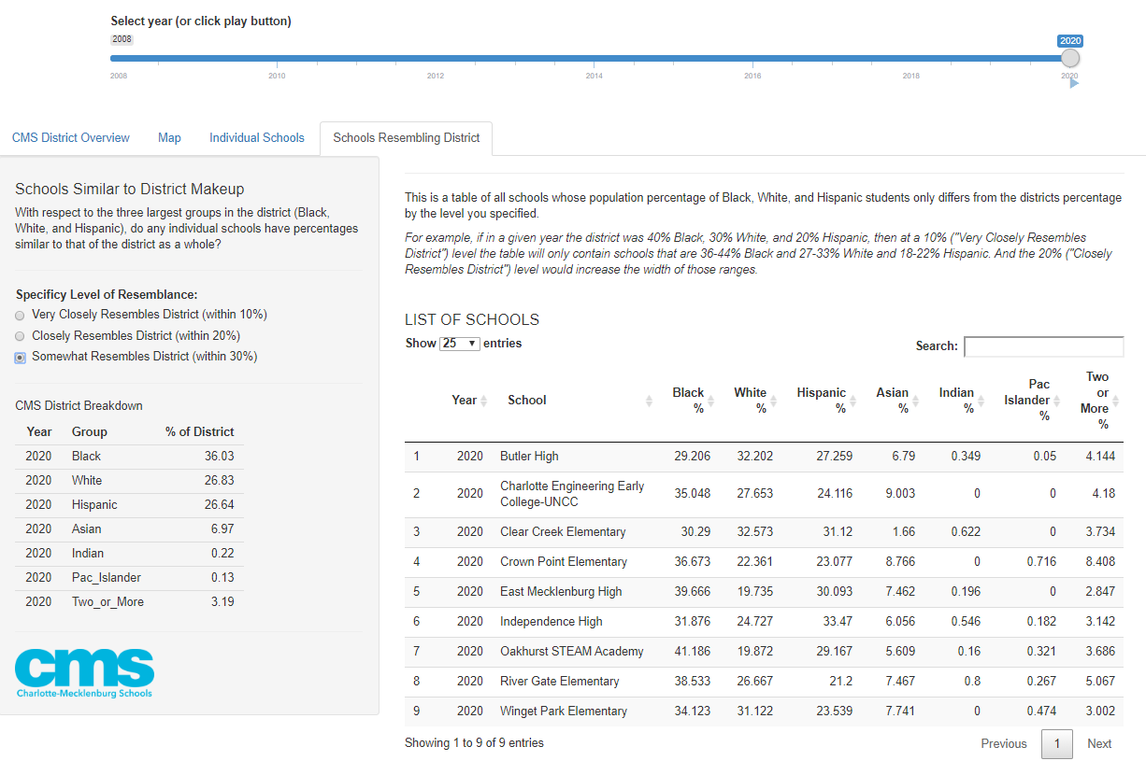
Schools Resembling District
At 30% Resemblance level

Slide 15
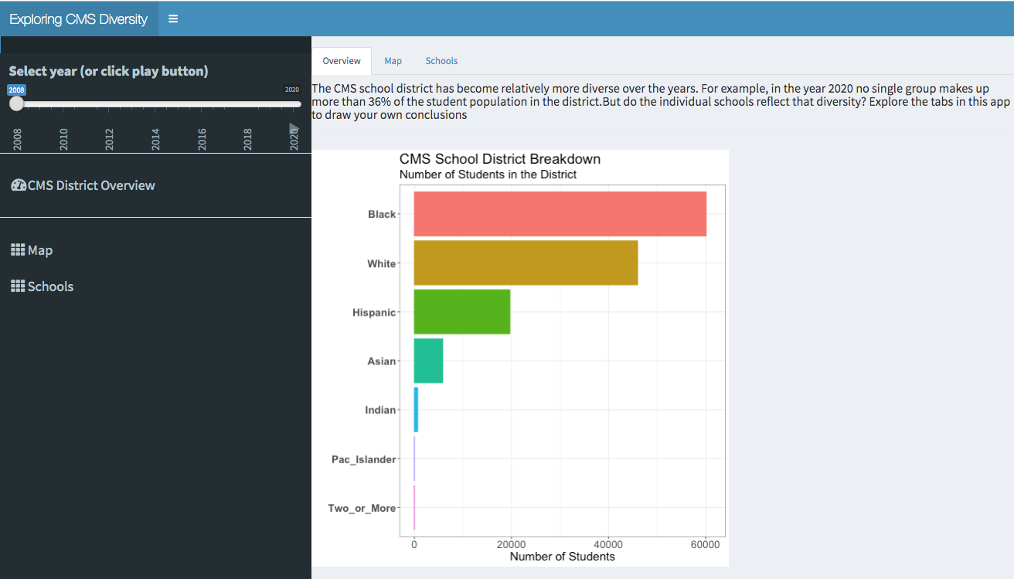
Shiny Dashboard

Slide 16
THANK YOU

