Slide 1
Tick-Tock
Time & Documentation

Slide 2
Structure
Week 1: Introduction
Week 2: Syntax, Variables & Functions
Week 3: Control Structures
Week 4: Lists & Collections
Week 5: RegEx & Strings
Week 6: Sorting & I/O
Week 7:Debugging, Errors & Strategies
Week 8: 4P: Packages, Practices and Patterns
Week 9: Object Oriented Programming
Week 10: Time, Space & Documentation
Week 11: Numpy & Matplotlib
Week 12&13: Neural Nets & Psychopy
Week 14: Honorable Mentions & Wrap Up

Slide 3
Last Week's Homework

Slide 4
Updates Soon
We are not far enough into corrections that we can draw conclusions on common mistakes
We will update you via stud.ip once we have

Slide 5
Time

Slide 6
Dates
How do you write down a date? For a journal? A presentation?
There are many ways to write down a date
Wednesday June 13, 2018
13 June 2018
2018-06-13
06/13/2018
6/13/18
2018-06-13T14:18:37+02:00
1528892317
2018164
Can you read all of those?

Slide 7
Date Ambiguity
08-07-06
08th of July? 06th of July? 07th of August? 07th of June?
Endianness defines the order
Little Endian -> Day – Month – Year
Germany primarily uses this: e.g. 13 Juni 2018
Middle Endian -> Month – Day – Year
US primarily uses this: e.g. 06/13/2018
Big Endian -> Year – Month – Day
Japan primarily uses this: e.g. 2018-06-13

Slide 8
Date Ambiguity
To solve this problem there exist many formats and standards
The important ones:
ISO 8601
UNIX Timestamp
RFC 3339
RFC 5322
Today, we will focus on ISO 8601 & the UNIX timestamp

Slide 9
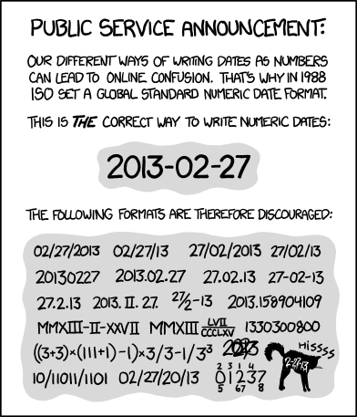
ISO 8601
Iso uses the big endian for dates
It generally sorts the datetime from biggest to smallest
Numbers have a fixed length and are padded by leading 0s
The general format is YYYY-MM-DD hh:mm:ss.sss
4 digit year (Y2k was scary)
2 digit month and day
2 digit hour and minute in the 24-hour system
2 digit seconds followed by a dot for fraction of a second
Date is separated by a dash, time with colons
Both can be omitted in the basic format
ISO 8601 was published on 06/05/88 and most recently
amended on 12/01/04. (Munroe 2013)

Slide 10
Why Use Dates?
So far we had no need to use dates
But there are quite a few applications:
Calendars
Transaction management
Timeseries data
Events
Identification
Logging

Slide 11
Python Dates
The datetime module offers a lot of functionality to deal with date & time
It offers several classes, including
date
Can represent a date up to the day
It does not include time information
datetime
Can represent a date including time, up to microseconds
You can see that the first three entries are shared, after that datetime includes the time information that date is missing
Docs: https://docs.python.org/3.5/library/datetime.html#module-datetime
import datetime
today = datetime.date.today()
print(today)
print(repr(today))
now = datetime.datetime.now()
print(now)
print(repr(now))
Output:
2018-06-04
datetime.date(2018, 6, 4)
2018-06-04 11:13:53.058980
datetime.datetime(2018, 6, 4, 11, 13, 53, 58980)

Slide 12
Have A Date
You can easily create new date instances
E.g. for appointments, schedules, etc.
There are more constructors
Like today() from earlier
fromtimestamp()
etc.
from datetime import date
# class datetime.date(year, month, day) bday = date(1993, 11, 24)
print(bday)
Output:
1993-11-24

Slide 13
More Dates
The same day. Two different days of the week.
weekday() is “programmer friendly”
It starts with Monday as 0
isoweekday() is the normed way
It starts with Monday as 1
So this was a Wednesday
from datetime import date
bday = date(1993, 11, 24)
print(bday.weekday())
print(bday.isoweekday())
Output:
2
3

Slide 14
Formatting Dates
You often want to output dates in a very specific format, or maybe only need to display parts of it
strftime exists for this purpose
it stands for string-format-time
We can match the formatting operators to the output
%a Wed, abbreviated day in locale
%d Day of the month in digits
%b abbreviated month in locale
%Y the four digit year
from datetime import datetime
now = datetime.now()
print(now)
print(now.strftime('%a, %d. %b %Y'))
print(now.strftime('%c'))
print(now.strftime('%Z %X %f %j’))
Output:
2018-06-13 14:27:34.053416
Wed, 13. Jun 2018
Wed Jun 13 14:27:34 2018
14:27:34 053416 164

Slide 15
Formatting Dates
The last two lines might seem a little weird
%c full date according to locale
%Z the time zone. None is present here
%X the date’s time
%f the date’s milliseconds
%j the current day of the year
For all the formatting rules see the docs docs.python.org/3.6/library/datetime.html#strftime-and-strptime-behavior
from datetime import datetime
now = datetime.now()
print(now)
print(now.strftime('%a, %d. %b %Y'))
print(now.strftime('%c'))
print(now.strftime('%Z %X %f %j’))
Output:
2018-06-13 14:27:34.053416
Wed, 13. Jun 2018
Wed Jun 13 14:27:34 2018
14:27:34 053416 164

Slide 16
Formatting Dates
Format | Meaning | Example
%Y | 4 digit year | 1993, 2018
%y | 2 digit year | 93, 18
%m | 2 digit month | 11, 06
%b | Abbreviated month | Nov, Mar
%B | Month | November, March (you might see März)
%H | Hours (24h) | 06, 11, 23
%M | Minutes | 00, 12, 47
%S | Seconds | 04, 43, 59
%a | Abbreviated weekday | Tue, Wed, Thu
%c | Locale default | Mon Jun 4 14:59:23 2018
The formatting rules follow the standards of the programming language C
This list is not exhaustive, it is just some of the more important ones
Locale can be seen as the language and location settings of your pc

Slide 17
Locale: A Formatting Example
The output of strftime of %c depends on your locale
We can use the strftime to emulate that output
If you try that for yourself, you might get a different output
from datetime import datetime
now = datetime.now()
print(now.strftime('%c'))
print(now.strftime('%a %b %d %H:%M:%S %Y’))
Output:
Wed Jun 13 14:56:13 2018
Wed Jun 13 14:56:13 2018

Slide 18
Changing Locale
We can use the locale module to change our current locale (as far as Python is concerned)
This also changes the output of %c
This can be practical sometimes
E.g. letting a user choose the format of the output they are getting
Depending on your system the string in setlocale can be different
For windows you can find a list here: docs.microsoft.com/en-us/cpp/c-runtime-library/language-strings
For linux (and probably mac) you can use locale -a for a list of available locales
from datetime import datetime
import locale
# locale.setlocale(category, locale=None) locale.setlocale(locale.LC_ALL, 'de-DE')
now = datetime.now() print(now.strftime('%c'))
print(now.strftime('%a %b %d %H:%M:%S %Y’))
Output:
13.06.2018 14:57:49
Mi Jun 13 14:57:49 2018

Slide 19
ISO Time
ISO time looks like this: 2018–06–13T15:07:34
It is great for making internationally compatible output
How can we create a format like this?
datetime offers a function which does it format you
Yay for no typos!
from datetime import datetime
someday = datetime(2016,11,28,18,29,37)
print(someday.strftime('%Y-%m-%dT%H:%M:%S'))
print(someday.isoformat())
Output:
2016-11-28T18:29:37
2016-11-28T18:29:37

Slide 20
Date Parsing
In contrast to strftime, there is strptime
Which stands for string parse time
You give it a date string, and in which format it is, and strptime creates a datetime object
This can be used to e.g. parse user inputted information from a form
from datetime import datetime
parsed = datetime.strptime( 'Wed Jun 13 14:47:12 2018’, '%a %b %d %H:%M:%S %Y’
)
print(parsed.isoformat())
Output:
2018-06-13T14:47:12

Slide 21
Date Calculations
Often we need to know how much time is between two dates
How many minutes/hours until the alarm rings
How many days are between 2018-02-28 and 2018-03-01
How many weeks are between 2018-04-03 and 2018-07-07?
E.g. how many lectures do we have
Python allows to calculate with dates only if they have a time component
Meaning we cannot calculate with date
But with datetime (but also not with time)
from datetime import datetime
a = datetime(2018, 6, 13, 14, 35)
b = datetime(2018, 6, 13, 17, 22)
print(b - a)
Output:
2:47:00

Slide 22
Date Calculations: Example
Detecting a leap year
Just giving a date defaults to 00:00 time
Using the days property we can access how many days there are in-between
Other attributes are seconds and microseconds
The function total_seconds() adds up the days, seconds and microseconds into a single number
from datetime import datetime
a = datetime(2000, 2, 28, 23, 59)
b = datetime(2000, 3, 1)
c = datetime(2100, 2, 28, 23, 59)
d = datetime(2100, 3, 1)
print((b - a).days) # leap year
print((d - c).days) # no leap year
Output:
1
0

Slide 23
Timedelta
Calculating with datetimes results in a new class: timedelta
Timedelta represents a time difference
At most times, when you see a delta (Δ, δ), it expresses a form of difference
It has the properties
days
seconds
microseconds
from datetime import datetime
a = datetime(2000, 2, 28, 23, 59)
b = datetime(2000, 3, 1)
print(type((b - a)))
Output:
<class 'datetime.timedelta'>

Slide 24
Timedelta
But what if we know the difference and need to calculate the date?
You can create timedeltas with the parameters
Weeks
Hours
Minutes
Seconds
Milliseconds
Microseconds
They will all get converted into days, seconds, microseconds
from datetime import datetime, timedelta
now = datetime.now()
days137 = timedelta(days=137)
print(now + days137)
Output:
2018-10-28 15:12:37

Slide 25
Timedelta
You can even divide by the time to get a certain time difference
E.g. how many weeks are in a semester (so how many lectures do we have)
We ceil the result to get full weeks instead of a fraction
import math
from datetime import datetime, timedelta
begin = datetime(2018, 4, 3)
end = datetime(2018, 7, 7)
print(math.ceil((end - begin) /
timedelta(weeks=1)))
print(math.ceil((end - begin) /
timedelta(weeks=2)))
Output:
14
7

Slide 26
Human Time Calculations
As humans though, we often use contextual time differences
Tomorrow, 5 minutes ago, Saturday
Those are harder to parse
There exists a neat library called parsedatetime for this purpose
time_struct holds the changed time after parsing
parse_status holds whether the parsing was successful
1 for success, 0 for no success
import parsedatetime as pdt
cal = pdt.Calendar()
time_struct, parse_status =
cal.parse("tomorrow")
print(time_struct)
print(parse_status)
Output:
time.struct_time(tm_year=2018, tm_mon=6, tm_mday=7, tm_hour=9, tm_min=0, tm_sec=0, tm_wday=3, tm_yday=158, tm_isdst=-1)
1

Slide 27
Human Time Calculations
As humans though, we often use contextual time differences
Tomorrow, 5 minutes ago, Saturday
Those are harder to parse
There exists a neat library called parsedatetime for this purpose
time_struct holds the changed time after parsing
parse_status holds whether the parsing was successful
1 for success, 0 for no success
If there was no success, time_struct is now
import parsedatetime as pdt
cal = pdt.Calendar()
time_struct, parse_status =
cal.parse(“hello")
print(time_struct)
print(parse_status)
Output:
time.struct_time(tm_year=2018, tm_mon=6, tm_mday=6, tm_hour=7, tm_min=57, tm_sec=28, tm_wday=2, tm_yday=157, tm_isdst=1)
0

Slide 28
Complexity

Slide 29
Complexity
We call the resources our program needs its complexity
This means mainly time and space (aka memory)
It is a measure of the efficiency of the program
We can compare algorithms that perform the same task by their complexity
Most often we are concerned with time complexity
This does not necessarily mean the seconds an algorithm needs to complete, but rather how many elementary operations need to be performed
The actual time taken is very dependent on the system it is executed on, but can still be a significant measure to compare algorithms when used on the same machine

Slide 30
Complexity
It is often impossible to count how many operations an algorithm performs
Since complexity generally grows with the input size, it is often expressed as a function of input size n
Since complexity may vary greatly for different input types, we often need to express complexity with many different functions
Two relevant measures then are the worst-case complexity and the average-case complexity
Where the worst-case is the highest complexity for all input types and the average-case is the average complexity over all input types
The exact numbers for this are near impossible to determine
And again vary from machine to machine

Slide 31
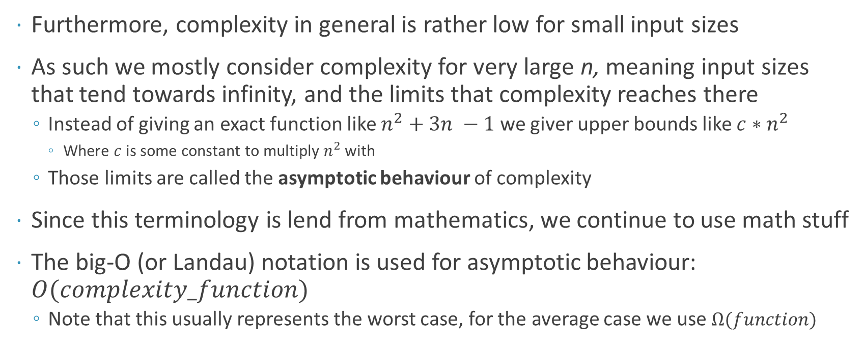
Landau (Big O) Notation
Furthermore, complexity in general is rather low for small input sizes
As such we mostly consider complexity for very large n, meaning input sizes that tend towards infinity, and the limits that complexity reaches there
Instead of giving an exact function like $n^{2}+3n −1$ we giver upper bounds like $c∗n^{2}$
Where $c$ is some constant to multiply $n^{2}$ with
Those limits are called the asymptotic behaviour of complexity
Since this terminology is lend from mathematics, we continue to use math stuff
The big-O (or Landau) notation is used for asymptotic behaviour: $O(complexity_function)$
Note that this usually represents the worst case, for the average case we use $Ω(function)$

Slide 32
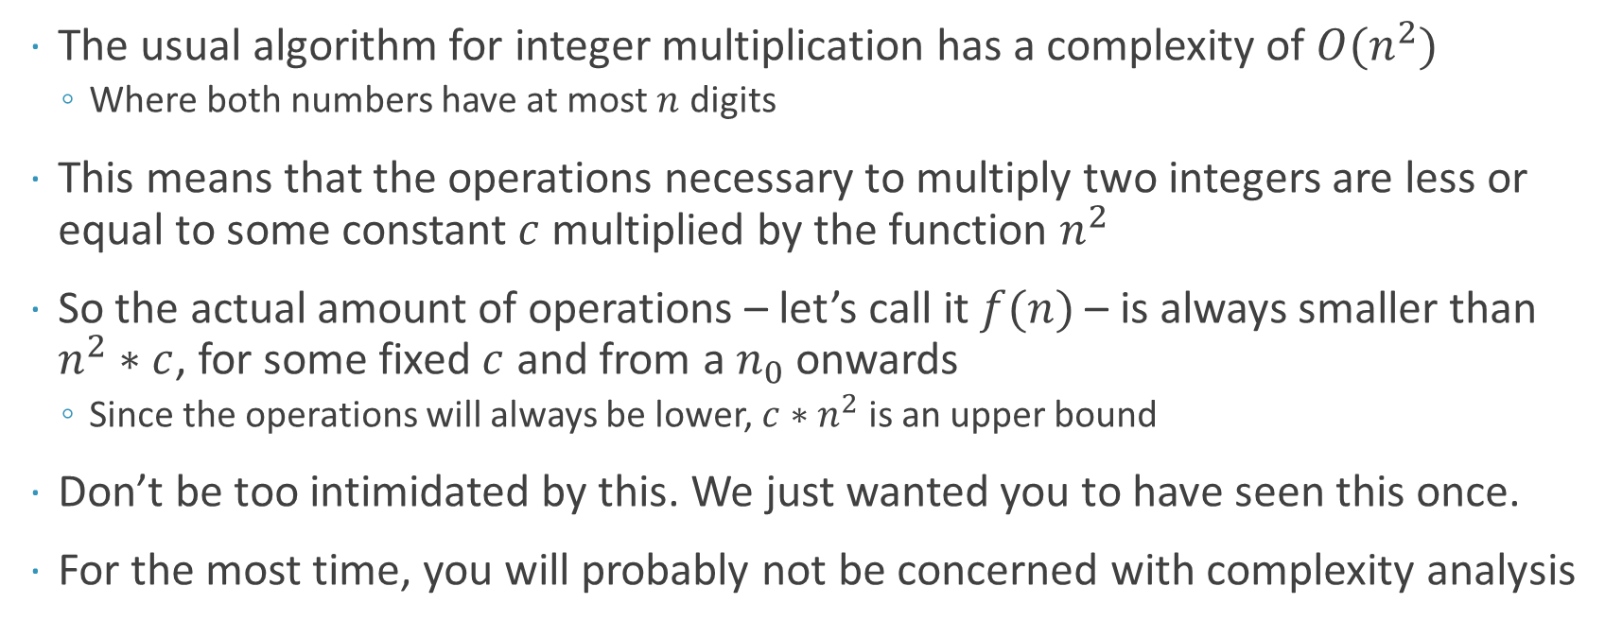
Landau Notation: Example
The usual algorithm for integer multiplication has a complexity of $O(n^{2})$
Where both numbers have at most $n$ digits
This means that the operations necessary to multiply two integers are less or equal to some constant $c$ multiplied by the function $n^{2}$
So the actual amount of operations – let’s call it $f(n)$ – is always smaller than $n^{2}∗c$, for some fixed $c$ and from a $n_{0}$ onwards
Since the operations will always be lower, $c∗n^{2}$ is an upper bound
Don’t be too intimidated by this. We just wanted you to have seen this once.
For the most time, you will probably not be concerned with complexity analysis

Slide 33
Measuring Complexity

Slide 34
The time Module
Time is – in a way – a more basic module than datetime, as it does not offer the many conversions of time available in datetime
Though there are some overlaps
Especially function names. A good idea: do not use from time/datetime import *
The probably most relevant functions of this modules are time() and sleep(s)
time() returns the seconds since the epoch^{[1]}
Also called the UNIX timestamp
The precision is dependent on the system, but it is always precise to the second
sleep(s) pauses the execution for s seconds
import time
print(time.time())
time.sleep(2)
print("I was delayed by 2 seconds!")
Output:
1528273434.4472227
I was delayed by 2 seconds!
^{[1]} Nearly. There are “leap seconds”, which throws this off a little: see here for an entertaining explanation https://youtu.be/-5wpm-gesOY

Slide 35
The UNIX Timestamp
The UNIX timestamp is the time that has passed since 1970-01-01T00:00:00
This is called the epoch
It is an arbitrary point in time that is used as 0 for many computer purposes
The accuracy of this timestamp depends on the hardware and operating system
It is used throughout the world’s computing system and builds the base for many processes
Stock markets, server protocols, network connections, etc.

Slide 36
Measuring Time
We can use time() to measure the time it took for a function to complete
This can be used for example to
Compare functions
Log time (taken)
Make nice loading bars
How long the program has been running
I get different results though, if I execute it several times
This might lead to inaccuracies when comparing times
import random
import time
size = 10000
seq = random.sample(range(10000000000), k=size)
start = time.time()
seq.sort()
end = time.time()
print(f"It took {end - start: .3f} seconds to sort {size} numbers.")
Output:
It took 0.004 seconds to sort 10000 numbers.

Slide 37
Measuring Time
Better: run a function many times and take some statistical value
The mean, the maximum, only the top quintile, etc.
This loop iterates 100 times and stores the results, and in the end can calculate different values from the collected results
In this example only the mean, for space reasons
We could even abstract this into a check_performance() function to test other functions
import random
import time
size = 10000
trials = 100
results = []
for i in range(trials):
seq = random.sample(range(10000000000), k=size)
start = time.time()
seq.sort()
end = time.time()
results.append(end-start)
avg = sum(results) / trials
print(f"Average of: {avg:.3f}s over {trials} trials.")
Output:
Average of: 0.005s over 100 trials.

Slide 38
timeit
And of course this already exists.
The timeit module is there to measure performance of functions
It runs a function multiple times, and returns the total time taken in seconds
I reduced the size immensely, since it defaults to 1’000’000 runs, and that would take a while
import timeit
size = 100
seq = random.sample(range(10000000000), k=size)
print(timeit.timeit(seq.sort))
Output:
1.9772904142155385

Slide 39
timeit
You can run timeit from the commandline as well, and this is actually the preferred method
Using the cli, timeit actually automatically determines a reasonable amount of repetitions for a function
It then returns the average of the best 3 runs
I used a fairly simple example here, but you can test your own functions as well
> python -m timeit "123 + 456”
Output:
100000000 loops, best of 3: 0.011 usec per loop

Slide 40
timeit
To test your own functions, a little setup is required
Inside python you can use the setup parameter
In the cli use the -s switch to include some setup
That will be executed once before executing the actual test
code.py:
def func():
"~".join(str(n) for n in range(100))
cli:
> python -m testit -s “import code” ‘code.func’
Output:
100000000 loops, best of 3:
0.00685 usec per loop

Slide 41
Calendar Module
Just a short addition
Python also offers the calendar module, which uses the time module
It implements functionality to output a calendar either in pure text or html
It also offers functions that can be further used
E.g. to get a month in the form of a list of lists, showing the days of the month and which day of the week they are
It is similar to the UNIX cal program
import calendar
calendar.prmonth(2018, 6)
print("\n", calendar.monthcalendar(2018, 6))
Output:
Juni 2018
Mo Di Mi Do Fr Sa So
1 2 3
4 5 6 7 8 9 10
11 12 13 14 15 16 17
18 19 20 21 22 23 24
25 26 27 28 29 30
[[0, 0, 0, 0, 1, 2, 3], [4, 5, 6, 7, 8, 9, 10], [11, 12, 13, 14, 15, 16, 17], [18, 19, 20, 21, 22, 23, 24], [25, 26, 27, 28, 29, 30, 0]]

Slide 42
Documentation 2.0

Slide 43
Documentation So Far
We have used docstrings to inform about our code
They handled parameters, general information and usage instructions
They did not however handle introductory words to and the structure and general information of a project
Neither are they accessible outside of the package
Meaning you need to install and use a package before you can get information on it
That is suboptimal

Slide 44
Prelude: Structuring a Project
If you are working on a bigger project that needs this kind of documentation, it is a good idea to properly structure it
On the right the general base for such a structure is given
Project Folder should have the name of your project
The docs folder holds all the documentation
More on that in a second
The src folder holds all your code pieces
Project Folder
|-- docs |-- src
|-- modules and packages

Slide 45
Introducing: Sphinx
Sphinx is the documentation software that was developed for the Python docs
You can install Sphinx with conda or pip
conda install sphinx
pip install sphinx
From the cli change into the docs folder and run sphinx-quickstart to setup the directory
This will set up the important files, and let you choose certain configurations
Inside the conf.py file is all the information about your project
Project Folder
|-- docs |-- conf.py
|-- index.rst
|-- _build
|-- _templates
|-- _static
|-- Makefile
|-- make.bat |-- src
|-- modules and packages

Slide 46
Introducing: Sphinx
You have now the basic information for your project set up!
You can run make html from the cli in the docs folder to create your documentation
If you want to have a look at it
Change into docs/_build/html
Type python -m http.server 8080
Open your browser at http://localhost:8080
Project Folder
|-- docs |-- conf.py
|-- index.rst
|-- _build
|-- _templates
|-- _static
|-- Makefile
|-- make.bat |-- src
|-- modules and packages

Slide 47
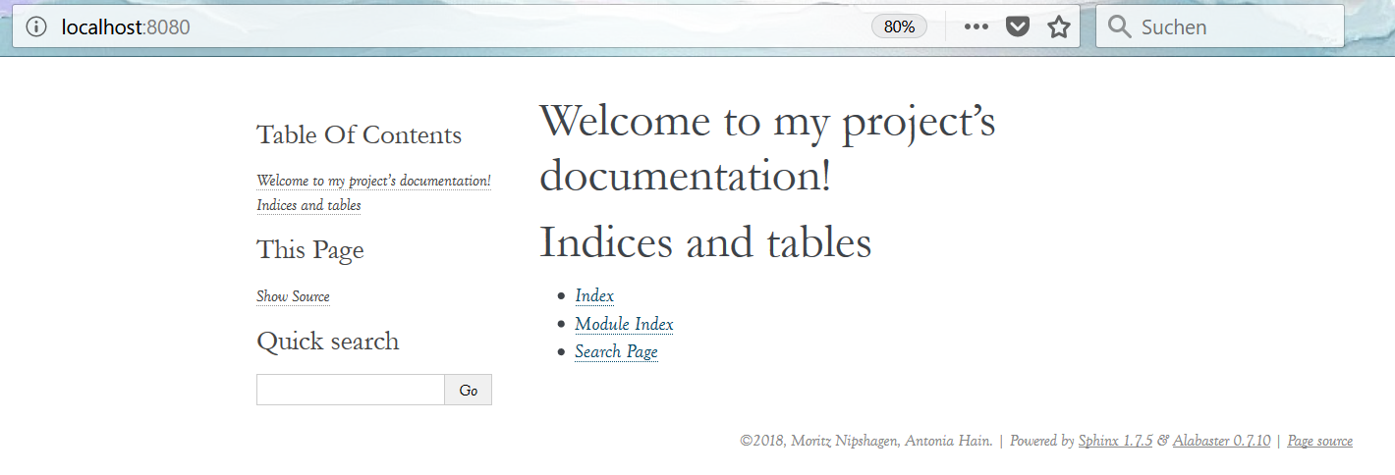
The Output

Slide 48
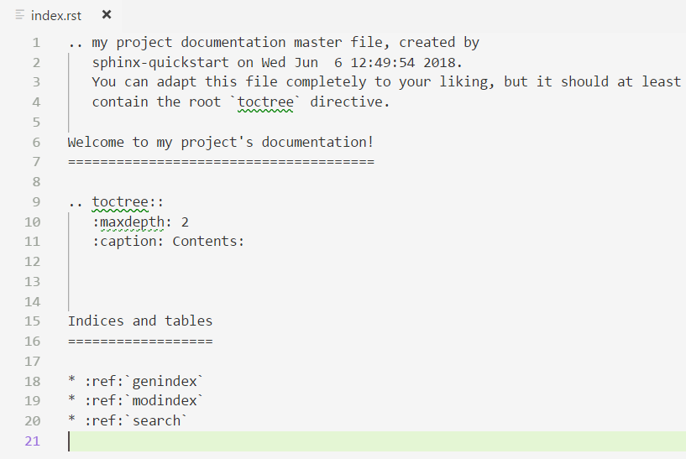
Sphinx
To change what you see, you need to edit the index.rst file
Then rebuild the project with make html

Slide 49
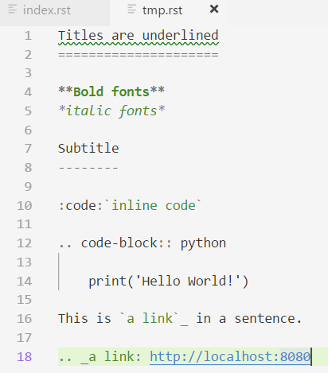
Sphinx
The format that you see used inside the file is a form of markup called restructured text (rst)
You can find more about rst and its rules here: www.sphinx-doc.org/en/ master/usage/restructuredtext/index.html
You can try it out online at http://rst.ninjs.org/#

Slide 50
Sphinx Extensions
Remember to use proper doc comments
This can be extracted and used by Sphinx
To this purpose Sphinx includes a couple of extensions
E.g. in the index file, this is used to include the modules folder inside the docs folder:
class SampleClass(object):
"""Summary of class here.
Longer class information....
Longer class information....
Attributes:
likes_spam: A boolean indicating if we like SPAM or not.
eggs: An integer count of the eggs we have laid.
"""
def __init__(self, likes_spam=False):
"""Inits SampleClass with blah."""
self.likes_spam = likes_spam
self.eggs = 0
def public_method(self):
"""Performs operation blah."""
.. toctree::
:maxdepth: 2
:caption: Contents:
modules/modules
From https://google.github.io/styleguide/pyguide.html#Comments

Slide 51
Homework

Slide 52
Next Homework
Make a dramatic countdown!
Log the time!
Calculate how much time passed since your birthday!

Slide 53
See you all next week!

