Slide 1
Some More Tricks in the Book
4P: Packages, Practical Python & Patterns

Slide 2
Structure
Week 1: Introduction
Week 2: Syntax, Variables & Functions
Week 3: Control Structures
Week 4: Lists & Collections
Week 5: RegEx & Strings
Week 6: Sorting & I/O
Week 7:Debugging, Errors & Strategies
Week 8: 4P: Packages, Practical Python & Patterns
Week 9: Object Oriented Programming
Week 10: Time, Space and documentation
Week 11: Numpy & Matplotlib
Week 12: Outlook & wrapping up
Week 13: TBA
Week 14: TBA

Slide 3
Last Week's Homework

Slide 4
Last Week's Homework
Docstrings:
Were often missing in the first task
Their purpose is to describe what a function is doing, what the arguments are and what it returns, so only put these at the beginning of the functions (right after the head)
Error task bonus solutions:
The loop did not decrement the number of turns. So if the grid was full, the game did not end and the players would be caught in an endless loop of being asked to choose a free cell
It was check_col(grid, col, row) while it should have been check_col(grid, row, col) as the function is called with the row first and the column second
Such a small mistake, but it can cause a lot of problems and confusion

Slide 5
Modules & Packages

Slide 6
Keeping Your Code Organized
As we already mentioned before, an important part of programming is knowing how to structure your code in order to make it readable & maintainable
For both yourself and other people
For this, we already learned how to use functions...
...and how to document your code
Now we'll cover another thing: Modules!

Slide 7
Modules
A module is a file that consists of Python code
So turns out that you have been writing modules all along
This might be either directly executable code or functions
A module has a name
If you're writing Python code into a file named my_code.py then the name of your module will be my_code
So just the name of the file without the .py extension
A module can be imported
So you can use code from other files in your program and therefore compose a project of multiple files

Slide 8
Why Use Modules?
The more complex your code gets, the more it makes sense to split it up into subparts
That way you can direct parts of the code with different purposes to different files
Which makes it easier to keep an overview and debug your code
Which makes it easier to work on a project with multiple people involved
Which enables you to reuse some files for other projects
For example, you could make modules for
Input and output
Mathematical operations
Data management
….

Slide 9
Packages
Packages bundle one or more modules (and subpackages)
Organized in a directory
So basically, packages are just folders
E.g. multiple files containing functions for simple mathematical operations (e.g. one module for linear algebra, one for arithmetics, …) could be part of a package maths

Slide 10
Creating Packages
You can create packages yourself, but will need to follow some guidelines for this
We will give more information about this on the homework sheet
As you will have to make your own little package
For more information, you can also see this tutorial:
https://packaging.python.org/tutorials/packaging-projects/

Slide 11
Importing
import is that magic statement we've used before to be able to access functions we could not use before, e.g.:
We can also use this to import our own modules
Use the module name, not the file name for this!
To use a function called func that is stored in my_code, you need to use this syntax:
import random
import my_code
my_code.func()

Slide 12
Importing
To be able to import something, it must be accessible from the file which contains the import statement or your path variable
You do not always have to import a complete package or module
If you want to only import a constant or function from a certain module, use:
You can also use this syntax to only import certain modules from a package:
However, if you want to import everything from a module/package, we recommend to NOT use this statement:
from module import func
from package import module
from package import *

Slide 13
Importing – Further Reading
More information about importing can be found here:
https://docs.python.org/3/reference/simple_stmts.html#import
https://docs.python.org/3/reference/import.html
https://www.python.org/dev/peps/pep-0008/#imports

Slide 14
Practical Python & Design Patterns

Slide 15
Practical Python & Design Patterns
During the last couple of weeks, we covered the basics of programming
In the following sections we will introduce some functions and paradigms that are helpful for programming
Some are specific to Python, but most are just general principles

Slide 16
Dunders

Slide 17
Dunders
Double underscores, also called magic, are variables and functions that have special meaning in Python​ (magic because you rarely actually see them)
There are many, many dunders in Python​
Often we have already used dunders in action without knowing​
For example help() uses the __doc__ dunder to access the docstring​
Today we will cover mostly dunder variables, and dunder functions next week​
You may have seen the syntax ​
Two dunders!​
This line is true when the module is the script that was executed (and not imported)​
if __name__ == '__main__':​
Notes:
Show in pres

Slide 18
Dunders: Modules & Packages
Dundername​ | Description​ | Usage / Example​
__name__​ | Holds the name of the object​ | To print the name, check if its main​
__doc__​ | Holds the docstring of the object​ | In the help function, documentation​
__file__​ | The file from which the module was imported​ | Mostly debugging, safety check if file is from a secure location​
__cached__​ | The compiled file as byte code​ | Mostly debugging​
__dict__​ | All the names available from the module​ | Check what is available, documentation​
__package__​ | The package which contains this object​ | Documentation​
__all__​ | Names that are imported by​ from module import *​ | Some things are only for internal use​
__version__​ | The version of this module / package​ | Documentation​
__author__​ | The author. There are moredunders for this​ | Documentation​
Notes:
Show in pres

Slide 19
Generators

Slide 20
Generators
Generators allow you to define functions that behave like iterators
That sounds more complicated than it is
Consider the code on the right, the function stores all numbers in a list in memory
With that function call that will be ~10 MB
This is not always acceptable
For this, generators exist, and we need to introduce a new built in:
yield
def firstn(n):
num, nums = 0, []
while num < n:
nums.append(num)
num += 1
return nums sum_of_first_n = sum(firstn(1000000))

Slide 21
Generators
yield is comparable to return as it stops the function and gives back a value
BUT the function state is preserved and can be called again by using next(), in a for loop, etc.
This way the next values are only generated when they are needed, we do not need to wait until all are calculated and do not store all of them in memory
Drawback: generators can only be used once
List comprehensions are actually generators, given to a list constructor
We can define generators inline, by exchanging square brackets for round ones
def firstn(n):
num = 0
while num < n:
yield num
num += 1
sum_of_first_n = sum(firstn(1000000))
# this is what the old function would return
[n for n in firstn(1000000)]
# a generator, whey!
gen = (n for n in firstn(1000000))
next(gen) # will give 0

Slide 22
Decorators

Slide 23
Decorators
Decorators add functionality to existing structures
They decorate a structure
They are great for dynamically changing systems or just for modular designs
Decorators are a pattern in object oriented programming (see next week), but also syntactic sugar in Python that is of a similar idea
They take an object, and whenever the object is executed, the decorator performs additional action
Decorators can be used for many simple & complex tasks
A more elaborate blog post on decorators: https://www.python-course.eu/python3_decorators.php

Slide 24
A Simple Example
We define a decorator to decorate functions
Our decorator should make a log entry every time the decorated function is called
The decorator, I called it simple_log, takes a function as an argument
Then we print the function __name__ to our log file
Python decorators are attached to functions by writing @decorator right before the function definition
The decorator is executed before the function
def simple_log(func):​
def wrapper_you_will_never_see():​
print(f"{func.__name__} was called",​ file=open('./path_to/logfile', 'a’))​
return func​
return wrapper_you_will_never_see​
@simple_log​
def show_trial1():​
print("fancy trial 1 stuff")​
@simple_log​
def show_trial2():​
print("control trial 2 stuff")​ ​
show_trial1()​
show_trial2()​
Output in logfile:
show_trial1 was called
show_trial2 was called
Notes:
Show_trial1 = Simple_log (show_trial1())

Slide 25
More Built-Ins

Slide 26
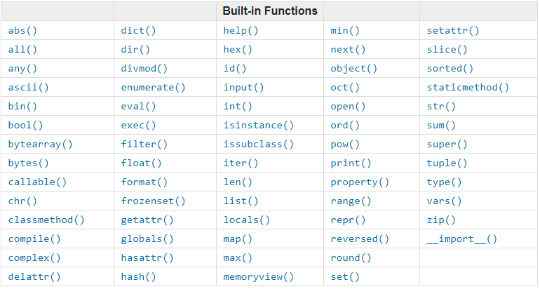
Built-Ins
Python has a variety of built-in functions
We've already covered many of them throughout the weeks
A list can be found here: https://docs.python.org/3/library/functions.html
Now we'll show a few more that could be important for you

Slide 27
Built-Ins: type() and isinstance()
These methods can be used to determine the type of an object
You've seen this one before
Usage is simple:
type(object)
some_number = 42
some_string = 'forty-two‘
print(type(some_number))
print(type(some_string))
Output:
<class 'int'> <class 'str'>

Slide 28
Built-Ins: type() and isinstance()
Using this function, you can specifically determine if your object is of a certain type
It will check if object is of classinfo or a subclass of classinfo
More about subclasses next week
Classinfo can also be a sequence of types
In this case, this function returns True when the object is of (or a subclass of) any of the elements in classinfo
isinstance(object, classinfo)
some_number = 42
some_string = 'forty-two‘
print(isinstance(some_number, int))
print(isinstance([some_number,some_string], float))
Output:
True False
Notes:
You could use type […] == but this won't check for subclasses

Slide 29
Built-Ins: map() and filter()
These functions both take a function and an iterable as parameters
map() will apply the function to the iterable and return a map object indicating the results of applying the function to each element
This map object can be made into a list
You can also use multiple iterables – in this case, your function has to take as many parameters as there are iterables
map(function, iterable, ...)
over_zero = lambda x : x > 0
my_list = [3,0,-1,2,-4]
print(list(map(over_zero, my_list)))
Output:
[True, False, False, True, False]

Slide 30
Built-Ins: map() and filter()
filter(function, iterable)
Filter will apply the function to the iterable and return a filter object containing the objects for which the function returns True
This filter object can be cast to a list as well
It does not necessarily mean that your function needs to return a boolean (in case it is not, it will get rid of all objects for which the function returns 0 / empty
over_zero = lambda x : x > 0
my_list = [3,0,-1,2,-4]
print(list(filter(over_zero, my_list)))
Output:
[3,2]

Slide 31
Built-Ins: zip()
zip(*iterables)
It often happens that you have separate data sequences that you need joined together
zip() is a really powerful function that can help you in these cases
At least if your sequences all have the same length
Imagine we have multiple lists of subject data and now want to make a tuple for each subject:
names = ['peter', 'rachel', 'chris']
ages = ['31','19','27']
times = ['0.91','0.78','0.75']
print(list(zip(names, ages, times)))
Output:
[('peter', '31', '0.91'), ('rachel', '19', '0.78'), ('chris', '27', '0.75')]
Notes:
Maybe show live

Slide 32
Built-Ins: zip() … and unzip!
zip(*iterables)
This functon is also useful for the other way around: If you have joined data you need separated:
data = [('peter', '31', '0.91'), ('rachel', '19', '0.78'), ('chris', '27', '0.75')]
names, ages, times = zip(*data)
print(names)
Output:
('peter', 'rachel', 'chris')

Slide 33
Backtracking

Slide 34
Throwback Lecture 3: Recursion
Recursion, in programming, is when a function calls itself in its own function definition (loosely defined)
with the goal to reduce a bigger problem to a solvable one
Though recursively solved problems can also be solved iteratively (with loops), using recursion is much more simple and straightforward in many cases
Therefore, recursion is already a principle that deserves to be used by itself
def factorial(n):
"""Calculates the factorial of the input number n"""
if n == 1: # the base case
return 1
# factorial is recursively defined as
# the multiplication of all integers before this number
return n * factorial(n-1)

Slide 35

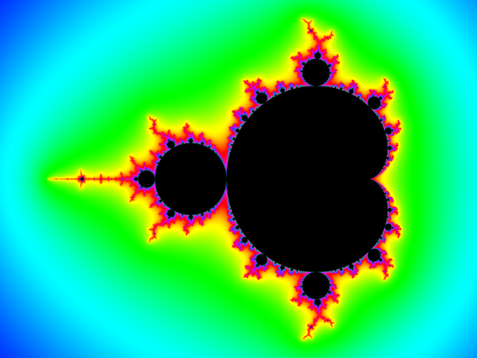
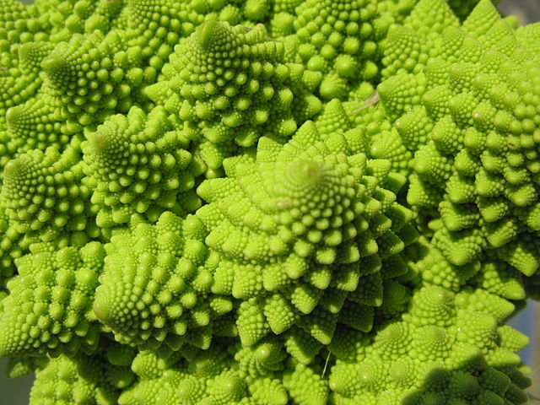
Recursion Is Beautiful
pixabay
Wikimedia Commons
Wikimedia Commons

Slide 36
Recursion Is Beautiful: Backtracking
Backtracking is a programming pattern in which a problem is solved in a trial-and-error fashion:
Try out some solution
If it doesn't work, go back to your last decision and try something else
Do this until you've solved the problem or tried everything
Example: Solving a Sudoku (in a brute-force way)
Try some field configuration
If it doesn't work, change the last field and try again
If all numbers were already tested for the last field, change the second last field
Changing the second last field once already yields 9 more configurations to test because now we can test this with different numbers in the last field all over again
Continue until Sudoku is solved

Slide 37
Backtracking: Magic Square
Another example is the magic square problem
A magic square is a square in which the all rows, columns and diagonals sum up to the same value (magic number):
We can solve this using backtracking
2 | 9 | 4
7 | 5 | 3
6 | 1 | 8

Slide 38
Backtracking: Magic Square
For the sake of understandability, we will use a very simple, inefficient algorithm here
Which is also not documented for space reasons (forgive us!)
This algorithm just walks through the square cell by cell and fills it in with the next best (unused) number from 1 to 9
Then it checks if using this number in this particular cell will lead to a solution by going to the next cell
If the square is full we either have a solution or we went wrong somewhere
In this case we walk a step back by returning False and try the next number
solved() returning True somewhere down the line is the only way to return True in this function
That means when we call the next cell with magic(square, (newrow,newcol)) we pretty much pass the duty of solving the square to the next cell, which passes it further until the last cell is filled and we can actually have a chance that the square is solved
def magic(square, pos=(0,0)):
if solved(square):
return True
row,col = pos
for val in range(1,10):
if not_used(square,val): square[row][col] = val
if row == len(square) - 1: newpos = (0, col + 1) else:
newpos = (row + 1, col)
if magic(square, newpos):
return True
else:
square[row][col] = 0
return False

Slide 39
Backtracking: Magic Square
With this algorithm, we will necessarily end up with the first square pictured here after a couple of recursive calls
The square is full, but still not solved and we have no unused numbers left. So we go back to the previous position:
And then the position before that because there was only one number we could use for the last field and that one did not work
1 | 4 | 7
2 | 5 | 8
3 | 6 | 9
1 | 4 | 7
2 | 5 | 8
3 | 6 | 0
1 | 4 | 7
2 | 5 | 0
3 | 6 | 0
1 | 4 | 7
2 | 5 | 9
3 | 6 | 0
1 | 4 | 7
2 | 5 | 9
3 | 6 | 8
we check the configuration and notice it's wrong
reset to 0 – however, there's no option but 9 for the last cell, so we will go back one more
we have reset the second last cell and will now test the next available number: 9
9 is set. Now we'll call the last cell
Only 8 is available, so we'll fill the last cell with that
... and so on and so forth

Slide 40
How To Tackle a Problem

Slide 41
How to Tackle A Problem
So now, how do we best get from the problem to the solution?
Especially as a beginner, one might often struggle to know where to start
Here's a rough guideline for how one could do it:
Formulate the problem or, if already given as a task, read the task thoroughly.
Think of (an outline of) the algorithm. Take notes if the task is complex.
Try to divide your algorithm into subparts until it's not dividable anymore.
Now you got your functions
If the task is rather big and there are many categorizable subparts, consider using multiple modules
Now create your function definitions (including the main one). Make comments stating what the functions should do
Fill in the subparts, starting with the most essential, debug with some toy values and add into the main what's needed for debugging. Only if it works, go on to the next subtask.
If finished, test for special cases. Clean up the code and write proper documentation (if you haven't done so during coding)

Slide 42
How to Tackle A Problem: Tic-tac-toe
In the next couple of slides, we have an example to illustrate this process
Take the Tic-tac-toe game from last homework: How would one go about actually writing the game, especially the first steps of conceptualizing?
1. Formulate the problem or, if already given as a task, read the task thoroughly.
Ok, so I want to make this game. How does it work exactly?
There is a grid (typically 3x3)
There are two players (with characters X and O)
Both players set their character into the grid in alternating turns
After every turn the game might be finished as someone could have won or the grid could be full

Slide 43
How to Tackle A Problem: Tic-tac-toe
2. Think of (an outline of) the algorithm. Take notes if the task is complex.
First, I need a grid
Then, I need a loop where the players play:
Show the grid each round so the player knows what's up
The player chooses a cell (the cell has to be valid)
I need to check if someone won after every turn (by filling a row or column or diagonal)
If someone did win or there are no cells left, leave the loop
Otherwise, switch players and repeat

Slide 44
How to Tackle A Problem: Tic-tac-toe
3. Try to divide your algorithm into subparts until it's not dividable anymore
First, I need a grid → I need a function that makes the grid
Then, I need a loop where the players play: → let's put this into a main game function
Show the grid each round so the player knows what's up → make a function that prints my grid
The player chooses a cell (the cell has to be valid) → make a function that reads and checks the input
I need to check if someone won after every turn (by filling a row or column or diagonal) → make a function that checks this (and, possibly, split it up again for the subparts)
If someone did win or there are no cells left, leave the loop → has to be part of the loop
Otherwise, switch players and repeat → has to be part of the loop
4. Now create your function definitions (including the main one). Make comments stating what the functions should do.
Notes:
create program from scratch and maybe write function definitions

Slide 45
How to Tackle A Problem: Tic-tac-toe
5. Fill in the subparts, starting with the most essential, debug with some toy values and add into the main what's needed for debugging. Only if it works, go on to the next subtask
I can't test anything without a grid, so I need to make this first
I can't test anything properly without seeing the grid either, so I need to make this second
I test the function somewhere in the main. Works? Even if the grid is not blank? Cool.
I make a loop
This loop "naturally" ends if there's no free fields left. So I choose my loop condition according to this
Player's can't play without being able to put in values, so this is next
I can consider to maybe code the input safety checks (boundaries, type, if cell is blank) later but only if I'm sure I don't forget – there's no particular reason to procrastinate this, so might as well just do it right away
I can now add the part of changing the active player into the loop and test this part by playing without anyone being able to win
For the game to not be boring, add the winning conditions
So I code these step by step and also test them step by step. Seriously, it's not a good idea to write all of these at once
I test this first by adding a print statement into the functions that check for winning and then adding the condition into the loop

Slide 46
How to Tackle A Problem: Tic-tac-toe
6. If finished, test for special cases. Clean up the code and write proper documentation (if you haven't done so during coding)
For example, does it still work if someone wins on two conditions simultaneously?
Delete all my debugging prints
Check structure
Add docstrings and improve comments

Slide 47
Homework

Slide 48
Homework
Solve a maze with backtracking! Fun!
Write modules
For reading and writing the maze from/to files
For displaying the maze
For solving the maze
Bonus: Make it a package
For Lohra reasons, we will extend your deadline this week:
Hand in the homework until Tuesday, 29th of May, 2 PM sharp!

Slide 49
See you all next week!

