Slide 1
Everything in Order
Sorting & I/O

Slide 2
Structure
Week 1: Introduction
Week 2: Syntax, Variables & Functions
Week 3: Control Structures
Week 4: Lists & Collections
Week 5: RegEx & Strings
Week 6: Sorting & I/O
Week 7:Debugging, Errors & Strategies
Week 8: Python Packages
Week 9: Practical Python & Good practices
Week 10: Object Oriented Programming
Week 11: Time, Space and documentation
Week 12: Numpy & Matplotlib
Week 13: Outlook & wrapping up
Week 14: TBA

Slide 3
Last Week's Homework

Slide 4
Last Week's Homework

Slide 5
Sorting

Slide 6
Why Sort?
It makes your data more readable and interpretable
Searching is easier
You can rank your data
And then proceed to work with it in a specific order

Slide 7
Sorting: Example

Slide 8
Sorting Algorithms

Slide 9
Intuitive Sorting
So how does one sort this in ascending order intuitively?
Most likely, you would pick the smallest number you see, write it down and then look for the next smallest number
Bad news – this is actually terribly inefficient
But we will talk about this algorithm nevertheless to get an idea of the topic
[3, 7, 1, 5]
[1
[1, 3
[1, 3, 5
[1, 3, 5, 7]

Slide 10
Selection Sort
This method of sorting is actually really close to the sorting algorithm Selection Sort
In Selection Sort, you always look for the smallest number (that has not been sorted yet) and swap it with the foremost number of the unsorted part of your list
Or look for the biggest number or put the smallest at the end of the list, if you want to sort in descending order

Slide 11
Selection Sort: Code
Just for illustration: a simple implementation
def selection_sort_general(data):
# go through array to put right number to each position
for i in range(len(data)):
# set index of next smallest number to current element
min_index = i
# go through all unsorted elements and find minimum
for j in range(i,len(data)):
if data[j] < data[min_index]:
min_index = j
# swap entry at current position and minimum
dummy = data[min_index]
data[min_index] = data[i]
data[i] = dummy
return data

Slide 12
Selection Sort
And a shorter way of doing it, in Python:
But don't be fooled, it's still bad.
def selection_sort_python(data):
for i in range(len(data)):
minimum = min(data[i:])
min_index = data[i:].index(minimum) + i
data[i], data[min_index] = data[min_index], data[i]
return data

Slide 13
Selection Sort: Why is it so bad?
Think about it: To sort a list of length n, you would have to go through each of the n elements once
This is a given. You cannot sort without looking at all elements.
(Correctly, that is...)
In Selection Sort, for each of these n elements, you have to go through the complete remaining list again to find the current smallest element
This adds up to n + (n-1) + (n-2) + … + 1 = n(n+1)/2 operations
For a list of length 3000, this would already equate to more than 4.5 million operations
And this will happen even if the list is already sorted
Therefore, people came up with other sorting algorithms
Notes:
(The 1 might be neglectable as we don't need to sort a single element)
Pretty much only thing that's worse is BogoSort :P (show?)

Slide 14
Insertion Sort
We don't need to go through the details here, but since we will refer to it later, this is roughly how it works:
Go through the list:
The first element is already sorted
Look at the second element: is it larger or smaller than the first? Keep its position or insert it in front of the first element accordingly
Look at the third element and insert it into the right position compared to the first two elements
….
Do this until you reached the end of the list
Surprise – it's still inefficient
Not only because for each element, you have to compare to the already sorted part to find the corresponding position
Many data structures also do not allow for insertion, so instead of inserting your element at the right position, you have to swap it with its neighbor until you reached the right position

Slide 15
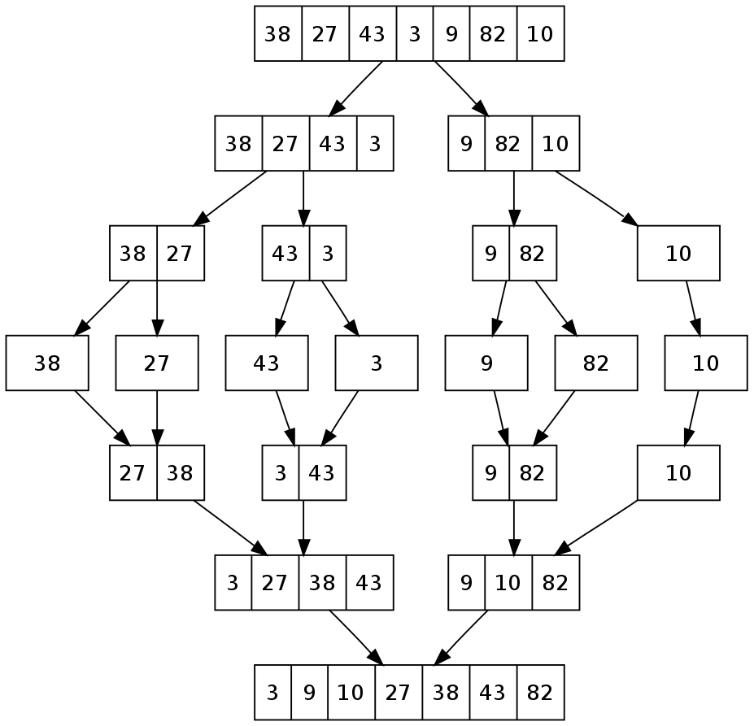
MergeSort
MergeSort is a Divide & Conquer algorithm
You divide the data and then conquer it by merging them together bit by bit
It works roughly as follows:
Divide the data into single elements
Take two neighboring single elements and sort them until you have all your data in groups of two
Then take two neighboring groups and sort them until you have all your data in groups of four
Continue doing this until you have all your data in one group again
Wikimedia Commons
Notes:
How exactly is the sorting done? Always selecting the smallest but since it's not swapped, not exactly selection sort
Needs memory of the size of the sequence for saving

Slide 16
QuickSort
QuickSort is one of the most commonly used sorting algorithms, so it's good to know about it
Going into the details of this algorithm would be outside the scope of this lecture, but, if interested, you can read about it here: https://en.wikipedia.org/wiki/Quicksort
Wikimedia Commons

Slide 17
Sorting in Python

Slide 18
Sorting in Python
Luckily, Python makes sorting easy for you
There are two methods we want to introduce here: sort() and sorted()
Python typically uses a specific sorting algorithm called Timsort which is derived from both Insertion Sort and MergeSort
Similar to determining a minimum or maximum in your data, sorting in Python only works on data types that are comparable to one another
So you can, for example, sort numbers and you can sort strings
But you cannot sort collections containing data of very different types like both numbers and strings (you can hardly find a meaningful order between these anyway)

Slide 19
sort()
sort() is a sorting method defined for lists only
It changes the order of the items in the given list, so it does not preserve the original list
So this is only recommended if you do not need to keep the original order
numbers = [3, 6, 1, 8, 6, 2]
numbers.sort()
print(numbers)
Output:
[1, 2, 3, 6, 6, 8]

Slide 20
sorted()
sorted() sorts the input and returns a sorted list
Therefore, the order in the original object is preserved!
The input does not have to be a list, but can also be another collection type!
However, it still always returns a list!
numbers = [3, 6, 1, 8, 6, 2]
numbers2 = sorted(numbers)
print(numbers)
print(numbers2)
Output:
[3, 6, 1, 8, 6, 2]
[1, 2, 3, 6, 6, 8]
Notes:
Dictionary: per default only sorts and returns keys

Slide 21
sort() and sorted() - Reverse
sort() and sorted() can be used with two more parameters: key and reverse
We will now demonstrate these with sorted(), but they work for both functions!
As given in the documentation:
If reverse is set to True, elements are sorted in reversed order
So, for numbers, in descending order
sorted(iterable, *, key=None, reverse=False)
numbers = [3, 6, 1, 8, 6, 2]
print(sorted(numbers, reverse=True))
Output:
[8, 6, 6, 3, 2, 1]

Slide 22
sort() and sorted() - Key
Using key, we can call a specific function and sort based on the output this function produces for each element in the sequence
We do not necessarily have to define this function ourselves, it may also be a built-in function
The function has to be able to return some value for an item that it is handed
sorted(iterable, *, key=None, reverse=False)

Slide 23
sort() and sorted() - Key
Usually strings are sorted comparing letters from the front until two letters differ from each other – but we can use key to only compare the second letter
def second_letter(item):
return item[1] # return item at 2nd position of object
letters = ['ab', 'ba']
letters = sorted(letters)
letters2 = sorted(letters, key=second_letter)
print(letters)
print(letters2)
Output:
['ab', 'ba'] ['ba', 'ab']
Notes:
Function is unsafe btw
TODO: confirm strings are actually sorted like this but it seems that way from my tests.

Slide 24
Sorting on Nested Collections
Nested collections are sorted the similarly to strings, since both strings and collections are sequences
So the nested sequences are compared element by element until a difference is found
Depending on the content of your list, defining a key can make sense here
numbers = [(1,3,4),(1,3,2)]
print(sorted(numbers))
Output:
[(1, 3, 2), (1, 3, 4)]
Notes:
so comparison is aborted as soon as difference is found, right?
Note how now the nesting element (tuple) is preserved and not converted to list

Slide 25
Addition to Last Week: String Splitting

Slide 26
String Splitting
You can split up a string into a list of substrings by using a certain character as a separator
fruits = 'apple, banana, pear, orange'
fruit_list = fruits.split(',')
print(fruit_list)
Output:
['apple', ' banana', ' pear', ' orange']

Slide 27
I/O

Slide 28
I/O
Stands for input/output
Is handled by data streams
We already used one: the standard output stream (stdout)
We used this with the print() function
But what are data streams?

Slide 29
Streams
"In computer science, a stream is a sequence of data elements made available over time"
Wikipedia
So data flows in one direction from one point to the other
What goes in first also comes out first (or FIFO for First In First Out)
All data elements are processed sequentially
There are three standard streams on most operating systems that are supported by most standard programming languages and connect the program with its environment:
Standard input stream (stdin)
Standard output stream (stdout)
Standard error stream (stderr)
Notes:
Maybe explain pipe/pipeline in lecture

Slide 30
Streams
The standard input stream leads data into an application
Usually this data comes from the keyboard or other hardware, unless specified otherwise
The standard output stream leads data out of an application
Usually to the terminal
The standard error stream leads error-/diagnostics data out of an application
Usually this also goes to the terminal, but can be redirected separately
So error data is transferred separately from the usual output data

Slide 31
Input and Output
Reading input in Python is simple
There is the input() function, which just takes one optional argument: a prompt given to the user
So you don't need to necessarily give a prompt, but it can be useful for giving directions to the user
sentence = input("Please enter a sentence here: ") # input
print(sentence) # output
Output:
Please enter a sentence here: Old MacDonald had a farm, E-I-E-I-O Old MacDonald had a farm, E-I-E-I-O
Notes:
Show no argument input

Slide 32
Another Look at the Output Function
From the documentation:
So, per default, the standard output stream is used and writes to the terminal
But we can also print elsewhere
objects to print
what to do at the end of the line
(not important for now)
print(*objects, sep=' ', end='\n', file=sys.stdout, flush=False)
separation between objects
where to print the objects
Notes:
TODO: animation
Flush pretty much forces the stream data to be written out (imagine emptying a pipeline)

Slide 33
Printing to Files
You can use print to write to a file after opening a file
Opening a file technically means creating a stream such that data is able to flow from the file to the application - you need to do it or the data can't be transferred
For that, you can create a file object which will help you handle the file
my_lottery_numbers = [21, 8, 19, 9, 1, 22]
lottery_file = open('lottery.txt', 'w') # lottery_file is now a file object
print(my_lottery_numbers, file=lottery_file)
lottery_file.close()
Output:
File: lottery.txt
[21, 8, 19, 9, 1, 22]

Slide 34
Files in Python - Opening and Closing
lottery_file = open('lottery.txt', 'w')
print(my_lottery_numbers, file=lottery_file)
lottery_file.close()
Files that were once opened need to be closed after use, too
the data stream needs to be closed down to confirm no more data will be transferred
to free up resources made available for the stream
to make the file accessible for other processes
So remember to use filename.close() to close a file after use
Notes:
If you don't close streams and create too many of them, you will have an overflow at some point (quite literally)
Other processes might be blocked

Slide 35
Files in Python - Opening and Closing
with open('lottery.txt', 'w') as lottery_file
print(my_lottery_numbers, file=lottery_file)
There is, however, another notation that makes all this easier for you: using with
The with statement calls a context manager
the context manager is an object that handles the entry to and exit from this with statement
it makes sure the object used in the with statement always follows a certain protocol for entering/exiting
The context manager handles opening and closing the file for you
Using this notation is heavily recommended and common practice
So we recommend you only use open() and close() manually if you cannot do it otherwise
Notes:
Even follows this protocol in case of errors

Slide 36
Files in Python - Path
Open your files using relative paths, such that your program won't have trouble finding files on other people's computers
A relative path means that the file is looked for starting from your working directory
For example: our script is in a folder named lottery and the file we need in a subfolder names files
but where exactly the lottery folder is stored in the system is not relevant
with open('C:/Users/Me/Documents/BPP/lottery/files/test.txt', 'w') as lottery_file:
[…]
with open('./files/lottery.txt', 'w') as lottery_file:
[…]
Notes:
Explain what is working directory. Demonstrate maybe (we have time... :D ).

Slide 37
Reading from Files
File objects can be read by using read()
Contents of lottery.txt:
[21, 8, 19, 9, 1, 22]
with open('lottery.txt', 'r') as lottery_file:
data = lottery_file.read()
print(data)
Output:
[21, 8, 19, 9, 1, 22]

Slide 38
Writing to Files
We can also use write() to write data to files
The data handed to this function must be a string, so don't forget to use a typecast when trying to write non-string objects to your file
my_lottery_numbers = [21, 8, 19, 9, 1, 22]
with open('files/lottery.txt', 'w') as lottery_file:
lottery_file.write(str(my_lottery_numbers))
File: lottery.txt
[21, 8, 19, 9, 1, 22]

Slide 39
File Modes
Spot the difference:
You can open a file in different modes which determine how you can use your file
So from a technical perspective, the mode determines in which direction data in your stream can flow
with open('files/lottery.txt', 'r') as lottery_file:
with open('files/lottery.txt', 'w') as lottery_file:

Slide 40
File Modes (Most Important Ones)
File Mode | Meaning | If file doesn't exist
r | Open the file for reading only | Error
w | Open the file for writing only Will overwrite complete file contents | Create new file
r+ | Open the file for reading and writing Will overwrite complete file contents | Error
w+ | Open the file for writing and reading Will overwrite complete file contents | Create new file
a | Open the file for appending Everything written into the file is written to the end of the file – no overwriting of previous contents | Create new file
a+ | Open the file for appending and reading Everything written into the file is written to the end of the file – no overwriting of previous contents | Create new file
Notes:
If you want to change your file mode, repoen the file
There's a couple other ones, but you wont need these

Slide 41
Files - seek()
fileObject.seek(offset[, whence])
seek() can be used to jump to a certain position in the file and it returns your current position in the file
offset is the parameter with which you determine the position to jump to (e.g. 0 for beginning)
whence is an optional parameter
0 / SEEK_SET is the default and stands for an absolute jump to the position given in offset (therefore returns your offset)
1 stands for the current position in the file – you cannot jump in relation to this but it is useful if you want to know your position
2 means a jump is performed to the end of the file (therefore returns last index in the file)

Slide 42
Files - seek()
my_lottery_numbers = [21, 8, 19, 9, 1, 22]
with open('files/lottery.txt', 'w+') as lottery_file:
lottery_file.write(str(my_lottery_numbers))
numbers = lottery_file.read()
print(numbers)
Output:
No output is displayed as, after writing, we were at the end of the file and there was nothing left to read

Slide 43
Files - seek()
my_lottery_numbers = [21, 8, 19, 9, 1, 22]
with open('files/lottery.txt', 'w+') as lottery_file:
lottery_file.write(str(my_lottery_numbers))
lottery_file.seek(0)
numbers = lottery_file.read()
print(numbers)
Output:
[21, 8, 19, 9, 1, 22]
So we use seek() to jump back to the beginning
However, if you need to both read from and write to a file, you should consider opening and closing it once for each purpose

Slide 44
Reading Files Line by Line
There are multiple ways of doing this
splitlines() simply takes the input and splits it up into a list, with a split at each line break
with open('old_macdonald.txt', 'r') as old_macdonald:
verse = old_macdonald.read().splitlines()
print(verse)
Output:
['Old MacDonald had a farm, E-I-E-I-O', 'And on his farm he had a cow, E-I-E-I-O', 'With a moo-moo here and a moo-moo there', 'Here a moo', 'There a moo', 'Everywhere a moo-moo', 'Old MacDonald had a farm, E-I-E-I-O']

Slide 45
Reading Files Line by Line
splitlines() also has an optional parameter keepends with which you can keep the line breaks in the string (if set to True)
There is also another function called readlines() that does the same as read().splitlines(True)
with open('old_macdonald.txt', 'r') as old_macdonald:
verse = old_macdonald.read().splitlines(True)
print(verse)
Output:
['Old MacDonald had a farm, E-I-E-I-O\n', 'And on his farm he had a cow, E-I-E-I-O\n', 'With a moo-moo here and a moo-moo there\n', 'Here a moo\n', 'There a moo\n', 'Everywhere a moo-moo\n', 'Old MacDonald had a farm, E-I-E-I-O']

Slide 46
Reading Files Line by Line
If you actually only want to read one line at a time or an arbitrary number of lines you can use readline()
with open('old_macdonald.txt', 'r') as old_macdonald:
for n in range(3):
print(old_macdonald.readline(), end='')
Output:
Old MacDonald had a farm, E-I-E-I-O And on his farm he had a cow, E-I-E-I-O With a moo-moo here and a moo-moo there
Notes:
Line break in end is deleted because there's already a line break in each line

Slide 47
Reading Files Line by Line
Lastly, you can read a complete file sequentially by simply using a for loop
with open('old_macdonald.txt', 'r') as old_macdonald:
for line in old_macdonald:
print(line, end='')
Output:
Old MacDonald had a farm, E-I-E-I-O And on his farm he had a cow, E-I-E-I-O With a moo-moo here and a moo-moo there Here a moo There a moo Everywhere a moo-moo Old MacDonald had a farm, E-I-E-I-O

Slide 48
Reconstructing Collections from Files
When we read things from files, Python will interpret them as strings
Unfortunately that means that whenever we (for example) saved a list of numbers, Python will not automatically recognize it as a list anymore when reading it back out of the file
my_lottery_numbers = [21, 8, 19, 9, 1, 22]
with open('files/lottery.txt', 'w+') as lottery_file:
lottery_file.write(str(my_lottery_numbers))
lottery_file.seek(0)
numbers = lottery_file.read()
print(numbers)
print(type(numbers))
Output:
[21, 8, 19, 9, 1, 22] <class 'str'>

Slide 49
Reconstructing Collections from Files
Luckily, this problem can often be fixed relatively easily using list comprehension
"Comprehension, what was that again?" - it's explained in week 4
Don't worry if this line looks confusing, we'll break it down now
my_lottery_numbers = [21, 8, 19, 9, 1, 22]
with open('files/lottery.txt', 'w+') as lottery_file:
lottery_file.write(str(my_lottery_numbers))
lottery_file.seek(0)
numbers = [int(n) for n in \ lottery_file.read()[1:-1].split(',')]
print(numbers)
print(type(numbers))
Output:
[21, 8, 19, 9, 1, 22] <class 'list'>
Notes:
So maybe consider, when saving your data, how to read it back out easily

Slide 50
Reconstructing Collections from Files
numbers = [int(n) for n in lottery_file.read()[1:-1].split(',')]
First, lottery_file.read() reads all contents of the file including the numbers and the brackets of the list: [21, 8, 19, 9, 1, 22]
We use [1:-1] to "slice away" the first and the last character of this string
So we got rid of the brackets, which leaves us with 21, 8, 19, 9, 1, 22
Then we split this into a list of separate strings for each number at the commas
Then we sequentially cast all these items to integer and store the results in a new list

Slide 51
More on I/O
If you want to find out more about I/O tools in Python, take a look at the documentation online
https://docs.python.org/3/library/io.html

Slide 52
Excursion: Lambda Functions
Notes:
Because we love excursions, don't we

Slide 53
Lambda Functions
lambda functions (also anonymous functions or in-line functions) are functions that are not bound to a function identifier
They can be used to formulate simple functions in a clear and concise manner
Using them is mostly a matter of good style
You could use ordinary functions instead
Sometimes lambda functions even help keeping an overview over your code
normal functions are usually declared at the beginning of the script - lambda functions can spare you the scrolling up if the function is short anyway

Slide 54
Lambda Functions - Assignment
A lambda function is defined by writing lambda, the parameters, : , and after that the function statement
The resulting anonymous function is then assigned to a variable:
Compare with:
square = lambda x: x**2
def square(x):
return x**2
Notes:
Function is still anonymous, even if assigned

Slide 55
Lambda Functions - Uses
They are useful as functions that are only needed temporarily
Another common use for lambda functions is as functions used as arguments for other functions:
sorted(iterable, *, key=None, reverse=False)

Slide 56
Lambda Functions - Common Uses
So we can use a lambda function as a key function for sorting
Or for comprehensions:
sorted(my_list, key=lambda x: x**2) # sorts list after squares of values
# this equals to squares = [x**2 for x in range(10)]
squares = [(lambda x: x**2)(x) for x in range(10)]
print(squares)
Output:
[0, 1, 4, 9, 16, 25, 36, 49, 64, 81]
Notes:
But really just if you just need a short function for a short time

Slide 57
Homework

Slide 58
Homework
This week you will start off light, with some small tasks to get you started into sorting and file I/O
After that, you will make a game!
In this week we will program the game hangman
You will need your newly gained I/O powers for that
And also quite a bit of what we did so far

Slide 59
Technicalities

Slide 60
There is no plain text
Text files are often called plain text
This is a misconception
Text files can differ in many different ways
Probably the most important: encoding
Under the hood, each text character is just a number
This number is then mapped by your editor/program/os/whatever to a glyph
Glyph is just a fancy and more general name for letter, as it also includes all kinds of characters, word-symbols, math operators, and so on

Slide 61
Encoding
Every file that includes text, is encoded in some way
When you press a letter on your keyboard, it will be saved as a number inside the file
Which number that is depends on the encoding
Encodings are basically huge tables (and sometimes tables of tables) that hold a glyph for each possible number

Slide 62
The important ones
ASCII
American Standard Code for Information Interchange
English alphanumeric symbols
UTF-8
The new kid in town
Backwards compatible to ascii
But includes many many many more

Slide 63
See you all next week!

