Slide 1
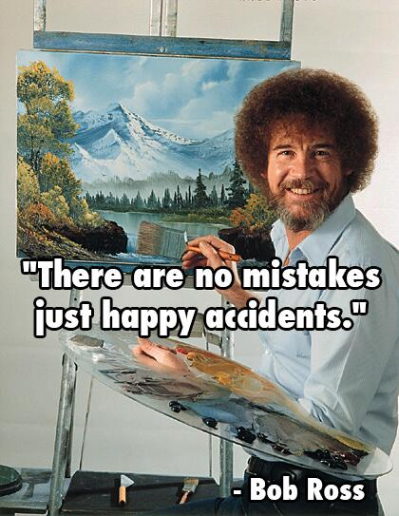
There Are No Mistakes
Debugging, Errors & Strategies

Slide 2
Structure
Week 1: Introduction
Week 2: Syntax, Variables & Functions
Week 3: Control Structures
Week 4: Lists & Collections
Week 5: RegEx & Strings
Week 6: Sorting & I/O
Week 7:Debugging, Errors & Strategies
Week 8: Python Packages
Week 9: Practical Python & Good practices
Week 10: Object Oriented Programming
Week 11: Time, Space and documentation
Week 12: Numpy & Matplotlib
Week 13: Outlook & wrapping up
Week 14: TBA

Slide 3
The Survey

Slide 4
Comments & Other Notes
We will try to explain code in more detail
When introducing functions, we will show (& explain parts of) the whole definition
On the homework we will try to either split big tasks into smaller subparts or give more hints to solve, so you better understand what to do
If you still struggle with the homework, there are still slots for feedback sessions
We will bring back bonus tasks
We will consider linking to blogs / documentation where appropriate

Slide 5
Comments & Other Notes
We will probably not implement (much) more live coding, as we both see more value in explaining existing code more detailed
We will try to use more “simpler” homework tasks as repetition
There will be no project spanning the last couple of weeks, but we will stick to weekly homework

Slide 6
Last Week’s Homework

Slide 7
Notes
We did not notice any major reoccurring issues
In a game of hangman it is advantageous to list the missed letters
Otherwise, great job!
Opening a file with mode w+ will delete all contents the moment open() is executed!

Slide 8
Some Terminology

Slide 9
Exceptions & Errors
In general those two are often used interchangeably
You will often find “Exception” to describe errors in the code logic or an unexpected value
Nothing too severe
Examples are KeyErrors, TypeErrors, …
“Errors” often refer to errors closer to the system level and imply a more serious issue
Examples are SyntaxError, OutOfMemoryError, …
Errors/Exceptions are thrown or raised and can then be caught or handled

Slide 10
Error Messages
EOL
End Of Line. This appears in error messages when a line unexpectedly ends
EOF
End Of File. This appears in error messages when the file ended, but the parses expected code
Last week we talked about the streams stdout and stderr
stdout is used for all kinds of output and usually errors are printed to stderr
Sometimes a terminal will show stderr in a different colour (mostly red)

Slide 11
Programming Errors

Slide 12
Mistakes Happen
During programming you might have encountered some errors
KeyError
KeyboardInterrupt
NameError
SyntaxError
TypeError
Traceback (most recent call last):
File "<stdin>", line 1, in <module>
ValueError: could not convert string to float: 'hallo’
Traceback (most recent call last):
File "<stdin>", line 1, in <module>
IndexError: list index out of range
Traceback (most recent call last):
File "<stdin>", line 1, in <module>
TypeError: 'int' object is not callable
Traceback (most recent call last):
File "<stdin>", line 1, in <module>
NameError: name 'value' is not defined

Slide 13
Mistakes Happen
So far we left you to your own devices to figure it out
As programs grow more complex this becomes a non-optimal solution
Let’s cover some basics of how to solve errors

Slide 14
Reading Error Messages

Slide 15
An Error Message
This is the same error message
Once it is from the python shell
Remember stdin from last week?
The other is from an executed python script
print "Hello World"
File "<stdin>", line 1
print "Hello World"
^
SyntaxError: Missing parentheses in call to 'print'.
File “c:/Basic_Programming_in_Python/2018/07/test.py", line 1
print "Hello World"
^
SyntaxError: Missing parentheses in call to 'print'.

Slide 16
Reading Error Messages
File <stdin> || File <path_to_file>
The file that was in execution when the error occurred
Line1 || Line x
The line in which the error occurred
^
Where in the line the error occurred (might be not the exact position)
SyntaxError
The type of error occurred (more on that in a bit)
Missing parentheses in call to 'print’.
A description of the error. This might not always be provided

Slide 17
Nested Error Messages
Sometimes you will see longer error messages
This is called a stacktrace
Note how the line numbers are “wrong”, because we are in the python shell and every line is line 1
From top to bottom you can follow through what was called and where the error occurred
In line 1 in <module> an error appeared, which came
From bar in line 2, and that came
From foo in line 2
And in line 2 in foo the error actually occurred
It was handed upwards one call at a time, until it crashed the program
>>> def foo():
... print(x)
...
>>> def bar():
... foo()
...
>>> bar()
Traceback (most recent call last):
File "<stdin>", line 1, in <module>
File "<stdin>", line 2, in bar
File "<stdin>", line 2, in foo
NameError: name 'x' is not defined

Slide 18
So Many Errors

Slide 19
The World Of Errors
There are many exceptions already built into Python
There are even more custom exceptions defined by single packages
In the following we will look at some of the more prominent built ins

Slide 20
Syntax Errors
Occur when the Python parser is not able to read your code
The error therefore lies in the syntax of the code, i.e. in the structure
Think of it as a grammatical error
As such they occur before the code is actually executed
Most often, syntax errors stem from typos and are therefore relatively easy to fix
Python will show you at which point in the program your error was found
Often it will suffice to just read through the line again very carefully
E.g. missing parentheses, quotes or escape characters, …

Slide 21
Syntax Errors - Examples
print("how many bottles of beer on the wall? " + str(99)
Error:
File "<ipython-input-84-6f8b23daa264>", line 3 print("how many bottles of beer on the wall? " + str(99) ^ SyntaxError: unexpected EOF while parsing
As indicated by the message, the error seems to be at the end of the line
The parser found the End Of File unexpectedly
Which therefore means it was still waiting for something to show up in the code before the end
In this case, a parenthesis is missing, without which the print statement is not complete

Slide 22
Syntax Errors - Examples
print("how many bottles of beer on the wall? " + str(99)))
Error:
File "<ipython-input-82-e2ca511b38dd>", line 3 print("how many bottles of beer on the wall? " + str(99))) ^ SyntaxError: invalid syntax
Using too many parentheses is not a good idea either

Slide 23
Syntax Errors - Examples
for i in range(5)
print(i)
Error:
File "<ipython-input-81-58700a3bfd43>", line 3 for i in range(5) ^ SyntaxError: invalid syntax
You will also get an "invalid syntax" error message when you forget the : after defining a loop
Or a function

Slide 24
Syntax Errors - Examples
my_list = [1;2;3]
Error:
File "<ipython-input-80-e9a350f1e8c5>", line 3 my_list = [1;2;3] ^ SyntaxError: invalid syntax
Using the wrong separators will also produce this error

Slide 25
Type Errors
As indicated by the name, this problem mostly occurs when you want to perform an operation to an object that is of inappropriate type
So the object does not support the kind of operation that is about to be performed
The actual problem is usually one of these:
You forgot to typecast a variable
Which is easy to fix
Your variable does not have the type it is supposed to have
The solution might be a little more tricky in this case
You try to call a variable or module by putting parentheses behind the name
You try to use a non-iterable as iterable (e.g. for x in 5)

Slide 26
Type Errors - Examples
number = 5
print("My number is: " + number)
Error:
TypeError Traceback (most recent call last) <ipython-input-2-a896177a7a70> in <module>() 2 3 number = 5 ----> 4 print("My number is: " + number) TypeError: must be str, not int
The code is simply missing a typecast in the print statement

Slide 27
Type Errors - Examples
def some_function(a,b,c):
return (a+b+c)**2
a = some_function('a','b','c')
Error:
TypeError Traceback (most recent call last) <ipython-input-30-99790ea37e83> in <module>() 2 return (a+b+c)**2 3 ----> 4 a = some_function('a','b','c') <ipython-input-30-99790ea37e83> in some_function(a, b, c) 1 def some_function(a,b,c): ----> 2 return (a+b+c)**2 3 4 a = some_function('a','b','c') TypeError: unsupported operand type(s) for ** or pow(): 'str' and 'int'
Here, you are calling the function with variables of a type it cannot work with

Slide 28
Type Errors - Examples
def square(x):
return x*x
square = square(2)
new_square = square(4)
Error:
TypeError Traceback (most recent call last) <ipython-input-73-ce6f554e48a3> in <module>() 5 6 square = square(2) ----> 7 new_square = square(4) TypeError: 'int' object is not callable
The solution to this one is not as obvious: When you are giving the same name to both a variable and a function, problems like this one might occur
While you want to call the square() function and assign the result to new_square, Python will assume you are trying to call the variable square (defined in the line above) instead

Slide 29
Type Errors - Examples
def some_function(a,b,c):
return (a+b+c)**2
a = some_function(2,3)
Error:
TypeError Traceback (most recent call last) <ipython-input-71-18c57e356c03> in <module>() 4 return (a+b+c)**2 5 ----> 6 a = some_function(2,3) TypeError: some_function() missing 1 required positional argument: 'c'
If you do not give as many arguments to a function as needed, you will also get a type error

Slide 30
Indentation Errors
If you mess up your code formatting, you might end up with indentation errors
They are a subtype of syntax errors
As the name implies, they occur when there is either too much indentation or indentation missing

Slide 31
Indentation Errors - Examples
for i in range(5):
print(i)
Error:
File "<ipython-input-75-54aa1dcc3062>", line 3 print(i) ^ IndentationError: expected an indented block
The code that is supposed to be inside the function is interpreted as outside the function because you did not indent it correctly
Therefore, Python assumes there is no code in the function and will therefore throw the "expected an indented block" message

Slide 32
Indentation Errors - Examples
def compare_numbers(a,b):
if a > b:
print("Bigger!")
elif a < b:
else:
print("Equal!")
compare_numbers(3,3)
Error:
File "<ipython-input-74-b2fff8bb364e>", line 8
else: ^ IndentationError: expected an indented block
You cannot open a block and then not include anything in it
In these cases, please fill the block or write pass if you want to fill it later

Slide 33
Key & Index Errors
They occur when you try to access an element that does not exist
KeyErrors happen when you're trying to access a key in a dictionary, but the key doesn't exist
You can avoid this by
1) checking if the name of your key was written correctly
2) checking if the dictionary actually contains the key by using in
IndexErrors happen when you use a non-existent index
This might happen when you try to access the last element (since Python uses 0-indexing)
You manually iterate and don’t stop early (this is why we use for … in [range])

Slide 34
Key Errors - Example
osna = {'name':'Osnabrueck', 'population':165000, 'state':'Lower Saxony'}
print(osna['country'])
Error:
KeyError Traceback (most recent call last) <ipython-input-3-197366f874ef> in <module>() 5 print('country' in osna) 6 ----> 7 print(osna['country']) KeyError: 'country
No key in osna is named country is so Python won't know what to do when trying to access the corresponding value

Slide 35
Index Errors - Example
my_list = [1,2,3,4]
print(my_list[len(my_list)])
Error:
IndexError Traceback (most recent call last) <ipython-input-5-659096991b8b> in <module>() 1 my_list = [1,2,3,4] 2 ----> 3 print(my_list[len(my_list)]) IndexError: list index out of range
Since indices start from 0, len of your object will be one step too far
a list with four items will only have indices ranging from 0 to 3

Slide 36
Name Errors
Are raised when a name is referenced that isn't known
E.g. a variable that wasn’t defined yet
To fix this, check the spelling of your variable
If that does not work, check the scope of your variable
That is, if the variable is known in the code block where you're trying to call it or, e.g., just part of some function
A subclass of Name Errors are UnboundLocalErrors
They happen if a name is not known in a certain scope
E.g. inside a function, lookup the global keyword and its usages docs.python.org/3/

Slide 37
Name Errors - Example
b = 5 > 3
if (b == true):
print("True!")
Error:
NameError Traceback (most recent call last) <ipython-input-76-514a374118eb> in <module>() 3 b = 5 > 3 4 ----> 5 if (b == true): 6 print("Richtig!") NameError: name 'true' is not defined
In this case, the name error is thrown because True was accidentally written as true
And Python therefore thinks it must be a variable

Slide 38
Value Errors
When the variable type of your variables works with the operation you are trying to perform, but the actual value does not, this error might be raised
E.g. a function works only on positive integers and you pass it -1, it may raise a Value Error
It can also occur, for example, when you are trying to unpack tuples, but the number of tuple elements and variables does not match

Slide 39
Value Errors - Examples
print(int('a'))
Error:
ValueError Traceback (most recent call last) <ipython-input-23-129476680eb9> in <module>() ----> 1 print(int('a')) ValueError: invalid literal for int() with base 10: 'a'
As the string contains a letter, Python will not know how to cast it to an integer

Slide 40
Value Errors - Examples
my_tuple = ('a','b','c')
a,b = my_tuple
Error:
ValueError Traceback (most recent call last) <ipython-input-34-8cd158515907> in <module>() 3 my_tuple = ('a','b','c') 4 ----> 5 a,b = my_tuple ValueError: too many values to unpack (expected 2)
Make sure to use enough variables when unpacking a tuple
If you don't care about one variable, you might use _ as a placeholder instead

Slide 41
Some More Errors
There are quite a few more Exceptions & Errors
See https://docs.python.org/3/library/exceptions.html#concrete-exceptions
And one can even define custom exceptions & errors
We will get back to this when we talk about object oriented programming

Slide 42
Dealing With Errors

Slide 43
Typical Checklist To Handle Errors
Read message
Try to locate the error, and try to fix it
Search the web, error message, docs, …
If you were able to identify your problem or even find a solution try to fix it
For many problems that should work
If it is an irregular error, or a more complex one, debugging is more complex

Slide 44
Typical Checklist To Handle Errors
Read message
Read and try to understand the message
Try to locate the error, and try to fix it
From the error message, go back to your code, try to locate the error and if you can fix it
Search the web, error message, docs, …
Your first stop should be the official documentation (docs.python.org or the module you are working with)
Next, try to search the internet for the error message, or your problem if you isolated it
Often there has been someone, who has fixed this problem before

Slide 45
Typical Checklist To Handle Errors
If you were able to identify your problem or even find a solution try to fix it
Now with your new gained knowledge go back to your code
Can you find the misbehaving code piece now?
For many (smaller) mistakes this should fix your problem
If however the error is not obviously systematic, or is still not fixed…
If it is an irregular error, or a more complex one, debugging is more complex

Slide 46
Questions To Ask While Debugging
When debugging, you should always check your data
Do your variables hold the correct data type?
Is there some None-Type? Is it a string instead of an int?
Do the values of the variables make sense?
Are you expecting positive numbers, but it’s -1?
Do you reach a certain position when executing?
Is the if block triggered? Do you enter the loop?
Are the functions executed in the right order?

Slide 47
Debugging and print(): Logging
Often a simple print is all you need!
print to check whether you reached a certain position in your code
print to check your variables and their types (using the type function)
It’s a very straightforward way to go and find and check the program
Don’t forget to delete your prints once you are done debugging!
A kind of extension to this method is logging, though this has appliances outside of debugging
Logging is usually into a file to check back when an error actually happened
Or just to keep check on what happens while the program runs

Slide 48
Debuggers
Many IDE’s provide so called Debuggers
They allow you to stop the code at breakpoints, step through the code line by line, and often modify variables at runtime
They can be really helpful, especially in larger projects, and you should try a debugger if you ever work on a larger project
They are often rather complex to use and understand
From the programmes we introduced Visual Studio Code, PyCharm and Spyder provide Debuggers
In this lecture, however, we will focus on other options of debugging

Slide 49
Debuggers
Python actually has its very own debugger that is independent of IDEs
The pdb module provides functionality to set break points and provides further functionality
More on pdb: https://docs.python.org/3/library/pdb.html?highlight=pdb#module-pdb
Python 3.7 will also implement natively the breakpoint() function without any modules, which will offer new possibilities for Python debugging
More on the breakpoint function: https://www.python.org/dev/peps/pep-0553/

Slide 50
Try | Except | Finally

Slide 51
Expecting & Accepting Exceptions
A scenario we know from last week
We ask the user from some input
In this case a positive number
But what if the user inputs a name?
number = None
while (not number) or not (number > 0):
val = input("Please enter a number > 0: ")
number = float(val)

Slide 52
Sometimes, Errors Are Unavoidable
Especially with user input and/or interaction
E.g. you are asking for an int and the user types a string
Opening a file, but an external process has moved the file
Dealing with network connections and downloading
User interrupt by CTRL+C
Often you need certain tasks to finish before your program ends
Closing open files
Saving the current state to your log
…
For these scenarios the try-except structure exists

Slide 53
Try & Except
We can structure our code in such a way that we can deal with expected mistakes
We put the code piece in which we expect errors in a try block (similar to ifs, def, …)
The try block will execute the code until an exception occurs or the end of the block is reached
That means any code after an exception occurred is not executed
After the try block ends we can expect certain errors that we want to deal with
We handle the exception
This block is only triggered when an exception occurred in the try block
An uncaught (unhandled) exception will crash the program just like it did so far

Slide 54
Try & Except: An Example
We try to read in a number that is not 0
not number will be false as long as number is None or 0
We then read in a string from the user, asking for a number != 0
Then we try to convert the input into a float
And we except a ValueError
Meaning all other errors are ignored by us
If we encountered an error we print it out
Number then stays None and the loop continues
number = None
while not number:
try_number =
input("Please enter a number != 0: ")
try:
number = float(try_number)
print("Got it!")
except ValueError as err:
print("Error: ", err)
Output:
Please enter a number != 0: Mo
Error: could not convert string to float: ‘Mo’
Please enter a number != 0: 0
Got it!
Please enter a number != 0: 1
Got it!

Slide 55
Finally
Often there is code that needs to be executed irrespective of an exception occurring
A common use-case: closing files
For this we use finally
The finally block comes after the except block
So the structure is: try … except … finally
Even in case of errors or unhandled exceptions the finally block is executed before crashing
The finally block is for the “clean-up code”

Slide 56
Finally: An Example
We are trying to open a file, and read the contents
So our try block is concerned with opening and reading the file
We except only IOError
IOErrors catches several errors that are concerned with IO
We don’t want to catch errors from e.g. our analyse function
And no matter whether we succeed or throw an error, we finally close the file when we are done
try:
file_handle = open("my_file")
content = file_handle.read()
result = analyse(content)
except IOError as err:
print("Could not open file! Error: ", err)
finally:
file_handle.close()

Slide 57
Try-Except-Finally And Files
So now we learned that we should always put the close() in the finally block
Actually, Python offers to do the work for you
Just remember to use the context manager from last week
with open(“file”) as file_handle:
We can do this with way more than just files. Lookup context manager
This kind of deals with the try-except-finally structure in the background for you

Slide 58
And Now: Python – What’s My Else Again
Try-Except-Finally is a pretty universal construct and most programming languages have it
Python implements one more keyword for this construct: else
The structure now is: Try – Except – Else – Finally
The else block is for code, that is not to be tried (try block), but doesn’t need to be executed when an exception triggers (finally block)
Exceptions occurring in the else block are raised and not handled in except
The idea behind this is that too much code in the try block can lead to a scenario where you catch exceptions that you did not mean to catch

Slide 59
And Now: Python – What’s My Else Again
Let’s stick to reading files
We try to open the file
So we except an IOError
Now if we opened it we want to read it
However, if we cannot read the file, something is wrong with the file itself and we want to raise an error
This is why we pack the read into the else part
finally we close the file again
try:
file_handle = open("my_file")
except IOError as err:
print("Could not open file! Error: ", err)
else:
content = file_handle.read()
result = analyse(content)
finally:
file_handle.close()

Slide 60
Catch Many
Sometimes you want to handle more than one exception
There are three options for this
Excepting all exceptions at once
Excepting all individually
A combination thereof
Except multiple exceptions at once, if it makes sense to deal with all of those exception in the same way

Slide 61
Catch Many At Once
key_list = ["key", "my_key", "bike_key", "transponder"]
key_to_lock = {
"my_key": "Finally I can go home again!",
"bike_key": "This unlocks my Bike!",
"transponder": "Back to work it is."
}
try:
idx = int(input(f"A number between 0 and {len(key_list)-1} please: "))
key = key_list[idx]
print(key_to_lock[key])
except (IndexError, KeyError, ValueError) as err:
print("Well this didn't work.", err)

Slide 62
Catch Individually
key_list = ["key", "my_key", "bike_key", "transponder"]
key_to_lock = {
"my_key": "Finally I can go home again!",
"bike_key": "This unlocks my Bike!",
"transponder": "Back to work it is."
}
try:
idx = int(input(f"A number between 0 and {len(key_list)-1} please: "))
key = key_list[idx]
print(key_to_lock[key])
except IndexError as err:
print("No, no. This index doesn't work.")
except KeyError as err:
print("Seems like that key has no lock. How strange.")
except ValueError as err:
print("That's not a number...")

Slide 63
Still Catching
key_list = ["key", "my_key", "bike_key", "transponder"]
key_to_lock = {
"my_key": "Finally I can go home again!",
"bike_key": "This unlocks my Bike!",
"transponder": "Back to work it is."
}
try:
idx = int(input(f"A number between 0 and {len(key_list)-1} please: "))
key = key_list[idx]
print(key_to_lock[key])
except (IndexError, ValueError) as err:
print("That was not a valid index:", err)
except KeyError:
print("Oh no! That key has no lock!")

Slide 64
To catch, or not to catch?
A rule of thumb: Handle only what you can handle well with an algorithm
Catch what is relevant to what you are trying
KeyError, ValueError, ZeroDivisionError, IndexError, …
But don’t handle e.g. a ValueError when you are trying to do a division
Don’t catch errors that happen due to syntax mistakes or system limitations
SyntaxError, IndentationError, OutOfMemoryError, RecursionError, …

Slide 65
Raising Errors

Slide 66
Custom Exceptions
When something goes wrong sometimes it is reasonable to throw an exception
E.g. in the 0-divison error, there is no reasonable way to deal with the input
You can raise exceptions with the raise keyword
You can either choose the plain exception or raise a more specific exception like e.g. a ValueError
You can even define your own custom exceptions, but we will talk about this when we cover Object Oriented Programming
def get_number(message):
number = None
while number is None:
try:
value = input(message)
number = float(value)
except ValueError:
print("That was no number.")
return number
def get_idx():
number = get_number("A positive integer please: ")
if number < 0 or not (int(number) == number):
raise ValueError(f"{number} is no positive integer")
return number

Slide 67
Best Thing: Avoiding Errors

Slide 68
Avoiding Errors
You will never be able to avoid 100% of all errors
Given a certain complexity of code. Hello World should work just fine
But it is quite helpful if you can test and evaluate your code while writing and before actual usage
This helps you to avoid errors due to incorrect usage and before the code is really complex and you have to dive through the whole structure
On that note, always test your code in parts when you are done writing a part, and not only in the very end

Slide 69
Assertions

Slide 70
Assertions
Assertions are a way to make sure your code works as expected
They allow you to test your code for logic errors and if it deals correctly with edge cases
What to test?
Simple examples
Complex examples
Edge cases (sometimes hard to think off)
When to test?
Mostly for (complex) calculations, as you need to know the result in advance
Over time it will (hopefully) be normal for you to use assertions where appropriate

Slide 71
Assertions
The syntax is assert condition, failmessage
If the condition is False, the assertion fails
Then it raises an exception and prints the failmessage
You don’t have to put a failmessage but it helps identify which assertion failed
def add(a, b):
return a + b
assert add(4, 5) == 9, 'adding 4 and 5 is not 9'
assert add(3, 4) == 7, 'adding 3 and 4 is not 7'

Slide 72
Assertions
def sub(a, b):
return a + b
assert sub(5, 4) == 1, '5 - 4 != 1'
assert sub(7, 3) == 4, '7 - 3 != 4’
Output:
Traceback (most recent call last):
File “<string>”, line 4, in <module>
AssertionError: 5 - 4 != 1

Slide 73
Assertions
def sub(a, b):
return a - b
assert sub(5, 4) == 1, '5 - 4 != 1'
assert sub(7, 3) == 4, '7 - 3 != 4’
Output:

Slide 74
A Short Intro To Documentation

Slide 75
Documentation and how it helps with errors
Reading documentation will teach you a lot with more in depth explanations
You will end up being an even better programmer!
Over time it will get easier to read and comprehend documentation. They are rather technical after all.
You don’t have to guess what a function does!
Often there already are solutions for your problem
The python docs (docs.python.org) are very elaborative and exhaustive
They should always be one of the first stops when you have troubles in Python

Slide 76
Documenting
If you had a look at the solutions from the last weeks, you will have seen something like this
The string in triple quotes is called a docstring
Docstrings always use three double-quotes, not single quotes
def diff(a, b):
"""Returns the absolute difference of a and b"""
sub = a -b
return sub if sub > = 0 else -sub
##########
help(diff)
Output:
diff(a, b)
Returns the absolute difference of a and b

Slide 77
Documentation: An Example
All well written modules / implementations provide doc strings
With the help function you can access this description
The online documentation usually provided further details, information and examples
import turtle
help(turtle.up)
Output:
Help on function up in module turtle:
up()
Pull the pen up -- no drawing when moving.
Aliases: penup | pu | up
No argument
Example:
>>> penup()

Slide 78
Writing Documentation
There are a lot of standards and style guides for coding
The important part is to stick with one, once you picked it for a project
Different projects may follow different standards
We will roughly follow the google style guide (which extends PEP-8)
There are way more though
Using Python Sphinx, a powerful documentation tool
The SciPy style guide
Aaaaaand way more
We hopefully will cover documentation in more detail in a couple of weeks

Slide 79
Documentation: An Example
def add(a, b):
"""Returns the sum of a and b
Args:
a : the left operand
b : the right operand
Returns:
The sum of of a and b
"""
return a + b

Slide 80
Documentation: An Explanation
def difficult_function(argument, other_arg=None):
"""Concise description.
Longer description (if concise is not enough)
which might need multiple lines.
Or even some paragraphs.
Args:
argument: A description of this argument.
other_arg: Another description.
Returns:
A short summary of what is returned, especially its format.
Raises:
ValueError: When does this occur?
"""
pass

Slide 81
Documentation
Now you know how to properly document code
Read up on and decide for a certain style
Use it from now on in your homework!

Slide 82
Homework

Slide 83
Debugging!
We wrote a couple of small scripts that throw errors
Find them, and fix them!
We also wrote a tic-tac-toe game, but that just doesn’t seem to work
Can you fix it for us?

Slide 84
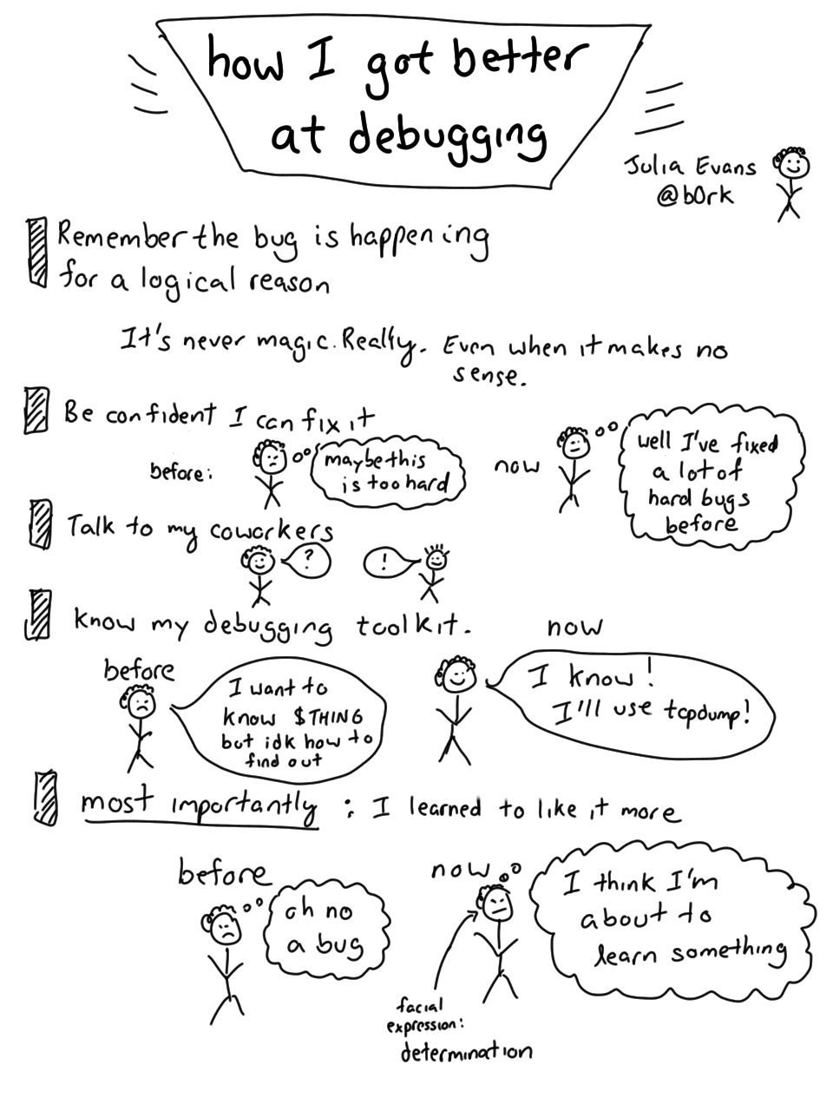
“How I got better at debugging”. Evans, Julia, 2016, Julia’s Drawings

Slide 85
See you all next week!

