Slide 1
Everything in Order
Sorting & I/O

Slide 2
Structure
Week 1: Introduction
Week 2: Syntax, Variables & Functions
Week 3: Control Structures
Week 4: Lists & Collections
Week 5: RegEx & Strings
Week 6: Sorting & I/O
Week 7:Debugging, Errors & Strategies
Week 8: Python Packages
Week 9: Practical Python & Good practices
Week 10: Object Oriented Programming
Week 11: Time, Space and documentation
Week 12: Numpy & Matplotlib
Week 13: Outlook & wrapping up
Week 14: TBA

Slide 3
Last Week's Homework

Slide 4
Last Week's Homework

Slide 5
Sorting

Slide 6
Why Sort?
It makes your data more readable and interpretable
Searching is easier
You can rank your data
And then proceed to work with it in a specific order

Slide 7
Sorting: Example

Slide 8
Sorting Algorithms

Slide 9
Intuitive Sorting
So how does one sort this in ascending order intuitively?
Most likely, you would pick the smallest number you see, write it down and then look for the next smallest number
Bad news – this is actually terribly inefficient
But we will talk about this algorithm nevertheless to get an idea of the topic
[3, 7, 1, 5]
[1
[1, 3
[1, 3, 5
[1, 3, 5, 7]

Slide 10
Selection Sort
This method of sorting is actually really close to the sorting algorithm Selection Sort
In Selection Sort, you always look for the smallest number (that has not been sorted yet) and swap it with the foremost number of the unsorted part of your list
Or look for the biggest number or put the smallest at the end of the list, if you want to sort in descending order

Slide 11
Selection Sort: Code
Just for illustration: a simple, Java-like implementation
def selection_sort_general(data):
# go through array to put right number to each position
for i in range(len(data)):
# set index of next smallest number to current element
min_index = i
# go through all unsorted elements and find minimum
for j in range(i,len(data)):
if data[j] < data[min_index]:
min_index = j
# swap entry at current position and minimum
dummy = data[min_index]
data[min_index] = data[i]
data[i] = dummy
return data

Slide 12
Selection Sort
and a more Pythonic way of doing it:
But don't be fooled, it's still bad.
def selection_sort_python(data):
for i in range(len(data)):
minimum = min(data[i:])
min_index = data[i:].index(minimum) + i
data[i], data[min_index] = data[min_index], data[i]
return data

Slide 13
Selection Sort: Why is it so bad?
Think about it: To sort a list of length n, you would have to go through each of the n elements once
This is a given. You cannot sort without looking at all elements.
In Selection Sort, for each of these n elements, you have to go through the complete remaining list again to find the current smallest element
This adds up to n + (n-1) + (n-2) + … + 1 = n(n+1)/2 operations
For a list of length 3000, this would already equate to more than 4.5 million operations
And this will happen even if the list is already sorted
Therefore, people came up with other sorting algorithms
Notes:
(The 1 might be neglectable as we don't need to sort a single element)
Pretty much only thing that's worse is BogoSort :P (show?)

Slide 14
For Completeness: Bubble Sort
Go through the list comparing each element to the next:
If the next element is smaller than the current element, swap them
If not, go to the next position in the list
At the end of the list
If you swapped any of the elements during this process, go to the beginning and repeat
If not, you're done
Bubble Sort is a very simple and well-known algorithm, but it's still way too inefficient
Wikimedia Commons

Slide 15
For Completeness: Insertion Sort
We don't need to go through the details here, but since we will refer to it later, this is roughly how it works:
Go through the list:
The first element is already sorted
Look at the second element: is it larger or smaller than the first? Keep its position or insert it in front of the first element accordingly
Look at the third element and insert it into the right position compared to the first elements
….
Do this until you reached the end of the list
Surprise – it's still inefficient
Not only because for each element, you have to compare to the already sorted part to find the corresponding position
Many data structures also do not allow for insertion, so instead of inserting your element at the right position, you have to swap it with its neighbor until you reached the right position

Slide 16
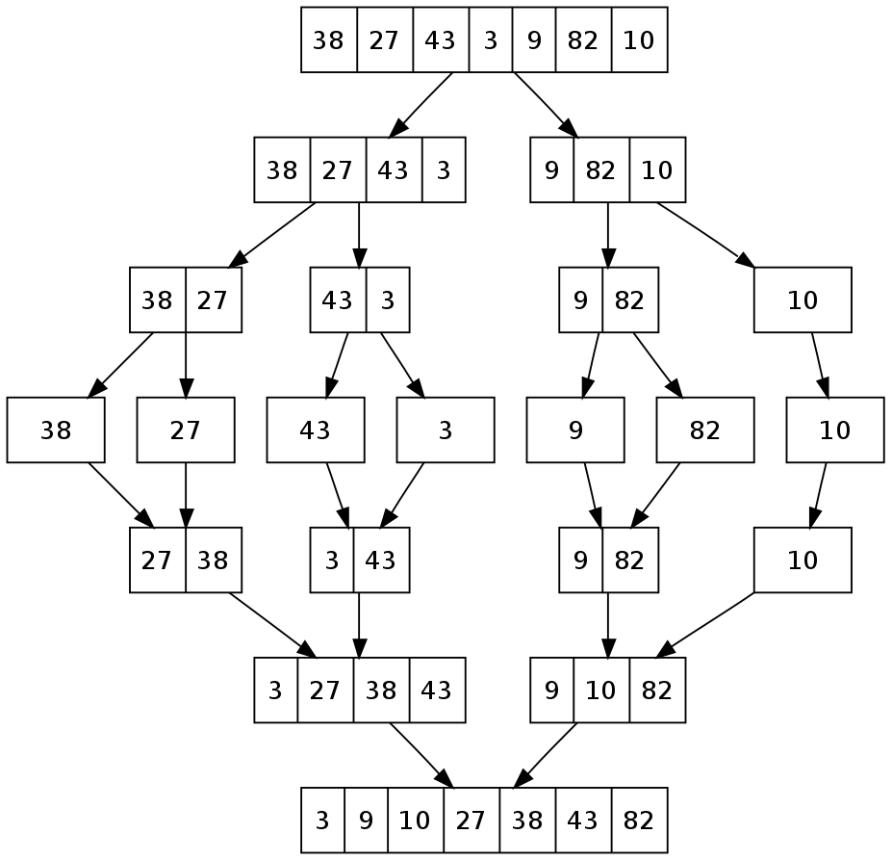
MergeSort
MergeSort is a Divide & Conquer algorithm
You divide the data and then conquer it by merging them together bit by bit
It works roughly as follows:
Divide the data into single elements
Take two neighboring single elements and sort them until you have all your data in groups of two
Then take two neighboring groups and sort them until you have all your data in groups of four
Continue doing this until you have all your data in one group again
Wikimedia Commons
Notes:
How exactly is the sorting done? Always selecting the smallest but since it's not swapped, not exactly selection sort

Slide 17
QuickSort
QuickSort is one of the most commonly used sorting algorithms, so it's good to know about it
Going into the details of this algorithm would be outside the scope of this lecture, but, if interested, you can read about it here: https://en.wikipedia.org/wiki/Quicksort
Wikimedia Commons

Slide 18
Sorting in Python

Slide 19
Sorting in Python
Luckily, Python makes sorting easy for you
There are two methods we want to introduce here: sort() and sorted()
Python typically uses a specific sorting algorithm called Timsort which is derived from both Insertion Sort and MergeSort

Slide 20
sort()
sort() is a sorting method defined for lists only
It changes the order of the items in the given list, so it does not presevere the original list
So this is only recommended if you do not need to keep the original order
numbers = [3, 6, 1, 8, 6, 2]
numbers.sort()
print(numbers)
Output:
[1, 2, 3, 6, 6, 8]

Slide 21
sorted()
sorted() sorts the input and returns a sorted list
Therefore, the order in the original object is preserved!
The input does not have to be a list, but can also be another collection type!
However, it still always returns a list!
numbers = [3, 6, 1, 8, 6, 2]
numbers2 = sorted(numbers)
print(numbers)
print(numbers2)
Output:
[3, 6, 1, 8, 6, 2]
[1, 2, 3, 6, 6, 8]
Notes:
Dictionary: per default only sorts and returns keys

Slide 22
sort() and sorted() - Reverse
sort() and sorted() can be used with two more parameters: key and reverse
We will now demonstrate these with sorted(), but they work for both functions!
As given in the documentation:
If reverse is set to True, elements are sorted in reversed order
So, for numbers, in descending order
sorted(iterable, *, key=None, reverse=False)
numbers = [3, 6, 1, 8, 6, 2]
print(sorted(numbers, reverse=True))
Output:
[8, 6, 6, 3, 2, 1]

Slide 23
Sort() and sorted() - Key
Using key, we can call a specific function and sort based on the output this function produces for each element in the sequence
We do not necessarily have to define this function ourselves, it may also be a built-in function
The function has to be able to return some value for an item that it is handed
sorted(iterable, *, key=None, reverse=False)

Slide 24
sort() and sorted() - Key
Usually strings are sorted comparing letters from the front until two letters differ from each other – here, we only compare the second letter
def second_letter(item):
return item[1] # return item at 2nd position of object
letters = ['Ab', 'Ba']
letters = sorted(letters)
letters2 = sorted(letters, key=second_letter)
print(letters)
print(letters2)
Output:
['Ab', 'Ba'] ['Ba', 'Ab']
Notes:
Function is unsafe btw
TODO: confirm strings are actually sorted like this but it seems that way from my tests.

Slide 25
Sorting with Different Data Types

Slide 26
Sorting on Nested Collections
Nested collections are sorted the similarly to strings, since both strings and collections are sequences
So the nested sequences are compared element by element until a difference is found
Depending on the content of your list, defining a key can make sense here
numbers = [(1,3,4),(1,3,2)]
print(sorted(numbers))
Output:
[(1, 3, 2), (1, 3, 4)]
Notes:
so comparison is aborted as soon as difference is found, right?
Note how now the nesting element (tuple) is preserved and not converted to list

Slide 27
Addition to Last Week: String Splitting

Slide 28
String Splitting
You can split up a string into a list of substrings by using a certain character as a separator
fruits = 'apple, banana, pear, orange'
fruit_list = fruits.split(',')
print(fruit_list)
Output:
['apple', ' banana', ' pear', ' orange']

Slide 29
I/O

Slide 30
I/O
Stands for input/output
Is handled by data streams
We already used one: the standard output stream (stdout)

Slide 31
Input and Output
Reading input in Python is simple
There is the input() function, which just takes one optional argument: a prompt given to the user
So you don't need to necessarily give a prompt, but it can be useful for giving directions to the user
sentence = input("Please enter a sentence here: ") # input
print(sentence) # output
Output:
Please enter a sentence here: Old MacDonald had a farm, E-I-E-I-O Old MacDonald had a farm, E-I-E-I-O
Notes:
Show no argument input

Slide 32
Another Look at the Output Function
From the documentation:
So, per default, things are printed to the standard output stream (terminal)
But we can also print elsewhere
objects to print
what to do at the end of the line
(not important for now)
print(*objects, sep=' ', end='\n', file=sys.stdout, flush=False)
separation between objects
where to print the objects
Notes:
TODO: animation

Slide 33
Printing to Files
You can print to a file by opening a file and specifying a name for a file object which will help you handle the file
my_lottery_numbers = [21, 8, 19, 9, 1, 22]
with open('lottery.txt', 'w') as lottery_file:
print(my_lottery_numbers, file=lottery_file)
Output:
File: lottery.txt
[21, 8, 19, 9, 1, 22]

Slide 34
Files in Python - Opening and Closing
with open('lottery.txt', 'w') as lottery_file:
print(my_lottery_numbers, file=lottery_file)
Files that were opened need to be closed, too (to free up resources and make the file accessible for other processes)
In the notation given above, using with to open a file, the file is closed implicitly after the code block
As that means you won't have to pay attention to closing it again, we highly recommend using this method
If you are not able to use with to open a file, remember to use filename.close() to close the file after use

Slide 35
Files in Python - Path
Open your files using relative paths, such that your program won't have trouble finding files on other people's computers
A relative path means that the file is looked for starting from the path where your Python script is stored
For example: our script is in a folder named lottery and the file we need in a subfolder names files
but where exactly the lottery folder is stored in the system is not relevant
with open('C:/Users/Me/Documents/BPP/lottery/files/test.txt', 'w') as lottery_file:
[…]
with open('files/lottery.txt', 'w') as lottery_file:
[…]

Slide 36
Reading from Files
File objects can be read by using read()
my_lottery_numbers = [21, 8, 19, 9, 1, 22]
with open('lottery.txt', 'r') as lottery_file:
data = lottery_file.read()
print(data)
Output:
[21, 8, 19, 9, 1, 22]

Slide 37
Writing to Files
We can also use the write() to write data to files
However, the data handed to this function must be a string, so don't forget to use a typecast when trying to write non-string objects to your file
my_lottery_numbers = [21, 8, 19, 9, 1, 22]
with open('files/lottery.txt', 'w') as lottery_file:
lottery_file.write(str(my_lottery_numbers))
File: lottery.txt
[21, 8, 19, 9, 1, 22]

Slide 38
File Modes
Spot the difference:
You can open a file in different modes which determine how you can use your file
with open('files/lottery.txt', 'r') as lottery_file:
with open('files/lottery.txt', 'w') as lottery_file:
Notes:
Demonstrate?

Slide 39
File Modes (Most Important Ones)
File Mode | Meaning | If file doesn't exist
r | Open the file for reading only | Error
w | Open the file for writing only Will overwrite complete file contents | Create new file
r+ | Open the file for reading and writing | Error
w+ | Open the file for writing and reading Will overwrite complete file contents | Create new file
a | Open the file for appending Everything written into the file is written to the end of the file – no overwriting of previous contents | Create new file
a+ | Open the file for appending and reading Everything written into the file is written to the end of the file – no overwriting of previous contents | Create new file
Notes:
If you want to change your file mode, repoen the file
There's a couple other ones, but you wont need these

Slide 40
Files - seek()
fileObject.seek(offset[, whence])
seek() can be used to jump to a certain position in the file
offset is the parameter with which you determine the position to jump to (e.g. 0 for beginning)
whence is an optional parameter that determines what kind of jump is performed
0 is the default and stands for an absolute jump to the position given in offset
1 means a jump is performed relative to the current position in the file
2 means a jump is performed relative to the end position of the file

Slide 41
Files - seek()
my_lottery_numbers = [21, 8, 19, 9, 1, 22]
with open('files/lottery.txt', 'w+') as lottery_file:
lottery_file.write(str(my_lottery_numbers))
numbers = lottery_file.read()
print(numbers)
Output:
No output is displayed as, after writing, we were at the end of the file and there was nothing left to read

Slide 42
Files - seek()
my_lottery_numbers = [21, 8, 19, 9, 1, 22]
with open('files/lottery.txt', 'w+') as lottery_file:
lottery_file.write(str(my_lottery_numbers))
lottery_file.seek(0)
numbers = lottery_file.read()
print(numbers)
Output:
[21, 8, 19, 9, 1, 22]
So we use seek() to jump back to the beginning

Slide 43
Reading Files Line by Line

Slide 44
Reconstructing Collections from Files

Slide 45
Homework

Slide 46
See you all next week!

