Slide 1
The Power of Patterns
Strings, RegEx & FSA

Slide 2
Structure
Week 1: Introduction
Week 2: Syntax, Variables & Functions
Week 3: Control Structures
Week 4: Lists & Collections
Week 5: RegEx & Strings
Week 6: Sorting & I/O
Week 7:Debugging, Errors & Strategies
Week 8: Python Packages
Week 9: Practical Python & Good practices
Week 10: Object Oriented Programming
Week 11: Time, Space and documentation
Week 12: Numpy & Matplotlib
Week 13: Outlook & wrapping up
Week 14: TBA

Slide 3
Last Homework

Slide 4
Common Mistakes & Solutions
Task 3: initialise an empty list, then use append to add all strings
+= does not work to append strings to lists, unless you wrap the string into a list
def clean_up(subjects, attributes):
# and as a one-liner:
# return {sub : attributes[subjects.index(sub):subjects.index(sub)+subjects.count(sub)] for sub in set(subjects)}
subject_dict = dict() # {}
for idx, subj_id in enumerate(subjects):
if subj_id not in subject_dict:
subject_dict[subj_id] = []
subject_dict[subj_id].append(attributes[idx])
return subject_dict

Slide 5

Common Mistakes & Solutions
Euclidean
$\sqrt[2]{\sum_{i=1}^{N}{{\left|x_{i}−y_{i}\right|}^{2}}}$
Minkowski
$\sqrt[p]{\sum_{i=1}^{N}{{\left|x_{i}−y_{i}\right|}^{p}}}$
Cityblock
$\sum_{i=1}^{N}{\left|x_{i}−y_{i}\right|}$
def pdist(x, y, **kwargs):
metric = kwargs['metric'] if 'metric' in kwargs else 'euclidean’
if metric == 'minkowski’:
p = kwargs[‘p’] if 'p' in kwargs else 2
if metric == 'euclidean’:
squared = [abs(z)**2 for z in sub(x,y)]
return math.sqrt(sum(squared))
elif metric == 'cityblock’:
diff = [abs(z) for z in sub(x, y)]
return sum(diff)
elif metric == 'minkowski’:
if p < 1:
return None
to_p = [abs(z)**p for z in sub(x, y)]
return sum(to_p) ** (1/p)
else:
return None

Slide 6
Common Mistakes & Solutions
def outer(x, y):
"""Returns a list of lists representing a matrix calculated from the two vectors, each list represents one row"""
# one liner:
# return [[xi * yi for yi in y] for xi in x]
result = []
for i in range(len(x)):
row = []
for j in range(len(y)):
row.append(x[i] * y[j])
result.append(row)
return result

Slide 7
Regular Expressions

Slide 8
Regular Expressions: RegEx
Regular Expressions (short: RegEx) are a way to describe a pattern
Formal description of possibly infinite combinations
RegEx are a form of grammar to describe regular languages
Look up ‘Chomsky Hierarchy’ if you want to learn more
RegEx is useful for many things
Text replacement
Filtering
Extracting data
…
Interesting websites
https://RegEx101.com/
https://visca.com/RegExdict/

Slide 9
RegEx & Python
RegEx consist of “normal” characters of the target language…
In our case mostly (a subset of) German & English or some more abstract language
… and some more meta-characters
Some characters that have a special meaning in the context of RegEx
Python offers the re package, which handles regular expressions
The re module offers more than what we are going to cover
While there is an object oriented interface, we are only going to look at the procedural one
You can compile a pattern and then call the re functions on that. It’s faster if you are going to reuse the same pattern often
import re
regex = re.compile(pattern) re.search(pattern, string)
regex.search(string)

Slide 10
RegEx: The Base
Ex1 and Ex2 are regular expressions
Ex1Ex2 : Concatenation. You can just put two regular expressions together
ab, abcd, 12ab, …
() : Parentheses can be used to group RegEx to form a single unit
(ab), (a(1234)b) -> a(1234)b, 2(cf)d
Parentheses around the whole RegEx statement can be omitted
Ex1* : The Kleene Star marks a expression as being repeated 0 or more times
ba* -> b, ba, baa, baaa, baaaa, …
Ex1|Ex2 : the pipe symbol (not a capital I) works as a disjunction, an either or
(a|b|ab)cd -> acd, bcd, abcd
Order is similar to logic: Parentheses > * “function” > Ex1Ex2 “and” > Ex1|Ex2 “or”

Slide 11
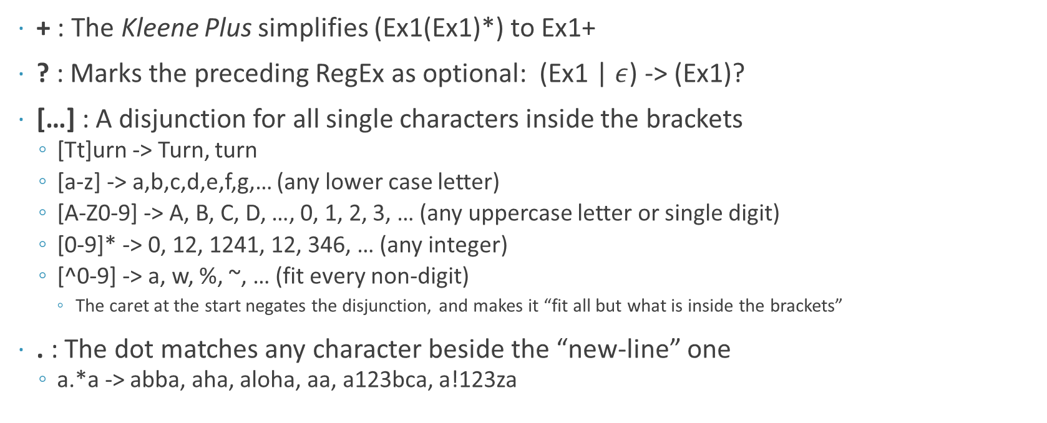
RegEx: QOL
+ : The Kleene Plus simplifies (Ex1(Ex1)*) to Ex1+
? : Marks the preceding RegEx as optional: (Ex1 | $ε$) -> (Ex1)?
[…] : A disjunction for all single characters inside the brackets
[Tt]urn -> Turn, turn
[a-z] -> a,b,c,d,e,f,g,… (any lower case letter)
[A-Z0-9] -> A, B, C, D, …, 0, 1, 2, 3, … (any uppercase letter or single digit)
[0-9]* -> 0, 12, 1241, 12, 346, … (any integer)
[^0-9] -> a, w, %, ~, … (fit every non-digit)
The caret at the start negates the disjunction, and makes it “fit all but what is inside the brackets”
. : The dot matches any character beside the “new-line” one
a.*a -> abba, aha, aloha, aa, a123bca, a!123za

Slide 12
RegEx: Relevant Escape Characters
\n
The newline character
\d
Matches any digit, equal to [0-9]
\D
Matches all but not digits, equal to [^0-9]
\w
Matches any alphanumeric character, equal to [a-zA-Z0-9_]
\W
Matches all non-alphanumeric characters equal to [^a-zA-Z0-9_]
\b
Matches a word boundary, so before the first character or after the last character
\B
Matches when it is no word boundary, so if there is no space before or after
\s
Matches whitespace: a tab, a space, a newline, …
\S
Matches no whitespace
In general the backslash escapes a character
\. -> a literal dot
\$ -> a literal dollar sign

Slide 13
The Great Escape
But what if we need a backslash?
We need to escape it -> \\
To get the input string ‘\\’, we need the RegEx ‘\\\\’
To avoid this we can use raw strings
Those strings are prepended by a r
In raw strings, quotes still need to be escaped, but the resulting string will still contain the backslash
In RegEx the backslash is still used as an escape character and \d, \n, … will still work as expected
print(re.match("\\\\", "\\"))
print(re.match(r"\\", "\\"))
Output:
<_sre.SRE_Match object; span=(0, 1), match='\\'>
<_sre.SRE_Match object; span=(0, 1), match='\\’>
print(r'quote \'')
Output:
quote \'

Slide 14
The Output
<_sre.SRE_Match object; span=(0, 1), match='\\’>
What can we infer from this ouput?
The first part up to the semicolon is simply the type of the object
span
The indices of the match
Our match started at index 0, the first backslash, and ended with index 1, the second backslash
match
What was matched
Here it is the whole input string, as it was the full match
The match object can be indexed like a list, with index 0 being the full match
We will talk about groups in a bit
Match can also be used in if conditions, and will only be true if something was matched

Slide 15
One More Thing: Groups
You can form groups in RegEx and reference them
e.g. rhyme finding
RegEx inside parentheses are a group
In the re module you can extract matched groups by using calling .groups()
Note that we used raw strings, otherwise we would need to escape the backslashes
Group indexing starts at 1, since the 0 index is the full match
The groups functions still starts at 0, since it only returns the subgroups, i.e. not the full match
.group() returns all matches including the full match
match = re.match(r"(a*)b\1", "aabaaa")
print(match[0])
match = re.match(r"(a*)b\1", "aaba")
print(match)
match = re.match(r"(a*)(b{1,3})\1\2", "abbabb")
print(match.groups())
Output:
aabaa
None
('a', 'bb')

Slide 16
Groups: An Example
Try RegEx to find rhymes
Matches:
House Mouse
Blue True
Bake Brake
Mock Sock
No matches:
Hippo horse
Dog cat
Home castle
Legend hero
import re
matches = ["house mouse", "blue true", "bake brake", "mock sock"]
no_match = ["hippo horse", "dog cat", "home castle", "legend hero"]
regex = r'(.+?)(..+) (.+)\2'
for i in matches:
print(re.match(regex, i)[2])
for i in no_match:
if re.match(regex, i):
print("{}! It's a match!".format(i))
Output:
ouse
ue
ake
ock

Slide 17
Greediness And The Last Symbols
You might have noticed the ? behind the +
This means that the + should not act greedily
By default, RegEx tries to match as many characters as possible
Sometimes we need minimal matches though
Then we can use the ?
Two more symbols:
^ means the start of the string
$ is the opposite, the end of the string
import re
print(re.search('a.*a', 'abbabba')[0])
print(re.search('a.*?a', 'abbabba')[0])
print(re.search('a.*?a$', 'abbabba')[0])
Output:
abbabba
abba
abbabba

Slide 18
Finite State Machines

Slide 19
Finite State Automata: FSA
This might sound familiar from other courses
Finite State Machines are a concept to understand and build many systems
They can decide about input (acceptors/classifiers) or produce output (transductors)
They have a finite number of distinct states
They can change their states by defined state transitions
These can be deterministic or non-deterministic
We will focus on deterministic classifiers (DFA: Deterministic Finite Automaton)

Slide 20
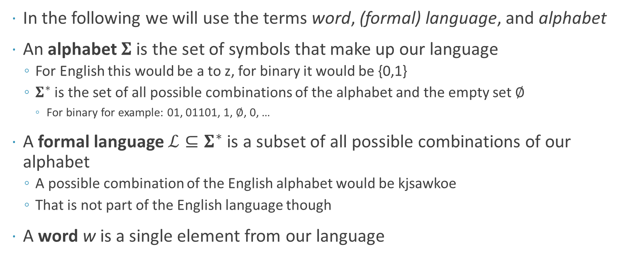
FSA: Some Terminology
In the following we will use the terms word, (formal) language, and alphabet
An alphabet $Σ$ is the set of symbols that make up our language
For English this would be a to z, for binary it would be {0,1}
$Σ^{∗}$ is the set of all possible combinations of the alphabet and the empty set $∅$
For binary for example: 01, 01101, 1, $∅$, 0, …
A formal language $ℒ⊆Σ^{∗}$ is a subset of all possible combinations of our alphabet
A possible combination of the English alphabet would be kjsawkoe
That is not part of the English language though
A word w is a single element from our language

Slide 21
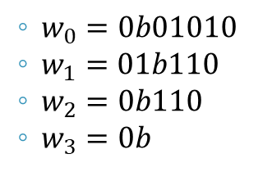
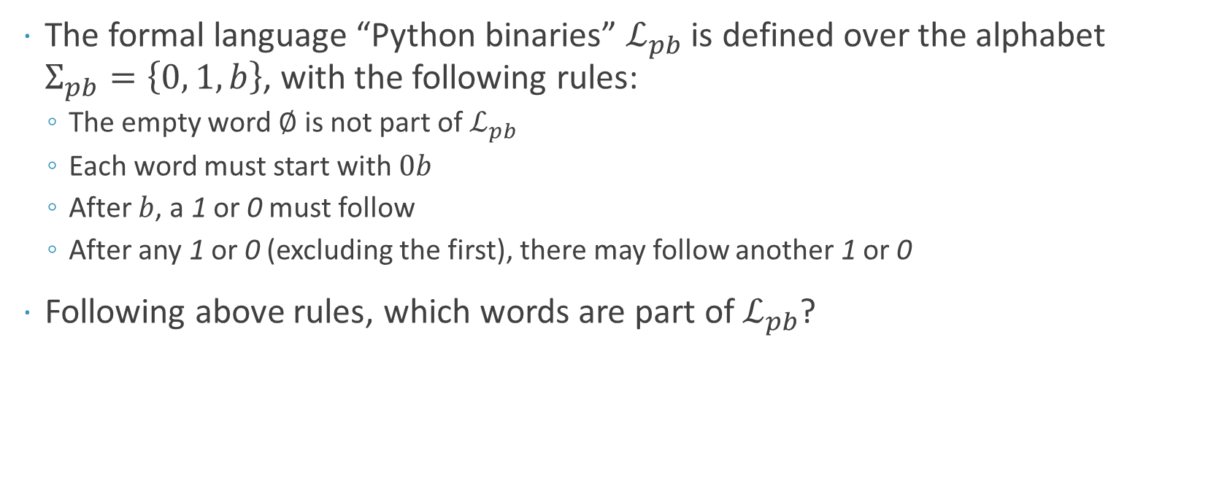
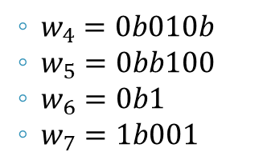
Let’s Look at an Example
The formal language “Python binaries” $ℒ_{pb}$ is defined over the alphabet $Σ_{pb}=\left\{0, 1, b\right\}$, with the following rules:
The empty word $∅$ is not part of $ℒ_{pb}$
Each word must start with $0b$
After $b$, a 1 or 0 must follow
After any 1 or 0 (excluding the first), there may follow another 1 or 0
Following above rules, which words are part of $ℒ_{pb}$?
$w_{0}=0b01010$
$w_{1}=01b110$
$w_{2}=0b110$
$w_{3}=0b$
Yes
No, 1 follows leading 0
Yes
No, no 0 or 1 after b
$w_{4}=0b010b$
$w_{5}=0bb100$
$w_{6}=0b1$
$w_{7}=1b001$
No, too many b’s
No, b after b
Yes
No, it starts with a 1

Slide 22
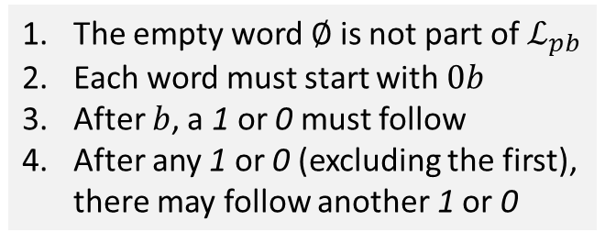
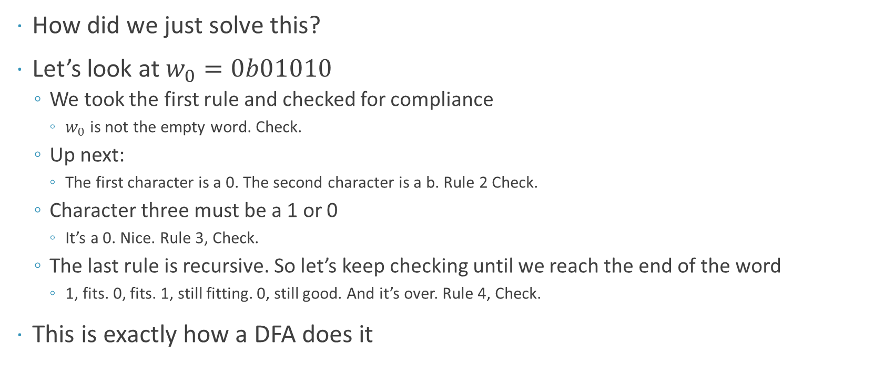
Determining Word Validity
How did we just solve this?
Let’s look at $w_{0}=0b01010$
We took the first rule and checked for compliance
$w_{0}$ is not the empty word. Check.
Up next:
The first character is a 0. The second character is a b. Rule 2 Check.
Character three must be a 1 or 0
It’s a 0. Nice. Rule 3, Check.
The last rule is recursive. So let’s keep checking until we reach the end of the word
1, fits. 0, fits. 1, still fitting. 0, still good. And it’s over. Rule 4, Check.
This is exactly how a DFA does it
The empty word $∅$ is not part of $ℒ_{pb}$
Each word must start with $0b$
After $b$, a 1 or 0 must follow
After any 1 or 0 (excluding the first), there may follow another 1 or 0

Slide 23
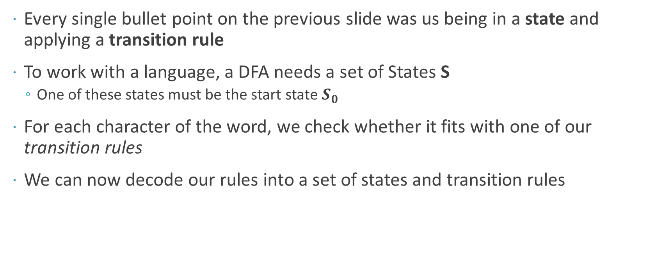
More Terminology: Introducing States
Every single bullet point on the previous slide was us being in a state and applying a transition rule
To work with a language, a DFA needs a set of States S
One of these states must be the start state $S_{0}$
For each character of the word, we check whether it fits with one of our transition rules
We can now decode our rules into a set of states and transition rules

Slide 24
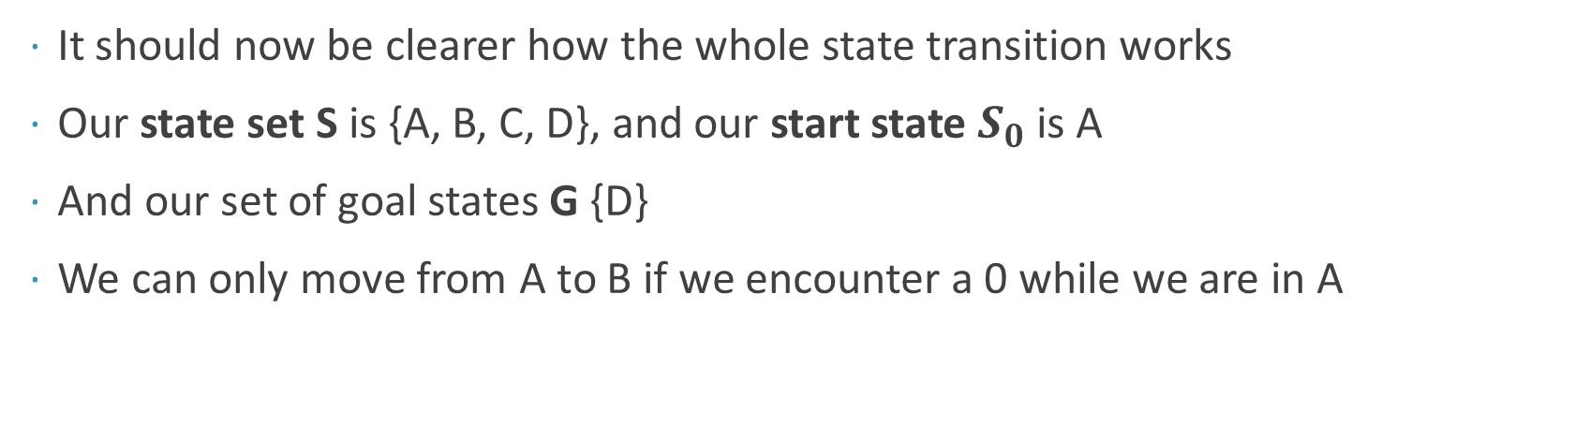
DFA as a directed Graph
A
B
C
D
Start
0
b
0,1
0,1
It should now be clearer how the whole state transition works
Our state set S is {A, B, C, D}, and our start state $S_{0}$ is A
And our set of goal states G {D}
We can only move from A to B if we encounter a 0 while we are in A

Slide 25
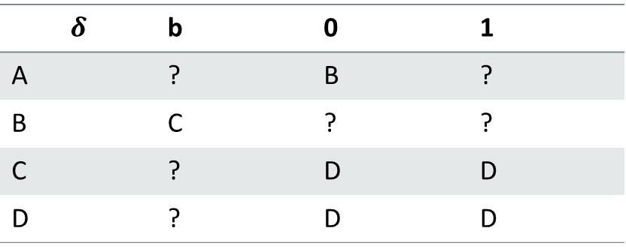
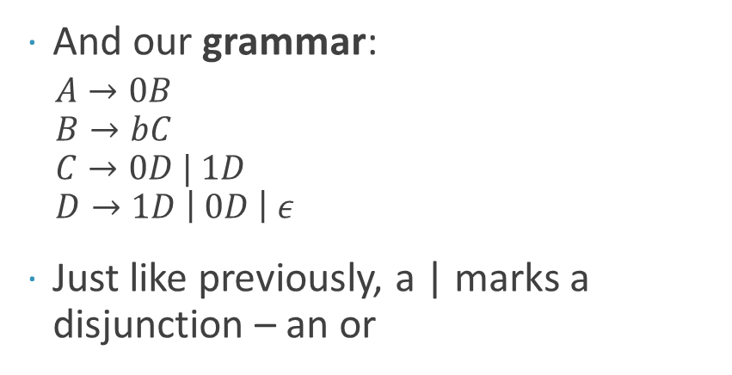
Transition Rules
A
B
C
D
Start
0
b
0,1
0,1
And our grammar:
$A→0B$ $B→bC$ $C→0D | 1D$ $D→1D \left| 0D \right| ε$
Just like previously, a | marks a disjunction – an or
Our transition rules:
$$δ$$ | b | 0 | 1
A | ? | B | ?
B | C | ? | ?
C | ? | D | D
D | ? | D | D

Slide 26
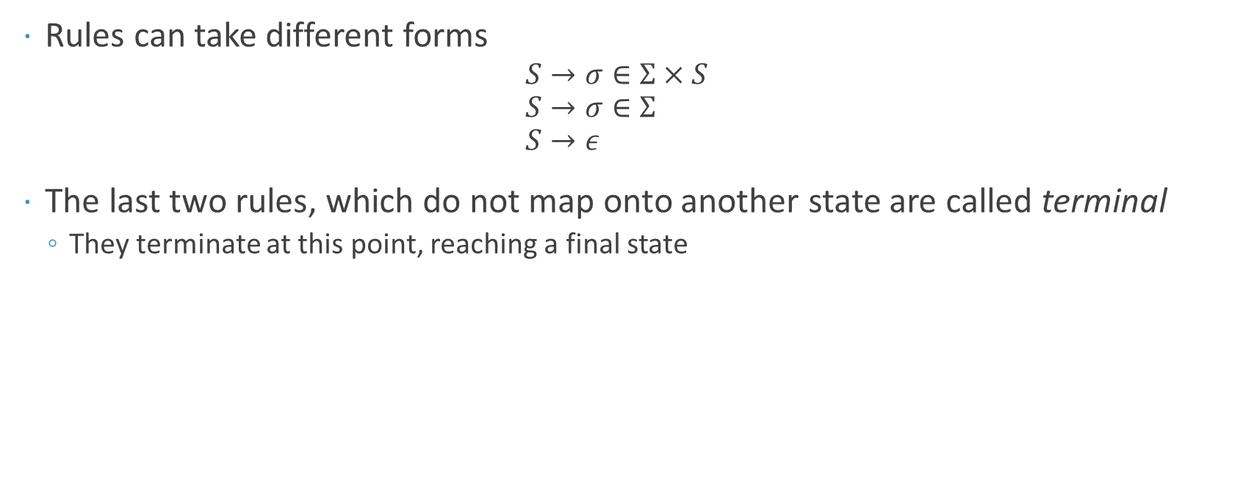
Transition Rules
Rules can take different forms
$$S→σ∈Σ×S \\ S→σ∈Σ \\ S→ε$$
The last two rules, which do not map onto another state are called terminal
They terminate at this point, reaching a final state

Slide 27
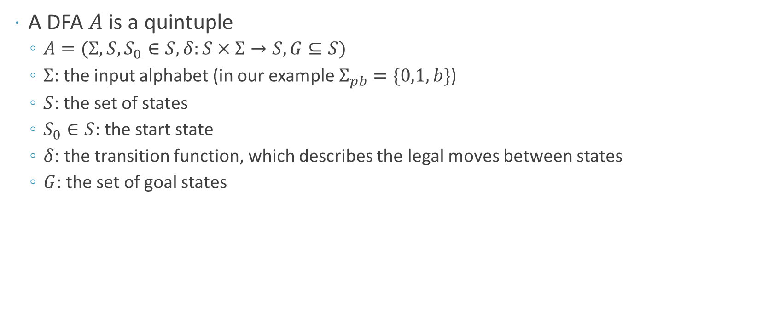
DFA: Formalities
A DFA $A$ is a quintuple
$A=(Σ, S,S_{0}∈S,δ:S×Σ→S,G⊆S)$
$Σ$: the input alphabet (in our example $Σ_{pb}=\{0,1,b\}$)
$S$: the set of states
$S_{0}∈S$: the start state
$δ$: the transition function, which describes the legal moves between states
$G$: the set of goal states

Slide 28
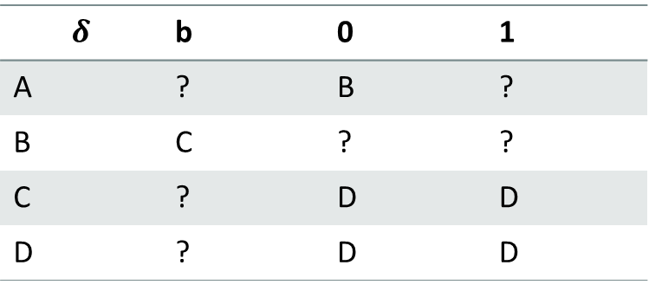
Back To The Rules
The transition table can be read like:
Given the current state (first column)
And an input symbol (the other columns)
The new state is the one from the corresponding cell
For example:
Given state B and the next input is b, the next state will be C
State A with input 0 leads to state B
…
But what about the question marks?
Our transition rules:
$$δ$$ | b | 0 | 1
A | ? | B | ?
B | C | ? | ?
C | ? | D | D
D | ? | D | D

Slide 29
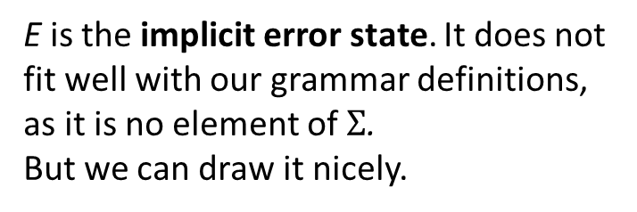
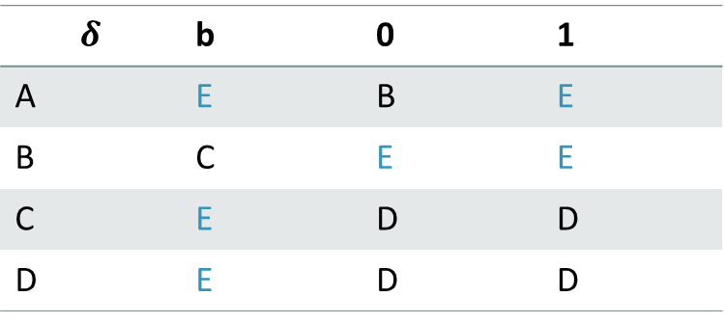
Implicit Error States
A
B
C
D
Start
0
b
0,1
0,1
E
1,b
0, 1
b
b
$$δ$$ | b | 0 | 1
A | E | B | E
B | C | E | E
C | E | D | D
D | E | D | D
E is the implicit error state. It does not fit well with our grammar definitions, as it is no element of $Σ$. But we can draw it nicely.
0, 1,b

Slide 30
Implicit Error States
The implicit error state is useful for implementing a FSA
To conclude what inputs leads to an error state, imagine all possible inputs
Those inputs that are not legal according to our grammar, lead to the error state
Once in an error state, the FSA states in an error state
Hence, the error state is sometimes called “trap”

Slide 31
Implementing an DFA
def delta(state, letter):
states, inputs = ['A', 'B', 'C', 'D', 'E'], ['b', '0', '1’]
transition = [
['E', 'B', 'E’],
['C', 'E', 'E’],
['E', 'D', 'D’],
['E', 'D', 'D’],
['E', 'E', 'E’]
]
return transition[states.index(state)][inputs.index(letter)]
def fsa(word):
state = 'A’
for letter in word:
state = delta(state, letter)
return state == 'D'
if __name__ == '__main__’:
for b in ['0b01', '011', '0b1101’]:
print('{} {}'.format(b, fsa(b)))
Output:
0b01 True
011 False
0b1101 True

Slide 32
Checking Our Examples
import binary # file from last slide
for b in ["0b01010", "01b110", "0b110", "0b", "0b010b", "0bb100", "0b1", "1b001"]:
print('{} : {}'.format(b, binary.fsa(b)))
Output:
0b01010 : True
01b110 : False
0b110 : True
0b : False
0b010b : False
0bb100 : False
0b1 : True
1b001 : False

Slide 33
Why DFA?
We can find DFA’s in a lot of places
Cars (e.g. the wiper motors)
Experiment design
Game Design
Interfaces
Regular Expressions
…
And in our next topic

Slide 34
String Formatting

Slide 35
So Far
When we wanted to use a variable in a string, we used this pattern:
And sometimes ran into this error:
So we needed to cast the variable to a string:
This is tedious and gets very convoluted quickly
age = 23
print("My age is " + age + "!")
Traceback (most recent call last):
File "lecture_code.py", line 2, in <module>
print("My age is " + age + "!")
TypeError: must be str, not int
print("My age is " + str(age) + "!")

Slide 36
A New String in Town
Most higher level programming languages offer string formatting
Formatting allows to input and modify values into a given string
We can think of the string as a template, in which we made pre-defined holes
Then we fill these holes with our variables, and adjust them to fit the hole
This makes code more readable
And gives us powerful options to how we want to display the values
Python offers us a whole of three options to format strings

Slide 37
.format()
This is probably the most straightforward one
Every string in Python implements the format function
In the string you can use {} to mark holes to be filled in
Then you call .format(var1, var2) on the string with the variables to be placed
You can swap them around by indexing (0-based) or naming
print("{1}{0}".format("a", "b"))
ba
print("Candidate {0}: {name}, {age}".format(1, age=23, name='Fred’))
Candidate 1: Fred, 23

Slide 38
.format()
But you can do more than simply fill in variables
You can format them
{[name] : [[fill]align][sign][width][.precision][type]}
For more info and details
https://docs.python.org/3.6/library/string.html#format-string-syntax
print("{:_>10s}".format("hi"))
print("{:+4}".format(35))
print("{:10.3f}".format(1/3))
Output:
________hi
+35
0.333

Slide 39
Formatting Rules
Example | Explanation | Example Output
.3f | Format as float (f) and display 3 decimal places (.3) | 3.14159 -> 3.141
*^20 | Pad with * symbols, align it centred (^), use at least 20 spaces | Help Guide -> *****Help Guide*****
0>10.2f | Pad with 0s, align right (>), use at least 10 spaces and display 2 decimal places | 4.6124 -> 0000004.61
+.3 | Display sign even for positive numbers (+) and display 3 decimal places | 3.14159 -> +3.131
10b | Use at least 10 spaces and display the input in binary (b) | 42 -> 101010
Notes:
Let’s take a look at the documentation

Slide 40
F-strings
Since Python 3.6 there is an even more compact form of formatting
Called f-strings, because they are “normal” strings with a f prepended
They are similar to .format(), but more compact
But it is not as versatile
With f-Strings you simply put the variable name you want to include
But you can put all kinds of statements there which will be evaluated
age = 17
print(f"My age is {age:-^6}.")
print(f"I will be {age + 1} next year! So I will be {'not ' if (age + 1) < 18 else ''}allowed to drive!")
Output:
My age is --17--.
I will be 18 next year! So I will be allowed to drive!

Slide 41
%-formatting: The Old One
It is the predecessor to .format(), and the formatting rules are similar
Can only deal with strings, ints and floats
This is however not advised anymore and only presented so you understand it should you encounter it
print("My age is %6d" % age)
Output: My age is 17

Slide 42
Homework

Slide 43
Homework
Practice RegEx by stating which statements they can describe and which not
Create an FSA
Practice modifying strings and string formatting
By singing Old MacDonald's song

Slide 44
See you next week!

