Slide 1
print(“Hello World”)
Introduction and Organisation
Notes:
Self-introduction: We are bachelor students finishing up our studies, we have been tutors before, but this is our first full on course that we are doing. We took over this course from Sebastian and Aline, who did this last year, and did this course from the ground up. We are building on their work.

Slide 2
Organisation

Slide 3
This Course
This will be a rather slow moving course
It is aimed foremost at masters who have no programming experience
This foremost is an introduction to programming and second to Python
If you already have experience with programming – even if not with Python – the Scientific Programming in Python course might be better suited
It will be quite a bit of work “for a 4 ECTS course”, but don’t worry, we are here to help you

Slide 4
Structure
Week 1: Introduction
Week 2: Syntax & Variables
Week 3: Control Structures
Week 4: Lists & Collections
Week 5: RegEx & Strings
Week 6: Sorting & I/O
Week 7:Debugging, Errors & Strategies
Week 8: Python Packages
Week 9: Practical Python & Good practices
Week 10: Object Oriented Programming
Week 11: Time, Space and documentation
Week 12: Numpy & Matplotlib
Week 13: Outlook & wrapping up
Week 14: TBA
Notes:
Schedule is preliminary and up to change
First 8 weeks are pretty fixed tho
The last three weeks are the more “real world” lectures
We won’t hold every lecture together, but will alternate in the coming weeks

Slide 5
Structure
There is one lecture every Wednesday, 14:00-16:00 in 32/102
There will be homework every week
There will be a walk-in session every Thursday, 14:00-18:00 in HS-SL 103
Feel free to come by if you have any questions or need help with your homework!
There will also be feedback sessions every Tuesday, 16:00-19:00 in 32/110
More about this on the next slide
Notes:
There might be projects that stretch over the last weeks instead of single homework. Maybe? Don’t know yet.

Slide 6
Homework
Homework is done in groups of up to 4 people
Don’t split the tasks!
Work together to solve your problems
You hand in your homework by uploading it on Stud.IP by Monday 8:00
We offer 10~12 feedback groups
There are not enough feedback sessions for everyone
Sign up for groups opens on Thursday, 05.04 at 18:00
Notes:
Please really try to form groups. Single hand ins make correcting all the harder.
Feedback groups are on the next slide.

Slide 7
Feedback Groups
Since they worked well last year we decided to offer them again
Each feedback session is 30 minutes long
The slots are Tuesdays between 16:00 and 19:00
You present your homework
We give you verbal feedback
If there are many small groups we might merge you
Notes:
Like Info-A, but actually not. No theoretical questions, no strict grading.
Just an offer to help you with this course.
Please be honest with yourselves, whether you actually need this or not.

Slide 8
Grading
There is only pass / fail
Thus you can only use this course in your optional fields
Pass 10 out of 12~14 homework to get the certificate
Your solution doesn‘t need to be perfect, but should show that you spent time on the topic
Each homework will be graded with a passed, failed or outstanding
We will upload a small table each week with your group id and the grading
If you have questions on our corrections, simply send us a mail and we will upload a commented version

Slide 9
Let’s Learn Together!
You can ask questions
In class
In the walk in sessions
In the stud.ip forum^{[1]} & blubber^{[2]}
Via mail
And answer the questions of your classmates when you can!
Explaining something is a great way to see whether you really understood it
[1] https://studip.uos.de/plugins.php/coreforum/index/index?cid=4f689242f85c14b4ca386a37b39c9d7c
[2] https://studip.uos.de/plugins.php/blubber/streams/forum?cid=4f689242f85c14b4ca386a37b39c9d7c

Slide 10
Introduction

Slide 11
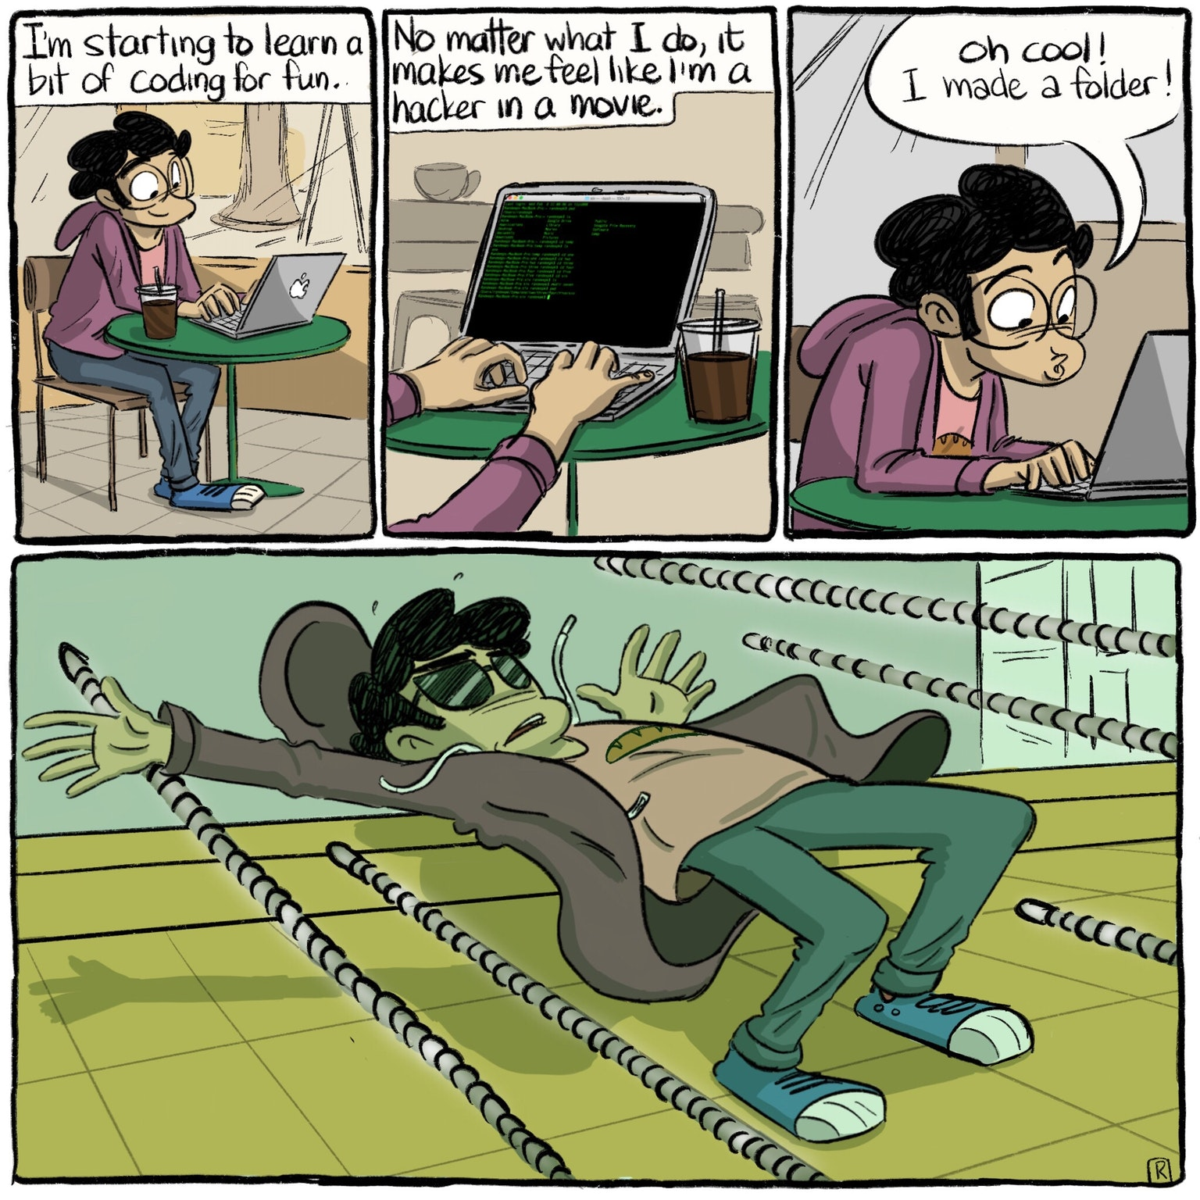
Preamble: Some Terminology
Terminal | Commandline | CMD | CLI | Prompt
Nearly every operating system comes with a command line interface (CLI)
It is solely text & command based and can be used to interact with your system
The terminal plays a central role in programming, as it is mostly used to execute/start code
Printing
In the context of programming, printing means to output something, usually to the terminal
You won’t need to bring any printers
Notes:
The terminal is a text based interface with your computer.
They are the “hacker” thing from movies.
Terminal is from pre-graphical interfaces.
Allows for more direct interaction with the system.
That’s really handy in programming.

Slide 12
What is Programming?
The planning, scheduling, or performing of a program (from Merriam-Webster)
Program:
a plan or system under which action may be taken toward a goal (from Merriam-Webster)
So basically, it is a formulated plan to solve a given problem
But: A computer is not all too good with human language (yet)
In order for a computer to solve a problem we write algorithms
An algorithm is a problem-solving procedure composed of a finite number of unambiguous steps.
Examples:
My morning routine
Recharging your Campus Card
...
Notes:
Explain algorithm.
It’s just a set of very specific instructions (how specific depends on programming language)
For each instruction there is only one option what to do.
That has to end at some point – that does not mean your program will actually come to an halt. We will talk about this later.

Slide 13
Where is Programming?
It’s easier to say where it isn’t
Obvious:
PCs, smartphones, experimental design
Less obvious:
TVs & monitors, microwaves, electric blinds
Programming is used in nearly every place with electricity

Slide 14
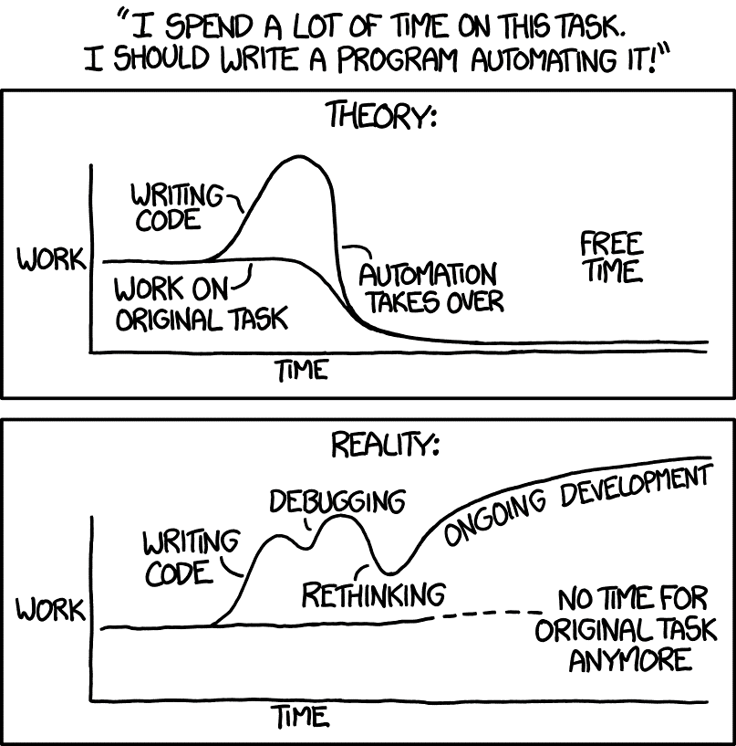
Why Should You Learn Programming?
Automation of tasks can save you a lot of time
Theses and papers become easier
Data analysis becomes easier
Devices & software become less magic
Programming principles are helpful in everyday tasks
Office programs
Understanding policies
They basically are a long list of if-then’s
A lot of jobs for academics involve coding
Xkcd, 2014, https://xkcd.com/1319/
Notes:
Point out "hacker" bullshit

Slide 15
Learning Programming
Programming is a lot like sports
„It’s easy to run, but hard to run a marathon”^{[1]}
Mastering a skill takes a long time
Malcolm Gladwell wrote it takes about 10,000 hours
We can only help you with the first ~60 hours
It should however give you a basis to further improve your knowledge
^{[1]} Sebastian Höffner, 2017, Basic Programming in Python

Slide 16
Code
We refer to programs and algorithms we write for computers as code
Code for the same algorithm varies a lot depending on the programming language
These differences are due to the syntax of a specific language
Outside of a specific programming language you often see pseudo code
Pseudo code is an algorithm but written to resemble natural language
Notes:
Syntax: rules, structure of the language, vocabulary, just like real world languages
Pseudo Code is not bound to any actual programming language, but to outline an algorithm

Slide 17
Algorithm Examples
My morning routine
Recharging your campus card
WAKE UP
IF IT IS NOT TOO LATE
HIT SNOOZE
SPEND 10 MINUTES DOING NOTHING
TURN OFF ALARM
STAND UP
IF LAST SHOWER > 16 HOURS:
TAKE A SHOWER
FOR EACH ITEM IN MY ORDERED OUTFIT:
PUT ON ITEM
GET A BOWL
GET CEREAL
POUR CEREAL INTO BOWL
(…)
APPROACH CHARGING MACHINE
PUT CAMPUS CARD INTO MACHINE
CHOOSE CHARGE AMOUNT
PRESS OK
INSERT BANK CARD
ENTER PIN
PRESS OK
WHILE TRANSFER NOT COMPLETED
WAIT
IF WAIT > 42 SECONDS:
PONDER MEANING OF LIFE
TAKE OUT BANK CARD
TAKE OUT CAMPUS CARD
Notes:
A lot of simple everyday tasks can be written as algorithms this way

Slide 18
Why Python?
Python is a high-level language, which means that...
its syntax is easier to grasp than "low-level" programming languages
one doesn't need much knowledge about hardware to use it properly
Python in particular was designed to resemble the English language
Somewhat anyway
There is an abundance of libraries that make your life easier
we'll talk more about libraries later in the semester
Python is widely used
especially in academia, for example for experiments
Python is free and open source
Notes:
Open source: everyone can see code, community-based

Slide 19
Hello World!
“Hello World!” is the standard introduction to programming
Wikipedia on Hello World^{[1]}
It is a program that simply prints Hello World
It is a rather short code snippet to show the syntax of a language
^{[1]} https://en.wikipedia.org/wiki/%22Hello,_World!%22_program
Notes:
(Hello World also useful for testing if you installed everything correctly)

Slide 20

The Hello Worlds
Whitespace:
Java:
class HelloWorld{
public static void main(String[] args){
System.out.println(“Hello World!”);
}
}
PIET:
Pseudocode:
print "Hello World!"
MATLAB:
disp('Hello World!')
C++:
#include <iostream>
int main() {
std::cout << "Hello World!" << std::endl;
}
Prolog:
message("Hello World!").
LOLCODE:
HAI
CAN HAS STDIO?
VISIBLE "HAI WORLD!"
KTHXBYE
Brainfuck:
++++++++++[>+++++++>++++++++++>+++<<<-]>++.>+.+++++++
..+++.>++.<<+++++++++++++++.>.+++.------.--------.>+.
Notes:
Esoteric languages

Slide 21
And Now: Python
# this prints "Hello World!“ print("Hello World!")
The line with `#` at the front is a comment
Fun Fact: # is called Pound, Hash-symbol, Octothorpe, Hashtag, Number Symbol
Comments can be used to explain you ideas, or a certain code piece
Comments are ignored by the interpreter when executing the code piece
Notes:
So comments are designed for humans to read the code

Slide 22
Setup

Slide 23
Installing Python
We will use Python 3.6 throughout the course
We recommend using miniconda
Miniconda is a package management system and manages a Python installation
It can save you a lot of hassle down the line
Download Miniconda from: conda.io/miniconda.html
Install and add it to your path
Refer to the documentation for that or, if you are having trouble, come into the walk in session
Then run the following commands in your terminal
conda install pip numpy matplotlib scipy
Some packages that are used in e.g. neuroinformatics, computer vision, etc.
conda install pandas jupyter scikit-learn scikit-image
You can of course also download Python from the official website at python.org
Notes:
Open page to simply show the links
Hint at walk in session for help

Slide 24
Installing Python
To find the command prompt
On MacOS hit Cmd+Space
On Windows hit Win + R and type cmd and press return
On Ubuntu use Ctrl + Alt + T
If the miniconda install does not automatically register in your path variable, you will need to add it manually
Adding miniconda to the path depends on your operating system
On MacOS edit the file ~/.bash_profile and on Ubuntu edit ~/.bashrc
At the end of the file add export PATH=“$PATH:~/miniconda3/bin” to add miniconda to your path
On Windows you have to go to your system settings and to “edit environment variables” (on Win10 you can also search for “environment” to find it)
There you have to add “C:\Users\<your_name>\Miniconda3” to the path

Slide 25
Using Python
You can use Python fully from the command line in the Python shell
To start the Python shell, in your terminal type: python
This should give some message about the version and the current line should start with >>>
However, this is a bit tedious as it is missing features and you cannot save your code
Better to use an text editor or even an IDE
An IDE is an Integrated Development Environment
It offers features which makes coding easier like syntax highlighting, code completion, debugging help, and, of course, saving your code
Notes:
Show python shell if > 10 minutes remaining

Slide 26
IDEs
While there are powerful and complex IDEs, they are not recommended to use for beginners, as you will learn to rely on the IDE instead of your knowledge, and they can be quite overwhelming at the start
There are however more lightweight, yet power- & featureful editors
We recommend Atom (atom.io) or Visual Studio Code (code.visualstudio.com)
Atom is an open source editor based on electron and developed by GitHub with a very well done Python extension
VS code is a proprietary electron editor developed from Microsoft, which is a tad more polished than Atom
You can use whichever editor you are most comfortable with
Notepad++, Vim, …
We do not recommend IDEs but if you really need to use one
We recommend Spyder (Pythonhosted.org/spyder/) or PyCharm (jetbrains.com/pycharm)
Please don’t use the default notepad / editor. They lack any kind of support for code.

Slide 27
Homework

Slide 28
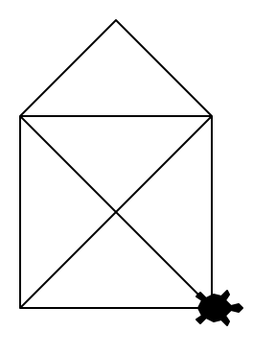
Homework
Install Python
This is kind of the prerequisite to the whole course.
Write your own small “Hello World!” program
Draw St. Nicholas house
We will use the turtle for that!
Turtles are used to teach programming and engineering for quite some time now
Because everybody likes turtles, right?

Slide 29
See you all next week!

