Slide 1
part 2: under the hood
Thornthwaite-Mather methodology
mechanisms used to simulate components of the water balance

Slide 2
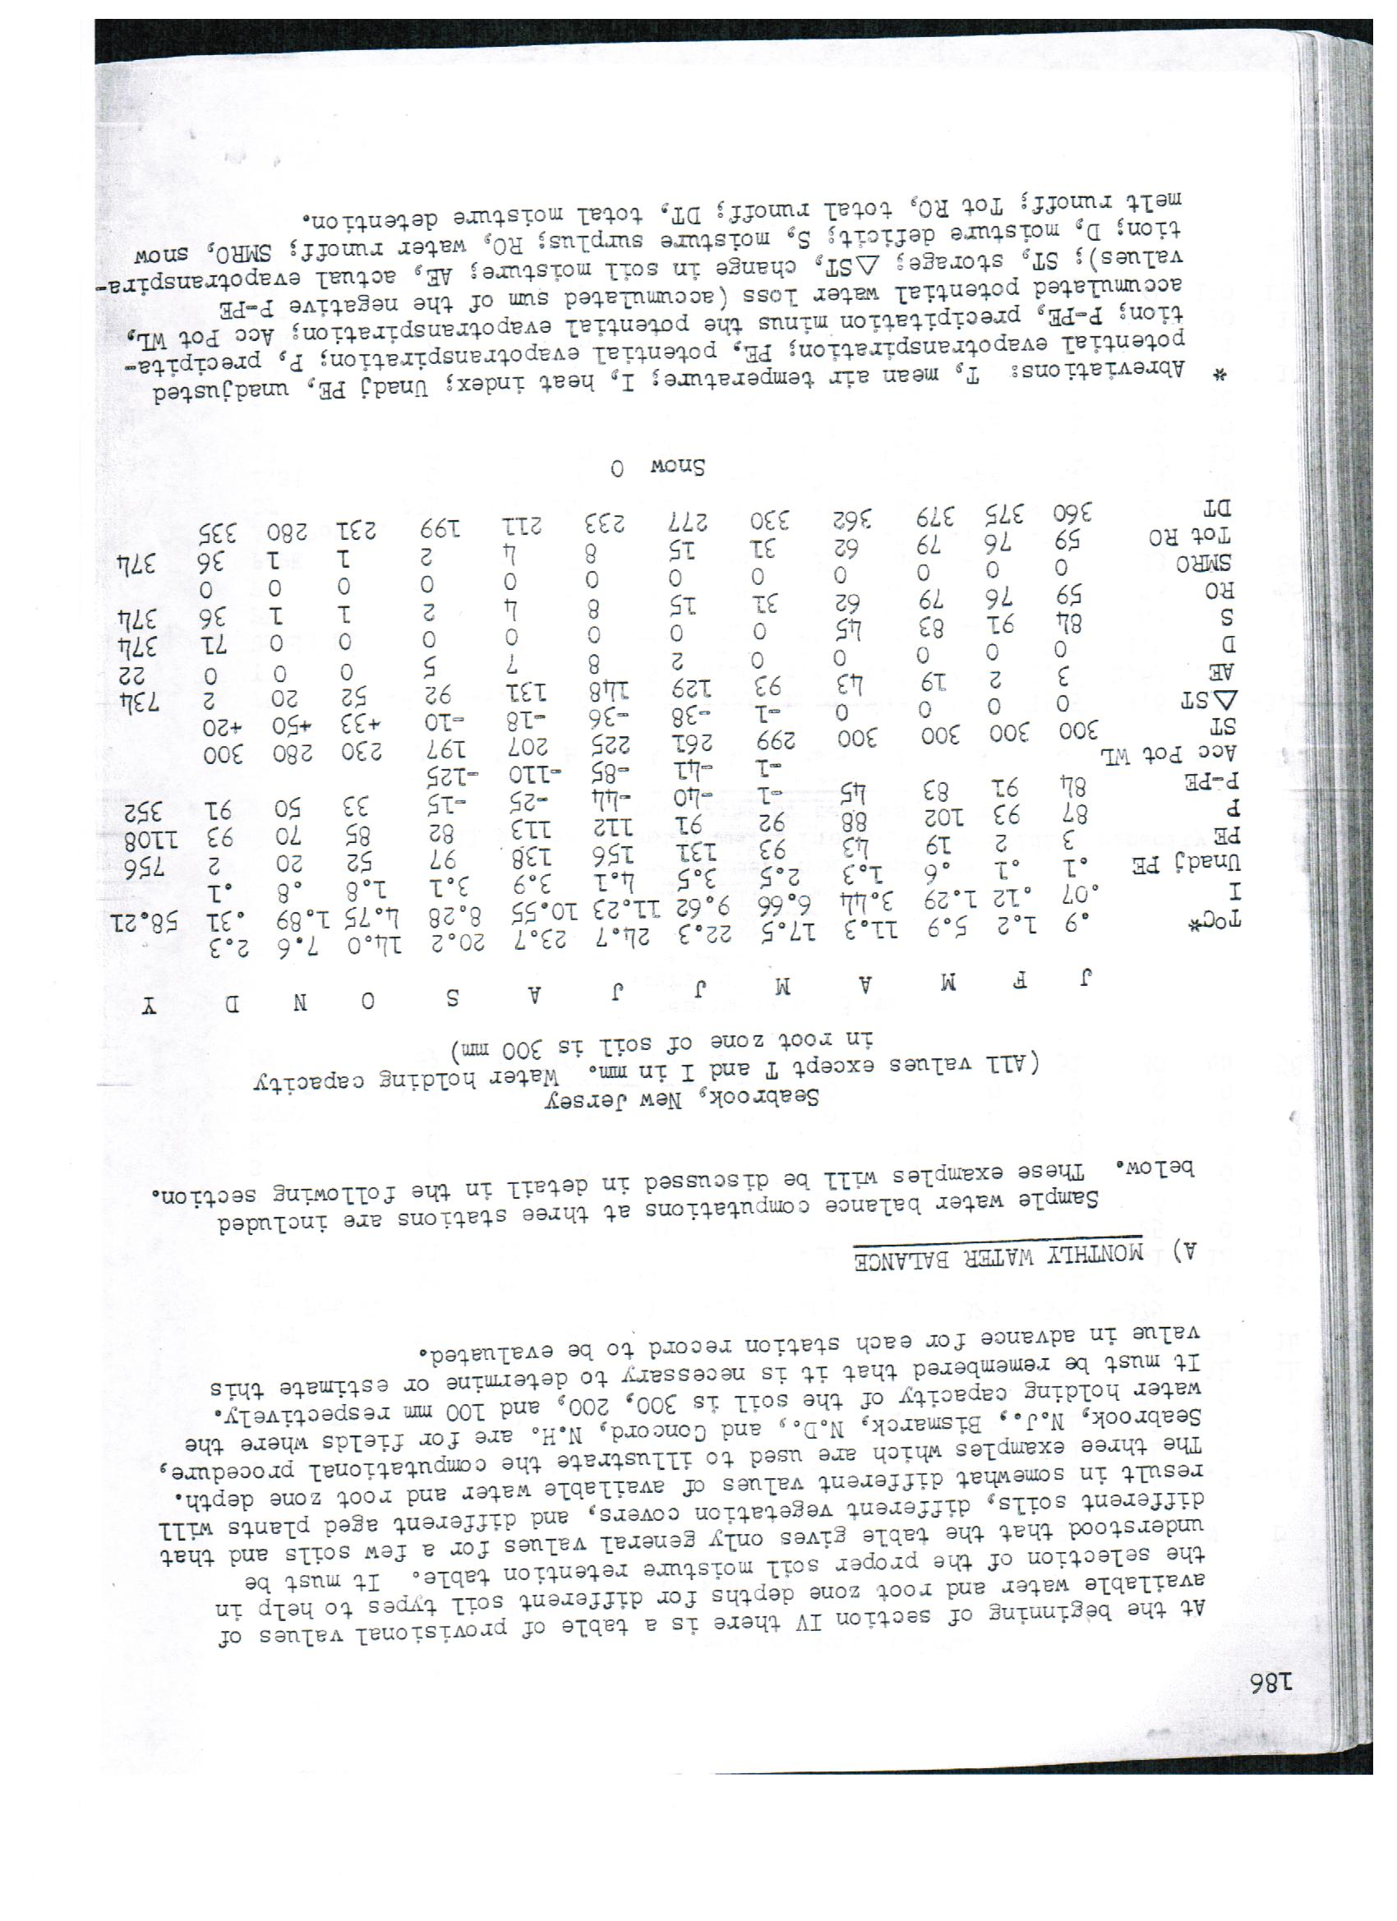
what is a “Thornthwaite-Mather approach”?
Source: Thornthwaite and Mather, 1957

Slide 3
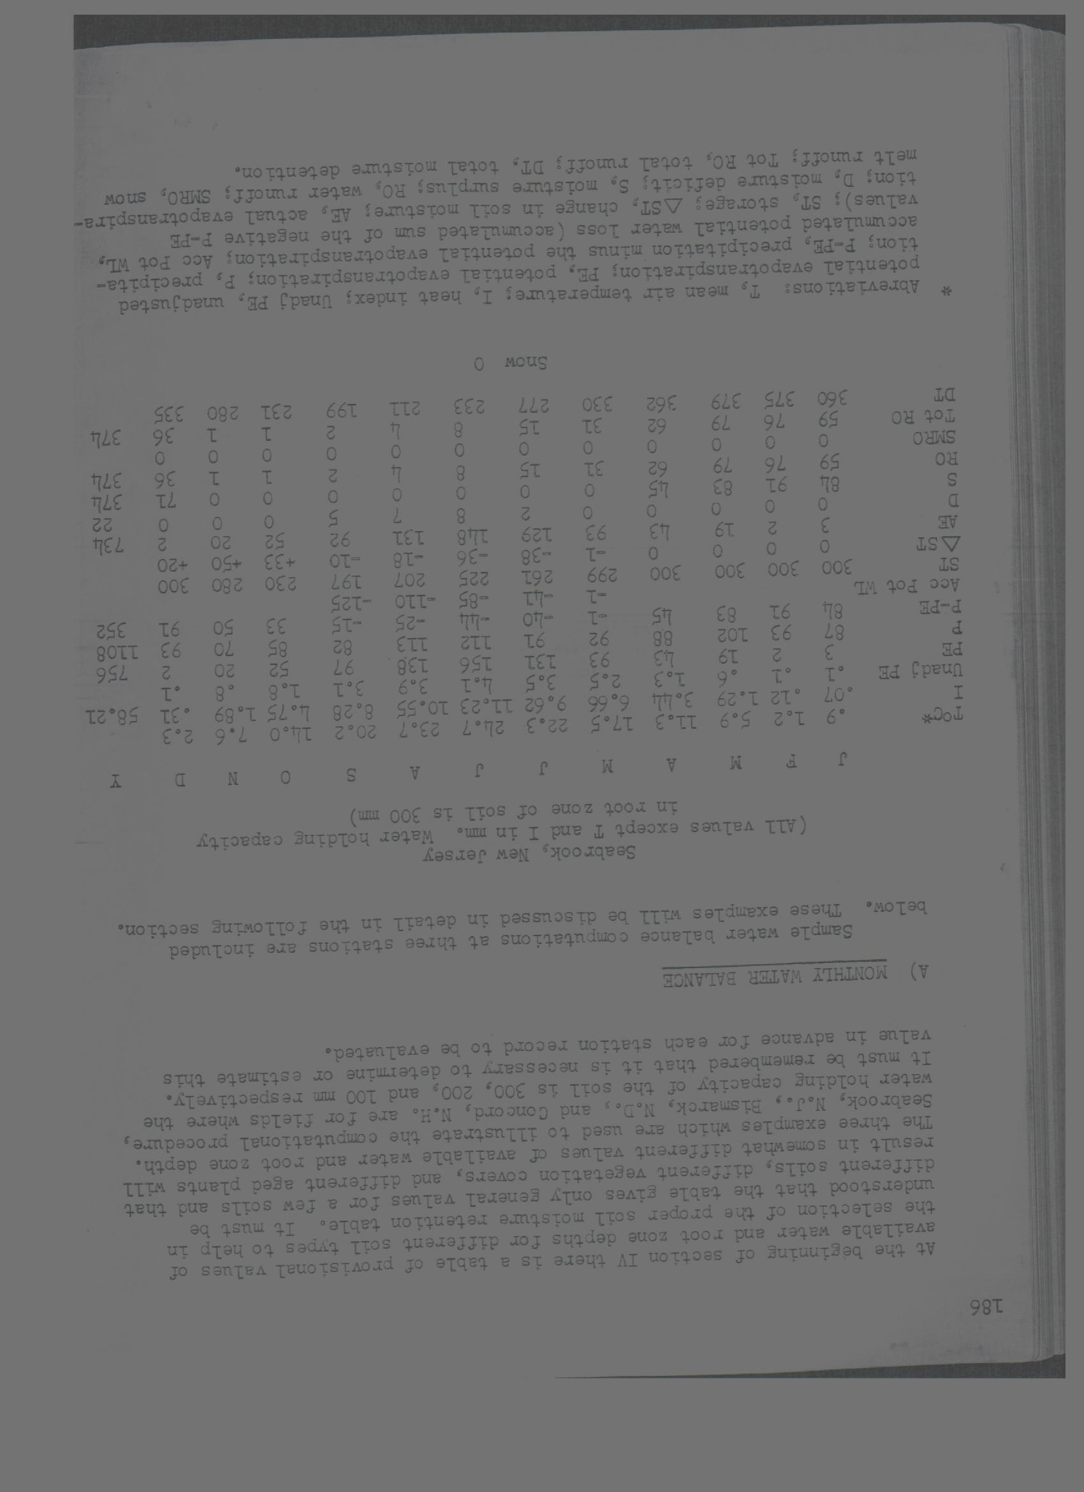
“From a comparison of the seasonal march of precipitation with evapotranspiration, the magnitude of other related moisture parameters, the water surplus, water deficit, soil moisture storage, and water runoff may be determined.”
potential recharge,
Source: Thornthwaite and Mather, 1957

Slide 4
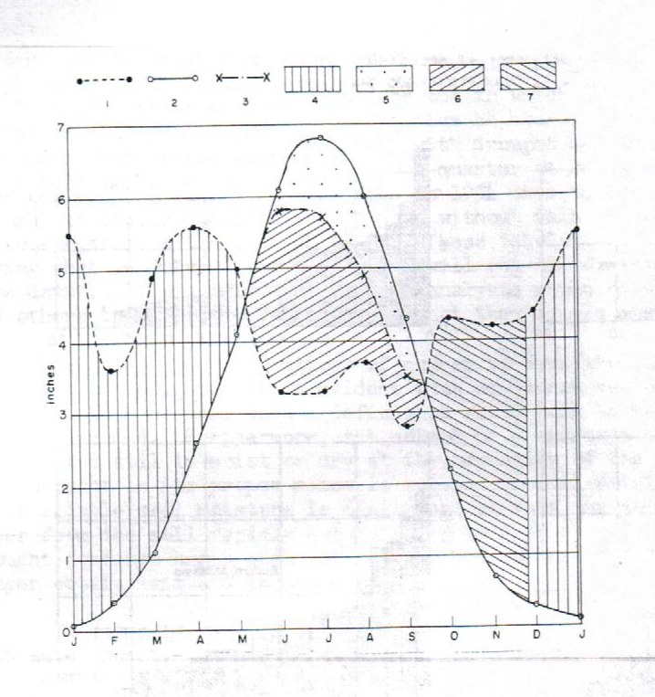
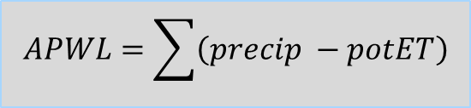
seasonal march of P and PE
Precip
potET
actET
Surplus
Deficit
Soil moisture
(-) (+)
soil moisture utilization
soil moisture “recharge”
$$APWL=\sum{\left(precip −potET\right)}$$
Modified from: Thornthwaite and Mather, 1955

Slide 5
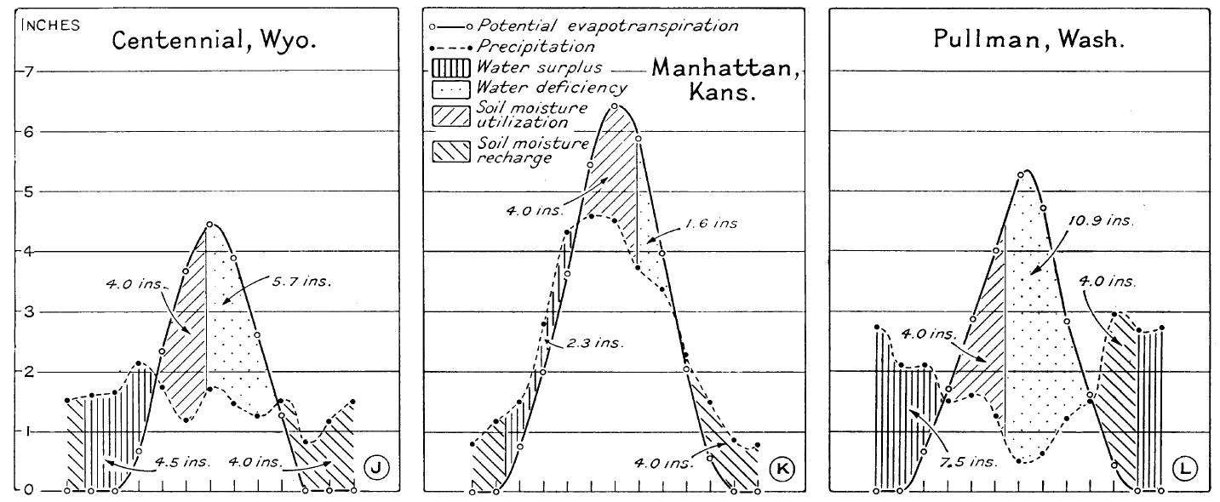
application of Thornthwaite and Mather’s method
Modified from: Thornthwaite , 1958

Slide 6
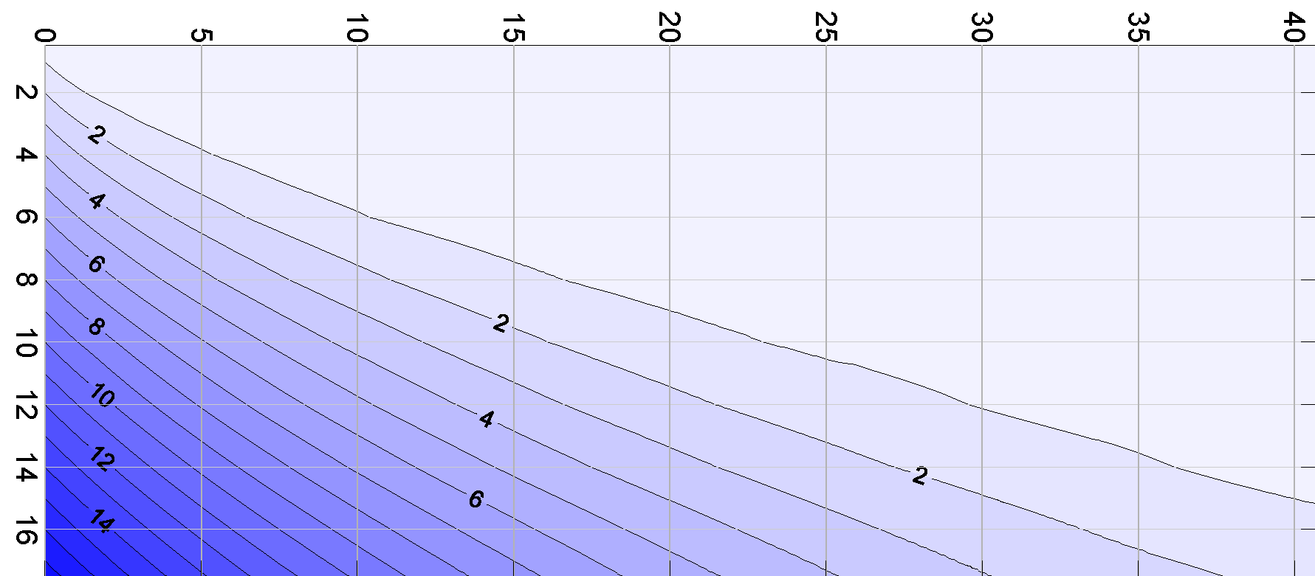
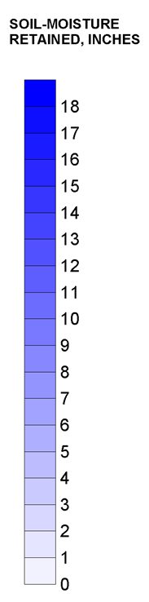

how much moisture can be pulled from the soil?
Accumulated Potential Water Loss (APWL)
Example:
a soil with 8 inches of
maximum water capacity
retains ~ 2.5 inches after
experiencing 10 inches of
APWL
Maximum Soil Moisture Capacity
$$APWL=\sum{\left(precip −potET\right)}$$
Source: Thornthwaite and Mather, 1957

Slide 7
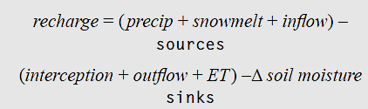
The heart of soil water balance methods

Slide 9
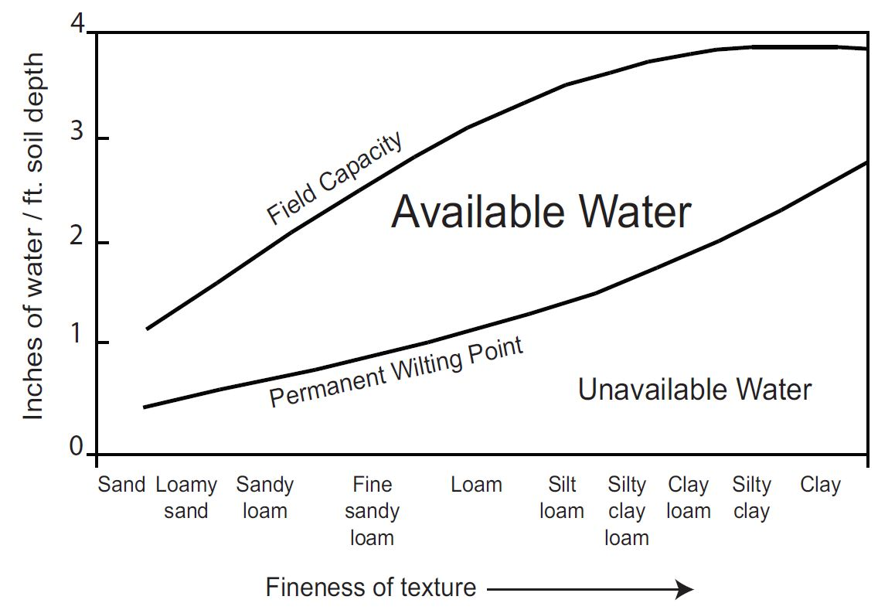
Values from Thornthwaite and Mather, 1957
Source: Ohio Agronomy Guide, 14th Edition, Bulletin 472-05

Slide 10


swb water balance
snowfall
interception
storage
rainfall
snow
storage
snowmelt
evapotranspiration
runoff
runoff
[upslope cell]
soil storage
potential recharge
[downslope cell]

Slide 11

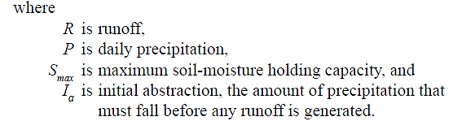
Runoff: SCS curve number
units are inches, of course!

Slide 12
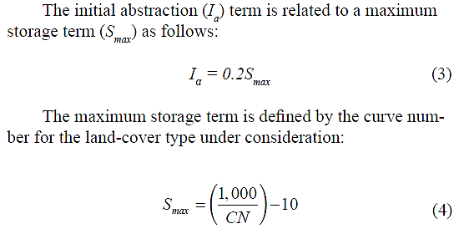
Initial Abstraction Term
Initial abstraction term represents the amount of precipitation
that falls *before* runoff begins. Conceptually, Ia includes
depression storage and interception.

Slide 13
Alternative Initial Abstraction Term
instead of:
Has the effect of increasing runoff generation for areas
with low curve numbers and for smaller storms. Woodward
and others (2003) suggest that this may be the more appropriate
formulation for long-term simulations. The default method in
swb is the “classic” formulation. The alternative may be selected
by including the following keyword in the control file:
INITIAL_ABSTRACTION_METHOD HAWKINS

Slide 14
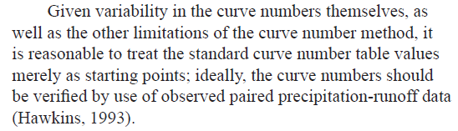
A last word on curve numbers

Slide 15
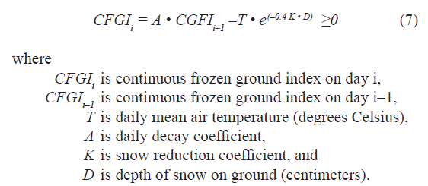
Continuous Frozen Ground Index
K=0.5 for above freezing conditions; K=0.08 if below freezing
A = 0.97
Source: Molnau and Bissel (1983)

Slide 16
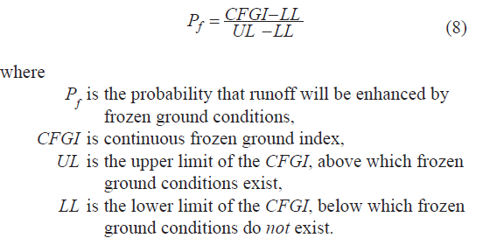
CFGI is used to increase runoff during frozen ground conditions
Molnau and Bissel (1983) suggest starting with values of
56 and 83 for the LL and UL, respectively.

Slide 17
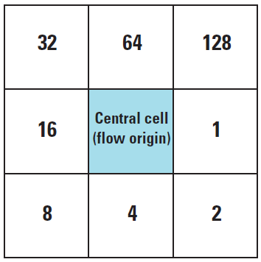
Flow direction processing
The first thing swb does in
a simulation is to determine
the upslope-downslope
relations between cells.
Water routed into a depression
moves no further; likely becomes
rejected recharge, which
is assumed to leave the model
domain via surface features.

Slide 18
Potential ET
Thornthwaite-Mather
Turc
Jensen-Haise
Blaney-Criddle
Hargreaves-Samani

Slide 19
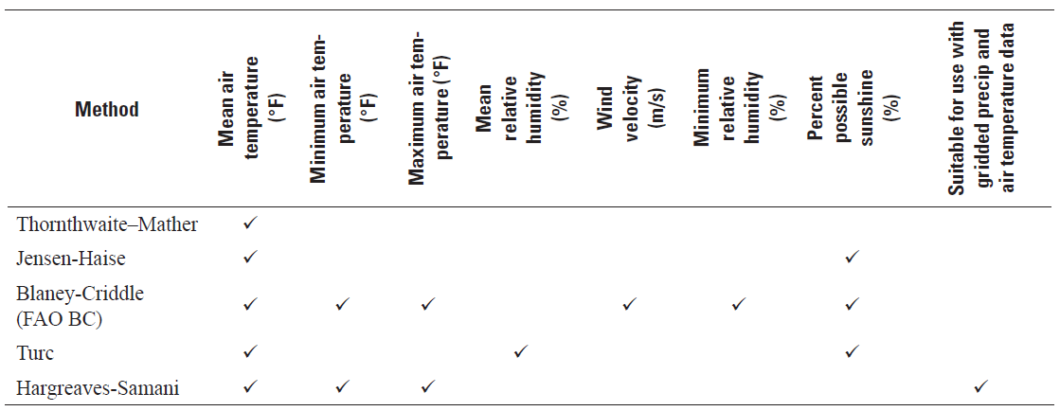
Data requirements for swb PET methods

Slide 20
Snow
Simple heat index
PRMS submodule

Slide 21
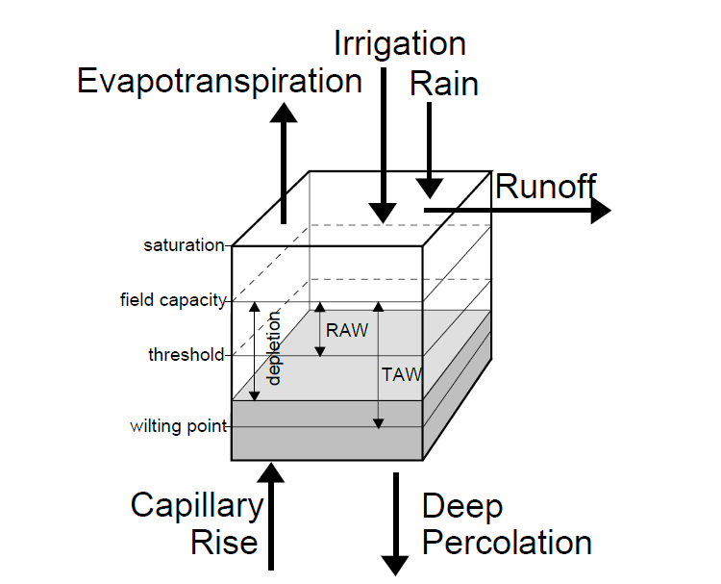
swb: irrigation demand
Source: Allen, R.G., Pereira, L.S., Raes, D. and Smith, M., 1998, Crop evapotranspiration-Guidelines for computing crop water requirements-FAO Irrigation and drainage paper 56: Rome, Food and Agriculture Organization of the United Nations, accessed May 5, 2011, at http://www.fao.org/docrep/X0490E/x0490e00.htm#Contents.

Slide 22
crop ET calculation
Plant growth
Bare soil evap

Slide 23
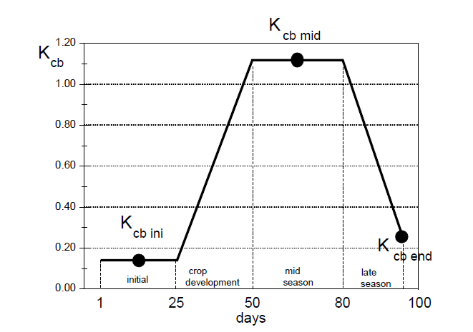
basal crop coefficient curve
Source: Allen and others (1998), FAO Irrigation and drainage paper 56

Slide 24
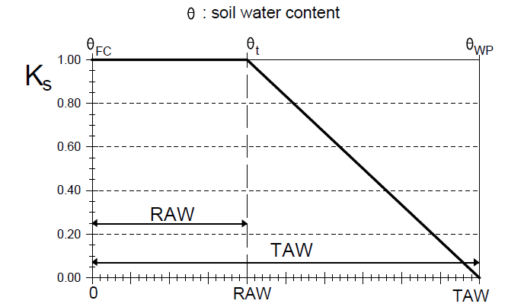
water stress coefficient Ks
Source: Allen and others (1998), FAO Irrigation and drainage paper 56

Slide 25
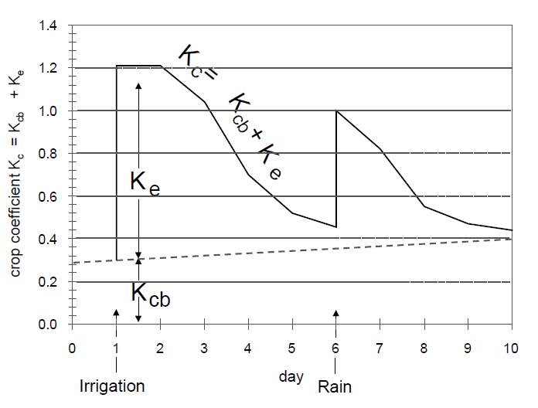
effect of dual crop coefficient Kc
Source: Allen and others (1998), FAO Irrigation and drainage paper 56

Slide 27
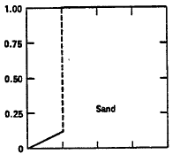
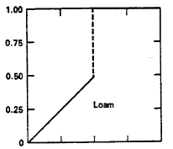
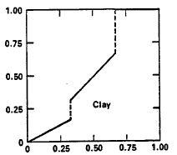
Ratio of Actual ET to Potential ET
Soil Moisture as a fraction of Available Water Capacity (AWC)

