Slide 1
part 3: simple application example
data sources
data wrangling
gridded data
tabular data
other considerations:
grid cell resolution
representation of land use and soils

Slide 2
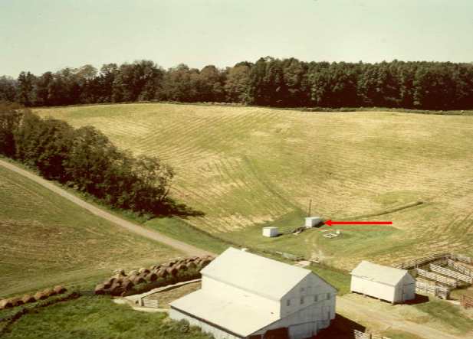
Challenge: create project files from scratch for this class…
Instrumented watersheds!
North Appalachian Experimental Watershed, Coshocton, Ohio

Slide 3
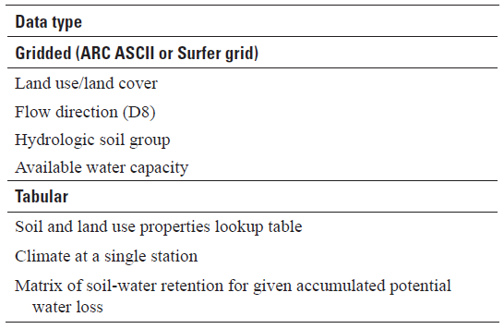
Data requirements for a basic swb application
(Standard Thornthwaite-Mather soil-moisture retention tables)

Slide 4
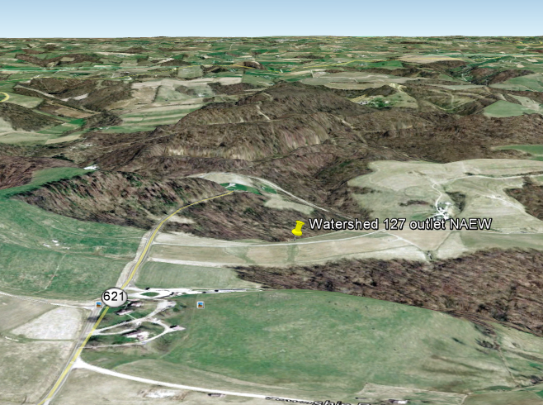
Location of experimental watershed 127

Slide 5
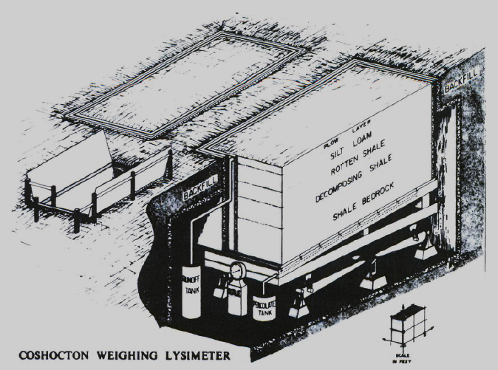
Weighing lysimeter at the (former) North Appalachian Experimental Watershed
Source: Soils of the North Appalachian Experimental Watershed,
Miscellaneous Publication 1296, USDA, 1975

Slide 6
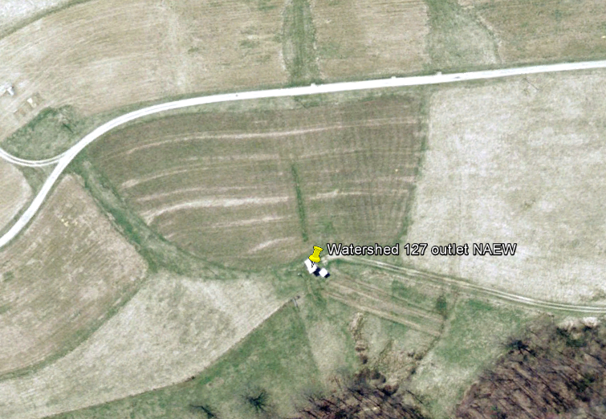
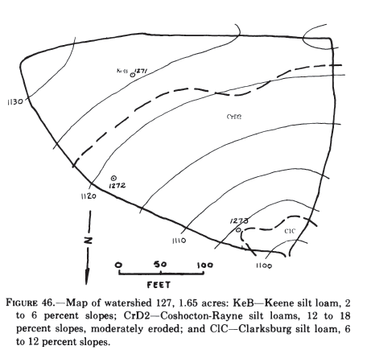
Source: Soils of the North Appalachian Experimental Watershed,
Miscellaneous Publication 1296, USDA, 1975

Slide 7
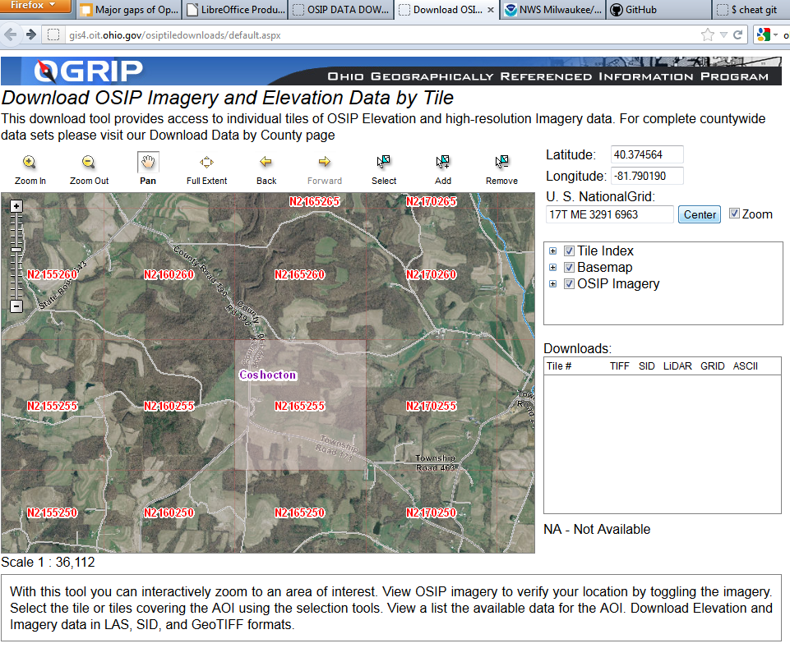
Obtain elevation from Ohio

Slide 8
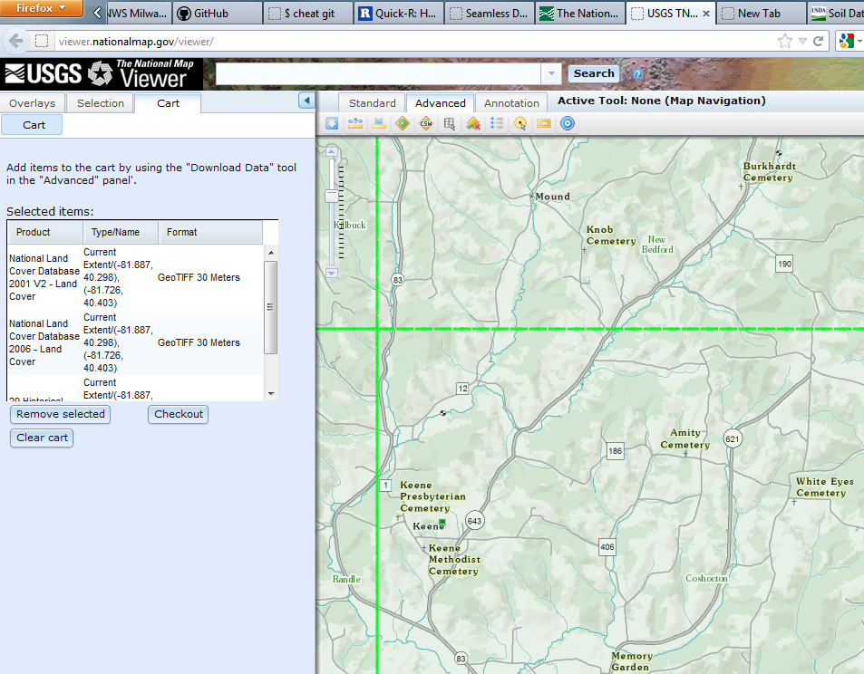
Obtain landuse from the National Map

Slide 9
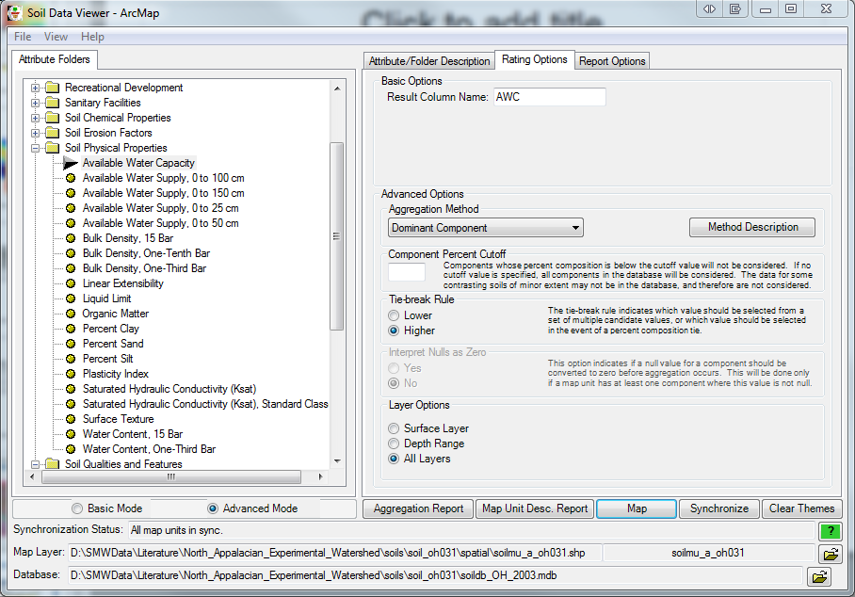

Slide 10
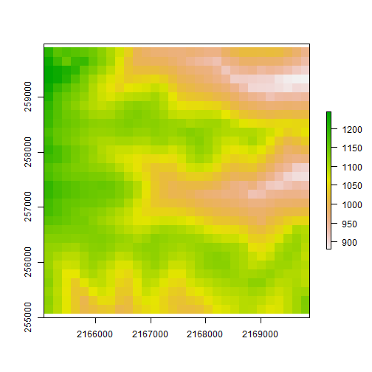


30 x 30 cells
60 x 60 cells
120 x 120 cells

Slide 11
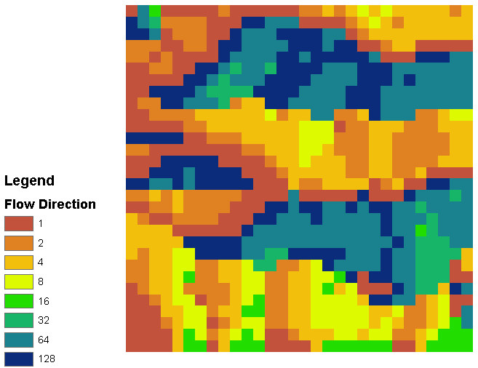
Coarse (30-cell by 30-cell) flow direction grid
32 | 64 | 128
16 |  | 1
8 | 4 | 2

Slide 12

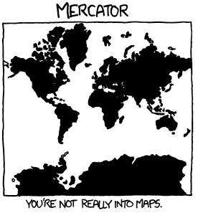
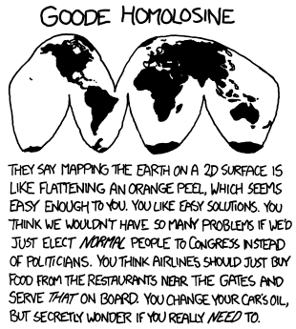
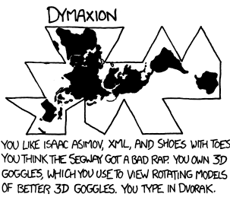
Source:
http://xkcd.com/977/

Slide 13
Projections and horizontal datums for the gridded data in this example
Data Type | Projection | Datum | Provider | Used for
Elevation | State Plane, Ohio North (feet) | NAD 1983 | Ohio Statewide Imagery Program | Flow direction grid
Soils | UTM Zone 17N (meters) | NAD 1983 | USDA Soil Data Mart | Available water content (AWC) and hydrologic soils group grids
Land Use / Land Cover | Albers Equal Area (meters) | NAD 1983 | USGS Seamless | Land use grid
< see R examples >

