Slide 1
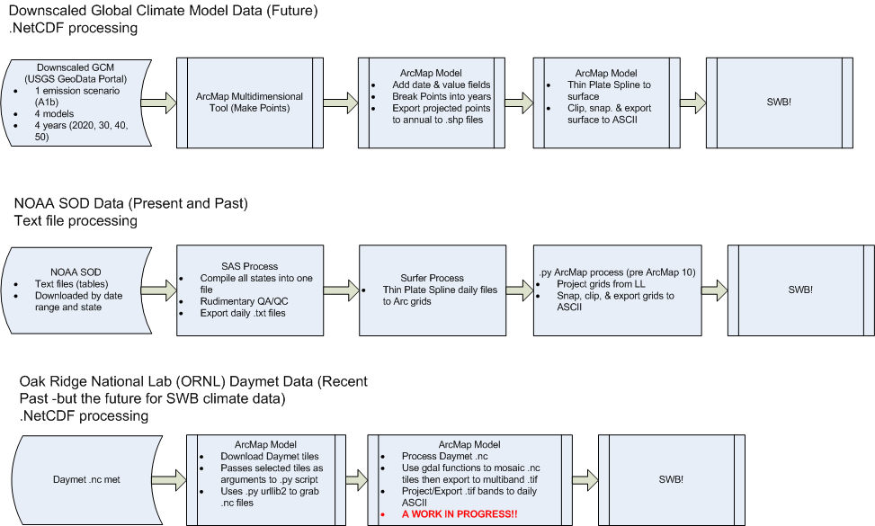
GCM/Emissions scenario was picked based on an analysis of models done by the North Jersey Public Transit Authority
Models used: bcm2, echo, gfld2, and hadcm3

Slide 2
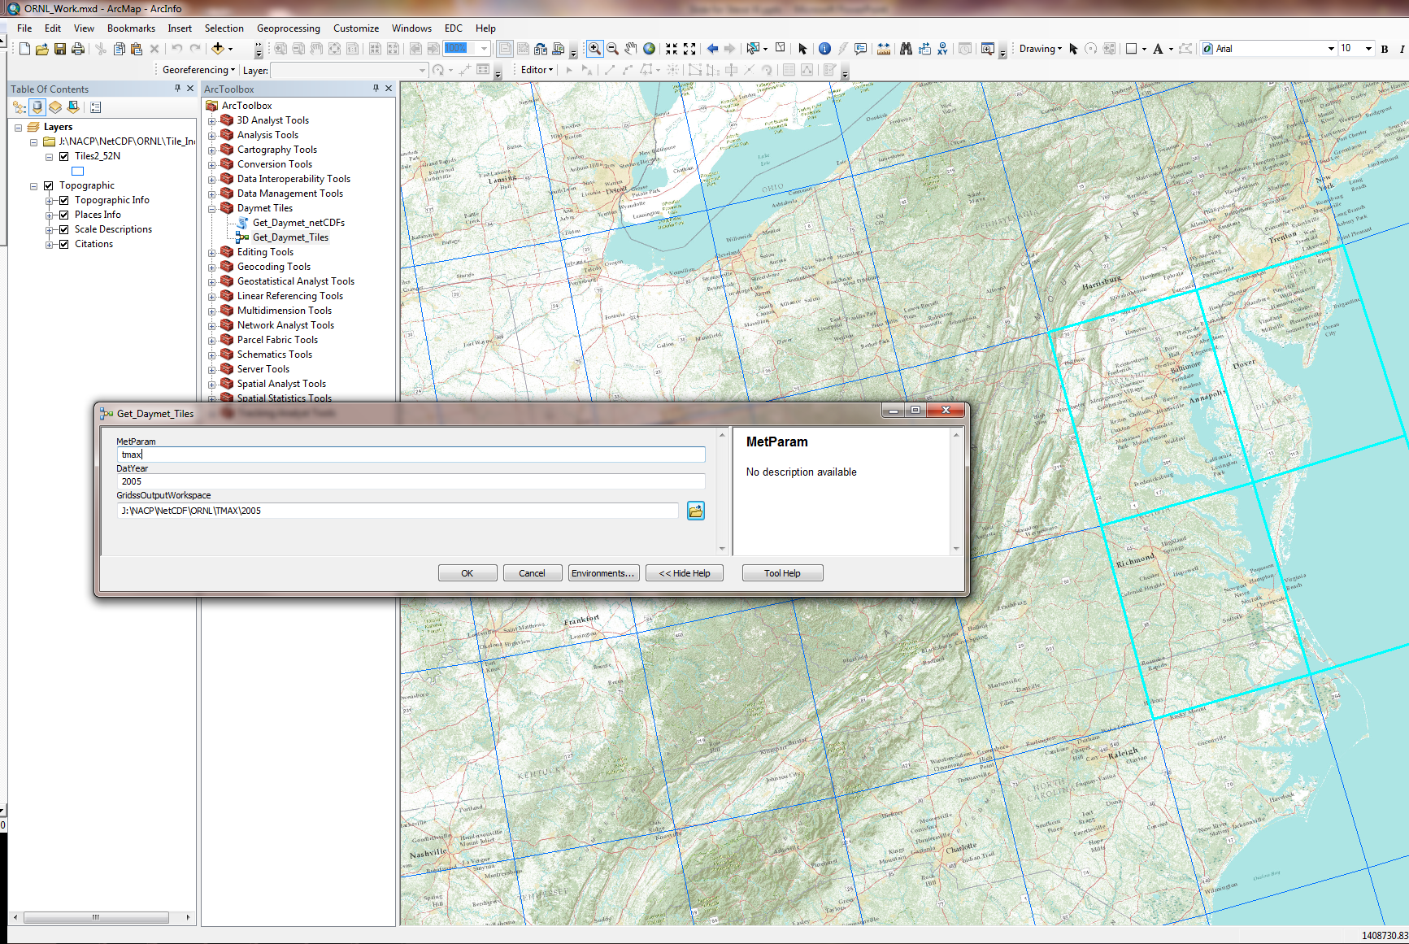
Screenshot of ArcMap model that grabs Daymet files

