Slide 1
part 4.5: future of swb
modular design of swb
development open to collaboration (see GitHub)
incorporate parts of other models?
features vs. performance

Slide 2
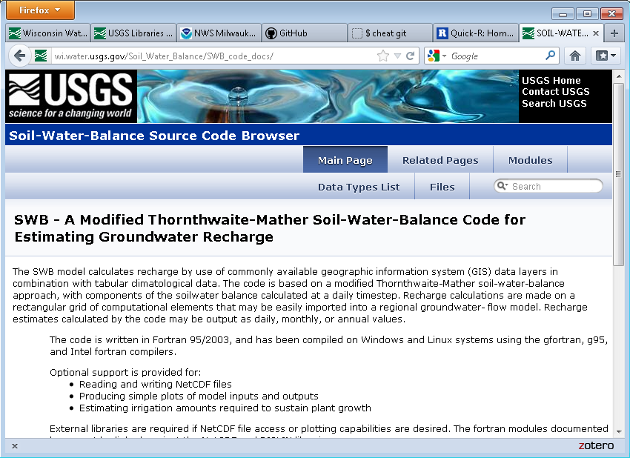
modular design of swb

Slide 3
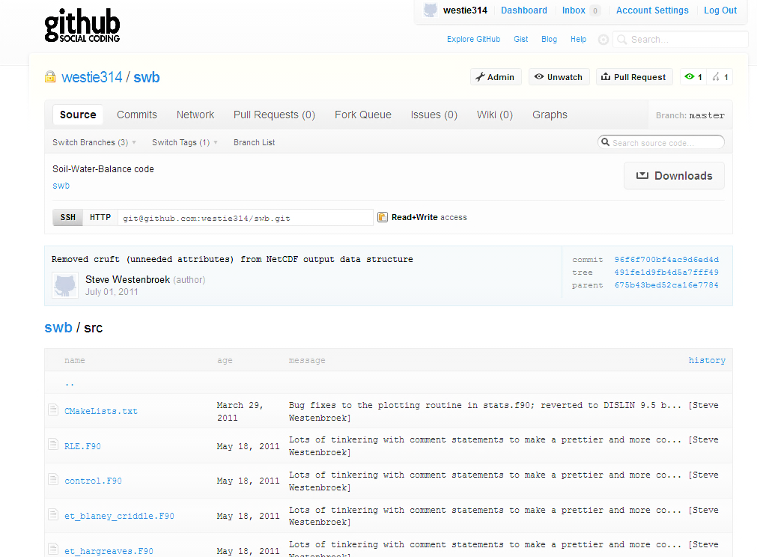
Current version: ported to Fortran 95/2003
Co-conspirators:
Wes Dripps
Randy Hunt
Vic Kelson
Ken Bradbury

Slide 4
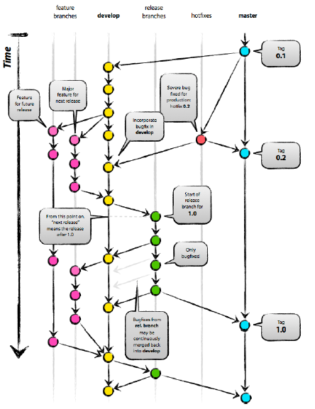
Git and GitHub: modern source code version control

Slide 5
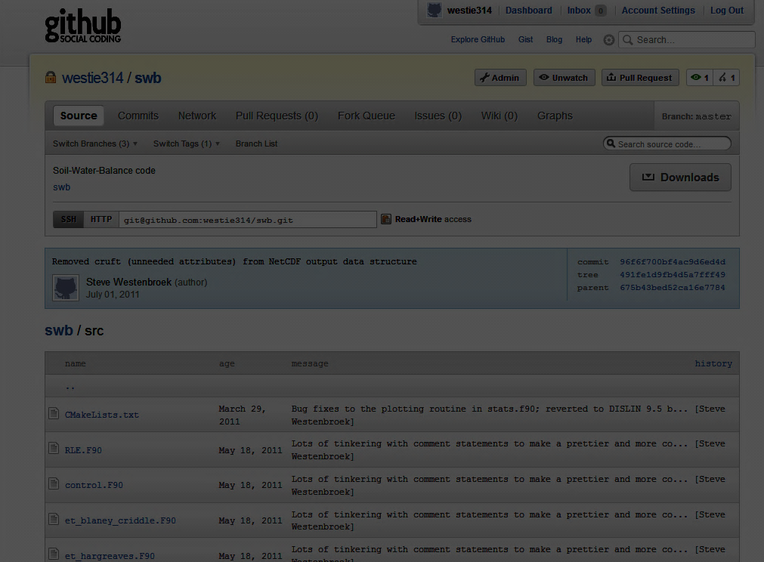
swb on GitHub == easier collaboration

Slide 6
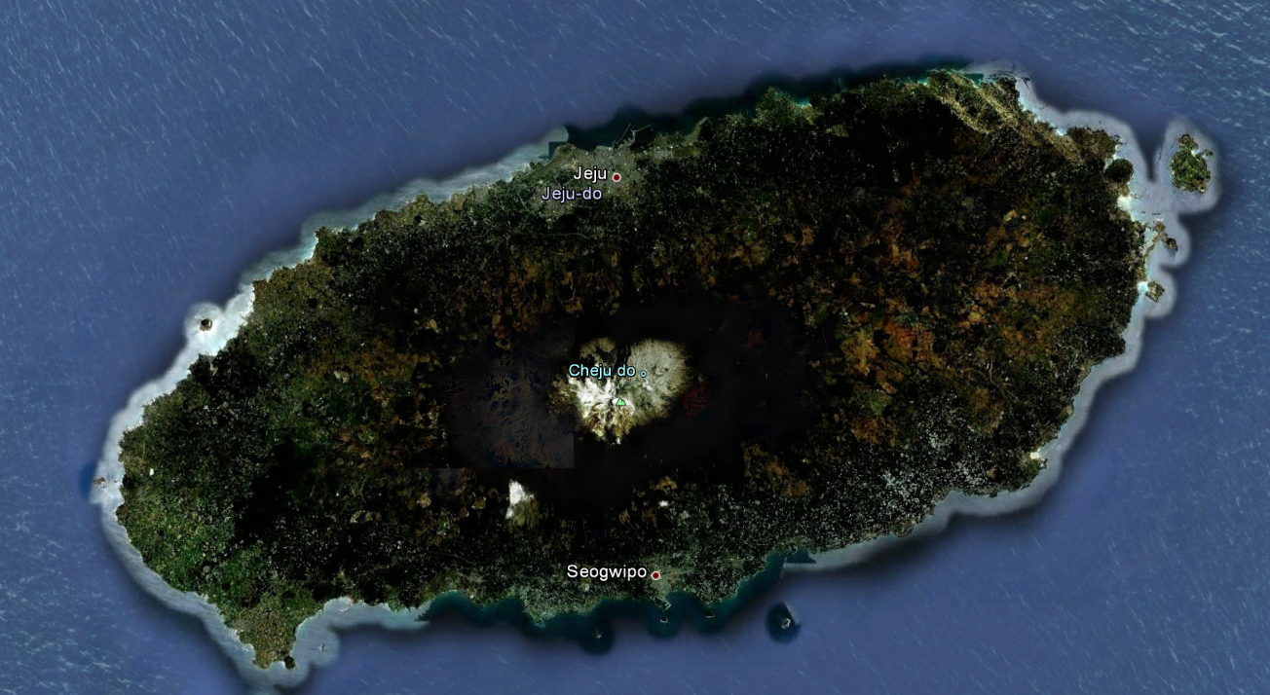
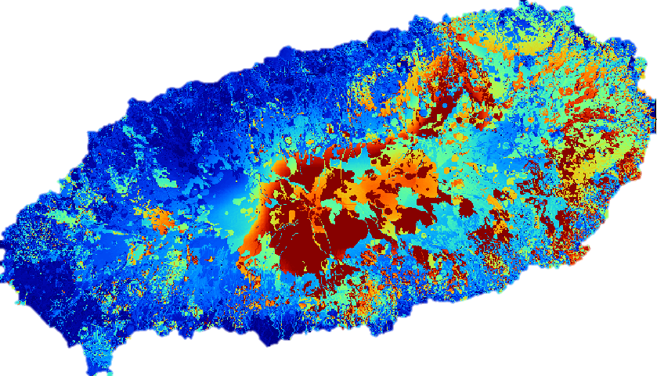

Je-ju Island, South Korea
Too much ET taken from soil storage
(no ET from interception storage)

Slide 7
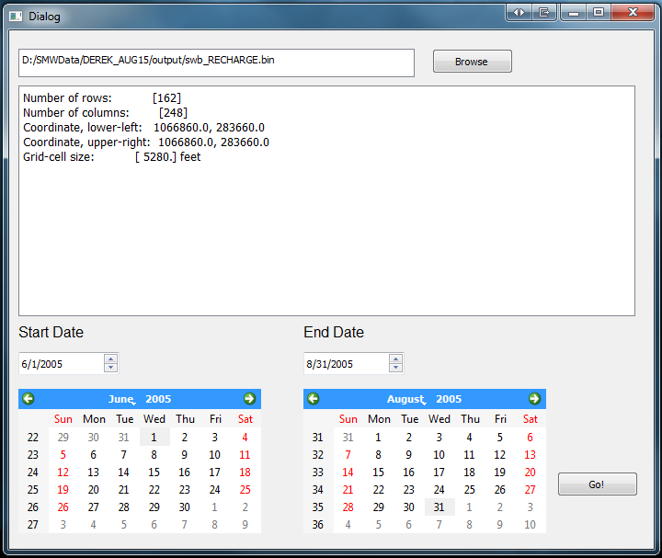
swb needs better tools for munging output

Slide 8
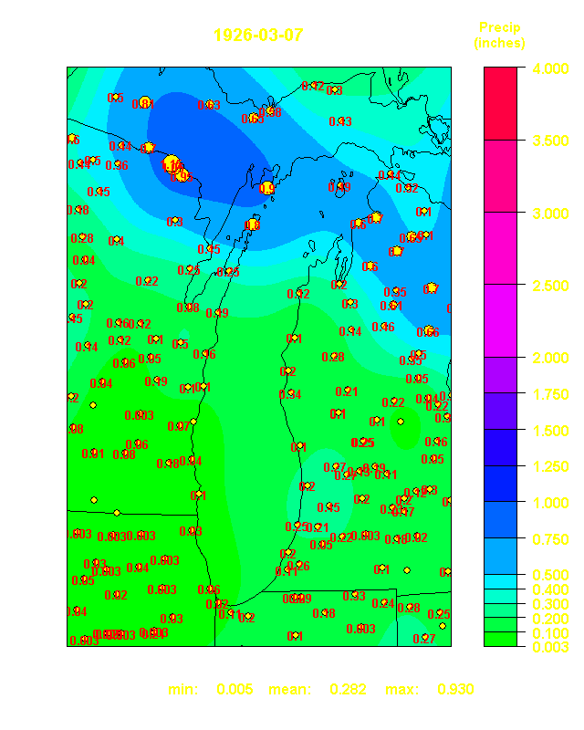
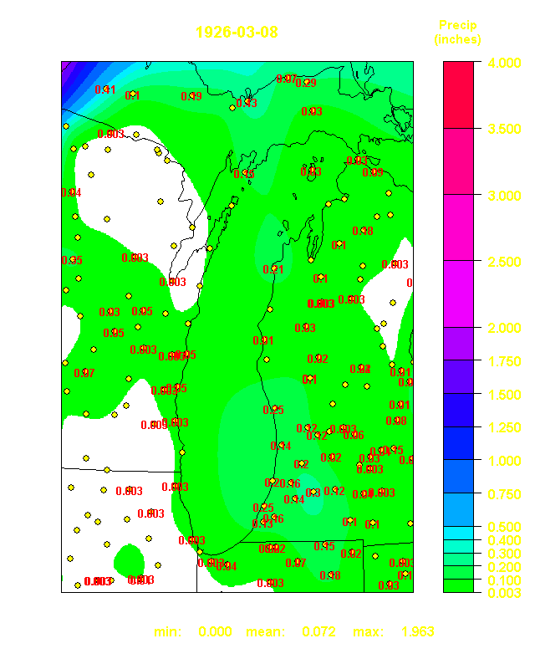
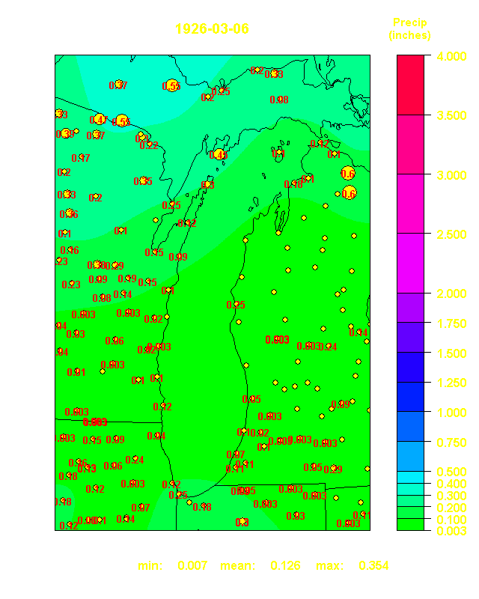
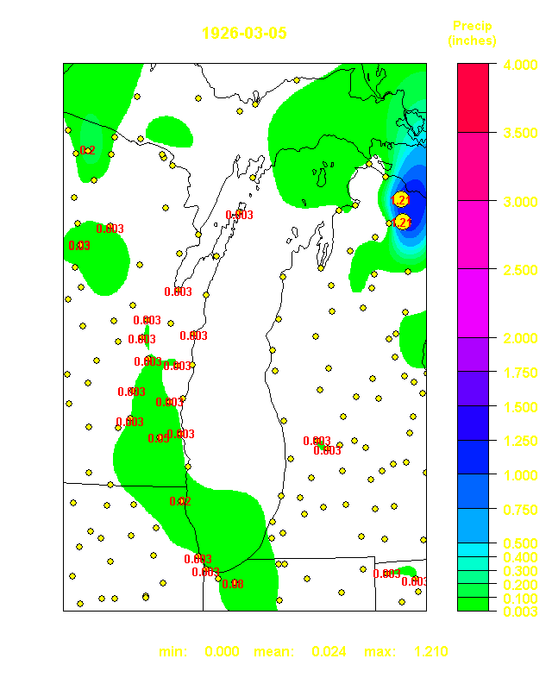
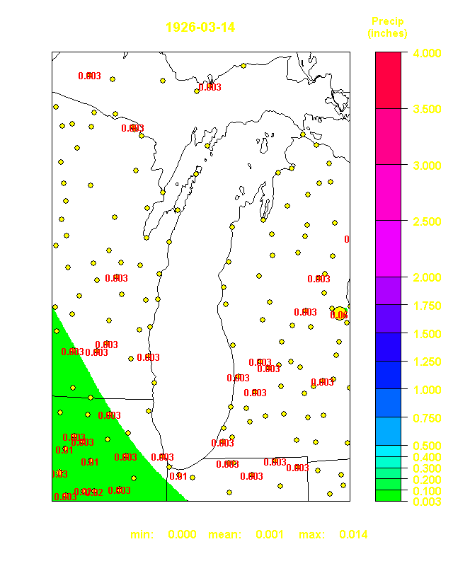
swb needs a better way of obtaining gridded daily climate data!

Slide 9
swb @TODO list
create interception storage reservoir, allow accumulation day-to-day and contribute to satisfying ET demand
revisit documentation; add NetCDF, irrigation routine, and undocumented directives to manual
continue evolution of swbstats and R/Python-based support tools
work out better methods for supplying gridded climate data

Slide 10
swb @WISH list
implement an ibound-array like mechanism to “turn off” uninteresting parts of the grid
enable swb to read MODFLOW stress periods; statistics would then be specific to each stress period rather than a calendar year or month…

Slide 11
the future of swb? features vs. performance
All programs evolve until they can send email.
- Richard Letts

