Slide 1
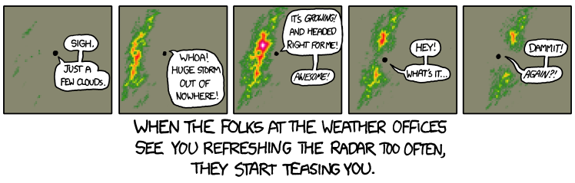
Preparing gridded climate data
Source: http://xkcd.com/831/

Slide 2
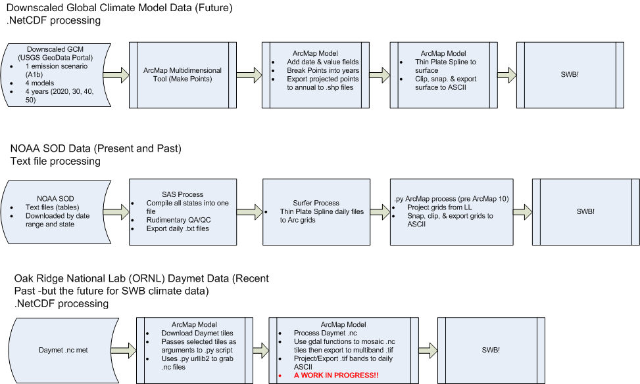
Preparing gridded climate data
Source: Mark Nardi, USGS

Slide 3
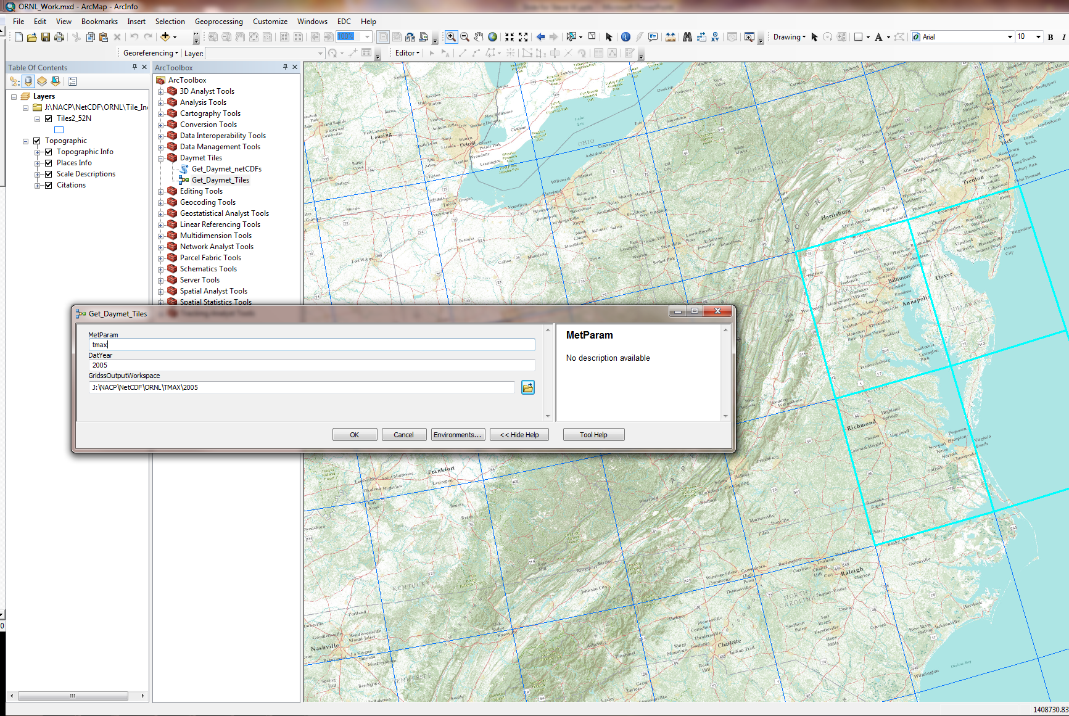
ArcMap tool to grab and process DAYMET
Source: Mark Nardi, USGS

