Slide 1
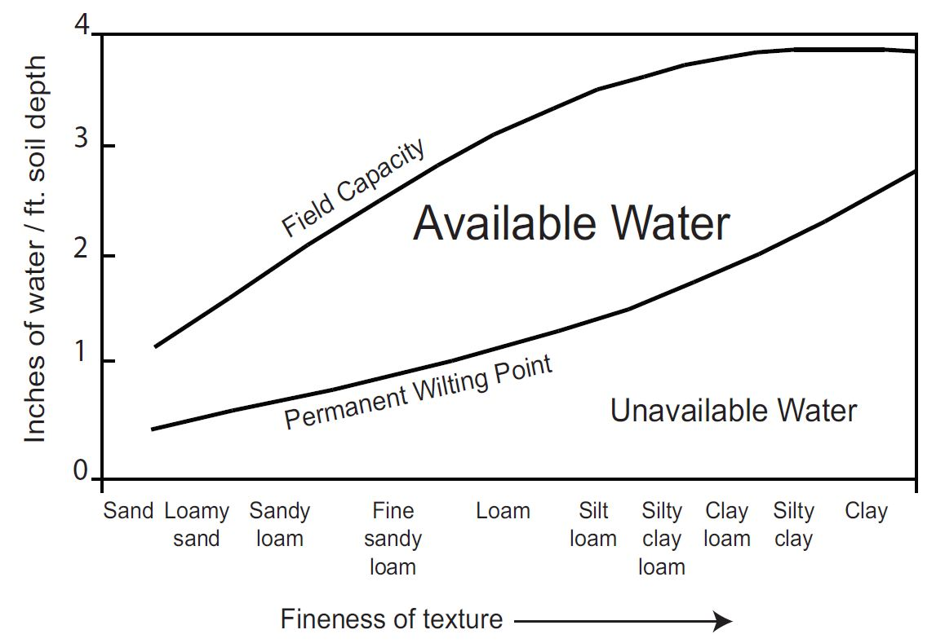
Values from Thornthwaite and Mather, 1957
Source: Ohio Agronomy Guide, 14th Edition, Bulletin 472-05

Slide 2
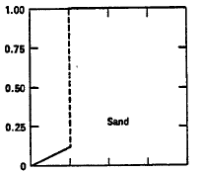
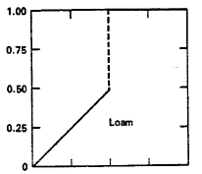
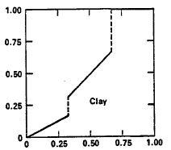
Ratio of Actual ET to Potential ET
Fraction of Available Water Capacity (AWC)

