Slide 1
part 4: tools, tips, and tricks for more advanced applications
gridded precipitation and temperature grids
netCDF(!)
PEST
use of irrigation module
accessing swb output:
swbstats, R/Python modules
what to do when swb bombs

Slide 2
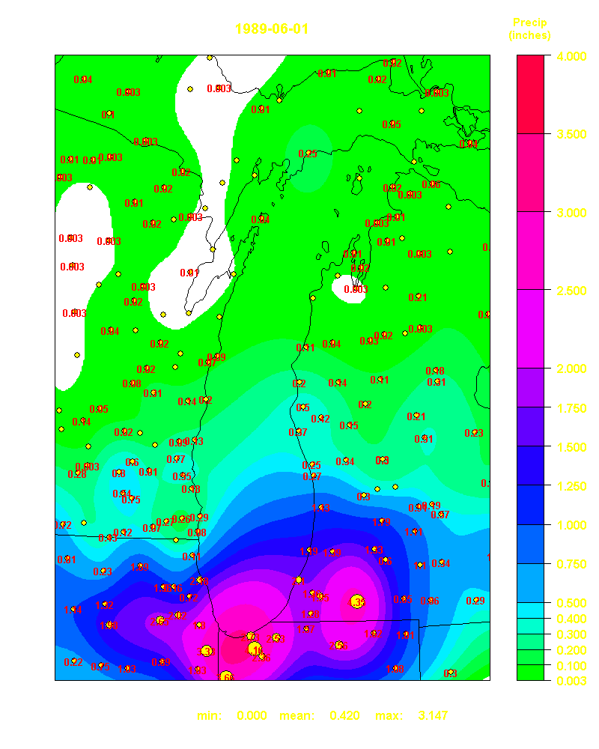
Precipitation and temperature inputs to the SWB code
Data from 250 NOAA cooperative climate stations pulled for the period 1989-2000
Interpolations made for each day of the simulation period
Thin plate spline interpolations performed on daily minimum and maximum air temperature and precipitation data
Each daily interpolation saved as an ASCII Arc GRID file for use as input to the soil water balance code (> 3650 files)

Slide 3
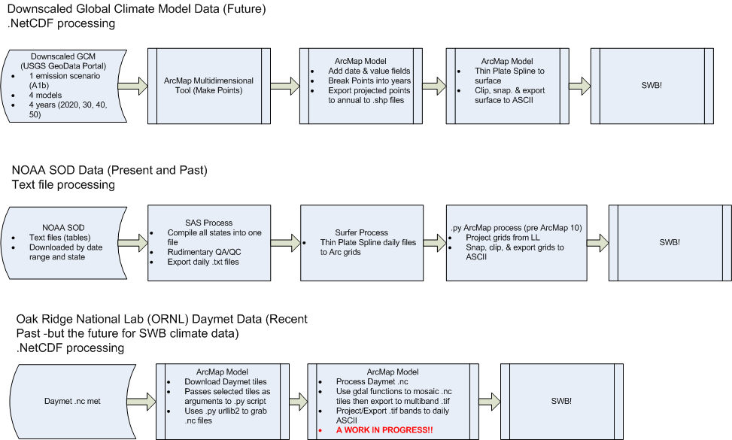
One gridded precipitation workflow…
Source: Mark Nardi, USGS

Slide 4
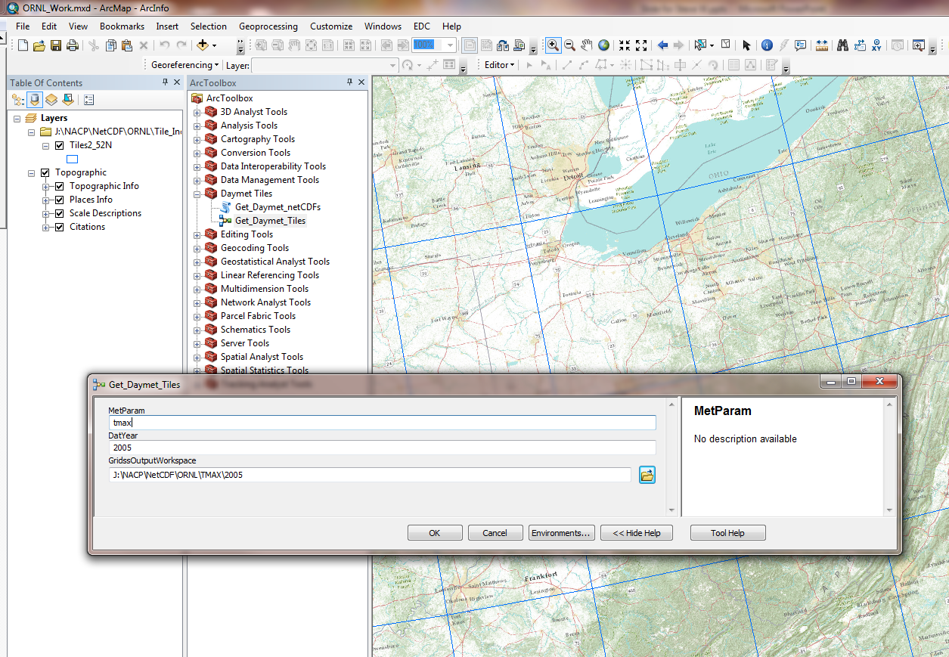
Prototype of a tool to grab DAYMET data
Source: Mark Nardi, USGS

Slide 5
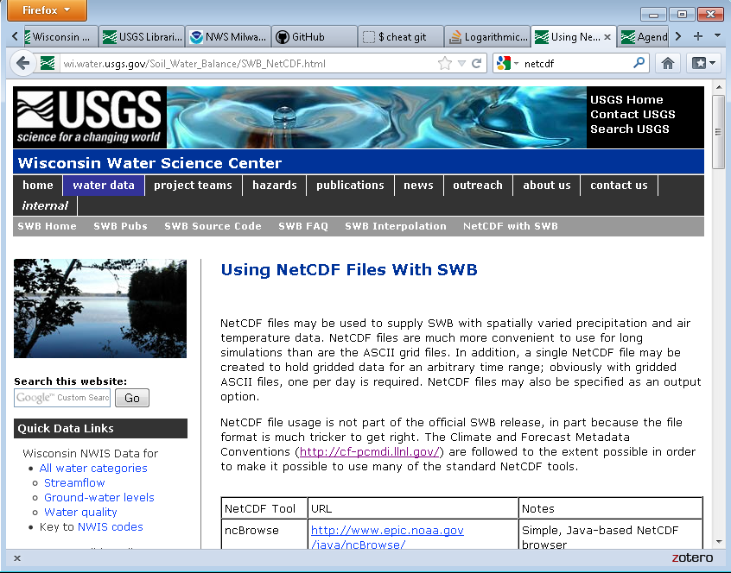
Use of NetCDF files (input and output)

Slide 6

Using swb with PEST
Composite model: batch or script file
PEST-created Model Input File(s)
Model Input Template
File
swb
PEST
PEST
Control File*
TSPROC-processed Observation
File(s)
Model
Output
File(s)
TSPROC-processed Simulated Model Output
*contains TSPROC- processed observed data
Instruction File
TSPROC
Control File
TSPROC

Slide 7
swb directives and utilities for applying PEST
WRITE_SSF
Extract swb output at a single grid cell
Can specify row and column or the
coordinates for the grid cell you are
interested in. Thus,
WRITE_SSF 8 8
Is the same as:
WRITE_SSF COORDS 2166238 258732

Slide 8
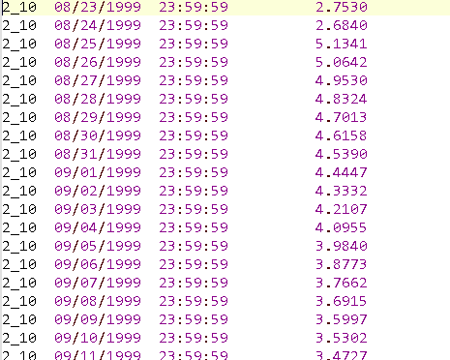
ssf = Site Sample File

Slide 9
some (undocumented) swb directives for use with PEST
REFERENCE_ET_EXPONENT
REFERENCE_ET_CONSTANT RAINFALL_CORRECTION_FACTOR SNOWFALL_CORRECTION_FACTOR TMAX_ALLSNOW
TMAX_ALLRAIN
SNWD_SLOPE
SNWD_INTERCEPT SNWD_DENOMINATOR

Slide 10
obtaining statistics pertaining to a subset of the model domain
BASIN_MASK_LOOKUP_TABLE
NUM_BASIN_MASK_FILES 137
Station_ID Station_name PEST_group PEST_weight Path_to_file File_type Qb_in Drain_area
05336000 ST. CROIX RIV NR GRANTSBURG, WI StCroix 1.0 input/mask/05336000.asc ARC_GRID 8.030 2980.0
04079000 WOLF RIVER AT NEW LONDON, WI FoxWolf 1.0 input/mask/04079000.asc ARC_GRID 8.830 2260.0
05382000 BLACK RIVER NEAR GALESVILLE, WI TrempBlack 1.0 input/mask/05382000.asc ARC_GRID 6.690 2080.0
ncols 5
nrows 5
xllcorner 227200
yllcorner 220800
cellsize 1600
NODATA_value -9999
-9999 -9999 -9999 -9999 -9999
-9999 1 1 -9999 -9999
-9999 1 1 -9999 -9999
1 1 -9999 -9999 -9999
-9999 -9999 -9999 -9999 -9999
Station ID
Station name
PEST_group
PEST_weight
Path_to_file
File_type
Qb_in
Drainage area in sq mi

Slide 11
RAINFALL CORRECTION FACTOR
ET (HARGREAVES-SAMANI) EXPONENT
CURVE NUMBER, LANDUSE 82
ET (HARGREAVES-SAMANI) SLOPE
SNOW CORRECTION FACTOR

Slide 12
using the irrigation/FAO-56 module
#****************************************************
LAND_USE_LOOKUP_TABLE std_input\LU_lookup.txt
#
IRRIGATION_LOOKUP_TABLE std_input\IRRIGATION_lookup.txt

Slide 13
using the dynamic landuse option
#****************************************************
# LANDUSE GRID
#
LAND_USE DYNAMIC ARC_GRID input\lu
#
# This specifies the PREFIX swb will look for.
# swb will look for a new file each succeeding year; if
# no new landuse data are found, nothing changes
# There *must* be a file for the first year of execution:
# there must be a file named “lu_1944.asc” (if your run
# starts in 1944.

Slide 14
Managing swb output
text file output
Five *.csv files
SWB_annual_statistics.csv
SWB_daily_mass_balance_report.csv
SWB_daily_MAXIMUM_values.csv
SWB_daily_MEAN_values.csv
SWB_daily_MINIMUM_values.csv
R script
binary file output
swbstats
R script (swb binary file reader)
Python script (also swb binary file reader)

Slide 15
what to do…
** FATAL ERROR - HALTING SWB **
Error reading input file: module RLE, subroutine RLE_readByte
(hint: try the logfile first!)

