Slide 1
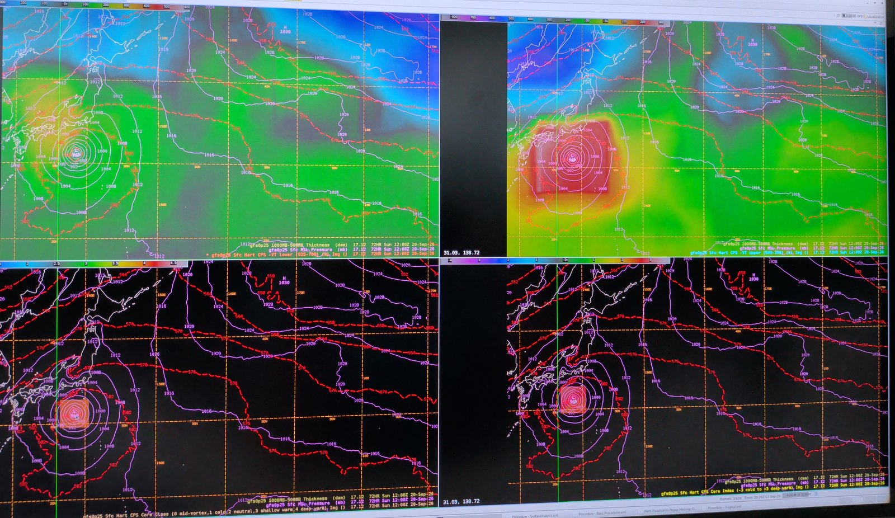
Cyclone Phase Space in AWIPS
Hart's storm structure diagnostics as gridded derived parameters
[Author], NOAA/NWS Ocean Prediction Center, September 2026
Notes:
I want to show you a tool that tells you what kind of cyclone a model is forecasting, not just where it is or how deep. It runs inside AWIPS, on every model we ingest, with nothing external.

Slide 2
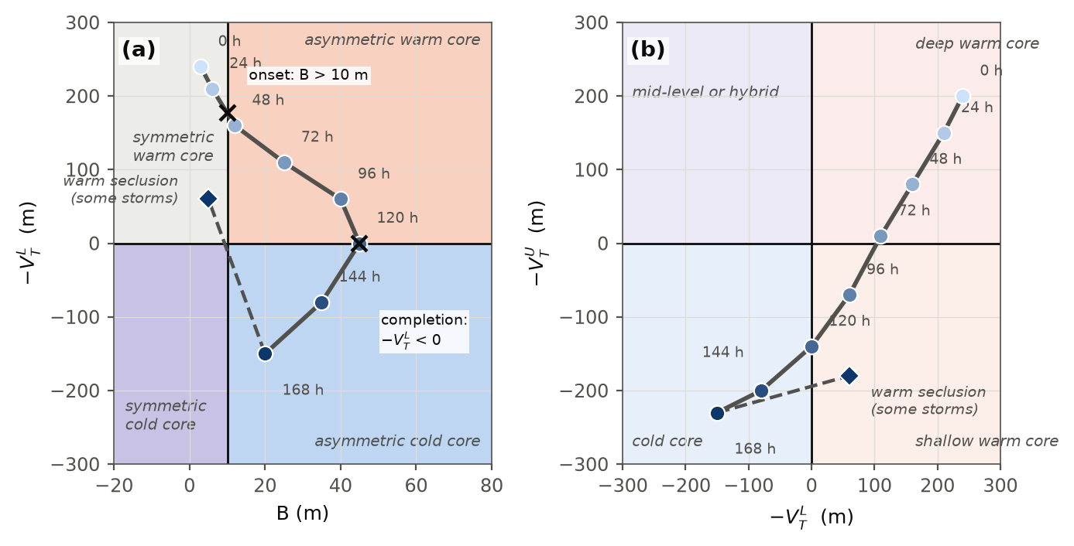
What the phase space measures
Two thermal wind terms: is the core warm or cold, lower and upper troposphere
B: is the storm frontal
All three from the height field inside a 500 km circle
Cyclone Phase Space in AWIPS | NOAA/NWS Ocean Prediction Center
2
Notes:
The science is Bob Hart's cyclone phase space from 2003. It describes a cyclone with three numbers from the height field alone, all taken inside a 500 kilometer circle around the center. Two are thermal wind terms, one for the lower troposphere and one for the upper, and they say whether the core is warmer or colder than its surroundings. The third, B, says whether the storm is frontal. Together they place any cyclone on a diagram, and a storm traces a path through it as it evolves.

Slide 3
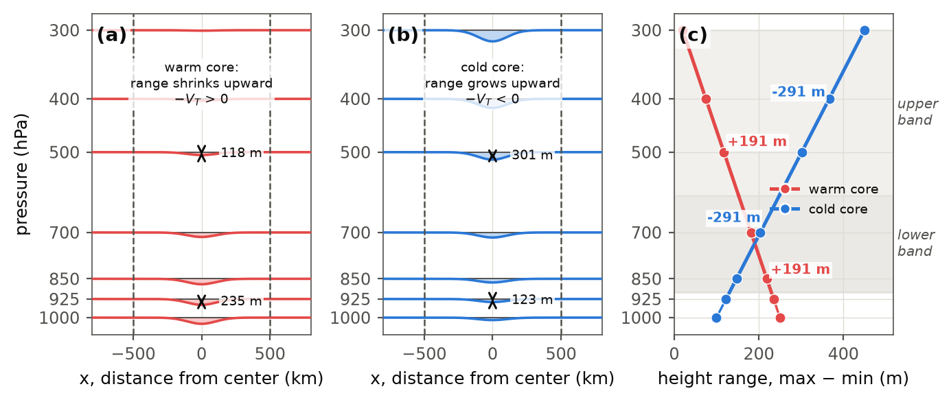
The thermal wind terms
Warm core: the height dip fills with altitude, the range shrinks, the slope is positive. Cold core: the dip deepens, the range grows, the slope is negative. Two layers separate deep warm core from shallow.
Cyclone Phase Space in AWIPS | NOAA/NWS Ocean Prediction Center
3
Notes:
Here is what the thermal wind terms actually measure. Take a cross-section through a storm. The height of a pressure surface dips over the low. In a warm-core storm, a hurricane, the column is warm, so it is thick, so the dip is deepest at the surface and fills in with altitude. The pressure surfaces flatten out aloft. In a cold-core low the column is cold and thin, so the dip deepens with altitude and the trough is strongest at the top.
Hart measures that with one number per level: the height range inside the circle, max minus min. Then he looks at how that range changes with height. Shrinking upward is warm core, positive. Growing upward is cold core, negative. He does it twice, once for the lower troposphere and once for the upper, and that split is what lets you tell a hurricane, warm all the way up, from a subtropical storm or a warm seclusion, which is warm only in the lower layer.

Slide 4
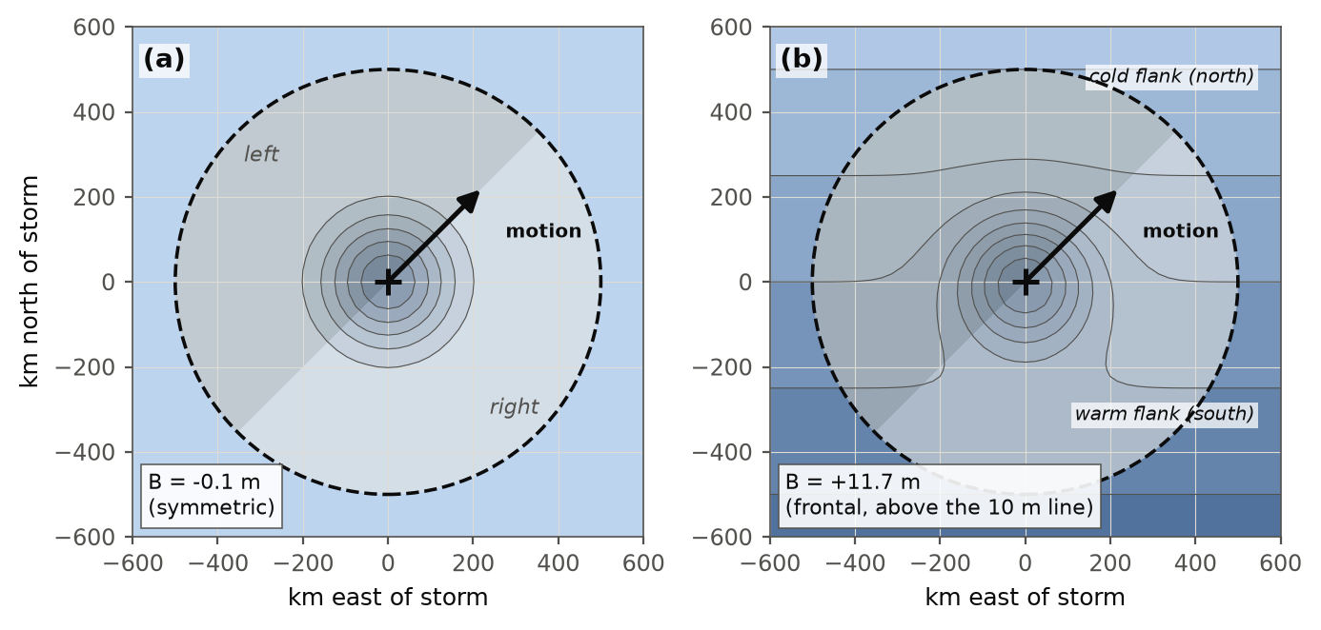
Parameter B, the asymmetry
Thickness is the layer's mean temperature
Split the 500 km circle left and right of the motion, subtract
Symmetric storm: B near 0. Storm in a front: B large. Threshold 10 m
Evans and Hart (2003): onset when B passes 10 m, completion when the lower term turns negative.
Cyclone Phase Space in AWIPS | NOAA/NWS Ocean Prediction Center
4
Notes:
The third number, B, is about the environment rather than the core. Thickness between two pressure levels is a measure of the mean temperature of the layer. Draw the 500 kilometer circle around the storm, split it into left and right of the direction of motion, and subtract the mean thickness of the two halves.
For a hurricane the thickness contours close around the storm, both halves are the same, and B is near zero. For a storm that has moved into a front, warm air sits on one flank and cold air on the other, and B is large. Hart's threshold is 10 meters. Evans and Hart use the hour B first exceeds it as the objective onset of extratropical transition, and the hour the lower thermal wind turns negative as completion.

Slide 5
The two diagrams and the life cycle
Deep warm core, then the B line, then the upper warm core goes, then the lower. Some storms hook back: warm seclusion.
Cyclone Phase Space in AWIPS | NOAA/NWS Ocean Prediction Center
5
Notes:
Put those together and you get Hart's two diagrams. On the left, B against the lower thermal wind: symmetric or frontal, warm or cold. On the right, lower against upper thermal wind: deep warm, shallow warm, or cold. A hurricane starts in the deep warm corner. During transition it crosses the B line first, then loses the upper warm core, then the lower one, and ends in the cold corner. Some storms then hook back toward shallow warm core: that is a warm seclusion re-forming a warm core at the surface, and those are the ones that deepen unexpectedly over cold water. The operational product we built turns all three numbers into one, so a forecaster reads a single class instead of two diagrams. For a marine center, transition is when the wind field expands, so these crossings are the forecast question.

Slide 6
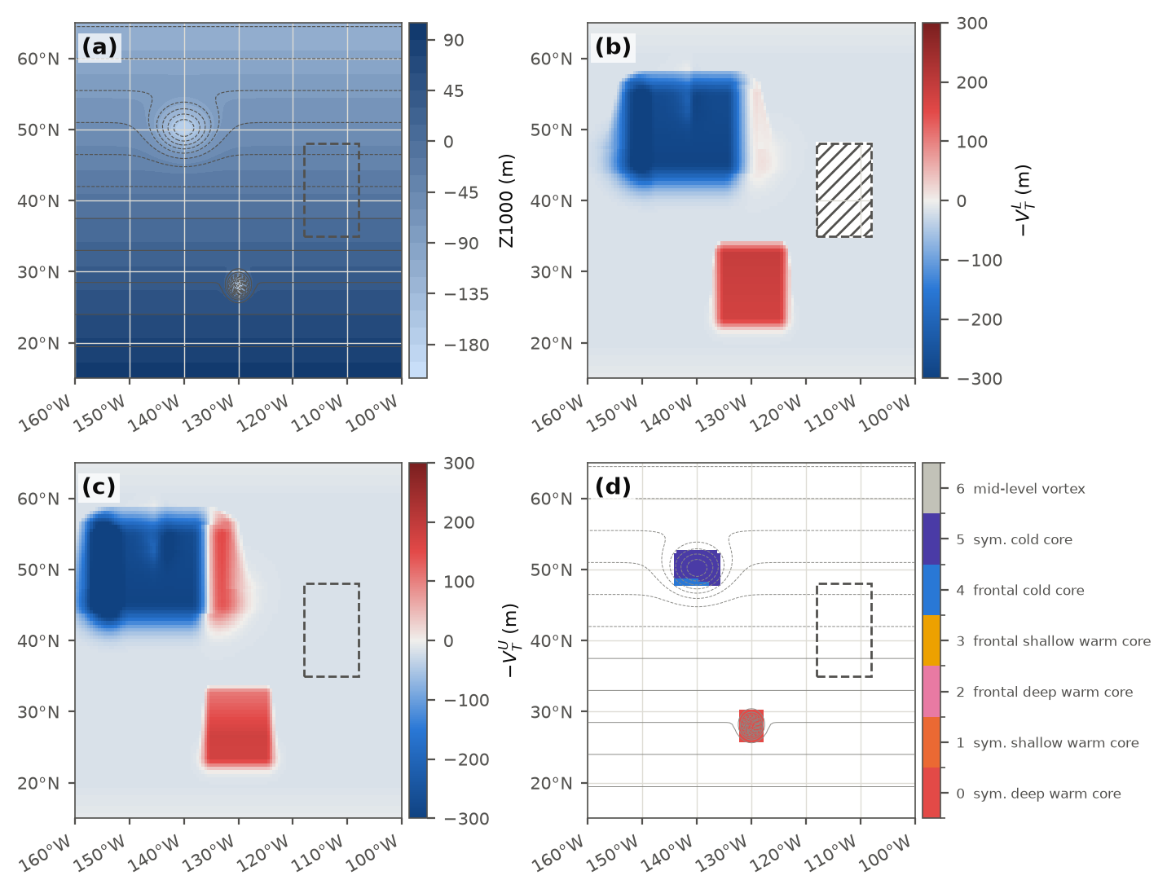
What we built
Hart's height-range regression at every grid point
500 km window, standard levels, surface pressure for terrain
Closed-low detector: only real lows get a class
Every model in D2D, no tracker, no advisory
Synthetic demonstration: a warm-core vortex, a tilted cold-core low, a terrain block, and the joint class in panel (d).
Cyclone Phase Space in AWIPS | NOAA/NWS Ocean Prediction Center
6
Notes:
Until now the only operational access was FSU's web page: static plots, computed externally, for tracked tropical cyclones only. The hybrid, post-tropical, and non-tropical systems that OPC actually warns on aren't on it.
We reformulated the parameters as gridded fields and implemented them as AWIPS derived parameters. At every grid point the code evaluates the height range inside a 500 kilometer window at each level and regresses it against log pressure. That is Hart's exact quantity, everywhere instead of at one tracked center. It needs only geopotential height on standard levels, surface pressure, and winds for the motion in B, so it works on every model in D2D with no tracker and no advisory. A closed-low detector on the 1000 hPa height blanks everything that isn't a real low, and terrain is masked below ground.

Slide 7
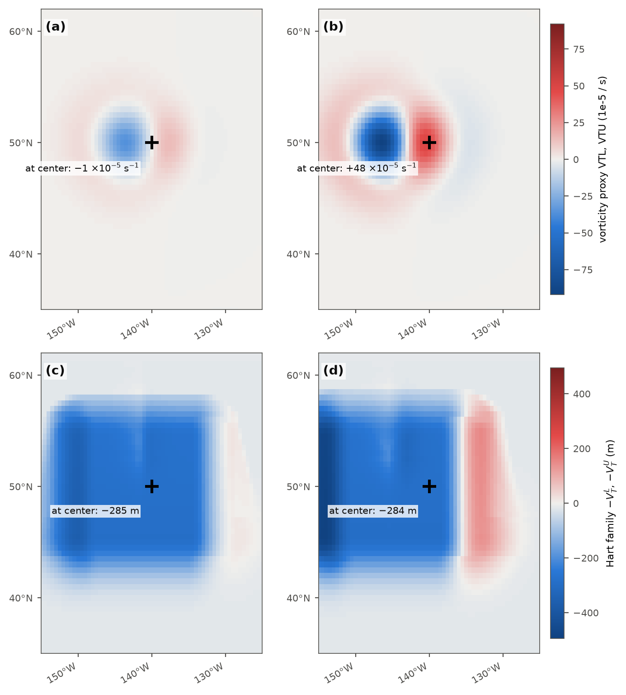
Why not the vorticity shortcut
A tilted low puts its upper trough west of the surface center. Vorticity differencing reads near zero or warm at the center and shows the cold signal as a dipole to the west.
Hart's 500 km window spans the tilt and reads cold at the center.
Vorticity proxy at center: about 0
Hart field at center: minus 285 m
Cyclone Phase Space in AWIPS | NOAA/NWS Ocean Prediction Center
7
Notes:
We tried a cheaper version first, differencing vorticity between levels. It fails in a specific way worth knowing. A baroclinic low is tilted: its upper trough sits west of the surface center. At the surface low the upper vorticity is weak, so the proxy reads warm, and the cold signal shows up displaced to the west as a dipole. Hart's window spans the tilt and reads cold at the center. On a synthetic tilted low the proxy reads near zero at the center and the Hart field reads minus 285 meters.

Slide 8
On shift
Operational CAVE display: lower term, upper term, class, index. Photograph of the live display.
Read one number at the center: 0 hurricane, 2 and 3 transition under way, 4 and 5 cold core, 1 after a warm seclusion. Compare models on the hour the class first reaches 2, and the hour it first reaches 4.
Cyclone Phase Space in AWIPS | NOAA/NWS Ocean Prediction Center
8
Notes:
This is the operational display. Four panels: the lower and upper terms, a joint class field, and an index. The class reads at the storm's center, one number for one of Hart's seven named states: symmetric or frontal, deep or shallow warm core, cold core, or a rare mid-level vortex. Step through the frames on a transitioning storm and the class climbs 0, then 2, then 3, then 4; a warm seclusion runs 4 and back to 1. Load a second model beside it and compare the hour each first reaches 2 or 3, and the hour each first reaches 4 or 5; where they disagree is your transition uncertainty. That is a product nobody had before, because it needed a tracker for every model.

Slide 9
Validation so far
120 m / 180 m
18Z 21 Sep
typhoon, lower and upper term, deep warm core
Dujuan: class leaves 4 at the same hour FSU shows deep to shallow warm core
Cold core
about 1.5 s
deep North Atlantic low reads cold core
per frame, full 0.25 degree global grid
Cyclone Phase Space in AWIPS | NOAA/NWS Ocean Prediction Center
9
Notes:
Three checks so far. A typhoon at 984 millibars read 120 and 180 meters, a deep warm core (class 4 in our earlier two-field product, class 0 or 2 in the joint field depending on B), comparable to what Hart published for hurricanes. For Typhoon Dujuan, the hour the storm's classification left its deep warm core state matched the hour FSU's page showed the same GFS run moving from deep to shallow warm core. And a deep North Atlantic low classified cold core, which the vorticity shortcut could not do. Greenland and the Rockies come out blank rather than contaminated. Compute cost is about a second per frame on the full global grid.

Slide 10
Limits and next
Limits
Next
Standard levels, not Hart's 50 hPa spacing
Square window: small cold bias on strong gradients
B and transition onset implemented, not yet validated
Three cases, not a season
A season of operational use
Model comparison of transition timing
Storm-centered diagram inside GFE
github.com/jkrek17/awips-tools, directory D2D
Questions
Notes:
Honest limits: we use standard levels, not Hart's 50 hectopascal spacing, so magnitudes are near his but not identical. The window is a square, which carries a small cold bias on a strong gradient. B and the transition-onset field are implemented but not yet validated. And it's three cases, not a season.
Next is a season of use, a model-comparison product for transition timing, and a storm-centered diagram inside GFE. The package, guides, and tests are in the repository. Questions.

