Slide 1
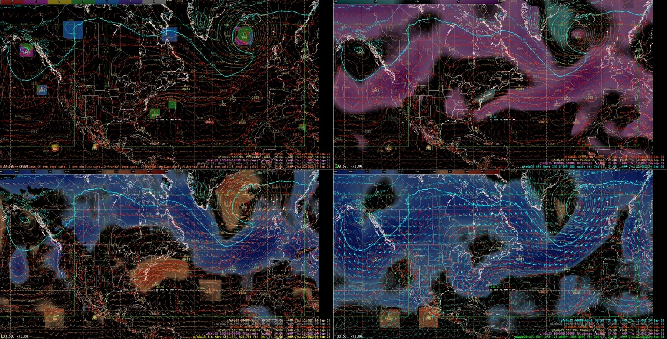
Cyclone Phase Space in AWIPS
Hart's storm structure diagnostics as gridded derived parameters
Jason Krekeler
NOAA/NWS Ocean Prediction Center, September 2026
Notes:
I want to show you a tool that tells you what kind of cyclone a model is forecasting, not just where it is or how deep. It runs inside AWIPS, on every model we ingest, with nothing external.

Slide 2
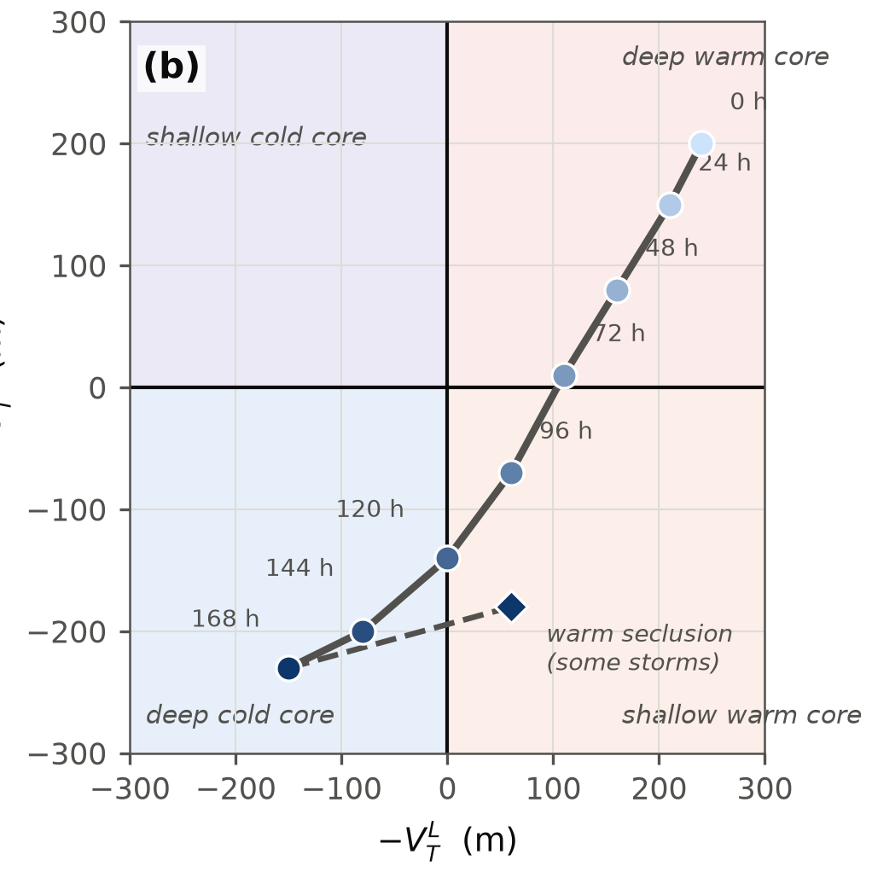
What the phase space measures
Two thermal wind terms: is the core warm or cold, lower and upper troposphere
B: is the storm asymmetric
All three from the height field inside a 500 km circle
Hart (2003)
Cyclone Phase Space in AWIPS | NOAA/NWS Ocean Prediction Center
2
Notes:
The science is Bob Hart's cyclone phase space from 2003. It describes a cyclone with three numbers from the height field alone, all taken inside a 500 kilometer circle around the center. Two are thermal wind terms, one for the lower troposphere and one for the upper, and they say whether the core is warmer or colder than its surroundings. The third, B, says whether the storm is asymmetric. Together they place any cyclone on a diagram, and a storm traces a path through it as it evolves.

Slide 3
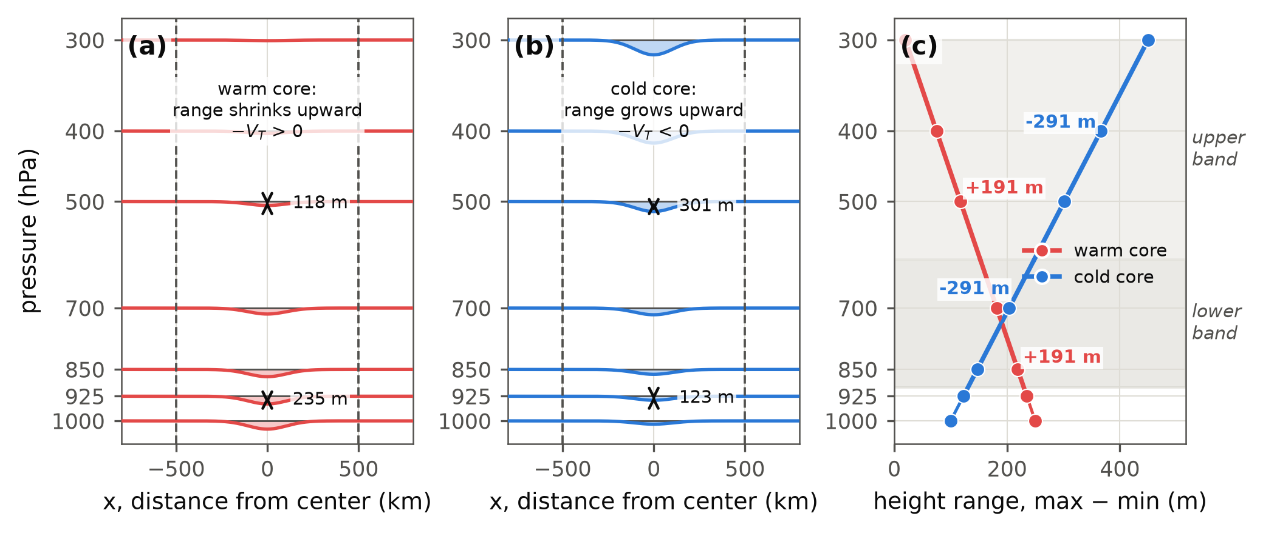
The thermal wind terms
Warm core: the height dip fills with altitude, the range shrinks, the slope is positive. Cold core: the dip deepens, the range grows, the slope is negative. Two layers separate deep warm core from shallow.
Hart (2003)
Cyclone Phase Space in AWIPS | NOAA/NWS Ocean Prediction Center
3
Notes:
Here is what the thermal wind terms measure. Take a cross-section through a storm: the height of a pressure surface dips over the low. In a warm-core storm, a hurricane, the column is warm and thick, so the dip is deepest at the surface and fills in with altitude; the pressure surfaces flatten out aloft. In a cold-core low the column is cold and thin, so the dip deepens with altitude and the trough is strongest at the top.
Hart measures that with one number per level: the height range inside the circle, max minus min, then how that range changes with height. Shrinking upward is warm core, positive; growing upward is cold core, negative. He does it twice, lower and upper troposphere, and that split tells a hurricane, warm all the way up, from a subtropical storm or warm seclusion, warm only in the lower layer.

Slide 4
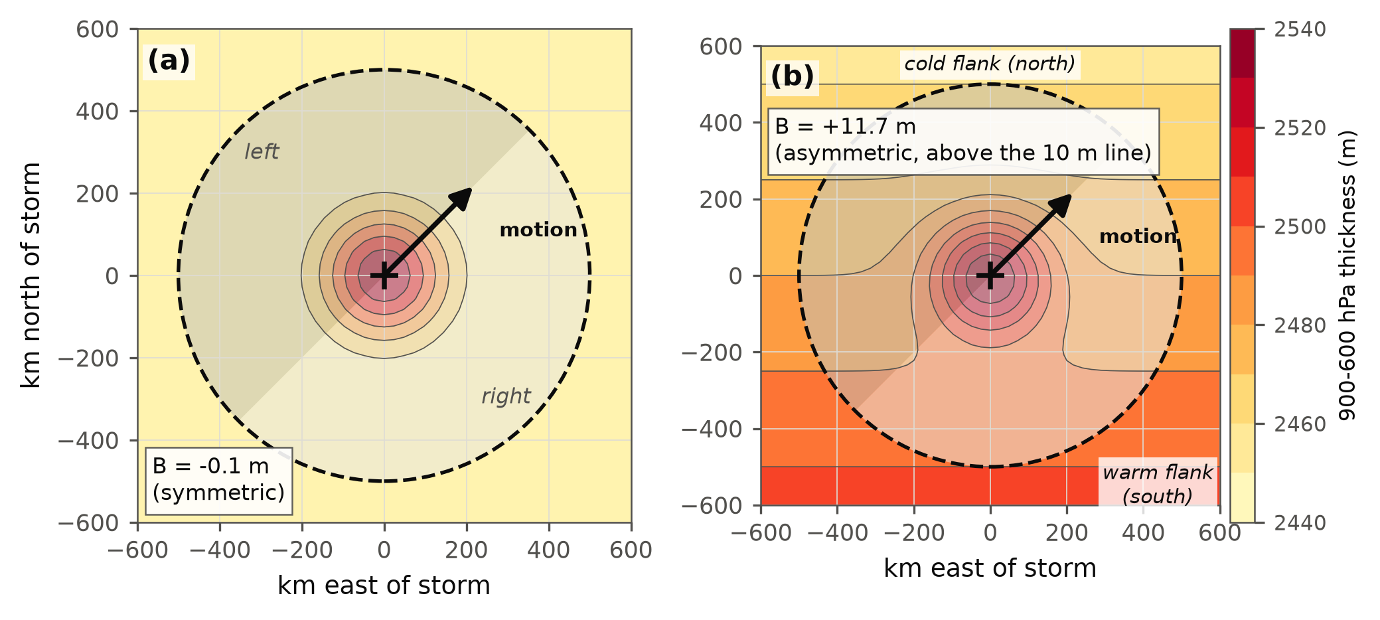
Parameter B, the asymmetry
Thickness measures a layer's mean temperature
Motion: deep-layer mean wind averaged over the window (vortex's own circulation cancels; floor 2 m/s)
Split left and right of that flow, subtract mean thickness
B near 0 if symmetric; large in a front. Threshold 10 m
Onset: HB crosses 10 m. Completion: HVTL crosses zero. Watched by animating those two fields; HCPSclass is the summary.
Cyclone Phase Space in AWIPS | NOAA/NWS Ocean Prediction Center
4
Notes:
The third number, B, is about the environment rather than the core. Thickness between two pressure levels measures a layer's mean temperature. The motion here is the deep-layer mean wind, averaged over that same 500 kilometer window: inside a symmetric vortex the storm's own circulation cancels out, leaving the environmental flow, with a floor of 2 meters per second. Split the circle left and right of that flow and subtract the mean thickness of the two halves.
For a hurricane both halves are the same and B is near zero. For a storm that has moved into a front, warm air sits on one flank and cold on the other, and B is large. Hart's threshold is 10 meters. Onset is read as the frame HB crosses 10 meters, completion as the frame HVTL crosses zero, from animating those two fields; HCPSclass is just the summary.

Slide 5
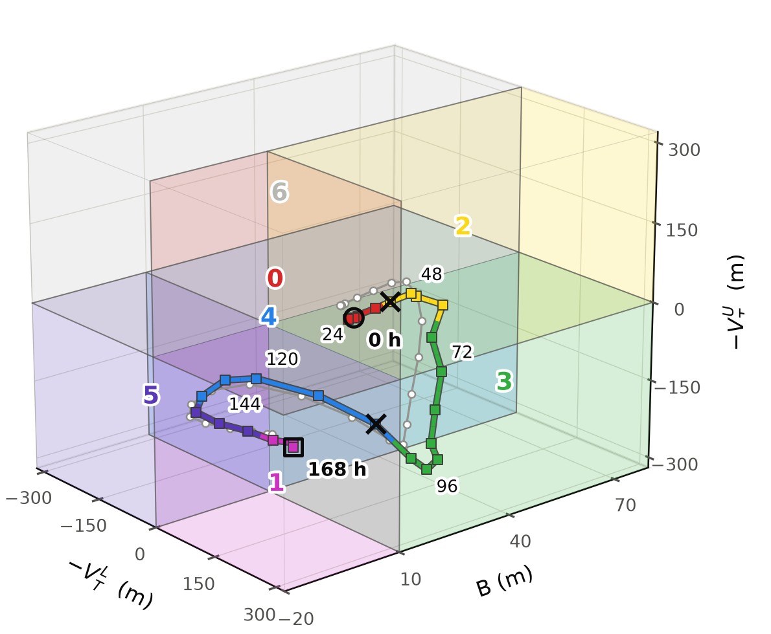
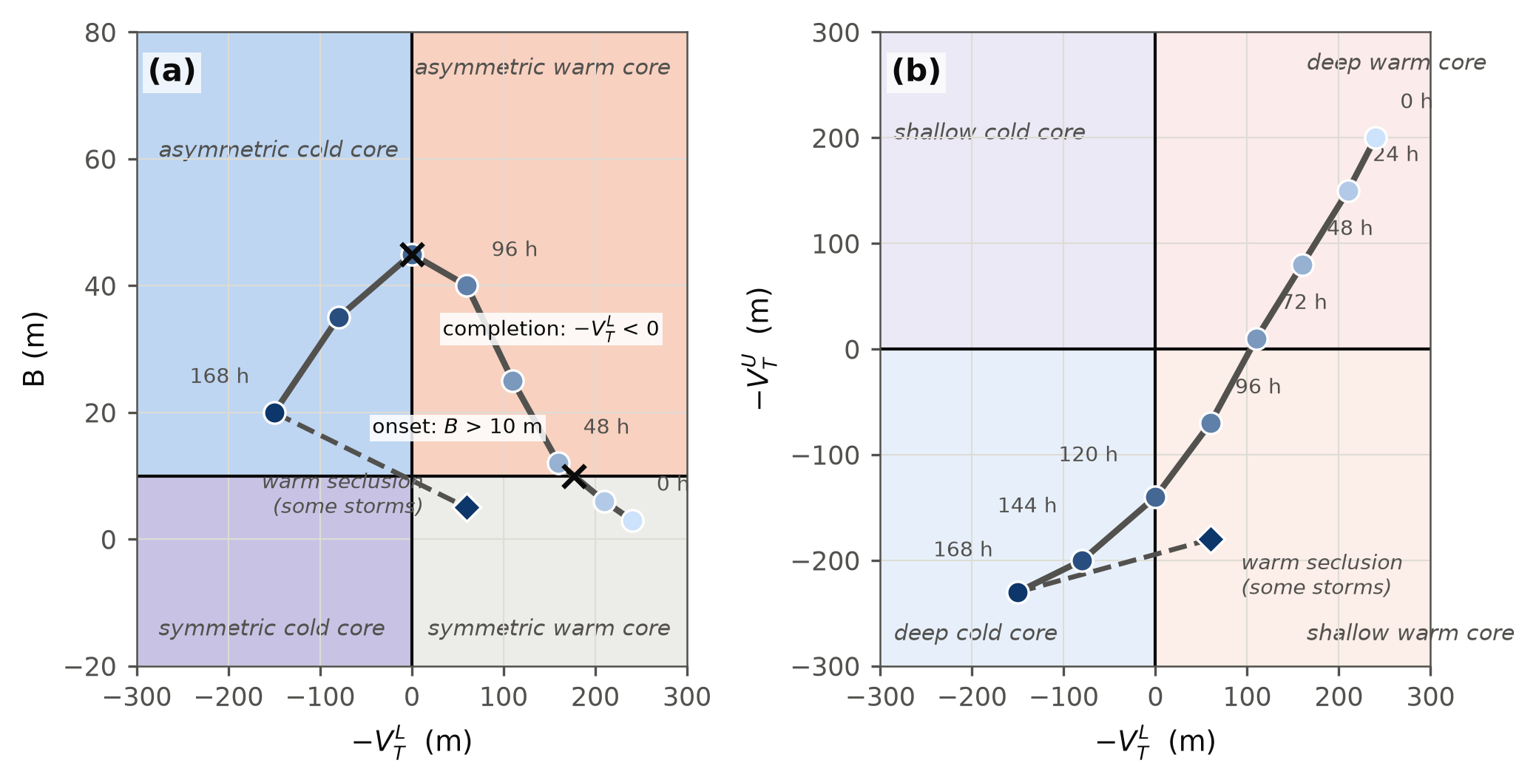
The two diagrams and the life cycle
Deep warm core, then the B line, then the upper warm core goes, then the lower. Some storms hook back: warm seclusion.
One 3-D space, seven boxes: the class is the box the storm's point sits in.
Hart (2003)
Cyclone Phase Space in AWIPS | NOAA/NWS Ocean Prediction Center
5
Notes:
Put those together and you get Hart's two diagrams. On the left, B against the lower thermal wind: symmetric or asymmetric, warm or cold. On the right, lower against upper thermal wind: deep warm, shallow warm, or cold. A hurricane starts in the deep warm corner; during transition it crosses the B line first, loses the upper warm core, then the lower one, and ends in the cold corner. Some storms hook back toward shallow warm core: a warm seclusion re-forming a warm core at the surface, the ones that deepen unexpectedly over cold water. The product we built turns all three numbers into one, so a forecaster reads a single class instead of two diagrams. The class is the box of Hart's three-dimensional space the storm sits in; the two diagrams are its projections. On the right, our transition, and in the article five other storm types. For a marine center, transition is when the wind field expands, so these crossings are the forecast question.

Slide 6
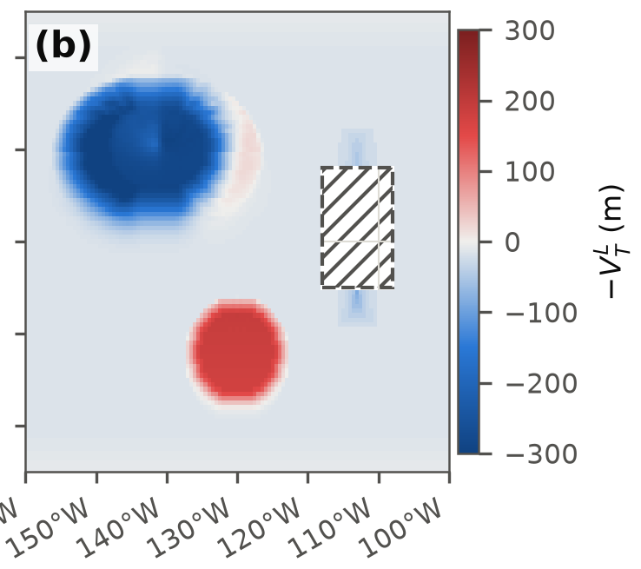
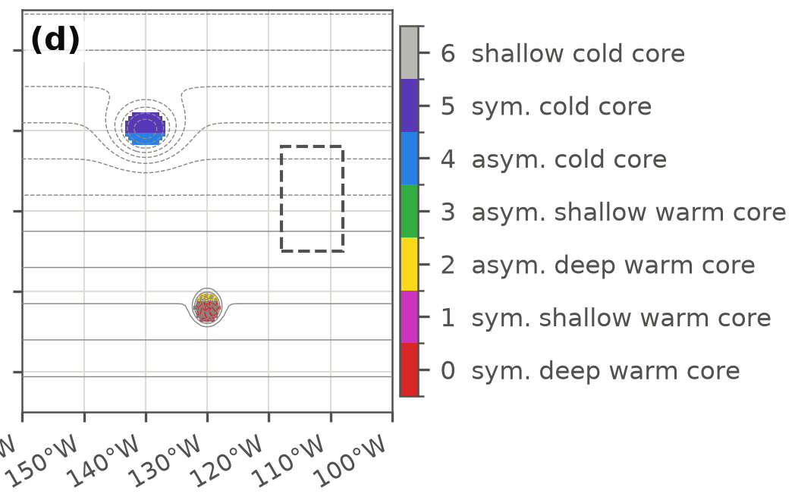
What we built
(b) HVTL, masked over the terrain block. (d) HCPSclass, the joint class field, at every grid point.
500 km circle (Hart's), standard levels, surface pressure; four wind levels too for B. Closed-low detector keeps the class off open ocean and open troughs tested. Any model with those fields, no tracker, no advisory.
Cyclone Phase Space in AWIPS | NOAA/NWS Ocean Prediction Center
6
Notes:
Until now, operational access was the FSU cyclone phase page: storm-centered diagrams for tracker-identified cyclones, in a fixed set of models, outside the workstation. What OPC needs is the same diagnostic inside D2D, on every model we run, for any low we point at.
We reformulated the parameters as gridded fields and implemented them as AWIPS derived parameters. At every grid point the code evaluates the height range inside a 500 kilometer circle at each level and regresses it against log pressure: Hart's own definition, evaluated everywhere instead of at one tracked center. The circle is his; the standard levels keep the magnitudes close to his, not identical. It needs geopotential height on standard levels, surface pressure and sea level pressure; the asymmetric term also needs winds at four levels. That runs on any model in D2D carrying those fields, with no tracker and no advisory. A closed-low detector on sea level pressure keeps the class off open ocean and open troughs in the cases we've tested, and terrain is masked below ground.

Slide 7
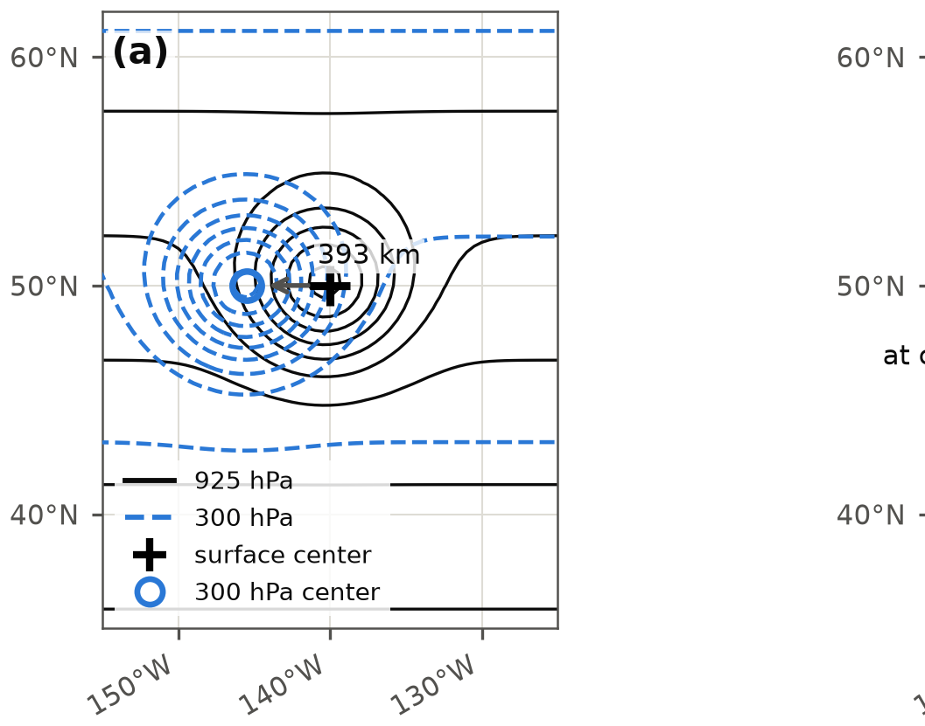
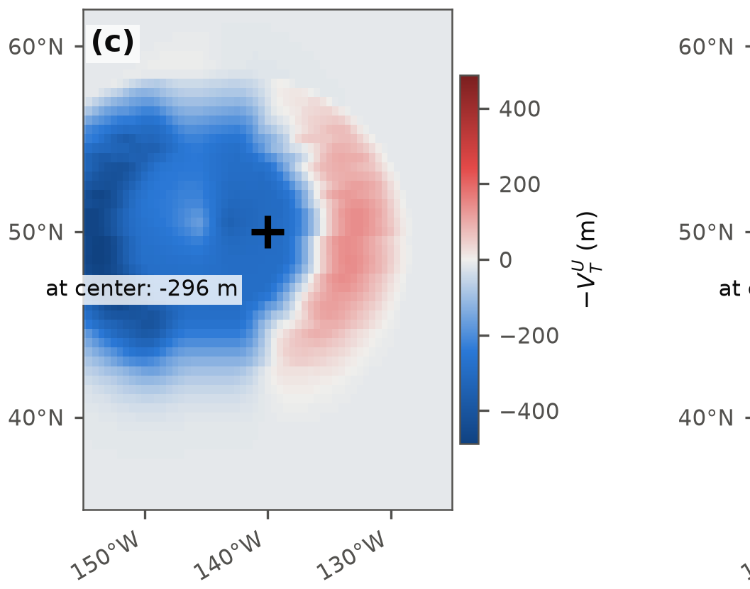
A tilted cold core
(a) Tilt geometry: 300 hPa minimum 393 km west of center, 8 m/s westerly steering. (c) HVTU there: -296 m; HVTL -288 m (not shown).
Class at center: 5, symmetric cold core
Cyclone Phase Space in AWIPS | NOAA/NWS Ocean Prediction Center
7
Notes:
Here is why measuring the height field directly matters, on a synthetic case. Build a cold-core cyclone whose upper trough sits 393 kilometers west of its surface center, tilted the way many real baroclinic lows are, under a uniform 8 meter per second westerly steering flow. One panel shows that geometry: the 925 and 300 hectopascal height contours, offset by the tilt. The others show the upper thermal wind term and the joint class. Hart's 500 kilometer window is wide enough to take in the tilted upper trough from the surface center, so both thermal wind terms read strongly cold there, HVTL minus 288 meters and HVTU minus 296, and the class comes out 5, symmetric cold core, right where the surface low sits.

Slide 8
On shift
Read one number at the center: 0 hurricane, 2 to 3 transition under way, 4 cold core, 6 shallow cold core (rare: lower cold, upper warm), 1 after a warm seclusion (4 to 3, or 4 to 1 if B falls too).
Compare models on the hour HB crosses 10 m and the hour HVTL crosses zero.
CAVE four-panel on the North Atlantic, 6 h of the 24 Sep 06Z GFS: class (top left), HB (top right), HVTL with 850 hPa wind (bottom left), HVTU with 300 hPa wind (bottom right). The 959 mb low south of Greenland reads as a warm seclusion: red HVTL, blue HVTU, HB near zero at the center, class 3 with 1 on the flanks.
Cyclone Phase Space in AWIPS | NOAA/NWS Ocean Prediction Center
8
Notes:
This is the operational display: four fields, HVTL, HVTU, the joint class, and the index. The capture is the North Atlantic at 6 hours of the 24 September run: HB paints the polar front magenta, HVTU is blue under the jet, and the 959 millibar low south of Greenland reads as a warm seclusion, red lower core, blue upper, B near zero at the center with the magenta band wrapped around it. The class reads at the storm's center, one number for one of seven classes built from Hart's two diagrams: symmetric or asymmetric, deep or shallow warm core, cold core, or shallow cold core, lower cold and upper warm, a rare state. Step through the frames on a transitioning storm and the class climbs 0, then 2, then 3, then 4; a warm seclusion runs it from 4 to 3, or to 1 if B falls too. Load a second model beside it and compare the hour each HB crosses 10 meters and each HVTL crosses zero; where they disagree is your transition uncertainty. That's not something we've had inside our own workstation before, because it needed a tracker for every model.

Slide 9
Validation so far
0 → 2 → 3 → 1
Matches FSU
one typhoon, GFS 20 Sep 06Z: deep warm at 0 h, onset by 24 h (B 13 m), upper core lost by 48 h, seclusion by 96 h (lower +241 m, upper −295 m, B 0.5 m)
Hart's own diagrams for the storm trace the same sequence; cold-phase upper term −290 m vs his −300 m
+3 m
about 2.4 s
the one class 6 frame at 120 h has an upper term of +3 m: a threshold artifact, read as class 4
per forecast hour, 0.25° global grid (median of 4 runs, 2.3–2.7 s)
Cyclone Phase Space in AWIPS | NOAA/NWS Ocean Prediction Center
9
Notes:
Checks so far are GFS cases from five cycles, sampled by hand: a smoke test, not a calibration. A typhoon at 984 millibars read 120 and 180 meters, a deep warm core; our bands differ from Hart's, so we don't compare that magnitude to his published values. For Typhoon Dujuan, the 2026 September 17, 1200 UTC GFS run valid 21 September 1800 UTC: the hour the class left its deep warm core state matched the hour FSU's page showed deep to shallow warm core, within one 6 hour frame. A deep North Atlantic low in the same cycle classified cold core; its values weren't recorded, so that case needs re-sampling. Greenland and the Rockies come out blank rather than contaminated. Compute cost is about 2.4 seconds per forecast hour on the full global grid, the median of four runs, ranging 2.3 to 2.7 seconds.

Slide 10
Limits and next
Limits
Next
Standard levels, not Hart's 50 hPa: deep warm core reads 12% high, seclusion 2 to 3 times his
B from semicircle means matches Hart on a synthetic life cycle; no real-storm check yet
A handful of cases, not a season
A season of operational use
Model comparison of transition timing
Storm-centered diagram inside GFE
Jason Krekeler, NOAA/NWS Ocean Prediction Center
github.com/jkrek17/awips-tools, directory cyclone_phase_space
Questions?
References: Hart (2003), Mon. Wea. Rev. 131, 585–616. Evans and Hart (2003), Mon. Wea. Rev. 131, 909–925. Hart et al. (2006), Mon. Wea. Rev. 134, 553–578.
Notes:
Honest limits: we use standard levels, not Hart's 50 hectopascal spacing, so magnitudes are near his but not identical. The standard-level band reads a deep warm core about 12 percent high and a warm seclusion two to three times Hart's value. The window is now Hart's own circle; the square we used before read cold cores about 50 meters too cold. B is now computed from true semicircle means and matches Hart's within one percent on a synthetic life cycle, with onset and completion at the same hours, but it has not yet been validated on a real storm. And it's a handful of cases, not a season.
Next is a season of use, a model-comparison product for transition timing, and a storm-centered diagram inside GFE. The package, guides, and tests are in the repository. Questions.

