Slide 1

Chameleon’s Journey
Chameleon’s Journey is operated by Hospice and Palliative Care of Charlotte.
Chameleon’s Journey, now in its 17th year, is a widely recognized regional grief camp that encourages help, hope, and healing for children as they face the aftermath of the loss of a loved one.

Slide 2
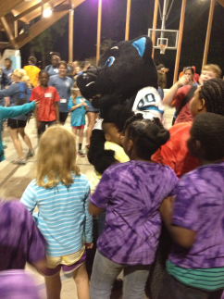
Placement Overview
The annual overnight camp, held at Camp Thunderbird in Lake Wylie, South Carolina, has served over 1,100 campers from in and around Charlotte since 2000.
The overnight camp includes a planned program of educational, artistic, creative, and physical activities that give campers, ages 7-16, the opportunity to express thoughts and feelings of grief and share their stories in a caring, confidential, and safe environment.
Campers come away from the camp with an increased knowledge of the grieving process and an appreciation for the face that grief itself is a journey.
They also develop new relationships to help them know they are not alone.

Slide 3
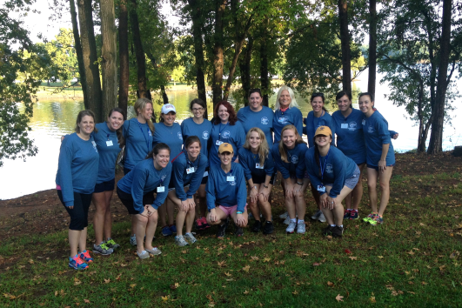

Placement Overview
The Junior League of Charlotte has partnered with Chameleon’s Journey for the past 12 years. In addition to providing volunteers, JLC is the camp’s largest donor.

Slide 4
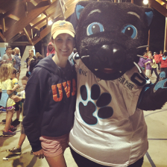
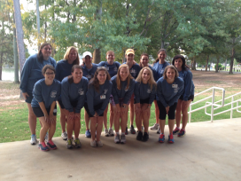
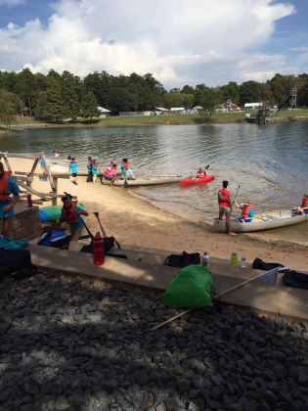
Placement Overview
20 Junior League of Charlotte members volunteer for Chameleon’s Journey annually.
Before camp, volunteers learn about the grieving process and what their role at camp will look like.
Some Junior League members serve as camp counselors and are grouped with other counselors and a licensed grief councilor from Hospice.
Other Junior League members volunteer as “All Abouts,” to help with the operation of camp activities.
Chameleon’s Journey is meaningful to so many Junior League volunteers, that many return year after year even after their placement is over.

Slide 5
Expectations of Placement:
Complete a minimum of 40 volunteer hours with the placement
Attend 2 trainings prior to camp in the fall
Attend camp Friday through Sunday (10/13/17 – 10/15/17)
Complete required paperwork, including background check
Optional mini camp in the spring
Example method of meeting Chameleon’s Journey placement requirements
Required Meetings and Trainings | 8 hours
College 101 monthly meetings with hija | 32 hours

