Slide 1
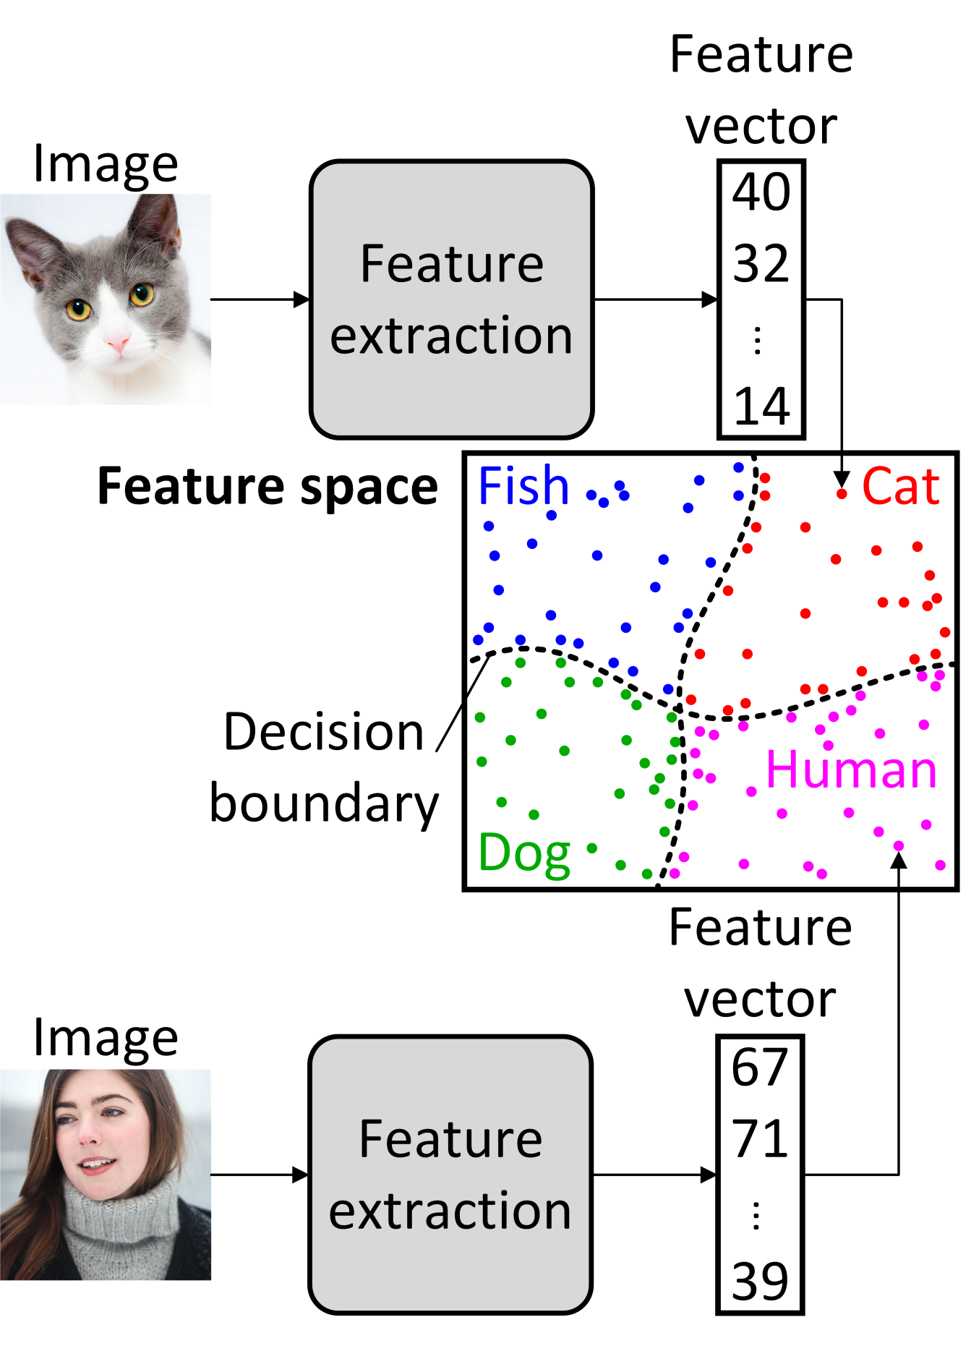
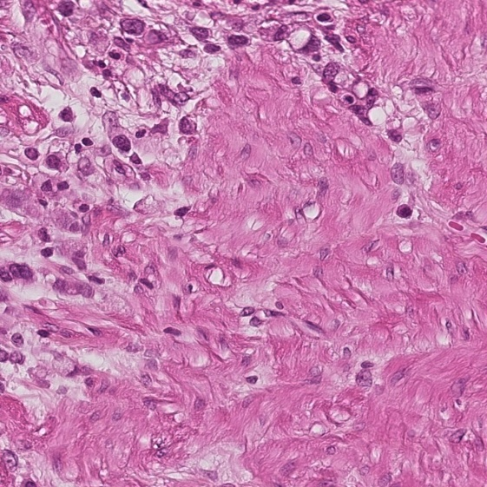
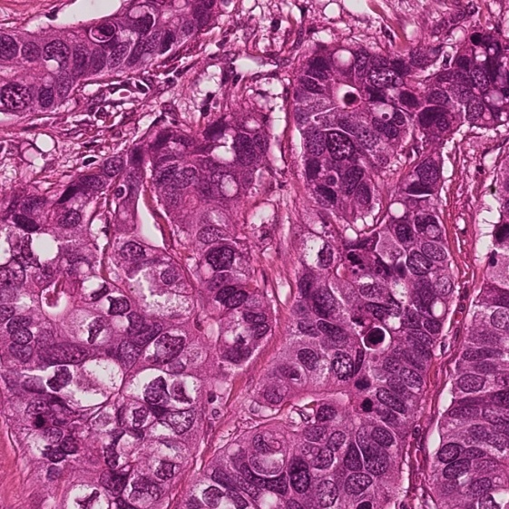
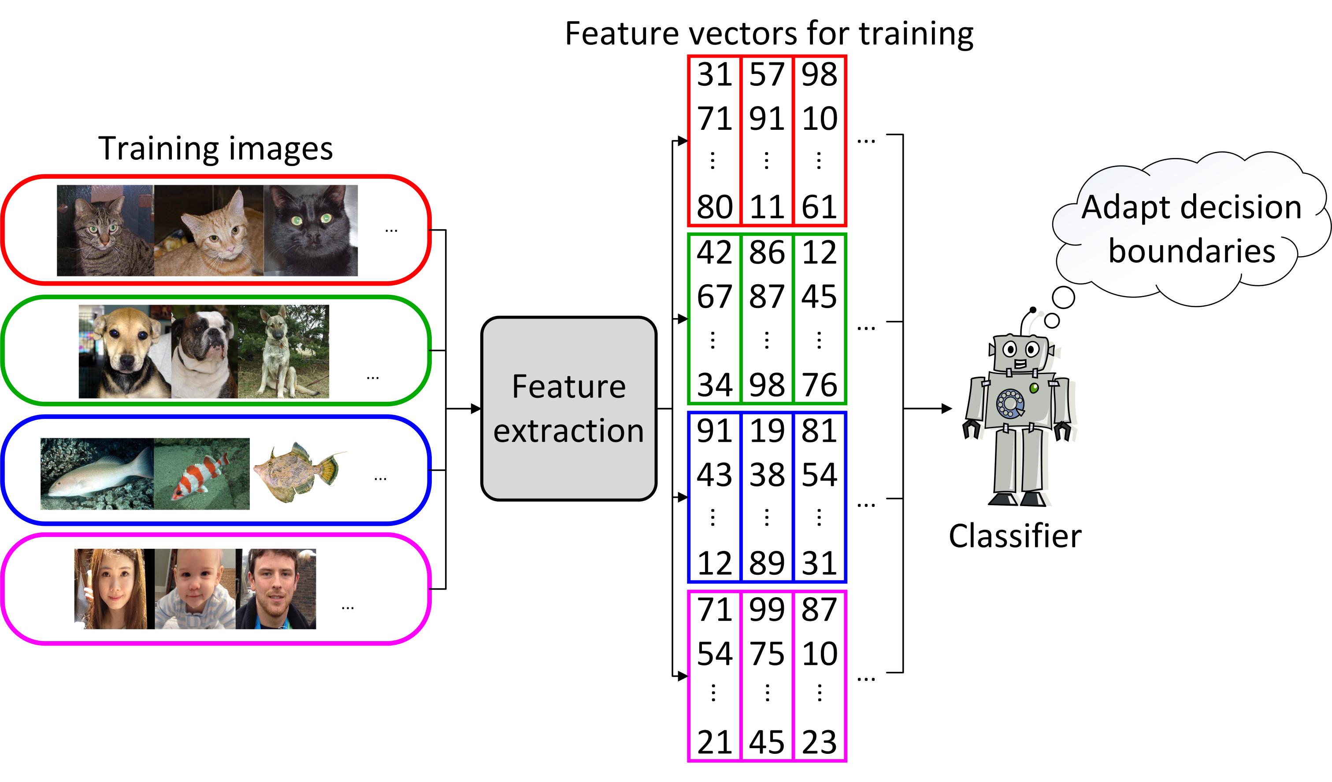
TASKO – The picture recognition challenge
How does the computer recognize a picture?
TASKO – Trained, Automatic System for (K)lassification and Object recognition
Medical tissue samples
It‘s all about features
The system looks for specific configurations within a picture like color, texture or contours. These mathematical properties of the picture are the features. For further analysis all of them are stored within a feature vector.
Finding the right class
The feature vector describes a position in the feature space. This provides information about which class the picture belongs to, thus about the content of the picture. Different classes are seperated by decision boundaries within the feature space.
Healthy
Diseased
Can you tell the difference?
A well trained classifier can recognise a picture faster and more precise than a human. A very usefull system for many applications – as in medicine! For the detection of cancer in human cells doctors have to evaluate several images of cells, like those shown above. This is often a time consuming process. A classifying system can detect diseased cells in these images and thus support the diagnosis.
Create a classifier
The computer needs to know where to set the boundaries in the feature space, therefore it has to be trained before-hand with ten-thousands of different, labeled pictures. The result is a classifier , tailored for a specific task like TASKO.

