Slide 1
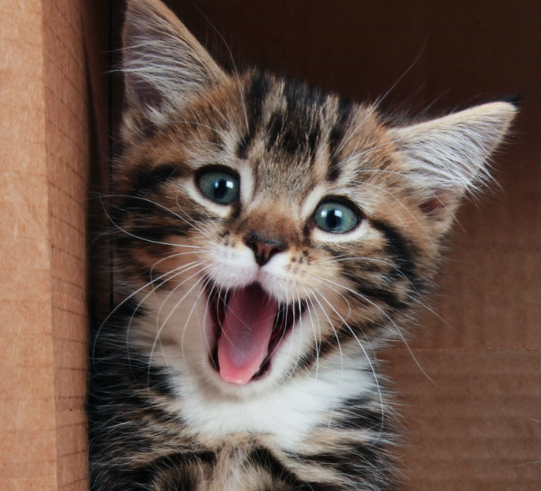
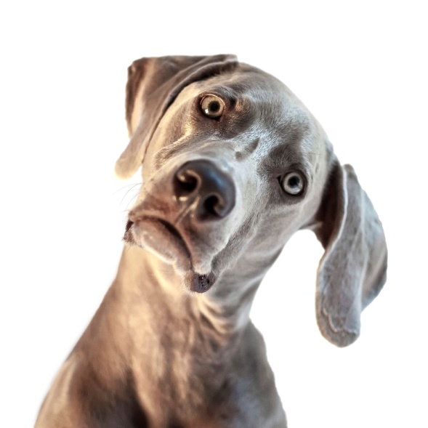
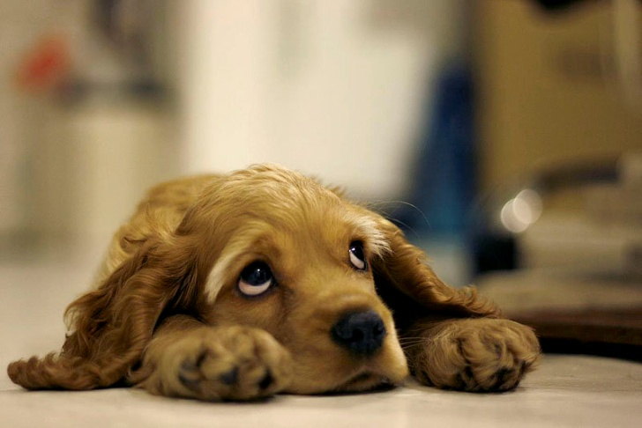
End images
Human points: H
Machine points: M
H > M
H = M
H < M
Win
Draw
Loose

Slide 2
Evaluation
Training images:
10,000 of each class
=> 4*10,000 = 40,000 in total
Test images:
2,500 for each class
=> 4*2,500 = 10,000 in total
Feature Extraction:
AlexNet CNN
Classification:
Multiclass SVM
Confusion matrix:
 | Cat | Dog | Fish | Human
Cat | 93.23 % | 6.47 % | 0.17 % | 0.13 %
Dog | 2.83 % | 97.00 % | 0.07 % | 0.10 %
Fish | 0.17 % | 0.23 % | 99.6 % | 0.00 %
Human | 0.10 % | 0.10 % | 0.03 % | 99.77 %

Slide 3
References
Cat and dog images:
https://www.kaggle.com/c/dogs-vs-cats/data
Fish images:
http://groups.inf.ed.ac.uk/f4k/GROUNDTRUTH/RECOG/
https://wiki.qut.edu.au/display/cyphy/Fish+Dataset
http://swfscdata.nmfs.noaa.gov/labeled-fishes-in-the-wild/
Human images:
http://www.openu.ac.il/home/hassner/Adience/data.html
AlexNet:
http://www.vlfeat.org/matconvnet/models/beta16/imagenet-caffe-alex.mat
Matlab Deep Learning Tutorial:
https://de.mathworks.com/company/newsletters/articles/deep-learning-for-computer-vision-with-matlab.html
https://de.mathworks.com/help/vision/examples/image-category-classification-using-deep-learning.html

