Slide 1
College Event Website
Group 18

Slide 2
Group Members
Alex Phillips
Luis Casanova
Jonathon Towne

Slide 3
Project Summary
Our project empowers student organizations to publish event for students of select universities. The website also allows students to browse these events that hosted at their university.
The students can become admins by creating petitions for new student organizations. The petitions become RSOs after five unique signatures are applied to the petition. The RSO admin create events for their organizations. Events are also pulled from university event feeds.

Slide 4


Description of the App
Development of the website was made on a WAMP server.
With that said we used windows machine, apache, MySQL, PHP.
For the website we wrote it in HTML, CSS and JavaScript.

Slide 5
ER Model

Slide 6
Relational Data Model

Slide 7
RSO Creation
After a petition is added every time a student joins, a trigger checks if the petition already has 5 signatures, when this is achieved, the petition's information is used to create a new RSO.
The petition's signatures create the RSO member's table and finally the petition table is deleted from the database.
If a the student is not part of the admin table, it will be added to it when RSO is created.

Slide 8
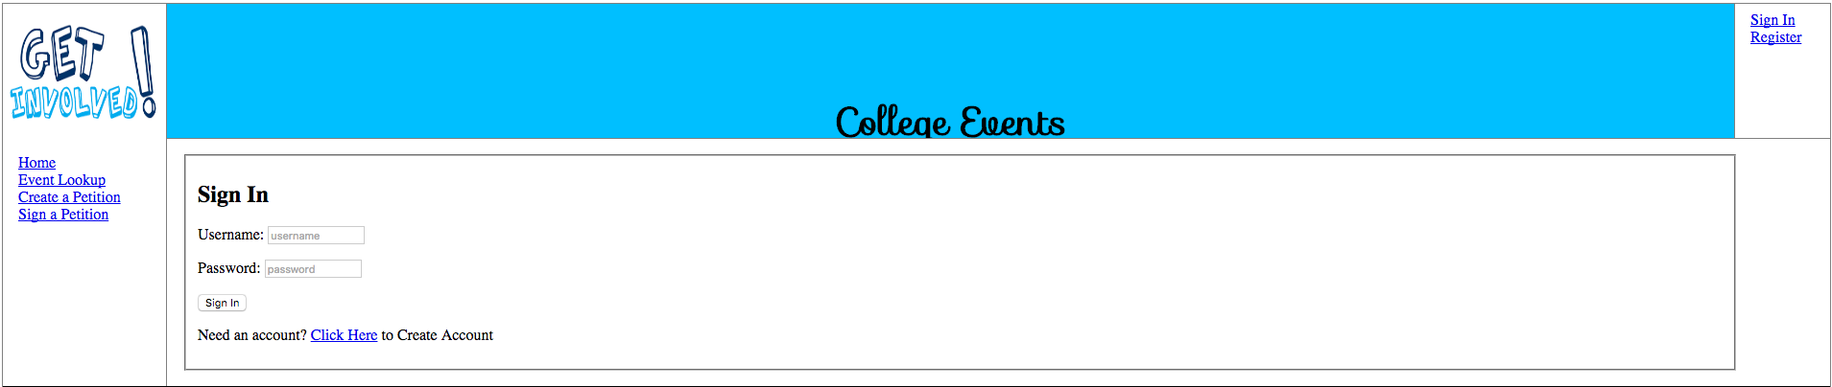
Screenshot GUI

Slide 9
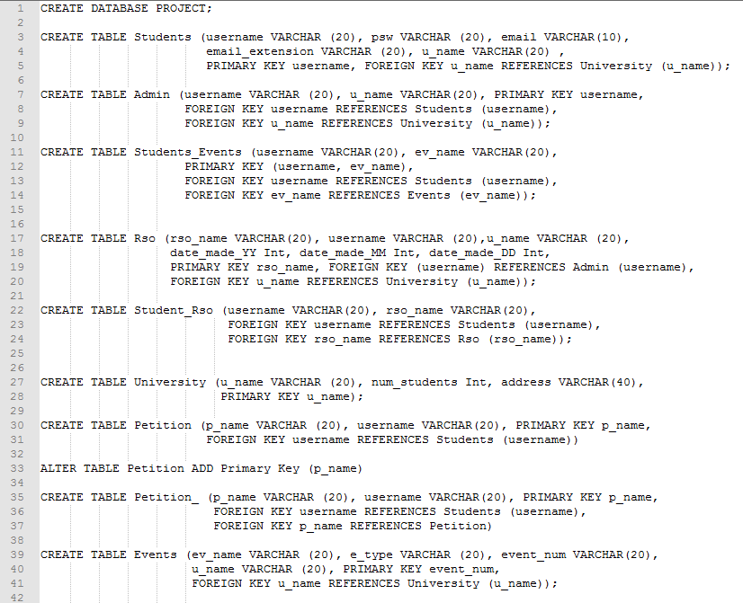
Screenshot Database

Slide 10
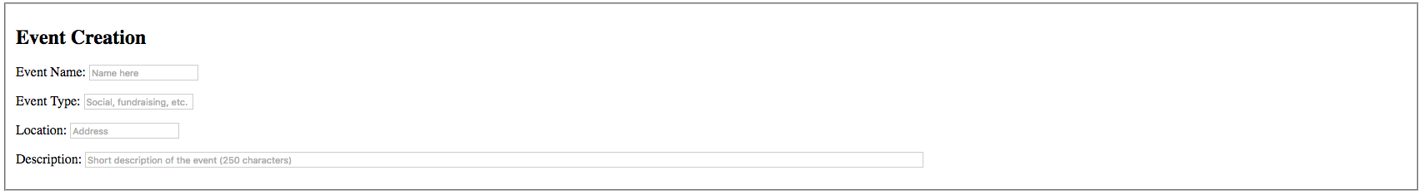
Screenshot Event Creation
Admin of RSOs will have the option to create an event that will be public for all students.

Slide 11
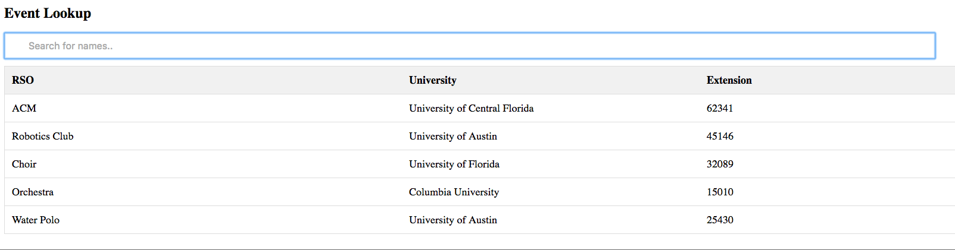
Screenshot Event Shown to User

Slide 12
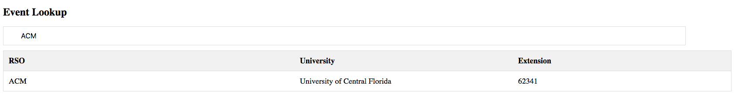
Search in use

Slide 13
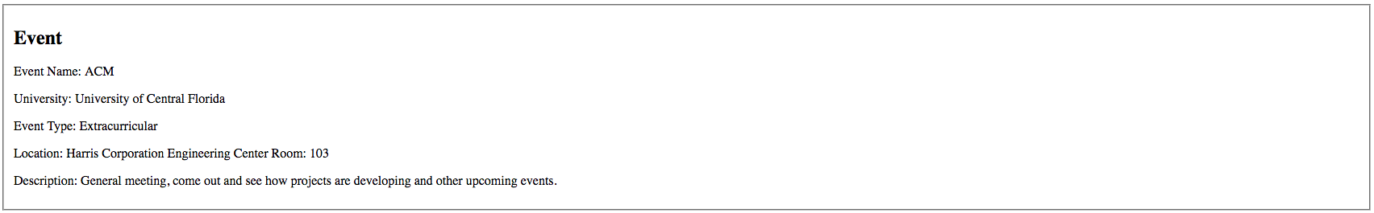
Screenshot Event Details

Slide 14
Additional Features
Our project uses a live search feature that changes display of the events as you type into the search bar.
We added a petition function for creating new RSO’s where students can sign current petitions as they become available.
A trigger will occur when the petition reacts max signature putting the temp RSO into the RSO table.

Slide 15
Conclusion
We will improve our project by including xml feeds from the universities’ events to be functional to our website.
We are currently working on getting the Google Maps API to show the universities’ location in the event pages.
We are working on the Facebook API into the events’ pages to allow students to show others on Facebook that they are going to attend.
Also we will polish up all webpages to make them look better visually.

