Slide 1

Supervised Learning Methods for Crop Yield Forecasting
Joseph Krueger
March 26, 2024

Slide 2
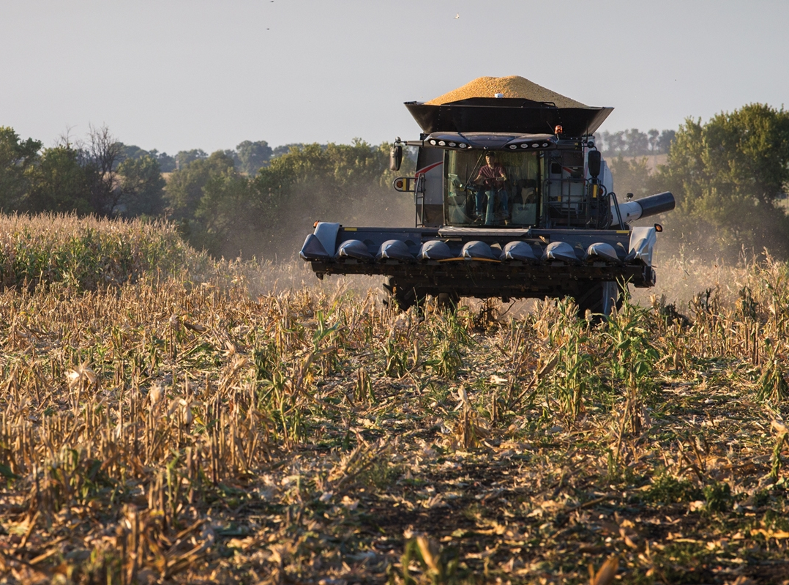
Why should we care about harvest yield?
Farmers:
What should they be growing?
Where should they be growing?
What can they expect from the upcoming harvest season?
Industry:
Where should they target their marketing?
Where should they focus their development?
Everyone :
Which products will be more/less expensive in the future?
Is there going to be enough food to feed all of us?

Slide 3
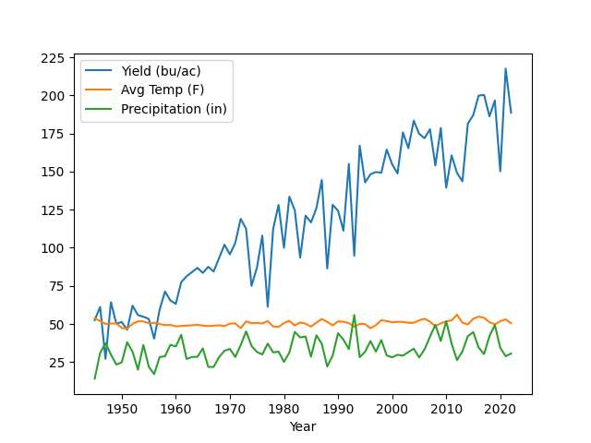
Dataset
Target:
Corn yields (bu/ac) in Polk County, IA
Data Sources:
United States Department of Agriculture (USDA)
National Oceanic and Atmospheric Administration (NOAA)
Data Augmentation:
Upsampled to monthly frequency using linear interpolation
Figure 2: Feature set

Slide 4
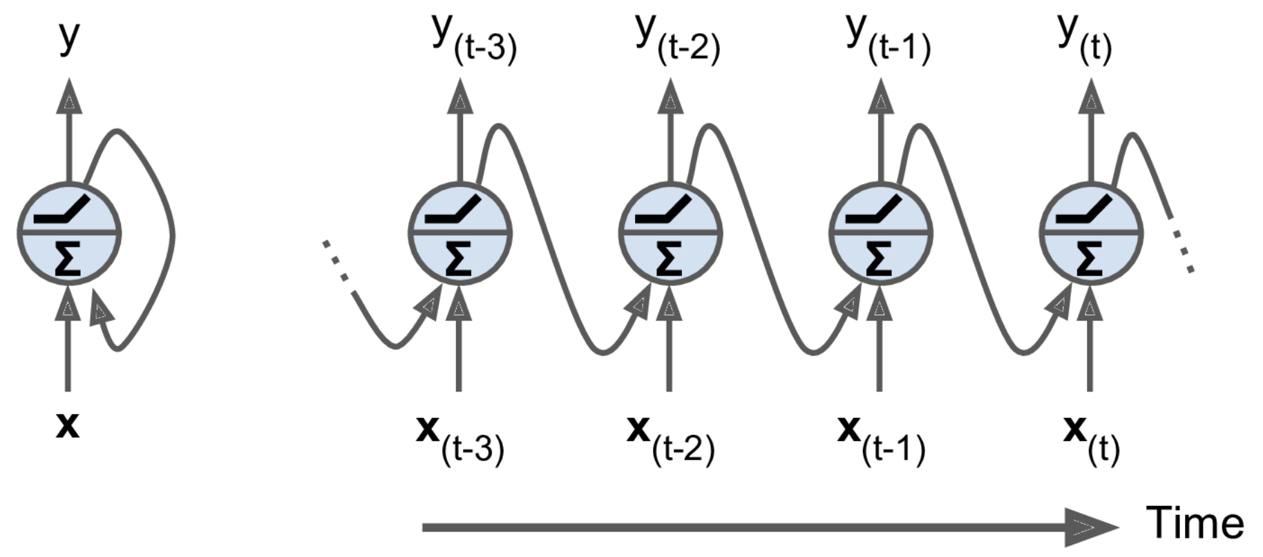
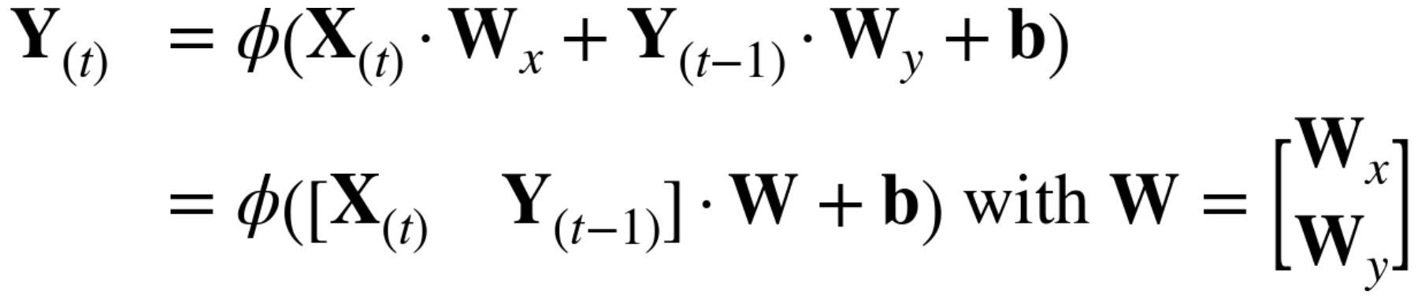
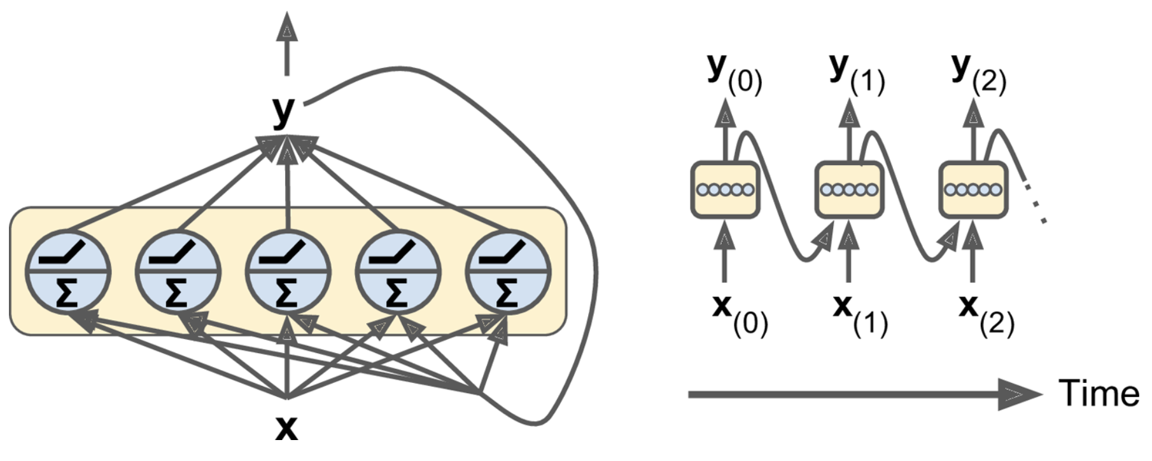
Recurrent Neural Networks (RNNs)
Mathematical Formulation:
Main ideas:
Trained on sequences of data
Has “memory”
Memory = better predictability
Use Cases:
Time-series forecasting
Natural Language Processing (NLP)
Figure 3: Recurrent neurons over time
Figure 4: Recurrent layers over time

Slide 5
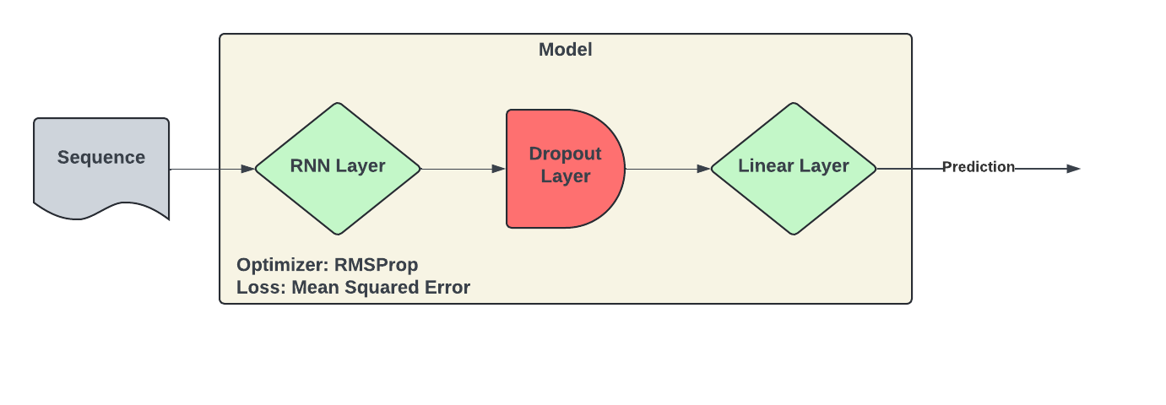
Implementation
Figure 5: RNN model architecture
Hyperparameters:
Batch Size: 64
Units: 60
Steps (look back): 110
Train set (%): 0.8
Validation set (%): 0.1
Learning rate: 0.001
Early Stopping:
Validation loss
Patience = 20
Dropout = 0.2

Slide 6
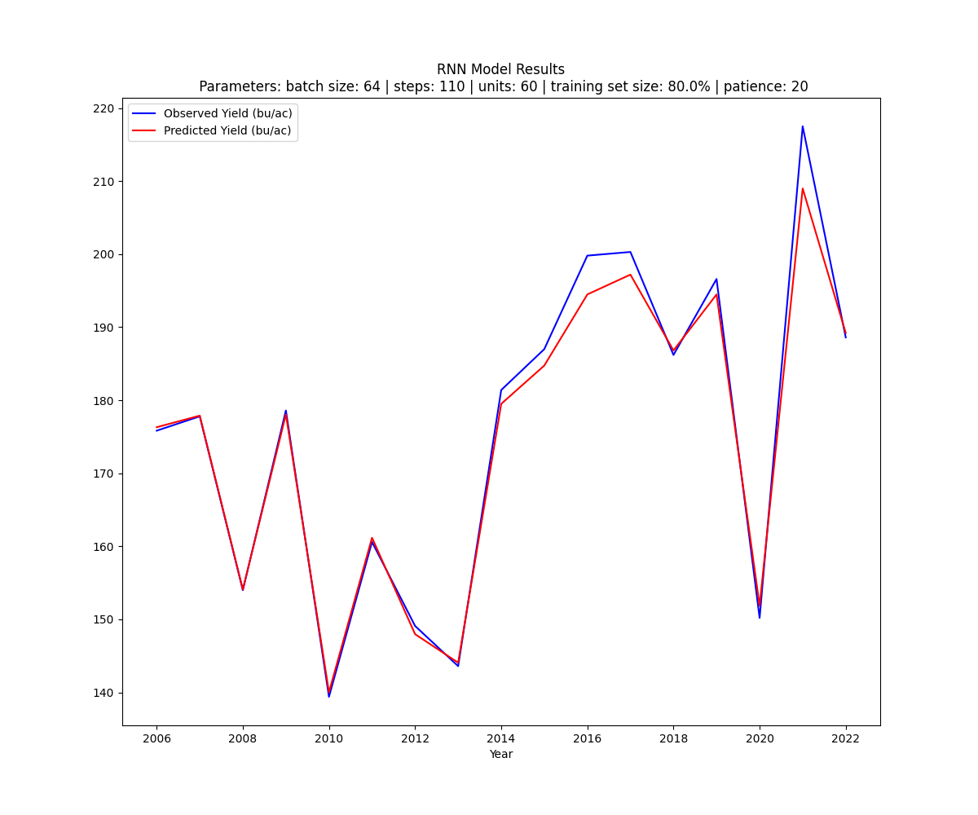
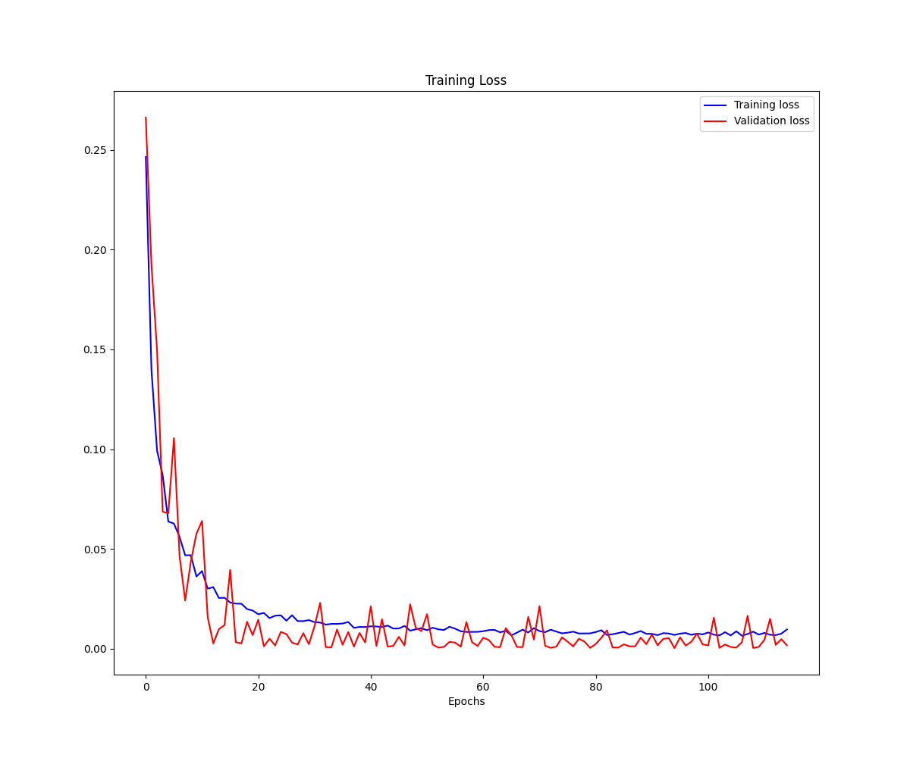
RNN Results – Rolling Forecast
Figure 6: RNN predictions vs observed
Figure 7: RNN training loss
Best training MSE: ~0.007
Best validation MSE: ~0.0005

Slide 7
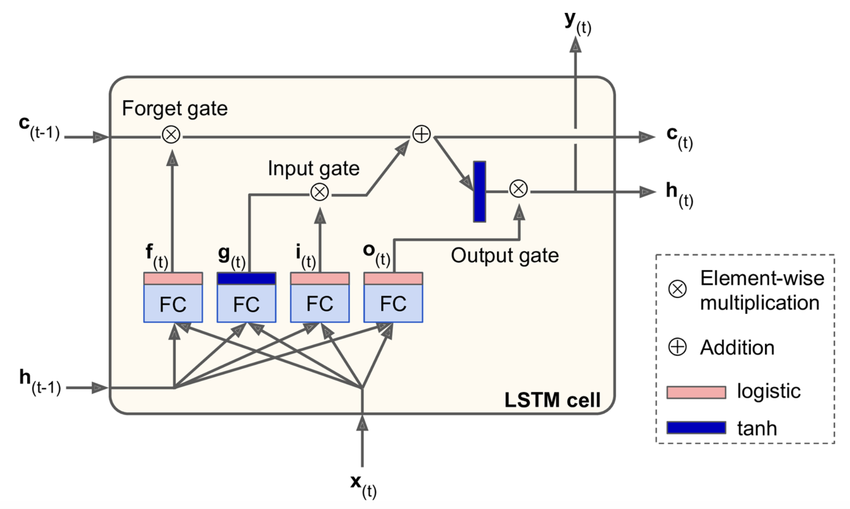
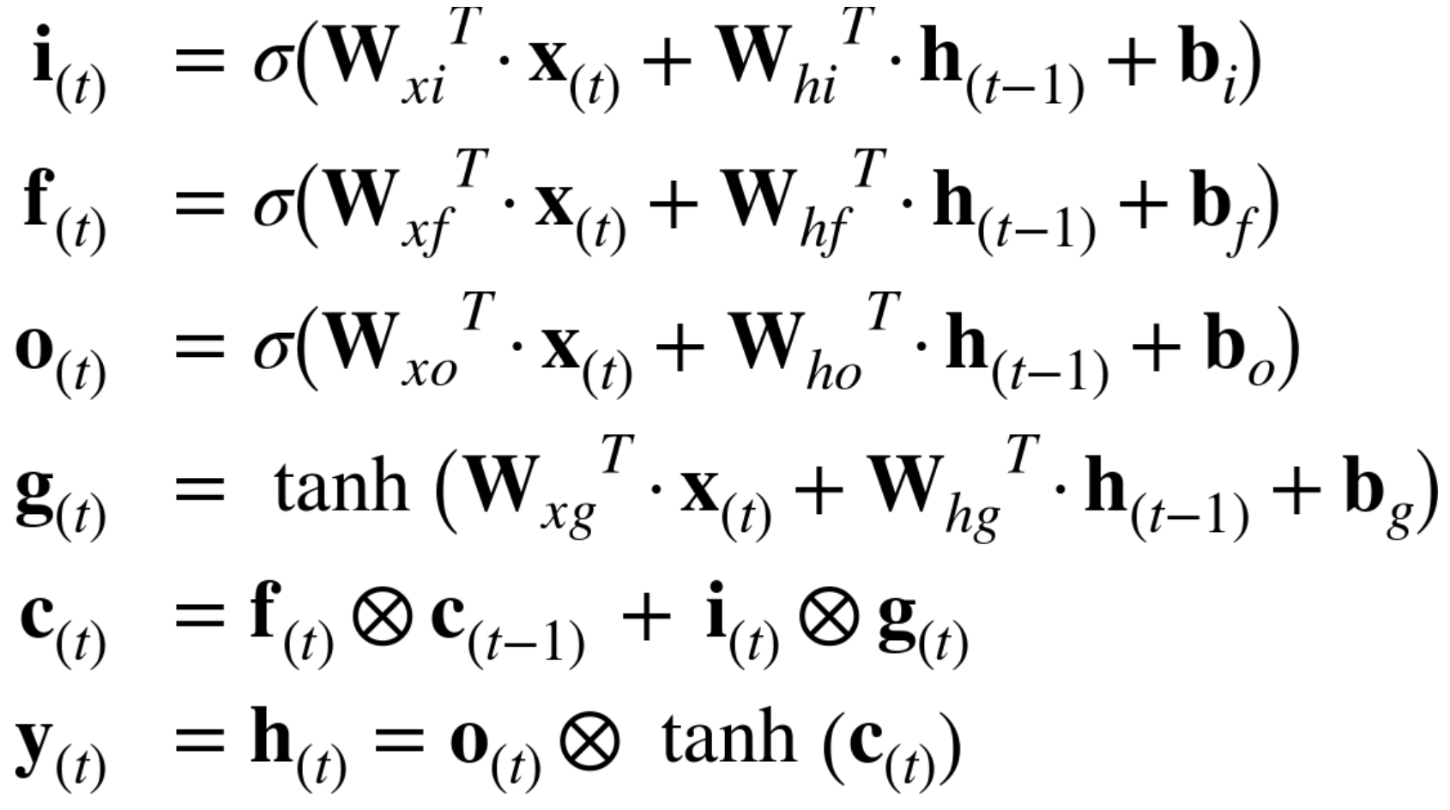
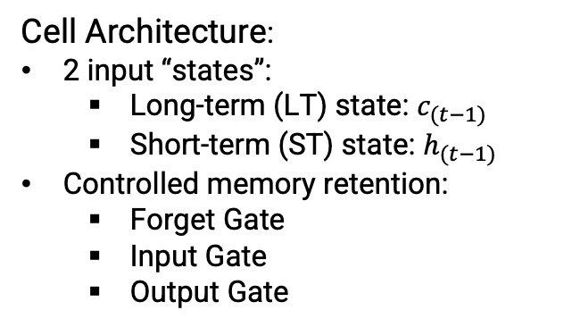
Long Short-Term Memory (LSTM) Networks
Cell Architecture:
2 input “states”:
Long-term (LT) state: $c_{(t−1)}$
Short-term (ST) state: $h_{(t−1)}$
Controlled memory retention:
Forget Gate
Input Gate
Output Gate
Figure 8: An LSTM cell
Mathematical Formulation:
Main Ideas:
The model can learn what to keep and what to forget from the input
Better at forecasting long-term time-series

Slide 8

Implementation
Figure 9: LSTM model architecture
Figure 5: RNN model architecture
Hyperparameters:
Batch Size: 64
Units: 60
Steps (look back): 110
Train set (%): 0.8
Validation set (%): 0.1
Learning rate: 0.001
Early Stopping:
Validation loss
Patience = 20
Dropout = 0.2

Slide 9
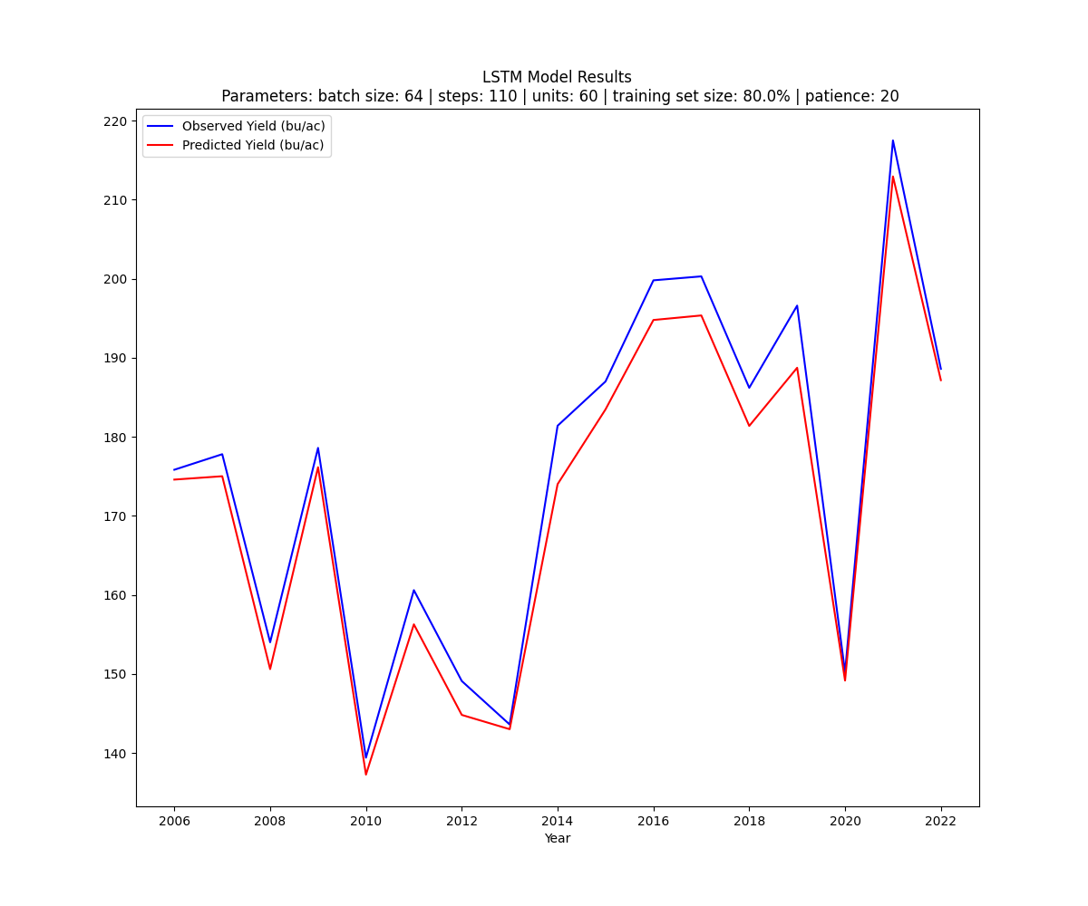
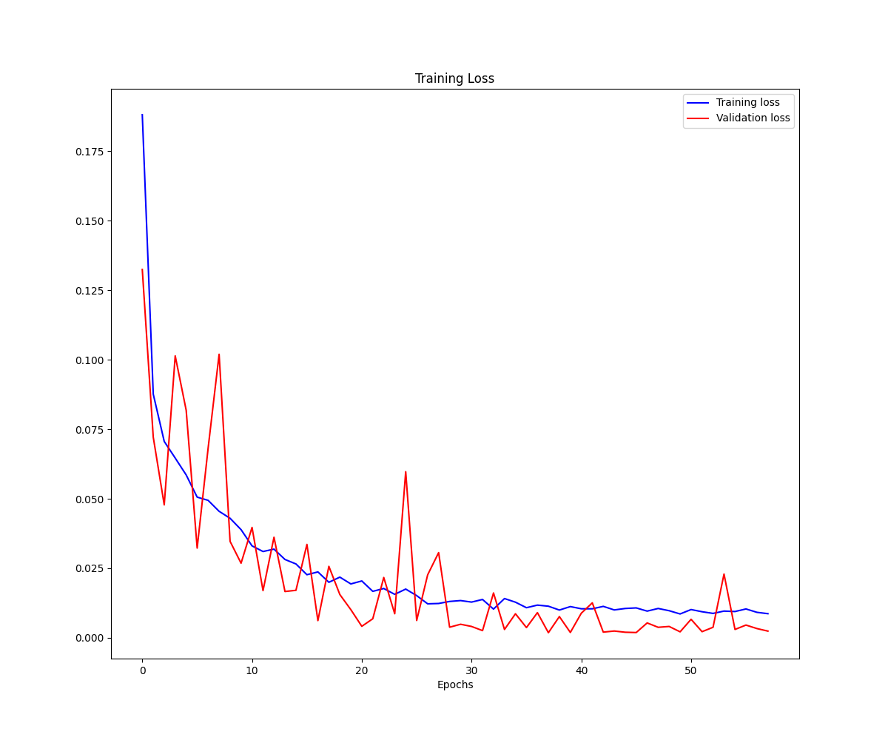
LSTM Results – Rolling Forecast
Figure 10: LSTM predictions vs observed
Figure 11: LSTM training loss
Best training MSE: ~0.0072
Best validation MSE: ~0.0012

Slide 10
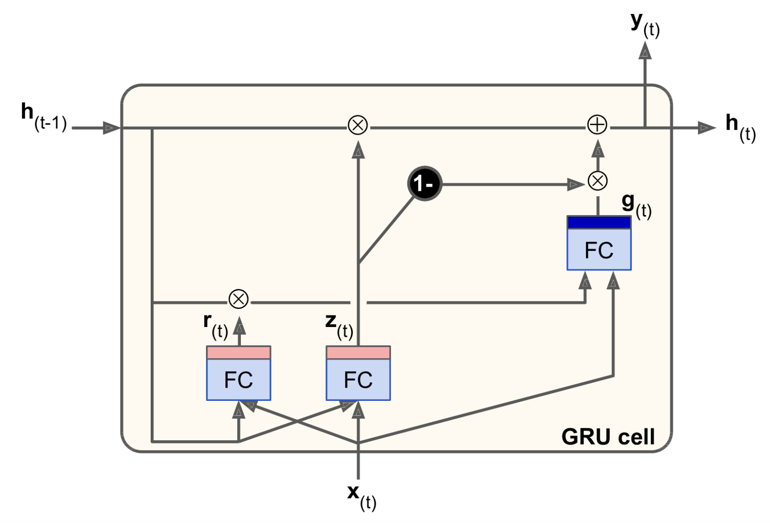
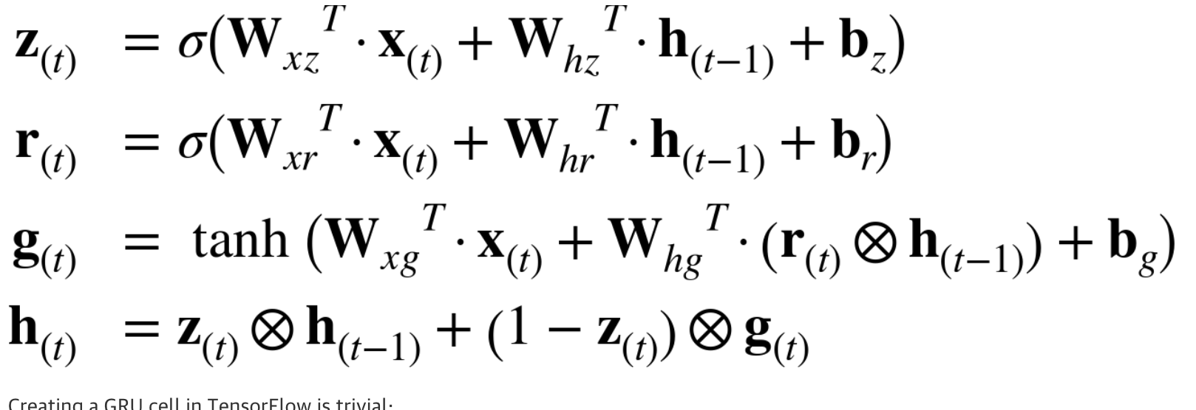
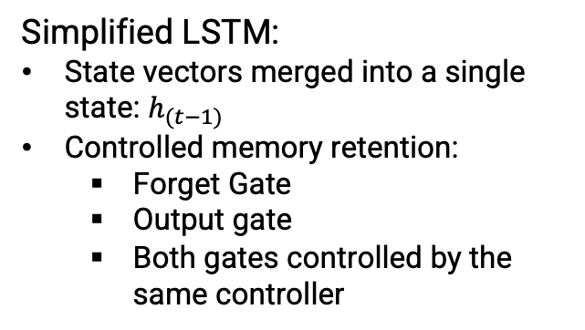
Gated Recurrent Unit (GRU) Networks
Simplified LSTM:
State vectors merged into a single state: $h_{(t−1)}$
Controlled memory retention:
Forget Gate
Output gate
Both gates controlled by the same controller
Figure 12: A GRU cell
Main Ideas:
Like the LSTM model, it should learn which data to forget and output
Better at forecasting long-term time-series
Mathematical Formulation:

Slide 11

Implementation
Figure 13: GRU model architecture
Hyperparameters:
Batch Size: 64
Units: 60
Steps (look back): 110
Train set (%): 0.8
Validation set (%): 0.1
Learning rate: 0.001
Early Stopping:
Validation loss
Patience = 20
Dropout = 0.2

Slide 12
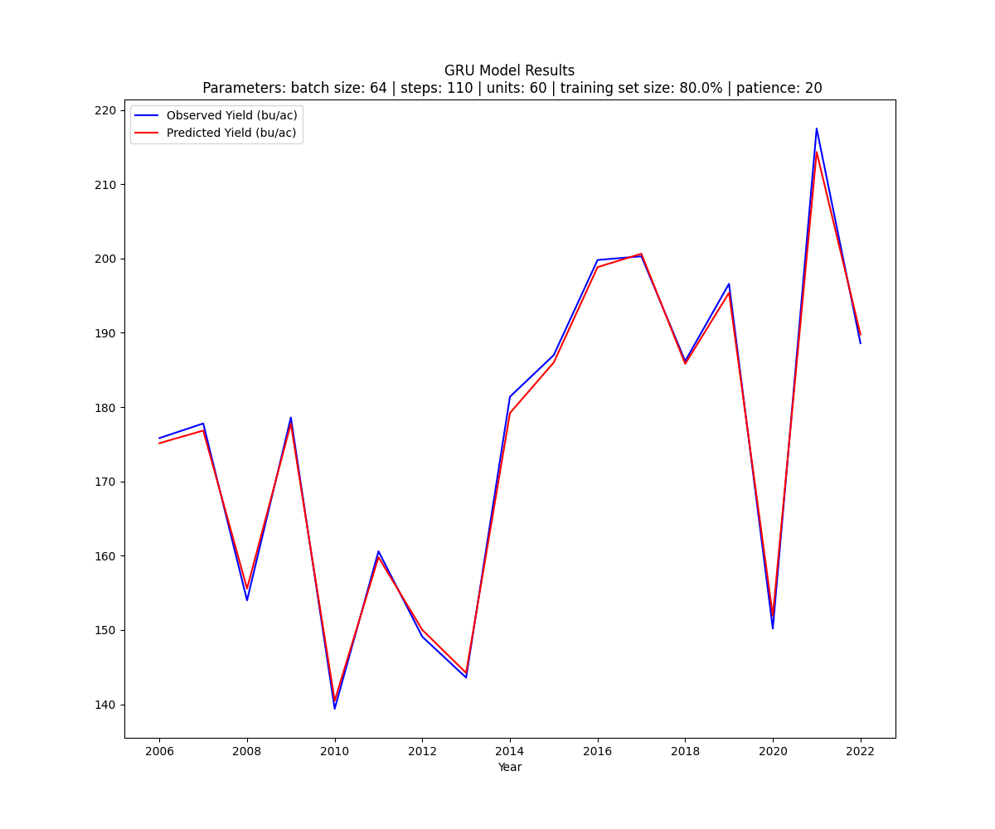
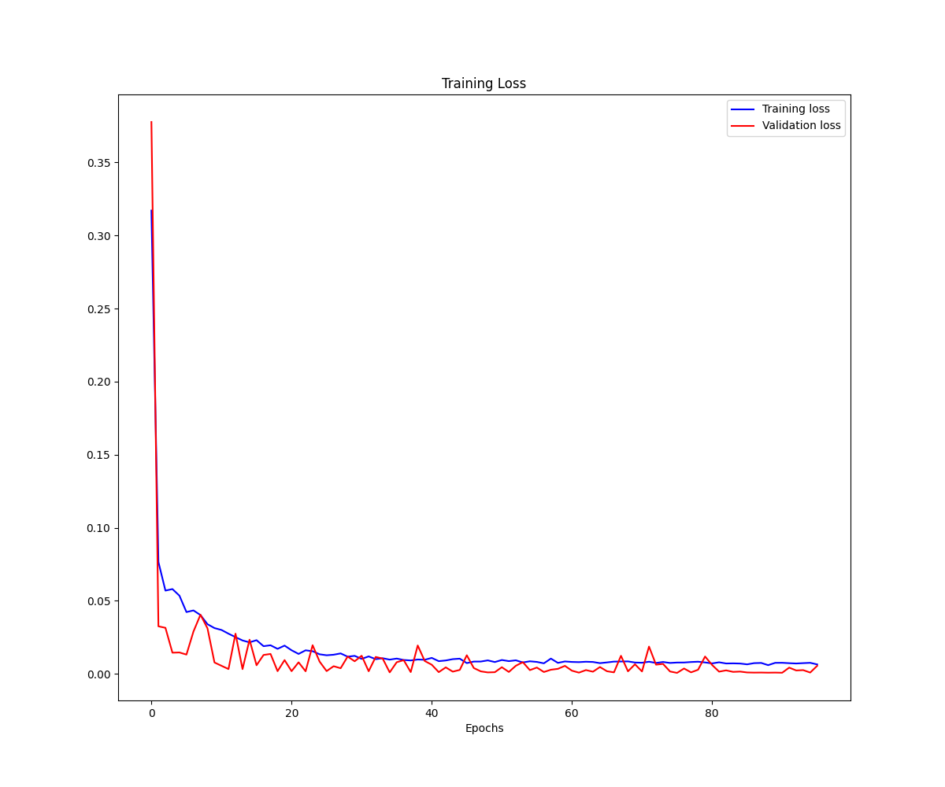
GRU Results – Rolling Forecast
Figure 14: GRU predictions vs observed
Figure 15: GRU training loss
Best training MSE: ~0.006
Best validation MSE: ~0.0006

Slide 13

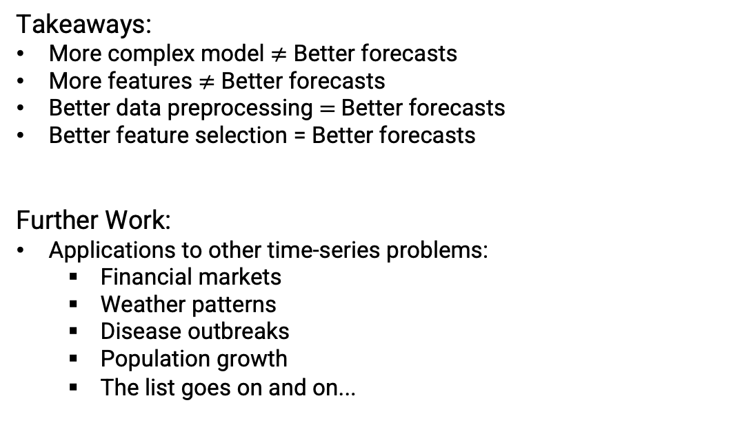
Conclusion
Takeaways:
More complex model $≠$ Better forecasts
More features $≠$ Better forecasts
Better data preprocessing $=$Better forecasts
Better feature selection = Better forecasts
Further Work:
Applications to other time-series problems:
Financial markets
Weather patterns
Disease outbreaks
Population growth
The list goes on and on...

Slide 14
Resources
Related Research:
Thomas van Klompenburg, Ayalew Kassahun, Cagatay Catal, “Crop yield prediction using machine learning: A systematic literature review,” Computers and Electronics in Agriculture, vol. 177, 2020, 105709, ISSN 0168-1699, https://doi.org/10.1016/j.compag.2020.105709.
K. Matsumura, C. F. Gaitan, K. Sugimoto, A. J. Cannon, and W. W. Hsieh, “Maize yield forecasting by linear regression and artificial neural networks in Jilin, China,” The Journal of Agricultural Science, vol. 153, no. 3, pp. 399–410, 2015. doi:10.1017/S0021859614000392, https://doi.org/10.1017/S0021859614000392.
Al-Adhaileh MH, Aldhyani THH. Artificial intelligence framework for modeling and predicting crop yield to enhance food security in Saudi Arabia. PeerJ. Computer science, 2022;8:e1104. Published 2022 Sep 30. https://doi.org/10.7717/peerj-cs.1104
RNN/LSTM/GRU Model Resources:
Géron, A. (n.d.). Chapter 15: Processing Sequences Using RNNs and CNNs. In Hands-On Machine Learning with Scikit-Learn, Keras, & TensorFlow (Third Edition, pp. 537–576). essay, O’Reilly Media.

Slide 15
Thank you
Joseph Krueger
Computer Science and Engineering

