Slide 1
Curse of knowledge
Jochen Kruppa-Scheetz

Slide 2
Want to be an expert, even though you're not?
That’s the hook to keep you hooked…

Slide 3

The older you get, the more stupid everyone becomes.

Slide 4
Expert knowledge
Knowledge
Novice knowledge
Time

Slide 5
Expert knowledge
Knowledge
Novice knowledge
Time

Slide 6
The curse of efficiency…
(as if that weren’t enough)
A large number!
20x

Slide 7

How about some solutions?
(Do you ever find that your slides turn passive-aggressive?)

Slide 8
Why don't you try doing something you're really not good at?

Slide 9
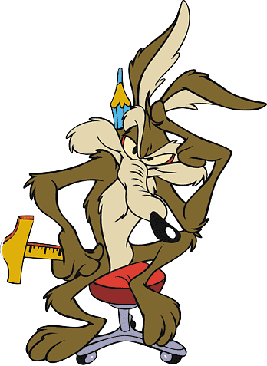
Beginners want specific examples…

Slide 10

Proverbs give structure to the day!
The mean always wears trousers!

Slide 11
Once upon a time…
Tell a story whenever you can.

Slide 12
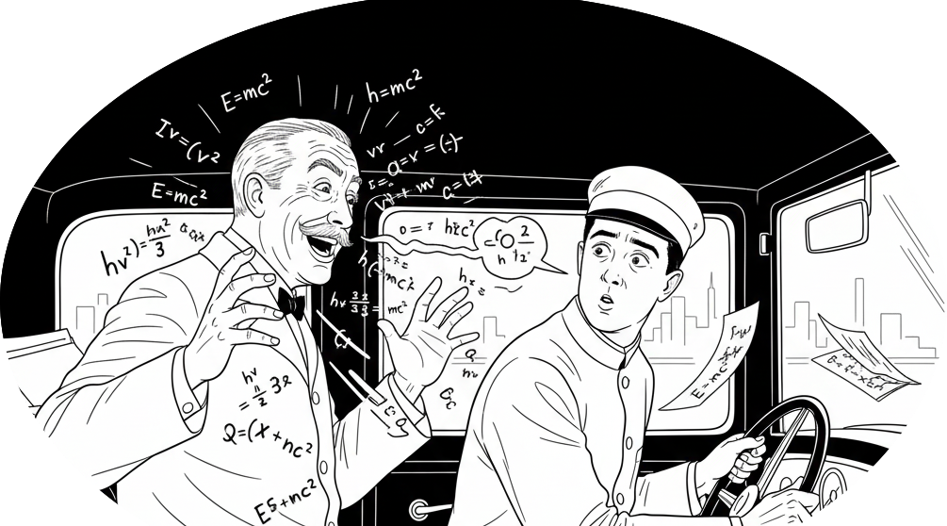

Slide 13
novice
expert
concrete
abstract

Slide 14
SCHNACK
ABSTRAKT.

