Slide 1
Chapter 5: CPU Scheduling

Slide 2
Objectives
To introduce CPU scheduling, which is the basis for multiprogrammed operating systems.
To describe various CPU-scheduling algorithms.

Slide 3

Basic Concepts
Maximum CPU utilization obtained with multiprogramming.
CPU–I/O Burst Cycle – Process execution consists of a cycle of CPU execution and I/O wait.
CPU burst followed by I/O burst.
CPU burst distribution is of main concern.

Slide 4
CPU Scheduler
Short-term scheduler selects from among the processes in ready queue and allocates the CPU to one of them.
  Queue may be ordered in various ways.
CPU scheduling decisions may take place when a process:
  Switches from running to waiting state.
  Switches from running to ready state.
  Switches from waiting to ready.
  Terminates.
Scheduling under 1 and 4 is nonpreemptive.
All other scheduling is preemptive.
  Consider access to shared data.

Slide 5
Dispatcher
Dispatcher module gives control of the CPU to the process selected by the short-term scheduler; this involves:
  switching context.
  switching to user mode.
  jumping to the proper location in the user program to restart that program.
Dispatch latency – time it takes for the dispatcher to stop one process and start another running.

Slide 6
Scheduling Criteria
CPU utilization – keep the CPU as busy as possible.
Throughput – # of processes that complete their execution per time unit.
Turnaround time – amount of time to execute a particular process.
Waiting time – amount of time a process has been waiting in the ready queue.
Response time – amount of time it takes from when a request was submitted until the first response is produced, not output (for time-sharing environment).

Slide 7
Scheduling Algorithm Optimization Criteria
Max CPU utilization.
Max throughput.
Min turnaround time.
Min waiting time.
Min response time.

Slide 8

First- Come, First-Served (FCFS) Scheduling
Process Burst Time
P₁ 24
P₂ 3
P₃ 3
Suppose that the processes arrive in the order: P₁ , P₂ , P₃
The Gantt Chart for the schedule is:
Waiting time for P₁ = 0; P₂ = 24; P₃ = 27
Average waiting time: (0 + 24 + 27)/3 = 17 msec.

Slide 9

FCFS Scheduling (Cont.)
Suppose that the processes arrive in the order:
P₂ , P₃ , P₁
The Gantt chart for the schedule is:
Waiting time for P₁ = 6; P₂ = 0; P₃ = 3
Average waiting time: (6 + 0 + 3)/3 = 3 msec.
Much better than previous case.
FCFS is nonpreemptive algorithm.
Convoy effect - short process behind long process.

Slide 10
Shortest-Job-First (SJF) Scheduling
Associate with each process the length of its next CPU burst.
  Use these lengths to schedule the process with the shortest time.
SJF is optimal – gives minimum average waiting time for a given set of processes.
  The difficulty is knowing the length of the next CPU request.

Slide 11

Example of SJF
ProcessArriva l Time Burst Time
P₁ 0.0 6
P₂ 2.0 8
P₃ 4.0 7
P₄ 5.0 3
SJF scheduling chart:
Average waiting time = (3 + 16 + 9 + 0) / 4 = 7 msec.

Slide 12


Determining Length of Next CPU Burst
Can only estimate the length – should be similar to the previous one.
  Then pick process with shortest predicted next CPU burst.
Can be done by using the length of previous CPU bursts, using exponential averaging:
Commonly, α set to ½
Preemptive version called shortest-remaining-time-first.

Slide 13

Prediction of the Length of the Next CPU Burst

Slide 14
Examples of Exponential Averaging
α = 0
  τ_{n+1} = τ_{n}
  Recent history does not count.
α =1
  τ_{n+1} = α t_{n}
  Only the actual last CPU burst counts.

Slide 15

Example of Shortest-remaining-time-first
Now we add the concepts of varying arrival times and preemption to the analysis:
ProcessA arri Arrival TimeT Burst Time
P₁ 0 8
P₂ 1 4
P₃ 2 9
P₄ 3 5
Preemptive SJF Gantt Chart:
Average waiting time = [(10-1)+(1-1)+(17-2)+(5-3)]/4 = 26/4 = 6.5 msec.

Slide 16
Priority Scheduling
A priority number (integer) is associated with each process.
The CPU is allocated to the process with the highest priority (smallest integer ≡ highest priority).
  Preemptive.
  Nonpreemptive.
SJF is priority scheduling where priority is the inverse of predicted next CPU burst time.
Problem ≡ Starvation – low priority processes may never execute.
Solution ≡ Aging – as time progresses increase the priority of the process.

Slide 17

Example of Priority Scheduling
ProcessA arri Burst Time Priority
P₁ 10 3
P₂ 1 1
P₃ 2 4
P₄ 1 5
P₅ 5 2
Priority scheduling Gantt Chart:
Average waiting time = 8.2 msec.

Slide 18
Round Robin (RR)
Each process gets a small unit of CPU time (time quantum q), usually 10-100 milliseconds. After this time has elapsed, the process is preempted and added to the end of the ready queue.
If there are n processes in the ready queue and the time quantum is q, then each process gets 1/n of the CPU time in chunks of at most q time units at once. No process waits more than (n-1)q time units.
Timer interrupts every quantum to schedule next process.
Performance:
  q large ⇒ FIFO
  q small ⇒ q must be large with respect to context switch, otherwise overhead is too high.
  q usually 10ms to 100ms, context switch < 10 usec.

Slide 19
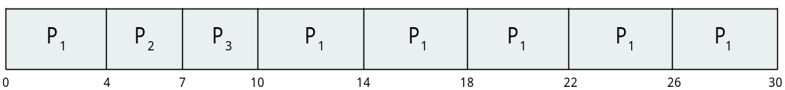
Example of RR with Time Quantum = 4
Process Burst Time
P₁ 24
P₂ 3
P₃ 3
The Gantt chart is:
RR provides a better response.

Slide 20

Time Quantum and Context Switch Time

Slide 21
Multilevel Queue
Ready queue is partitioned into separate queues, example:
  foreground (interactive).
  background (batch).
Process permanently in a given queue.
Each queue has its own scheduling algorithm:
  foreground – RR
  background – FCFS
Scheduling must be done between the queues:
  Fixed priority scheduling; (i.e., serve all from foreground then from background). Possibility of starvation.
  Time slice: each queue gets a certain amount of CPU time which it can schedule amongst its processes; i.e., 80% to foreground in RR.
  20% to background in FCFS.

Slide 22

Multilevel Queue Scheduling

Slide 23

Example of Multilevel Feedback Queue
Three queues:
  Q₀ – RR with time quantum 8 milliseconds.
  Q₁ – RR time quantum 16 milliseconds.
  Q₂ – FCFS.
Scheduling:
  A new job enters queue Q₀ which is served FCFS.
    When it gains CPU, job receives 8 milliseconds.
    If it does not finish in 8 milliseconds, job is moved to queue Q₁
  At Q₁ job is again served FCFS and receives 16 additional milliseconds.
    If it still does not complete, it is preempted and moved to queue Q₂

Slide 24
Multilevel Feedback Queue
A process can move between the various queues; aging can be implemented this way.
Multilevel-feedback-queue scheduler defined by the following parameters:
  number of queues.
  scheduling algorithms for each queue.
  method used to determine when to upgrade a process.
  method used to determine when to demote a process.
  method used to determine which queue a process will enter when that process needs service.

Slide 25
Thread Scheduling
Distinction between user-level and kernel-level threads.
When threads supported, threads scheduled, not processes.
Many-to-one, thread library schedules user-level threads to run.
  Known as process-contention scope (PCS) since scheduling competition is within the process.
Kernel thread scheduled onto available CPU is system-contention scope (SCS) – competition among all threads in system.

Slide 26
Pthread Scheduling
API allows specifying either PCS or SCS during thread creation:
  PTHREAD_SCOPE_PROCESS schedules threads using PCS scheduling.
  PTHREAD_SCOPE_SYSTEM schedules threads using SCS scheduling.
Can be limited by OS – Linux and Mac OS X only allow PTHREAD_SCOPE_SYSTEM.

Slide 27
Pthread Scheduling API
#include <pthread.h>
#include <stdio.h>
#define NUM_THREADS 5
int main(int argc, char *argv[]) {
int i, scope;
pthread_t tid[NUM THREADS];
pthread_attr_t attr;
/* get the default attributes */
pthread_attr_init(&attr);
/* first inquire on the current scope */
if (pthread_attr_getscope(&attr, &scope) != 0)
fprintf(stderr, "Unable to get scheduling scope\n");
else {
if (scope == PTHREAD_SCOPE_PROCESS)
printf("PTHREAD_SCOPE_PROCESS");
else if (scope == PTHREAD_SCOPE_SYSTEM)
printf("PTHREAD_SCOPE_SYSTEM");
else
fprintf(stderr, "Illegal scope value.\n");
}

Slide 28
Pthread Scheduling API
/* set the scheduling algorithm to PCS or SCS */
pthread_attr_setscope(&attr, PTHREAD_SCOPE_SYSTEM);
/* create the threads */
for (i = 0; i < NUM_THREADS; i++)
pthread_create(&tid[i],&attr,runner,NULL);
/* now join on each thread */
for (i = 0; i < NUM_THREADS; i++)
pthread_join(tid[i], NULL);
}
/* Each thread will begin control in this function */
void *runner(void *param)
{
/* do some work ... */
pthread_exit(0);
}

Slide 29
Multiple-Processor Scheduling
CPU scheduling more complex when multiple CPUs are available
Homogeneous processors within a multiprocessor.
Asymmetric multiprocessing – only one processor accesses the system data structures, alleviating the need for data sharing.
Symmetric multiprocessing (SMP) – each processor is self-scheduling, all processes in common ready queue, or each has its own private queue of ready processes.
  Currently, most common.
Processor affinity – process has affinity for processor on which it is currently running.
  soft affinity.
  hard affinity.
  Linux implements soft affinity, but it also provides the sched_setaffinity () system call, which supports hard affinity.

Slide 30
Multiple-Processor Scheduling – Load Balancing
If SMP, need to keep all CPUs loaded for efficiency.
Load balancing attempts to keep workload evenly distributed.
Push migration – periodic task checks load on each processor, and if found pushes task from overloaded CPU to other CPUs.
Pull migration – idle processors pulls waiting task from busy processor.
Load balancing techniques destroy the affinity concept.

Slide 31
Multicore Processors
Recent trend to place multiple processor cores on same physical chip.
  Faster and consumes less power.
Multiple threads per core also growing.
  Takes advantage of memory stall to make progress on another thread while memory retrieve happens.

Slide 32


Multithreaded Multicore System

Slide 33
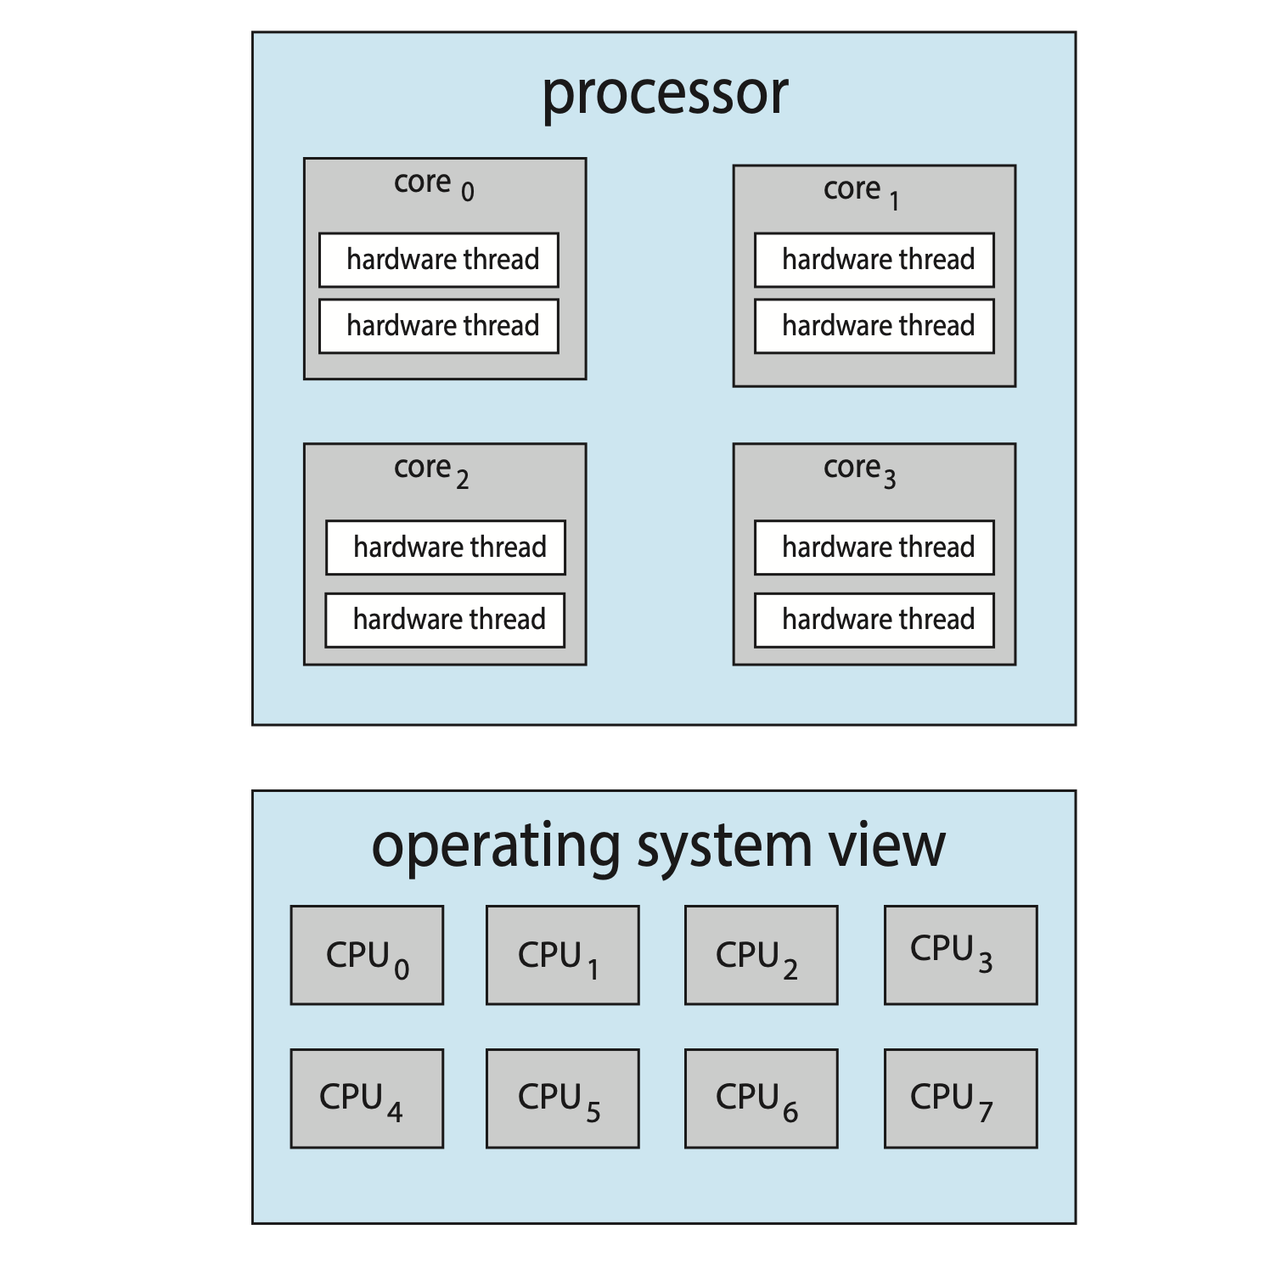
Chip Multithreading

Slide 34

Real-Time CPU Scheduling
Can present obvious challenges.
Soft real-time systems – no guarantee as to when critical real-time process will be scheduled.
Hard real-time systems – task must be serviced by its deadline.
Two types of latencies affect performance:
  Interrupt latency – time from arrival of interrupt to start of routine that services interrupt.
  Dispatch latency – time for schedule to take current process off CPU and switch to another.

Slide 35

Priority-based Scheduling
For real-time scheduling, scheduler must support preemptive, priority-based scheduling.
  But only guarantees soft real-time.
For hard real-time must also provide ability to meet deadlines.
Processes have new characteristics: periodic ones require CPU at constant intervals.
  Has processing time t, deadline d, period p
  0 ≤ t ≤ d ≤ p

Slide 36

Rate Montonic Scheduling
A priority is assigned based on the inverse of its period.
Shorter periods = higher priority;
Longer periods = lower priority.
P₁ is assigned a higher priority than P₂.

Slide 37

Missed Deadlines with Rate Monotonic Scheduling

Slide 38

Earliest Deadline First Scheduling (EDF)
Priorities are assigned according to deadlines:
the earlier the deadline, the higher the priority;
the later the deadline, the lower the priority.

Slide 39
POSIX Real-Time Scheduling
The POSIX.1b standard.
API provides functions for managing real-time threads.
Defines two scheduling classes for real-time threads:
  SCHED_FIFO - threads are scheduled using a FCFS strategy with a FIFO queue. There is no time-slicing for threads of equal priority.
  SCHED_RR - similar to SCHED_FIFO except time-slicing occurs for threads of equal priority.
Defines two functions for getting and setting scheduling policy:
  pthread_attr_getsched_policy(pthread_attr_t *attr, int *policy)
  pthread_attr_setsched_policy(pthread_attr_t *attr, int policy)

Slide 40
POSIX Real-Time Scheduling API
#include <pthread.h>
#include <stdio.h>
#define NUM_THREADS 5
int main(int argc, char *argv[])
{
int i, policy;
pthread_t_tid[NUM_THREADS];
pthread_attr_t attr;
/* get the default attributes */
pthread_attr_init(&attr);
/* get the current scheduling policy */
if (pthread_attr_getschedpolicy(&attr, &policy) != 0)
fprintf(stderr, "Unable to get policy.\n");
else {
if (policy == SCHED_OTHER) printf("SCHED_OTHER\n");
else if (policy == SCHED_RR) printf("SCHED_RR\n");
else if (policy == SCHED_FIFO) printf("SCHED_FIFO\n");
}

Slide 41
POSIX Real-Time Scheduling API (Cont.)
/* set the scheduling policy - FIFO, RR, or OTHER */
if (pthread_attr_setschedpolicy(&attr, SCHED_FIFO) != 0)
fprintf(stderr, "Unable to set policy.\n");
/* create the threads */
for (i = 0; i < NUM_THREADS; i++)
pthread_create(&tid[i],&attr,runner,NULL);
/* now join on each thread */
for (i = 0; i < NUM_THREADS; i++)
pthread_join(tid[i], NULL);
}
/* Each thread will begin control in this function */
void *runner(void *param)
{
/* do some work ... */
pthread_exit(0);
}

Slide 42
End of Chapter 5

