Slide 1
Chapter 11: Mass-Storage Systems

Slide 2
Objectives
To evaluate disk scheduling algorithms.

Slide 3

Moving-head Disk Mechanism

Slide 4
Disk Scheduling
The operating system is responsible for using hardware efficiently — for the disk drives, this means having a fast access time and disk bandwidth.
Minimize seek time.
Seek time ≈ seek distance.
Disk bandwidth is the total number of bytes transferred, divided by the total time between the first request for service and the completion of the last transfer.

Slide 5
Disk Scheduling (Cont.)
There are many sources of disk I/O request.
  OS.
  System processes.
  Users' processes.
I/O request includes input or output mode, disk address, memory address, number of sectors to transfer.
OS maintains queue of requests, per disk or device.

Slide 6
Disk Scheduling (Cont.)
Note that drive controllers have small buffers and can manage a queue of I/O requests (of varying “depth”).
Several algorithms exist to schedule the servicing of disk I/O requests.
We illustrate scheduling algorithms with a request queue (0-199).
98, 183, 37, 122, 14, 124, 65, 67
Head pointer 53

Slide 7

FCFS
Illustration shows total head movement of 640 cylinders.

Slide 8

SSTF
Shortest Seek Time First selects the request with the minimum seek time from the current head position.
SSTF scheduling is a form of SJF scheduling; may cause starvation of some requests.
Illustration shows total head movement of 236 cylinders.

Slide 9
SCAN
The disk arm starts at one end of the disk, and moves toward the other end, servicing requests until it gets to the other end of the disk, where the head movement is reversed, and servicing continues.
SCAN algorithm Sometimes called the elevator algorithm.
Total number of cylinders?

Slide 10

SCAN (Cont.)

Slide 11
C-SCAN
Provides a more uniform wait time than SCAN.
The head moves from one end of the disk to the other, servicing requests as it goes.
  When it reaches the other end, however, it immediately returns to the beginning of the disk, without servicing any requests on the return trip.
Treats the cylinders as a circular list that wraps around from the last cylinder to the first one.
Total number of cylinders?

Slide 12

C-SCAN (Cont.)

Slide 13
C-LOOK
C-LOOK a version of C-SCAN.
Arm only goes as far as the last request in each direction, then reverses direction immediately, without first going all the way to the end of the disk.
Total number of cylinders?

Slide 14

C-LOOK (Cont.)

Slide 15
Selecting a Disk-Scheduling Algorithm
SSTF is common and has a natural appeal.
SCAN and C-SCAN perform better for systems that place a heavy load on the disk.
  Less starvation.
Performance depends on the number and types of requests.
Requests for disk service can be influenced by the file-allocation method
  And metadata layout.
The disk-scheduling algorithm should be written as a separate module of. the operating system, allowing it to be replaced with a different algorithm if necessary
Either SSTF or LOOK is a reasonable choice for the default algorithm
What about rotational latency?
  Difficult for OS to calculate
How does disk-based queueing effect OS queue ordering efforts?

Slide 16
Selecting a Disk-Scheduling Algorithm
SSTF is common and has a natural appeal.
SCAN and C-SCAN perform better for systems that place a heavy load on the disk.
  Less starvation.
Performance depends on the number and types of requests.

Slide 17
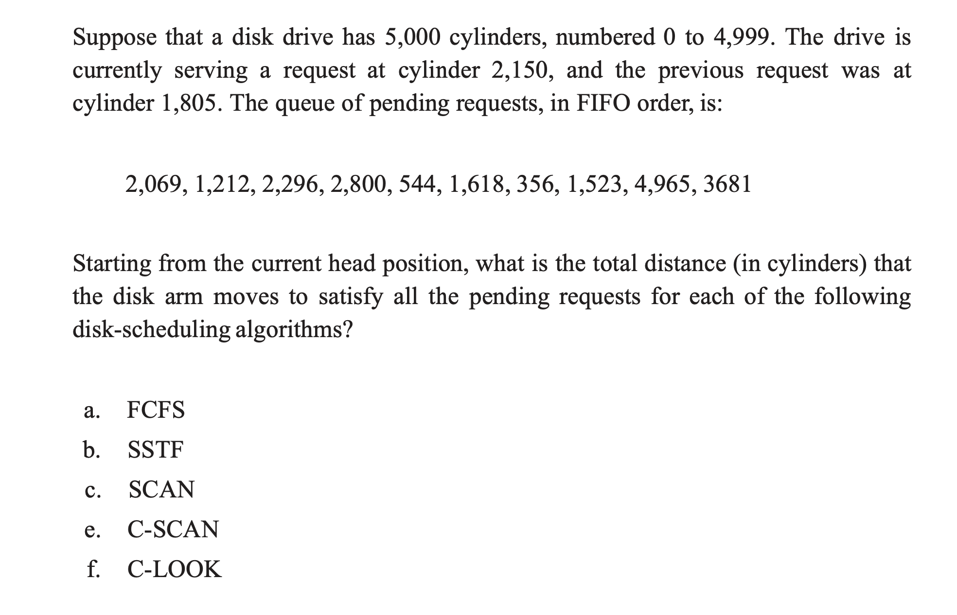
Check Point

Slide 18
End of Chapter 11

