Slide 1

BEACON
Behavioral Explainable AI for Cyber Operations Network
A final-year project on malware detection that explains its own reasoning — across network and memory evidence.
Presented to the Fellow Project Group · Iqra University
Notes:
Welcome slide. Say: BEACON is our malware detector that doesn't just say 'malicious' -- it tells you why, using both network traffic and computer memory as evidence.

Slide 2


THE PROBLEM
Current malware tools fall short in two ways
No explanation
Single-source blindness
A typical tool says “malicious, 94% confidence” and stops there. An analyst still has to manually dig through the file to check if that's even right — which takes time you don't have during a real incident.
Most tools check only ONE kind of evidence — just network traffic, or just what's happening in memory. A real infection leaves footprints in both places, so checking only one means missing things.
BEACON is built to fix both problems together — not as an afterthought, but as the whole point of the design.
02 / 15
Notes:
Two real weaknesses in existing tools: they don't explain themselves, and most only look at one type of evidence. Both of these are the actual reasons this project exists.

Slide 3



WHAT IS BEACON
A security guard that shows its reasoning
Upload a sample's behavior — network traffic or a memory snapshot — and BEACON does three things:
1
2
3
Classify
Explain
Rate the risk
Which of 9 malware families is this — or is it benign?
Which specific behaviors made it decide that, in plain terms.
Critical, High, Medium, or Low — so an analyst knows what to check first.
Not a binary “malicious / not” call — a specific, explained, risk-rated verdict.
03 / 15
Notes:
Think of it as three steps every time: figure out WHAT it is (one of 9 families), explain WHY it thinks that, and say HOW urgent it is.

Slide 4


PROJECT SCOPE
What this project does — and deliberately doesn't
In scope
Deliberately out of scope
9-class malware classification (8 families + benign)
Two independent evidence streams: network flow & memory dump
A SHAP-based explanation attached to every verdict
A working, testable Streamlit dashboard
Honest, measured evaluation — including negative results
Real-time / live traffic capture (works on exported CSVs)
Fusing both streams into one combined verdict — tested, found worse, deliberately dropped
Cloud-scale deployment or multi-user accounts
Persisted prediction history across sessions
Novel malware detection — this is applied ML + XAI engineering, not new theory
04 / 15
Notes:
Being clear about what we did NOT try to do is as important as what we did -- it shows the scope was a decision, not a gap we didn't notice.

Slide 5


WHAT SUPERVISORS EXPECT
This project is a vehicle for specific skills
What's being graded
Skills we're building
Can you clean and use a genuinely messy, real dataset?
Are design choices backed by evidence, not guesses?
Do you understand your OWN system's limits?
Is there working software — not just slides?
Imbalanced, real-world data handling
Explainable AI (XAI) — the point, not a bonus feature
Honest evaluation — spotting a number that lies
Recognizing a real ceiling vs. giving up early
05 / 15
Notes:
This slide answers 'what do they actually want from us' -- it's not really about malware, it's about whether we can be trusted with messy data and honest reporting.

Slide 6
THE DATASET
BCCC-Mal-NetMem-2025
From York University's Behaviour-Centric Cybersecurity Center — recommended to us by our supervisor.
9
2
2,235
5,731
CATEGORIES
EVIDENCE TYPES
NETWORK CAPTURES
MEMORY SAMPLES
8 malware families + benign
network flow + memory dump
348 raw features per flow
98 raw features per dump
THE NINE CATEGORIES
Benign
Backdoor
Exploit
HackTool
Hoax
Rootkit
Trojan
Virus
Worm
Every raw file needed cleaning: duplicate rows, a labeling inconsistency, and severe class imbalance in one category.
06 / 15
Notes:
Point out this is a REAL dataset, not a toy one -- and that it came recommended by our supervisor specifically, from a legitimate academic research center at York University.

Slide 7





HOW IT WORKS
From raw file to explained verdict
1
2
3
4
5
Upload
Clean & prepare
Classify
Explain
Display
A CSV of network flow or memory-dump features
Fix duplicates, missing values, scale features
A trained model (XGBoost) picks one of 9 categories
SHAP identifies which features drove the decision
Verdict, confidence, risk, and reasoning on screen
The critical rule: the exact same cleaning code runs at training time AND when you upload a file later — so the dashboard can never silently drift from how the model was actually trained.
07 / 15
Notes:
Walk left to right. Emphasize the bottom box -- it's a real engineering lesson: training and prediction must use identical code, or you get silent bugs.

Slide 8



DESIGN DECISION
Two independent classifiers — tested, not assumed
Network stream
Memory stream
Classifies traffic behavior — packet timing, byte rates, connection patterns.
Classifies what's happening inside a running computer's memory.
Why not combine them into one verdict?
We built it and measured it. Fusing both streams scored 78.5% — worse than the network stream alone at 99.1%. So we kept them separate — on evidence, not assumption.
08 / 15
Notes:
This is a great example of the project's honesty theme: our first-draft report assumed fusion was impossible. We actually built it, tested it, and it made things WORSE. So we kept the streams separate for a measured reason, not a guess.

Slide 9
EXPLAINABILITY (XAI)
Every verdict comes with its reasons
We use SHAP — a method that scores how much each feature pushed the decision toward, or away from, the final verdict.
PUSHES AWAY
PUSHES TOWARD VERDICT
packets_IAT_mode
median_fwd_packets_delta_time
dst_port
handshake_duration
total_header_bytes
packets_count
In plain terms: “This was flagged as Backdoor mainly because of unusual packet timing patterns and destination port — not because of a black-box guess.”
09 / 15
Notes:
This chart is a simplified version of what the real dashboard shows. Blue bars push TOWARD the answer, red bars push AWAY -- an analyst can see the actual reasoning, not just a percentage.

Slide 10

RESULTS — NETWORK STREAM
Two honest numbers, not one flattering one
99.1%
68.2%
PER CAPTURE
PER FLOW
n = 447 · combining ~hundreds of flows into one verdict per sample
n = 129,118 · judging a single flow in isolation — the harder task
Why report both? A capture is hundreds of flows from ONE sample. Averaging them is how the system is actually used, and errors cancel out — but quoting only the 99.1% without saying so would overstate what the model does.
10 / 15
Notes:
Don't just say 99%! Explain WHY there are two numbers. This is one of the most important honesty points in the whole project -- a single number here would be misleading.

Slide 11

RESULTS — MEMORY STREAM
Lower, and reported exactly as measured
59.2%
Some families separate cleanly — others genuinely don't
Backdoor · Hoax · HackTool
separate cleanly
ACCURACY · 9-CLASS
n = 1,836 held-out samples
Benign · Rootkit · Trojan · Virus · Worm
mutually confused
These families simply don't leave distinguishable footprints in process/handle/DLL counts alone.
This isn't a bug we missed — it's investigated in depth on the next slide.
11 / 15
Notes:
Memory stream is lower. Don't be defensive about it -- say plainly it's lower, then bridge to the next slide where we PROVE we investigated why, rather than just accepting it.

Slide 12

WHY THE LIMITATIONS ARE THERE ON PURPOSE
We investigated the 59% — five different ways
Every one of these was actually tried and measured. None recovered meaningful accuracy — which is itself the finding.
More training data
Flat — extra rows barely moved the score
Wider hyperparameter search
60 trials did not beat the original 20
8 different ML models tested
All landed within noise of each other
2-stage architecture (benign vs. family)
No recovery — confusion isn't a staging problem
Feature engineering / task reframing
No material gain
The conclusion: the ceiling is in the DATA, not the model. A defensible, evidenced finding — not a failure to tune harder.
12 / 15
Notes:
This is the single most important slide for showing supervisors real engineering maturity: we didn't just stop at 59%, we PROVED there was nothing left to gain with five separate experiments.

Slide 13
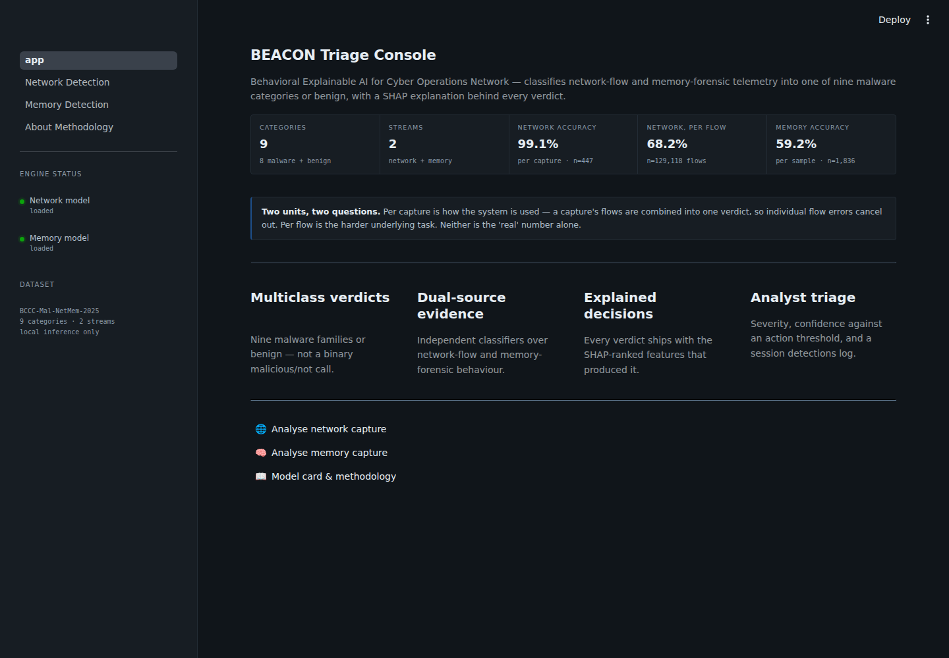
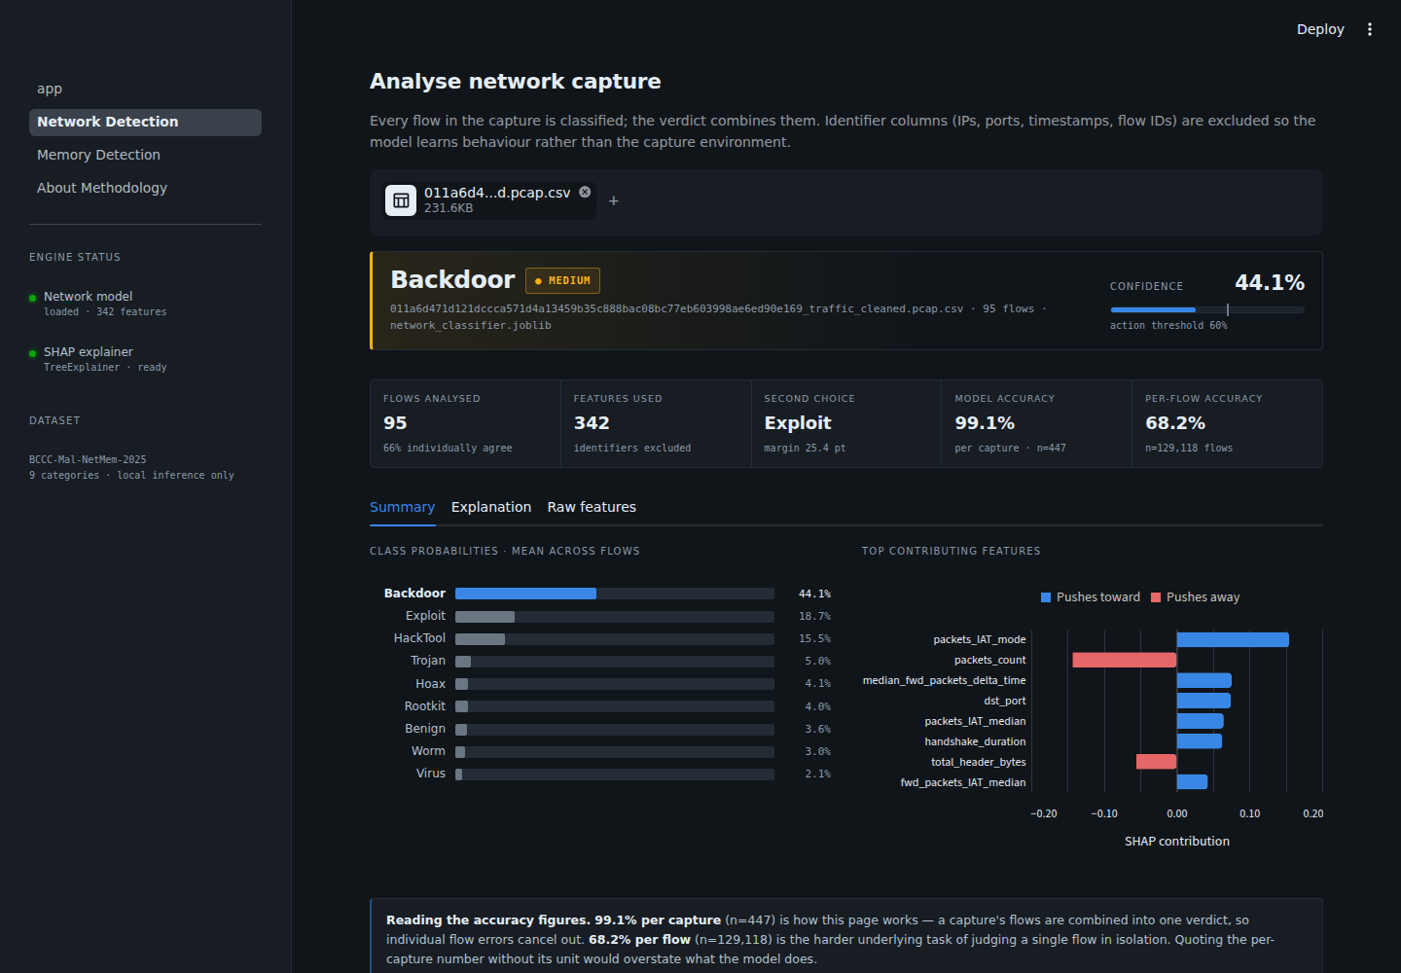
THE DASHBOARD
A working product, not a notebook
Live triage console — status of both models
Upload → verdict → SHAP explanation, in one view
13 / 15
Notes:
These are REAL screenshots of our actual running app, not mockups. Point out the risk chip, the confidence meter, and the SHAP bars on the right screenshot.

Slide 14

STATUS CHECK
What's solid — and what's still ahead
Done, and verified
Still ahead
Both models trained on the real dataset
88 automated tests — run with zero raw data present
Same code trains and predicts — no silent drift
Dashboard tested end-to-end, both streams
Every reported number traced to a real metrics file
Public deployment (Streamlit Community Cloud)
Final report chapter revisions from these findings
Persisted prediction history (currently session-only)
Possible future work: richer memory features
14 / 15
Notes:
Be honest here too -- there's real stuff left. That's normal and expected at this stage.

Slide 15
Accurate isn't enough. Explainable is the point.
99.1%
68.2%
59.2%
network · per capture
network · per flow
memory · per sample
Two explained, independently-evaluated streams. Honest numbers, including the ones that aren't flattering. A working dashboard behind every claim.
Thank you — questions welcome.
15 / 15
Notes:
Close by repeating the theme: the interesting part of this project isn't that the numbers are high, it's that every number is true and explained. Open for questions.

