Slide 1
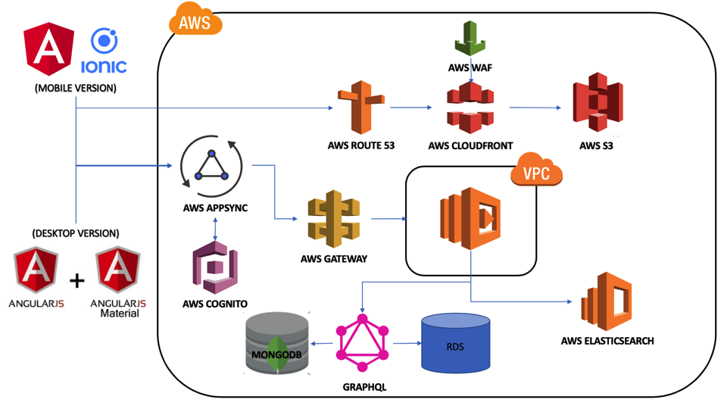

Slide 2
Architecture
Website is hosted on AWS S3 with cloudfront
Serverless API backend using AWS Lambda
Authentication and Authorization via AWS Cognito and AWS Gateway
GraphQL to handle RDS and NOSQL databases

Slide 3
 | Sunday | Monday | Tuesday | Wednesday | Thursday | Friday | Saturday
MARCH 31 – APRIL 6
APRIL 7 – APRIL 13
 |  |  |  | MEETING
 |  | MEETING
Setup development machines [all]
Setup aws architecture [jay][arif]
Buy udemy courses [jay]
Learn angular + ionic [all]
Build login + cognito [all]
Learn angular + ionic [all]
Learn angular + graphql + mongodb [all]
Build Inbound call page
Integrate inbound call page + graphql + mongodb [all]

Slide 4
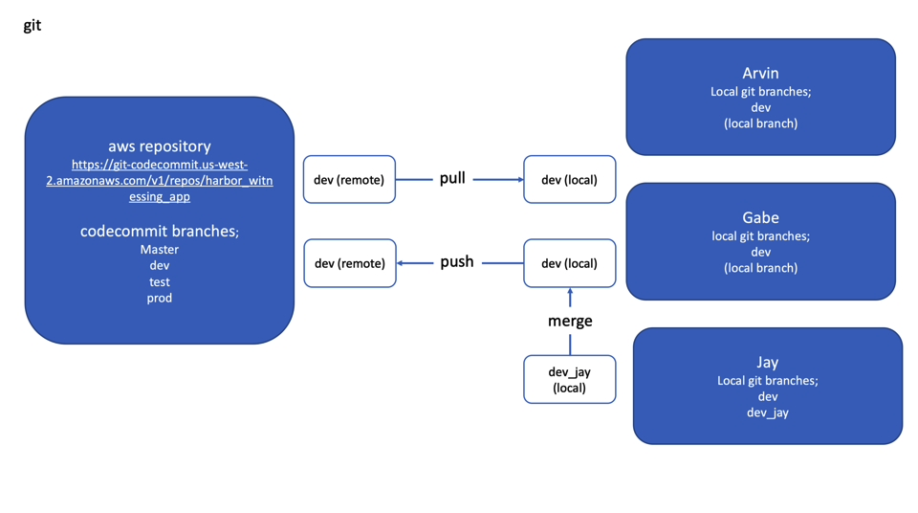

Slide 5
Aws router
https://d1eogw63z1cfv8.cloudfront.net

Slide 6
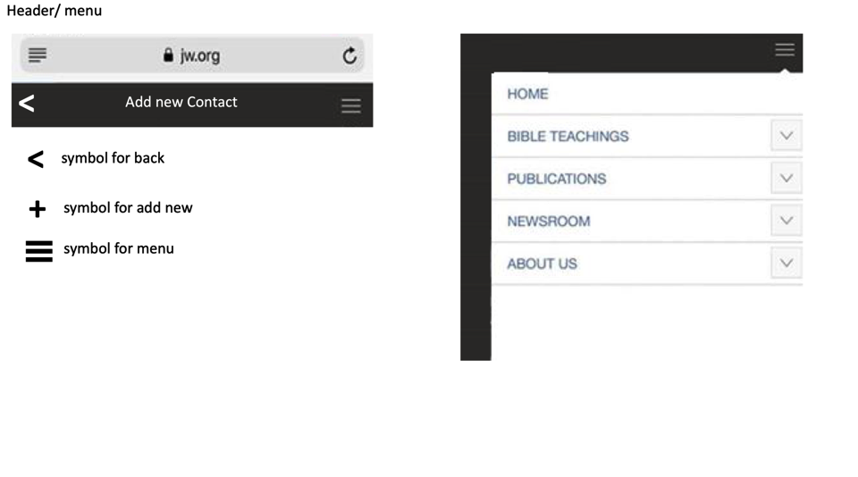

Slide 7

https://aws-amplify.github.io/docs/js/authentication#common-authentication-use-cases
https://aws-amplify.github.io/docs/js/angular#components
Authenticate
WATCH UDEMY: cognito course
email
Enter code
password
Login
click

Slide 8

Sales Agents
Details
Details
+
<
<
Click+
Name, email
name:
Email:
Company:
Phone:
name:
A
Email
click
Company
Phone
Team Leader
Name:
Email
Save Details
B
Referral
Name:
Email:
C
Team Members
Name:
Email:

Slide 9
Details
Details
Details
<
<
<
name:
Email:
Company:
Phone:
name:
name:
Email:
Company:
Phone:
Email
Save Details
Team Leader
Delete Details
Team Leader
Name:
Email
Click+
Name:
Email
Referral
Referral
Name:
Email:
Click+
Name:
Email:
Team Members
Save Details
Name:
Email:

