Slide 1
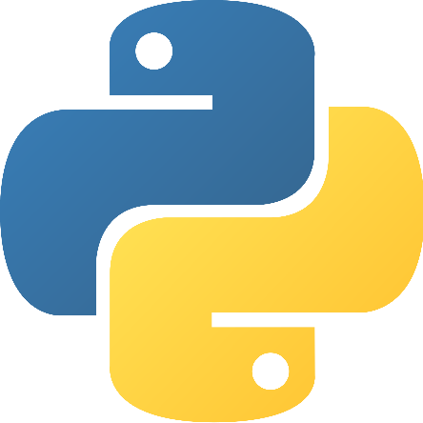

Automation with python programming
Kyle Stephens
GISC 3200K - Python Programming
Fall 2017

Slide 2
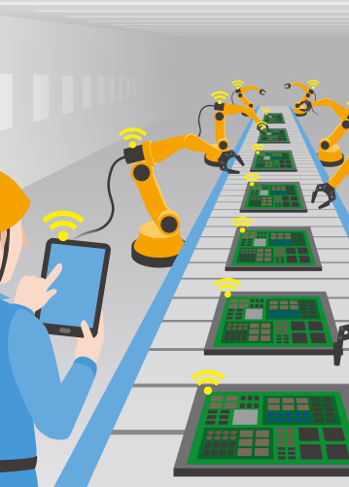
What is automation?
“The use of largely automatic equipment in a system of manufacturing or other production process.”

Slide 3
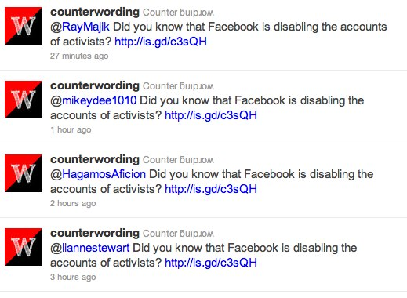
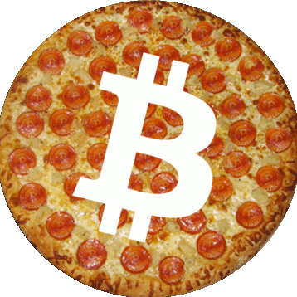
Automation is common
Currently 330 Million Twitter Accounts
Out of these, an estimated 48 million users are bots (14.5%)
500 million tweets per day
Uses may be for advertisements, political uses, or even malicious use.

Slide 4
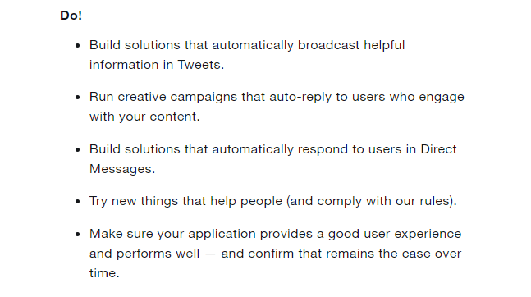
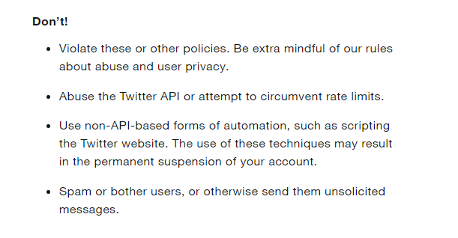


Slide 5
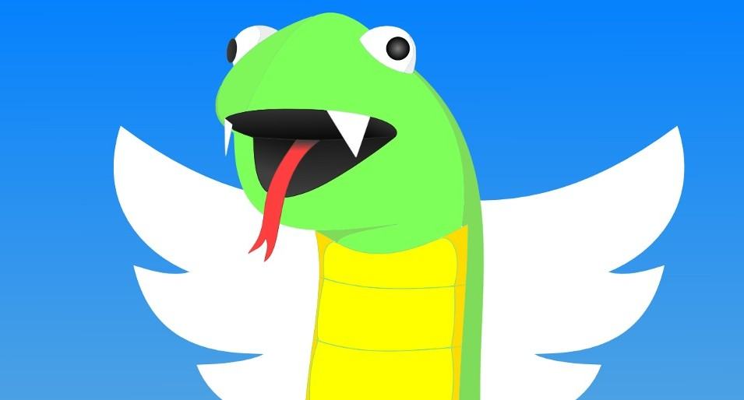
Integrating python into twitter
Python can be configured to work with Twitter using a number of tools available to the public
Python based clients such as Tweepy available
Automated tweets, follows, retweets, etc.

Slide 6
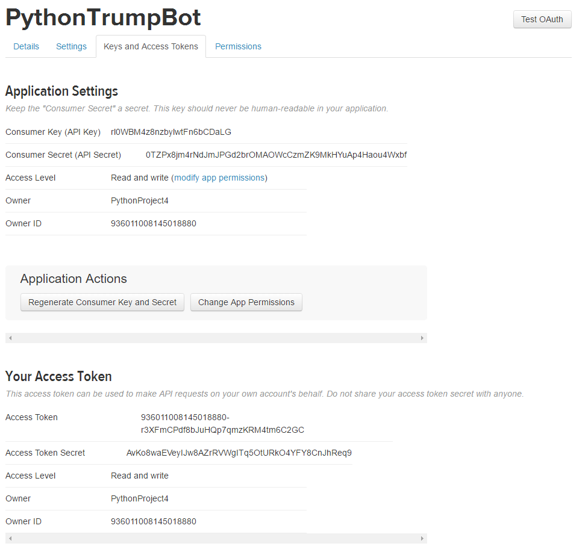
Integrating python into twitter
Integration of python programming requires access to our account
Because of this, we need four things-
Consumer Key (API Key)
Consumer Secret (API Secret)
Access Token
Access Token Secret

Slide 7
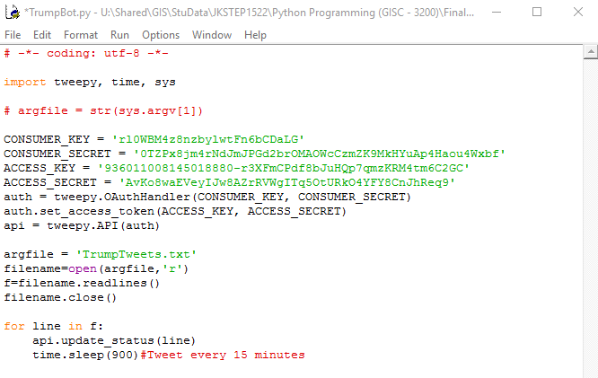
What should our code should look like?

Slide 8
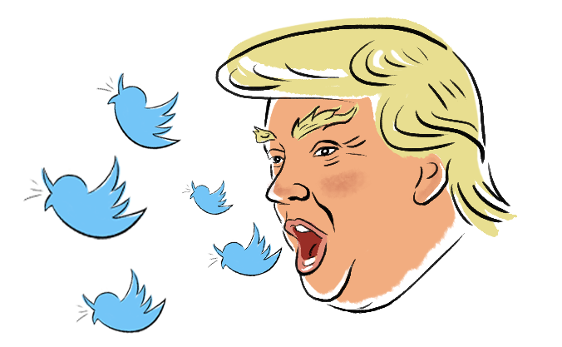
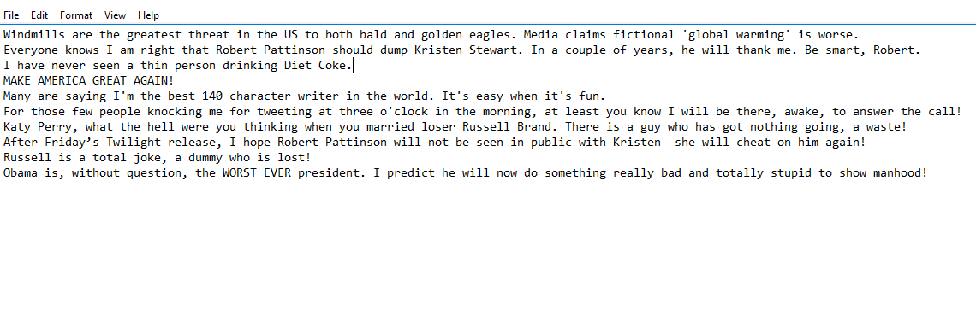
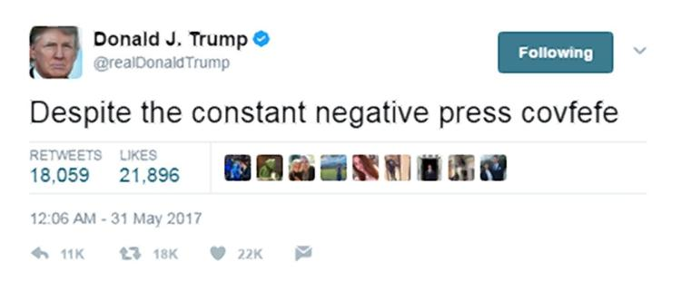
Where does our tweets come from?

Slide 10
Sources Used
https://www.omnicoreagency.com/twitter-statistics/
https://www.digitalocean.com/community/tutorials/how-to-create-a-twitterbot-with-python-3-and-the-tweepy-library
https://python-twitter.readthedocs.io/en/latest/
http://www.tweepy.org/

