Slide 1
Security Goals
Data Privacy(confidentiality) : Can the message be concealed?
Integrity: Can the recipient be confident that the message has not been accidentally modified?
Authentication: Can the recipient be confident that the message originated from the sender?
Non-repudiation: If the recipient passes the message and the proof to a third party, can the third party be confident that the message originated from the sender?

Slide 2
Cryptographic Methods
One Way Coding
Two Way Coding

Slide 3
One-Way Coding
Generates unique code from “Original Message”.
Code generation is repeatable from Original Message
Does not allow to generate-back original message from the Code.
Algorithms:
HASH or Message Digest or Checksum.
MAC(Message Authentication Code) /HMAC
Digital Signature
Flow for HASH/Message Digest
A-> generates “One-Way-Code” using HASH algorithm(SHA-256/ SHA-512)
A -> sends “Original Message” + “One-Way-Code”
B -> generates “One-Way-Code” using the same HASH algorithm
B -> compares the “One-Way-Code” before using “Original Message”

Slide 4
One-Way Coding(continued)
Flow for MAC(Message Authentication Code) /HMAC:
A-> generates HMAC “One-Way-Code” using HmacSHA256/HmacSHA512 shared-secret-key
A -> sends “Original Message” + “One-Way-Code”
B -> generates “One-Way-Code” using the same shared-secret-key
and HMAC algorithm
B -> compares the “One-Way-Code” before using “Original Message”

Slide 5
One-Way Coding(continued)
Flow for Digital Signature
Public-Private asymmetric key pair are generated beforehand.
A-> generates the digital signature “for message or file etc.” with a private-key.
B-> receives “original message”+ digital signature
B-> verifies the digital signature with the corresponding public key before using the original message.
Note :
Digital signature represents one-way-code
Only the holder of the private key can create the signature, and normally anyone knowing the public key can verify the signature.
Most signature schemes are implemented with the help of a hash/MessageDigest function to "compress" the large data sets into a more manageable form, then sign the MessageDigest with private key.
E.g. SHA256withECDSA/SHA256withRSA/SHA1withDSA
Usually slower than MACs

Slide 6
One Way Coding (Crypto Matrix)
Security Goals | Hash(MessageDigest) | MAC(Message Authentication code : HMAC) | Digital Signature Algorithm (DSA/ECDSA)
Integrity | YES | YES | YES
Authentication | NO | YES | YES
Non-repudiation | NO | NO | YES
Key Used | NONE | SYMMETRIC(single key) | ASYMMETRIC(public/private key pair)

Slide 7
Two-Way Coding
Data Privacy(confidentiality)
Allows to encrypt and decrypt back the original message.
Cryptographic Algorithm classes:
Symmetric-Key cryptography
Asymmetric/Public-Key cryptography
Hybrid Cryptography
Uses both symmetric and asymmetric cryptography

Slide 8
Two-Way Coding
Symmetric-Key cryptography
Uses Shared Secret key for both encryption and decryption
E.g. AES
block cipher
that means that it always operates on units or "blocks" that are some fixed number of bytes in size
AES block is 16 bytes, or 128 bits
In CBC mode, the initialisation vector must be randomised; never use a counter or trivially changing value directly as the IV.
For CBC mode IV vector is the size of block i.e 16 bytes or 128 bits.
The IV does not need to be kept secret. It can be transmitted in the clear between the two parties, or can be based on information (such as message number) which isn't a secret to an attacker.
Notes:
Symmetric algorithms are faster than asymmetric algorithms.
May leak the information about the structure of plaintext, if block size and text pattern size are same.
So must need to select Block Mode properly.

Slide 9
Two-Way Coding
Asymmetric/Public-Key cryptography
Refer PKCS "Public Key Cryptography Standards
Uses Public/Private key pair.
Uses Public key for Encryption
Uses Private Key for Decryption
Too slow in comparison to Symmetric Algorithm
Cannot encrypt data larger than Key Size MINUS padding size.
Application :
Encryption/Decryption(Mainly for Keys or small data)
RSA
ECIES(Elliptic Curve Integrated Encryption Scheme)
Digital Signature
DSA(Digital Signature Alogorithm), ECDSA(Elliptic Curve DSA), RSA
Key Agreement
DiffieHellman, ECDH(Elliptic Curve Diffie-Hellman)

Slide 10
Two-Way Coding
Hybrid Cryptography
Combines Key Encapsulation Mechanism (KEM) with a Data Encapsulation Mechanism (DEM).
Uses Public-Key crypto for Key Agreement(Key Exchange) i.e. KEM
Uses Symmetric crypto for data or payload exchange i.e. DEM
E.g.
TLS protocol (TLS_ECDHE_ECDSA_WITH_AES_128_GCM_SHA256)
TLS is the protocol being used.
ECDHE is the key exchange algorithm (Elliptic curve DiffieHellman Ephemeral)
ECDSA is the authentication algorithm (Elliptic Curve Digital Signature Algorithm).
AES_128_GCM is the data encryption algorithm (Advanced Encryption Standard 128 bit with Galois/Counter block Mode).
SHA256 is the Message Authentication Code (MAC) algorithm (Secure Hash Algorithm 256 bit).

Slide 11
Hybrid Cryptography(Key Agreement)
Key Agreement(Key Exchange) Goal:
Both party generates the common secrete key
A -> generates Public and Private Key pair
A-> shares Public Key to B.
B -> generates Public and Private Key pair
B-> shares Public Key to A
A -> generates common secret key using: Private-Key(A) + Public-Key(B)
B -> generates common secret key using: Private-Key(B) + Public-Key(A)
A -> uses this common secret for symmetric encryption/decryption of message payload
B -> uses this common secret for symmetric encryption/decryption of message payload
Algorithms
DiffieHellman, ECDH(Elliptic Curve Diffie-Hellman)
Vulnerabilities
man-in-the-middle attacks
Hacker can generate its own common secret.

Slide 12
Hybrid Crypto Algorithms
Key Agreement(Key Exchange) Vulnerabilities
Vulnerabilities
man-in-the-middle attacks
Crypto analyst(HACKER) can generate its own common secret.
Solution Using asymmetric-cryptography:
Client(A) -> keeps already trusted-public-key
Server(B)-> keeps corresponding trusted-private-key
Exchange the DiffieHellman Key using already trusted public private key.
Scheme A
Client can send encrypted DH(Public key) and encrypted ephemeral HMAC-SECRET-KEY to server.
Server can decrypt the DH-public key and HMAC key, sends server-DH-public and HMAC(server-DH-public, HMAC-SECRET-KEY )
Scheme B
Even digital signatures can be used (ECDH(elliptic curve DH)/ECDSA(elliptic curve Digital Signature Algo))

Slide 13
Selecting Asymmetric Cryptography
RSA
ECIES(Elliptic Curve Integrated Encryption Scheme)
Elliptic Curve Cryptography(ECC)

Slide 14
Selecting Asymmetric Cryptography
RSA
ECIES(Elliptic Curve Integrated Encryption Scheme)
Elliptic Curve Cryptography(ECC)

Slide 15
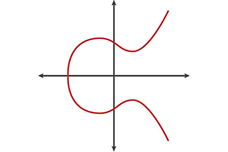
ECC(Elliptic Curve Cryptography)
ECC stands for Elliptic Curve Cryptography, and is an approach to public key cryptography based on elliptic curves over finite fields.
Refer for mathematics behind:
http://andrea.corbellini.name/2015/05/17/elliptic-curve-cryptography-a-gentle-introduction/

Slide 16
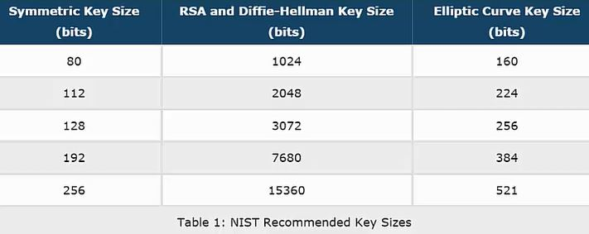
ECC(Elliptic Curve Cryptography) vs RSA - Key size comparison
ECC is able to provide the same cryptographic strength as an RSA-based system with much smaller key sizes. For example, a 256 bit ECC key is equivalent to RSA 3072 bit keys (which are 50% longer than the 2048 bit keys commonly used today). The latest, most secure symmetric algorithms used by TLS (eg. AES) use at least 128 bit keys, so it makes sense that the asymmetric keys provide at least this level of security.

Slide 17
ECC(Elliptic Curve Cryptography) vs RSA
We can use RSA for both signatures and encryption, but we need different algorithms for that. E.g. RSAES-OAEP is an encryption algorithm, while RSASS-PSS is a signature algorithm. Both use the RSA cryptosystem and have similar keys, but otherwise the algorithms differ.
Elliptic curves are the most practical and widely used option. The same curve can be used for encryption (e.g. ECIES) and signatures (e.g. ECDSA).
Note that using the same key-pair for both encryption and signatures is not necessarily secure, even if the algorithms allow it. So in practice we should use completely different algorithms for signatures and encryption.

Slide 18
ECC(Elliptic Curve Cryptography)
Why would I want to use ECC?
The small key sizes make ECC very appealing for devices with limited storage or processing power, which are becoming increasingly common in the IoT. In terms of more traditional web server use cases, the smaller key sizes can offer speedier SSL handshakes (which can translate to faster page load times) and stronger security.
Example
WhatsAPP end-to-end encryption
Bitcoin
iOS device uses for its internal.
Google Pay(Tez)

Slide 19
ECC(Elliptic Curve Cryptography)-ECIES
ECC encrypt is not a primitive operation. Instead we can use ECDH (Elliptic Curve Diffie Helman) to generate a shared secret, and use this as a secret key. This is called ECIES (Elliptic Curve Integrated Encryption Scheme).
ECIES a hybrid cryptography proposed by Victor Shoup in 2001.
Refer :
https://www.cryptopp.com/wiki/Elliptic_curve_integrated_encryption_scheme
https://www.cryptopp.com/wiki/Elliptic_curve_integrated_encryption_scheme

Slide 20
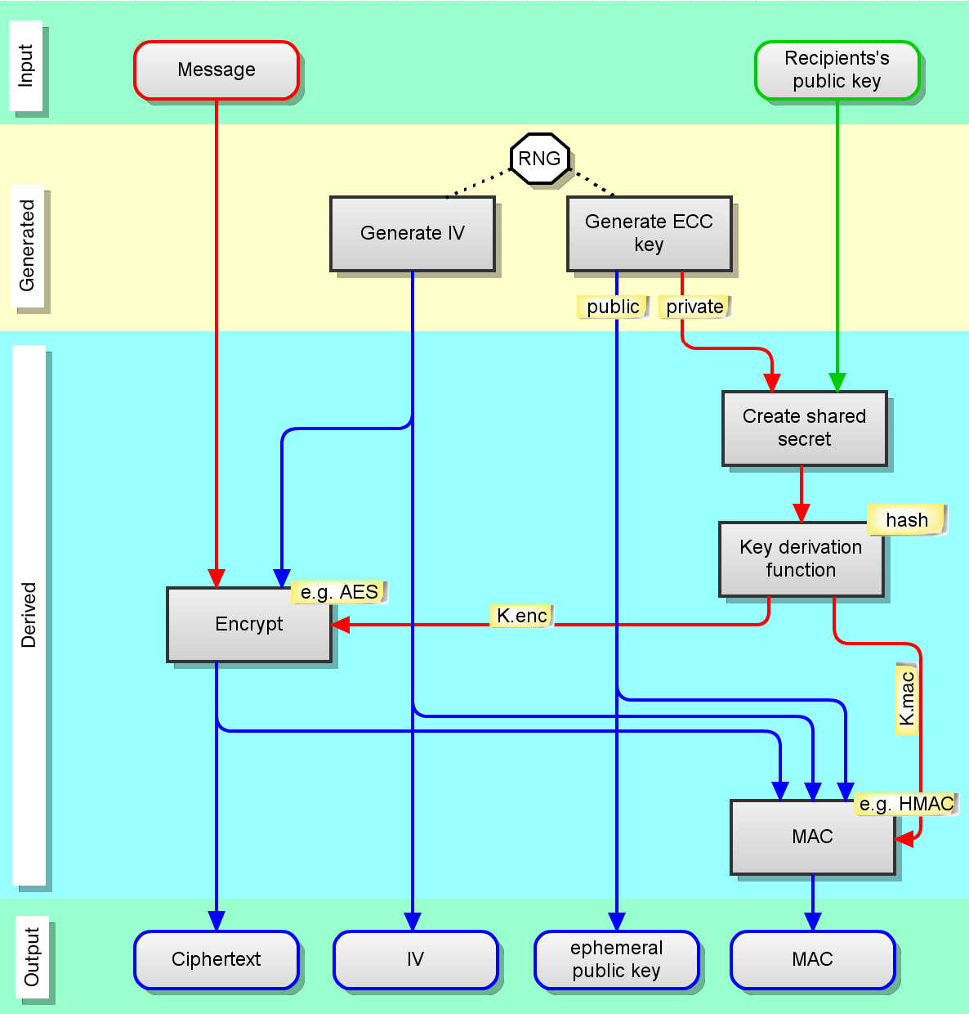
ECC(Elliptic Curve Cryptography)-ECIES

Slide 21
ECC-ECIES
ECIES Steps:
inputs are the plaintext message, and the recipient’s ECC public key
an IV (initialisation vector) is generated (random bytes)
an ephemeral ECC key is generated (random bytes). The public key is derived from the private key
the ephemeral private key is combined with the recipient’s public key – this is the ECDH shared secret
the shared secret is stretched using a KDF (key derivation function) to create 2 secret keys
one secret key is used to encrypt the plaintext
the other secret key is used to generate a MAC
the output is ciphertext + the IV + the ephemeral public key + the MAC

Slide 22
ECC-ECIES
Sender & Recipient need to agree on
specific curve (e.g. Curve25519 )
input padding
Key Derivation Function
hash function (+ size)
encryption function (+ size)
MAC function (+ size)
encoding of transmitted data

Slide 23
ECC-ECIES
Notes:
With RSA, generating a keypair is slow – we need to search for & test big pseudoprimes. However with ECC it’s quick & simple, just random bytes (with minor constraints). This is why it’s possible to generate an ephemeral key for each encryption.
the Key Derivation Function isn’t as complicated as password-based KDFs are; e.g. ANSI-X9.63-KDF
Unfortunately the details are not well standardized. For example, Crypto++ and Bouncy Castle don’t interoperate by default because they use a different word-size for a length when calculating the MAC.

Slide 24
JCA(Java Cryptography Architecture) for RSA
Refer
https://www.veracode.com/blog/research/encryption-and-decryption-java-cryptography
Cipher specification:
Cipher uses the “transformation string”
Transformation :
3 parameters to be specified (algorithm, mode of operation(block mode) and padding scheme)
Algorithm
Mode of operation(Block Mode)
Padding Scheme

Slide 25
RSA Specifications (Continued)
Algorithm
RSA
Mode of operation(Block Mode)
Mode of operation, as part of transformation, is only relevant to block ciphers. While using asymmetric ciphers, use ECB as the mode of operation, which essentially is a hack behind-the-scenes, meaning ignore this value.
Padding Scheme for Asymmetric algo(RSA)
Optimal Asymmetric Encryption Padding
refer: https://en.wikipedia.org/wiki/Optimal_asymmetric_encryption_padding
Make sure to only use OAEPWith<digest>And<mgf>Padding schemes.
For Digest
SHA256/384/512
For Mask Generation Function(MGF), use MGF1
PKCS1Padding with RSA has been susceptible to Chosen Ciphertext attacks since 1998.
Git : https://github.com/1MansiS/java_crypto

Slide 26
Key Size Calculation
The RSA algorithm can only encrypt data that has a maximum byte length of the RSA key length in bits divided with eight minus padding bytes, i.e.
number of maximum bytes = (key length in bits / 8) – (padding length)
2048/8 = (256 bytes – Padding length)
HMAC-SHA256 = 32 bytes
https://crypto.stackexchange.com/questions/34864/key-size-for-hmac-sha256

Slide 27
JCA(Java Cryptography Architecture) providers
https://www.flexiprovider.de/
Bouncy Castle
Default JDK
Links:
https://docs.oracle.com/javase/7/docs/technotes/guides/security/crypto/CryptoSpec.html
https://www.veracode.com/blog/research/how-get-started-using-java-cryptography-securely

Slide 28
SAMPLE DEMO

