Slide 1
task
project
ACTION
accomplishment
What you do
resources
intention
fulfillment
Core value
satisfaction
What you are
desire
Personal roles

Slide 2
Desires, events, cast off,
Resources filter
action
fulfillment

Slide 3
Desire
Desire
Time
Scheduler
prioritizer
Interest
Core Value/ Value output analyzer
Money
Budget, accounting
Energy
Action plan
Collaboration

Slide 4
urgent
Not urgent
important
Not important

Slide 5
Thoughts
Idea
notepad
Concern
Event
Incident

Slide 6
Quotes
token
Soul badge
Inspiration
Achievement review

Slide 7
Incubation
Inception
Commencement
Artifacts
Project

Slide 8
What you do
What you are

Slide 9
Other features:
Recurring task
Labels
Archive
Reminders –with recurring too
Reminder priority
Search
Group tasker – check box
Color category
Icon
Add multimedia
Templating
Defining details og goals to tasks

Slide 10
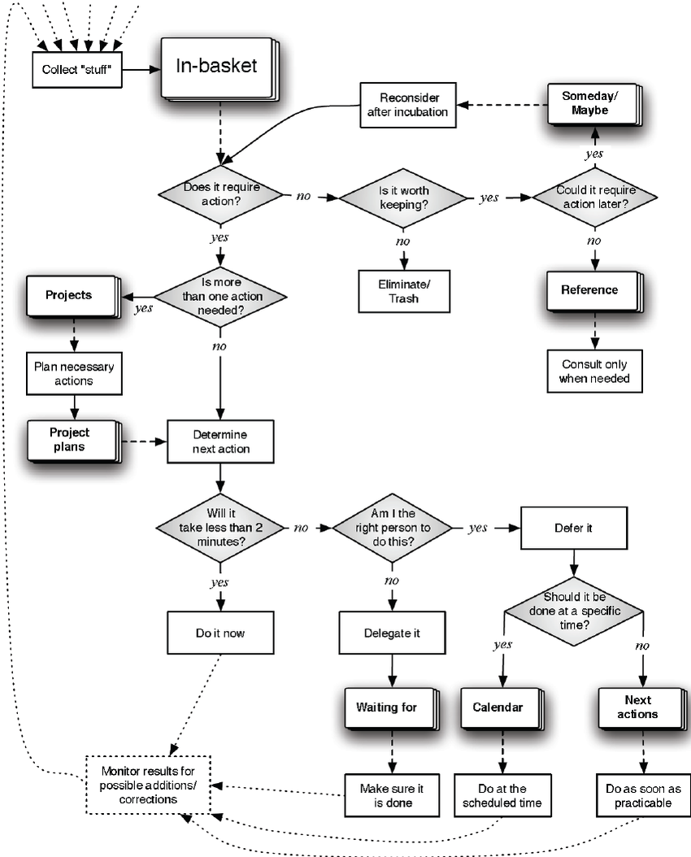

Slide 11
Generation
Incubation
Inception
Culmination
Delegation
Archival

