Slide 1

VISUALIZATION FOR AI · PROJECT PRESENTATION
Reading the U.S. Economy
Interest rates, unemployment, inflation and sentiment — four questions in 26 years of FRED data
Team Bounty Hunters
Notes:
Hi, I'm Saqib, presenting our visualization project for team Bounty Hunters. We looked at how the U.S. economy moves — interest rates, unemployment, inflation and consumer sentiment — to answer four questions about how these forces connect.

Slide 2

The Data: FRED Macroeconomic Bundle
8
2000–2026
3
economic indicators
monthly observations
major crises covered
What it is
The eight series
Eight U.S. economic time series from the Federal Reserve Bank of St. Louis (FRED) — the standard public source for macroeconomic data — sampled monthly from 2000 to 2026.
Fed Funds Rate
10-Yr Treasury
2-Yr Treasury
Inflation (CPI)
Why we chose it
Unemployment
S&P 500
A quarter-century spanning the dot-com bust, 2008, and COVID — real, dramatic events to test our hypotheses against, not quiet noise.
30-Yr Mortgage
Consumer Sentiment
Notes:
Our data is the FRED Macroeconomic Bundle, from the Federal Reserve Bank of St. Louis — the standard public source for U.S. economic data. Eight monthly series from 2000 to 2026: the Fed Funds Rate, two Treasury yields, inflation, unemployment, the S&P 500, the 30-year mortgage rate, and consumer sentiment. We chose it because it covers a quarter-century with three major crises — the dot-com bust, 2008, and COVID — giving us real events to test against.

Slide 3



Four Questions
Two descriptive, two we dug into deeper
A.1
A.2
How do interest rates and unemployment relate over time?
Does an inverted yield curve precede recessions?
B.1
B.2
How does a Fed rate change spread through the economy?
Does sentiment react more sharply to bad news than good?
Notes:
We asked four questions. Two descriptive: how interest rates and unemployment relate over time, and whether an inverted yield curve precedes recessions. And two deeper: how a Fed rate change spreads through the economy, and whether consumer sentiment reacts more sharply to bad news than to good. Let me take them in turn.

Slide 4
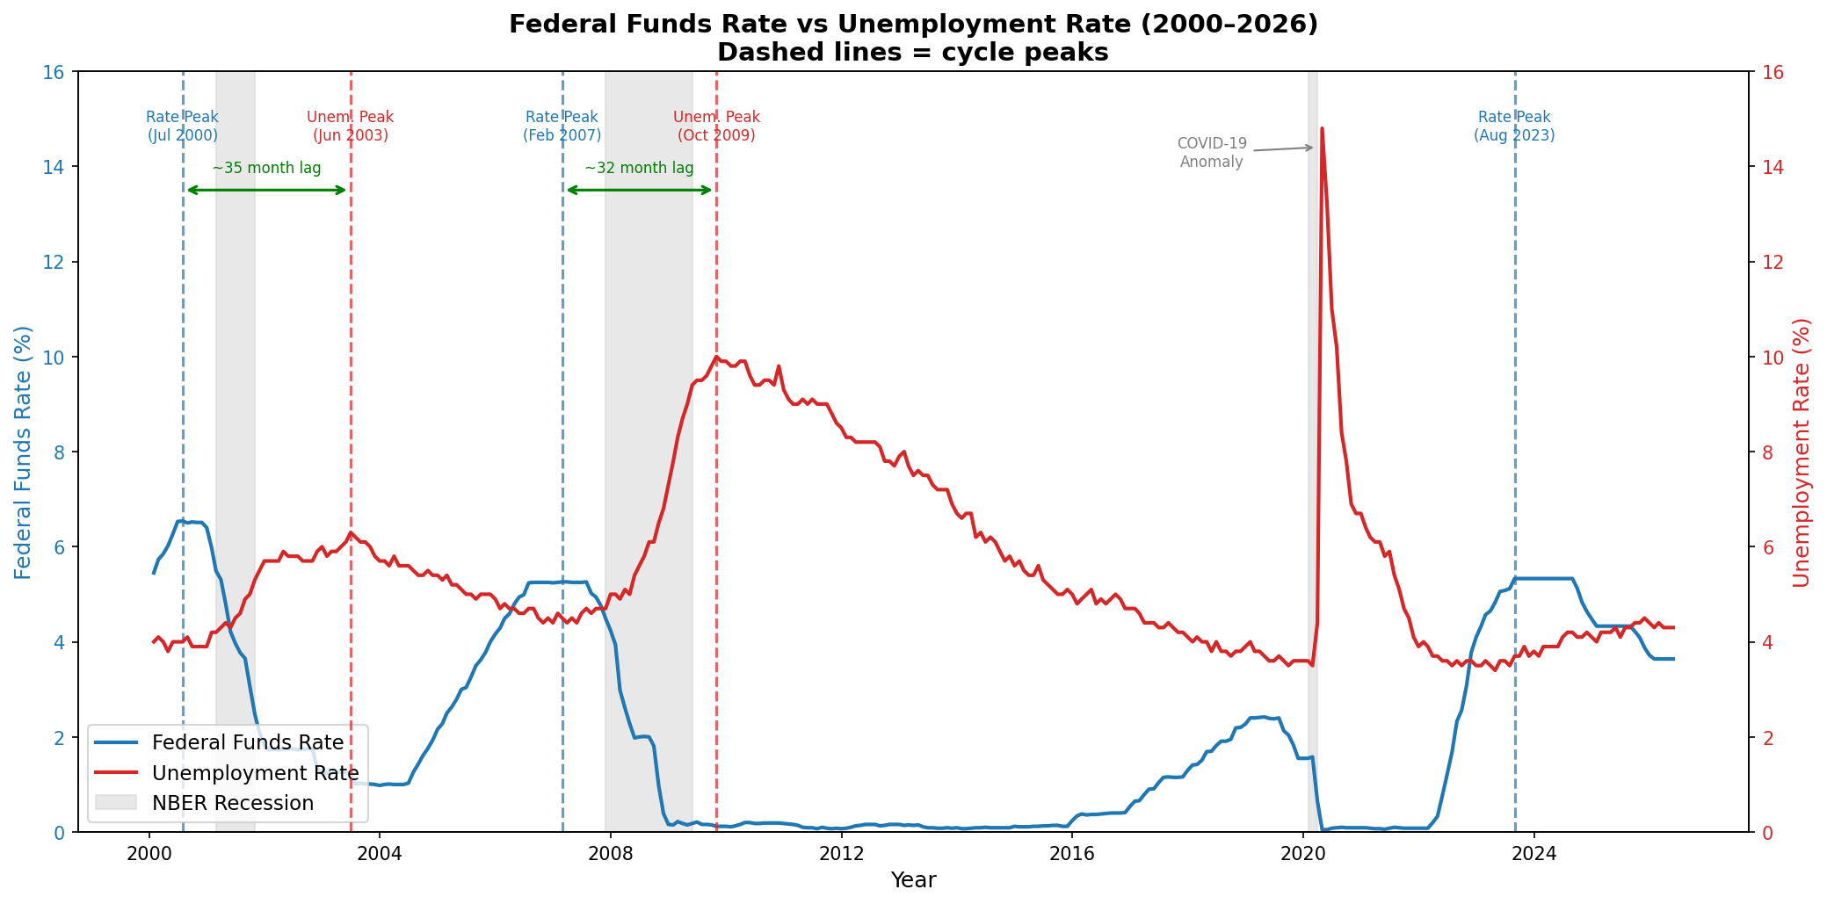
Rate Peaks Lead Unemployment Peaks by ~3 Years
Hypothesis How are the Fed Funds Rate and unemployment related over time?
FINDING
~32–35 months
Each time the Fed Funds Rate peaks, unemployment peaks about 32–35 months later — the two move inversely across the cycle, with rates leading.
Notes:
First, the Fed Funds Rate against unemployment, with recessions shaded. The two move inversely across the cycle — but the striking pattern is the timing: each time the Fed Funds Rate peaks, unemployment peaks about three years later. So the cost of a tightening cycle, rising unemployment, tends to show up years afterward, around recessions.

Slide 5
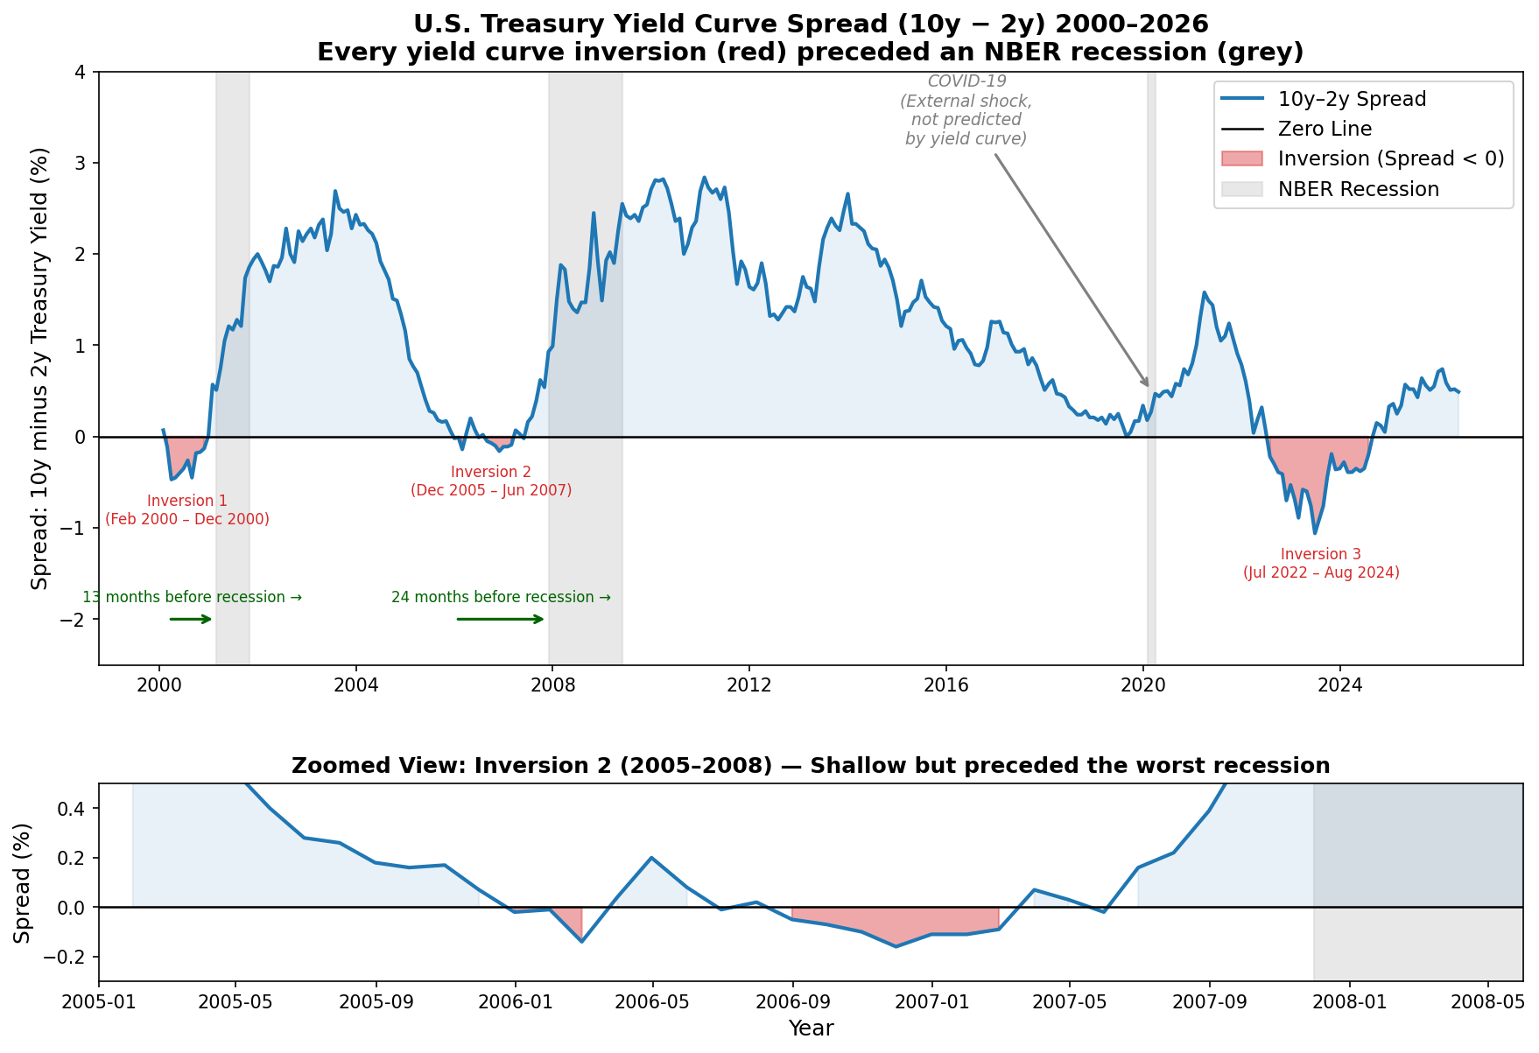
Every Inversion Has Preceded a Recession
Hypothesis Does an inverted yield curve precede recessions?
FINDING
13–24 mo. lead
The two completed inversions — in 2000 and 2005–07 — each preceded a recession, 13 and 24 months ahead. The curve flags each one automatically.
Notes:
Second, the yield curve — the gap between the 10-year and 2-year Treasury yields. When it turns negative, the curve is inverted, which historically warns of recession. Our chart detects every inversion automatically, and the two completed cases, in 2000 and 2005 to 2007, each preceded a recession, by 13 and 24 months.

Slide 6
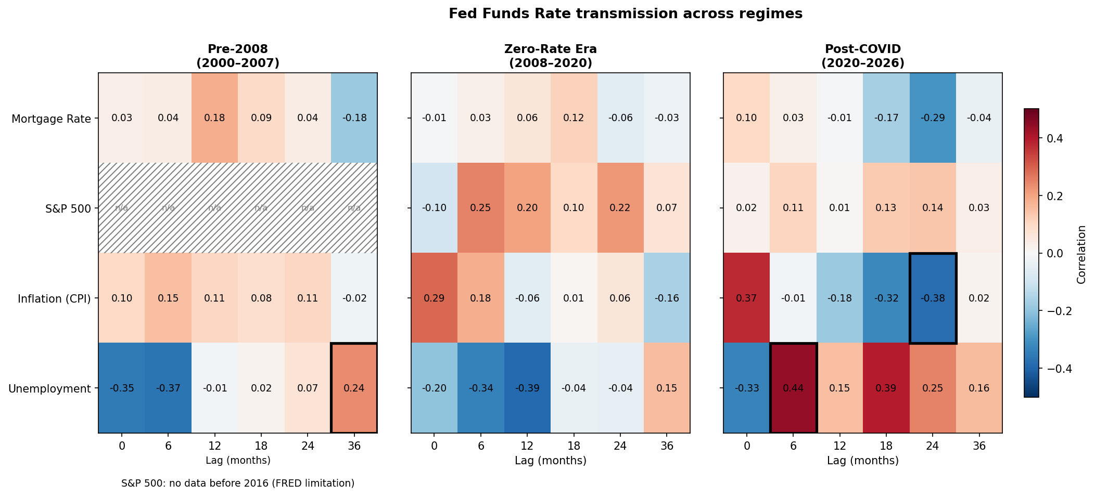
The Fed's Influence Spreads with a Lag
Hypothesis How does a Fed rate change transmit to other variables?
FINDING
Lag 36 → 6 months
Unemployment confirms A.1's lag — but flips 30 months faster post-COVID (lag 6, +0.44).
Inflation, the clearest mechanism: +0.37 immediately, reversing to −0.38 by lag 24.
Mortgage & S&P 500 stay weak — markets price expectations, not realized changes.
Notes:
Third, how a Fed rate change transmits to the economy — this heatmap correlates it with four variables, at increasing lags, across three eras. Two findings. First, unemployment: its correlation flips from negative — the Fed reacting to a hot economy — to positive as the hikes bite. That flip takes 36 months before 2008, but only 6 months post-COVID — the same delayed effect from A.1, transmitting much faster in the modern era. Second, inflation shows the clearest mechanism: strongly positive immediately, reversing to negative within about two years as the hikes take hold. Mortgage rates and the stock market stay weak throughout — markets are forward-looking, pricing expectations rather than realized changes.

Slide 7
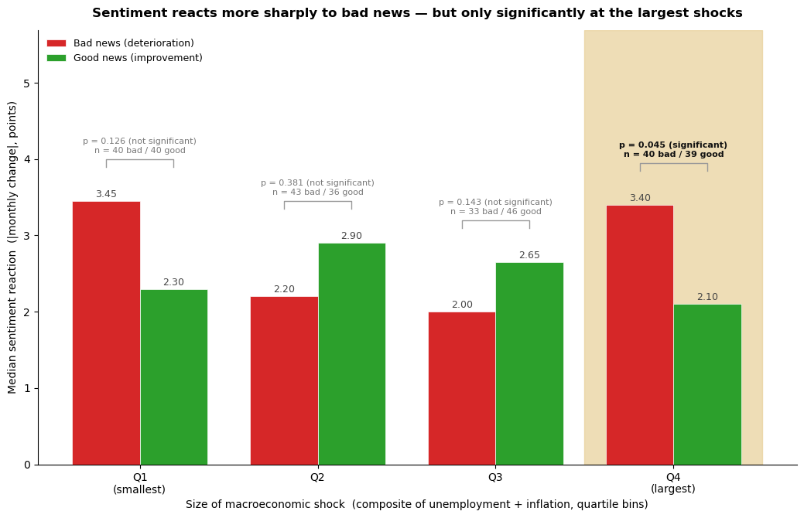
Sentiment Reacts more sharply to Bad News — Only at the Largest Shocks
Hypothesis Does sentiment react more sharply to bad news than to good of equal size?
FINDING
3.4 vs 2.1
At the largest shocks the sharper drop to bad news is statistically significant; the smaller bins are indistinguishable from noise.
Notes:
Our fourth question is the one we dug into hardest: does sentiment react more sharply to bad news than to good news of the same size — the idea of loss aversion. The hard part is a fair comparison, so we scored every month's conditions, sorted months into four groups by shock size, and within each group compared bad- and good-news months of comparable size. At the largest shocks — Q4, on the right — sentiment reacts more sharply to bad news: a drop of 3.4 versus 2.1 points, and that difference is statistically significant, while the smaller differences are not. That's the honest part: the smaller gaps could be noise, so we don't claim them. The asymmetry is real, but only clearly at the big, crisis-level events — exactly where loss aversion should bite hardest.

Slide 8


What We Found
Rate peaks lead unemployment peaks by about three years.
Every yield-curve inversion has preceded a recession.
The Fed's influence spreads with a lag — and faster in the modern era.
Sentiment reacts more to bad news — but only at the largest shocks.
The thread: we showed not just where effects exist, but where they don't — letting the data say only what it can support.
Notes:
Pulling it together: rate peaks lead unemployment peaks by about three years. Every yield-curve inversion has preceded a recession. The Fed's influence spreads with a lag, and faster in the modern era. And sentiment punishes bad news more than it rewards good — but only at the largest shocks. The thread through all of it: we tried to show not just where effects exist, but where they don't, letting the data say only what it can support.

Slide 9
Thank you
Team Bounty Hunters
github.com/jku-icg-classroom/visualization-ss26-lab-assignment-bounty-hunters
Notes:
That's our project — team Bounty Hunters. Thanks for watching.

