Slide 1
Netflix Content Analysis
Exploring Genre, Geography, and Temporal Trends
Team Powerpuff Girls * Visualization Lab SS26 * JKU Linz
Elmedin Zukic * Egzona Gashi * Saba Zia Naserani
Notes:
Welcome. Today we present our visualization project on Netflix content data. We are team Powerpuff Girls from JKU Linz.

Slide 2
DATASET
Netflix Titles Dataset
8,807
12
2021
Total Titles
Attributes
Coverage
movies + TV shows
per title
up to this year
Key attributes
Title
Type
Director
Cast
Country
Date Added
Release Year
Rating
Duration
Genre
Source: Kaggle -- Netflix Movies and TV Shows dataset
Notes:
Our dataset comes from Kaggle -- it covers all Netflix titles available up to 2021 with 8,807 entries and 12 attributes including type, genre, country, date added and release year. This gives us rich metadata to explore content trends.

Slide 3
HYPOTHESES
What We Set Out to Explore
A.1 Simple Netflix contains significantly more Movies than TV Shows.
A.2 Simple The number of titles added to Netflix has increased substantially over the years.
B.1 Complex Movies and TV shows differ in genre composition -- storytelling format drives genre choice.
B.2 Complex Content type depends on both country of origin and the year it was added to the platform.
Notes:
We explored four hypotheses in total -- two simple and two complex. The simple ones confirmed basic platform characteristics. The complex ones dug deeper into genre and geographic patterns.

Slide 4
FINDING A.1
Movies Dominate Netflix's Catalog
69.6%
30.4%
Movies
TV Shows
6,131 titles
2,676 titles
[OK] Hypothesis confirmed: Netflix offers roughly 2.3x more movies than TV shows. Any further analysis of Netflix content should treat the two types separately due to their significantly different volumes.
Notes:
Our first hypothesis is confirmed. Nearly 70% of Netflix's catalog is movies -- a clear 2.3 to 1 ratio. This baseline is important because it means TV shows are underrepresented and should always be analysed separately.

Slide 5
FINDING A.2
Netflix's Rapid Expansion: 2014-2019
2014: Global expansion begins -- 2019: Peak additions (2,016 titles added)
Notes:
The line chart shows dramatic growth from near-zero additions before 2014 to over 2,000 titles per year by 2019. The 2020 dip is likely due to pandemic-related production delays. The Netflix Effect is clearly visible.

Slide 6
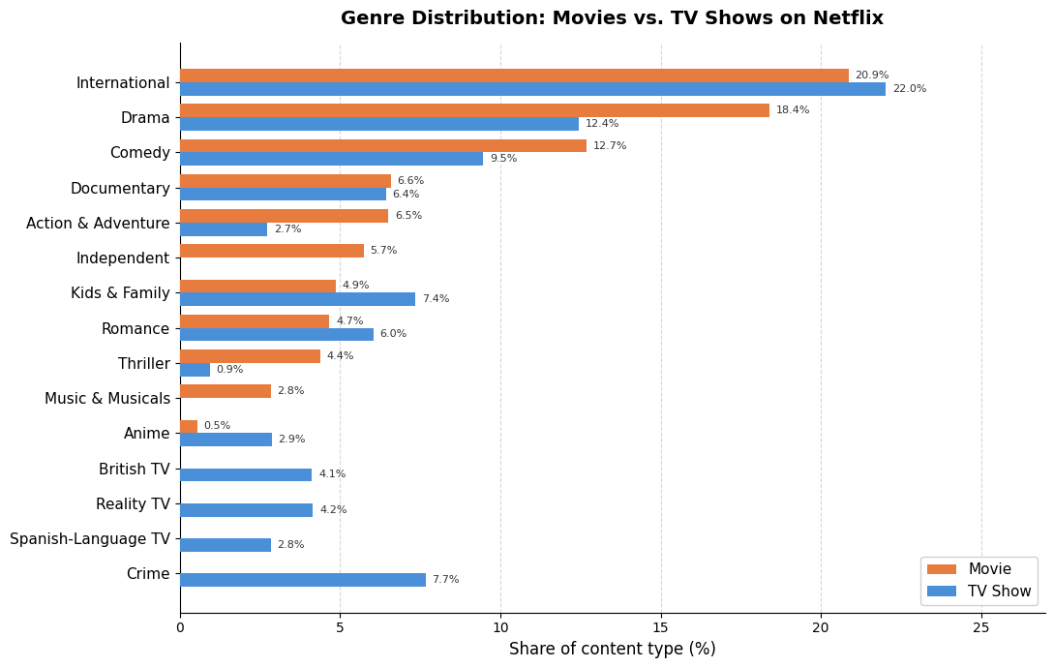
FINDING B.1
Genre Composition Differs by Content Type
Drama: 18.4% of Movies vs 12.4% of TV Shows
Crime: TV-exclusive genre (7.7%)
Stand-Up: Movie-exclusive genre (2.6%)
Horror: Thriller & Horror lean Movie-heavy
Reality TV: TV-exclusive genre
Notes:
The grouped bar chart shows genre share normalised within each content type. The key insight is that while Drama, Comedy and International dominate both, many genres are exclusive to one medium. Crime and Reality TV are TV-only; Stand-Up Comedy and Independent films are Movie-only. Hypothesis B.1 is confirmed.

Slide 7
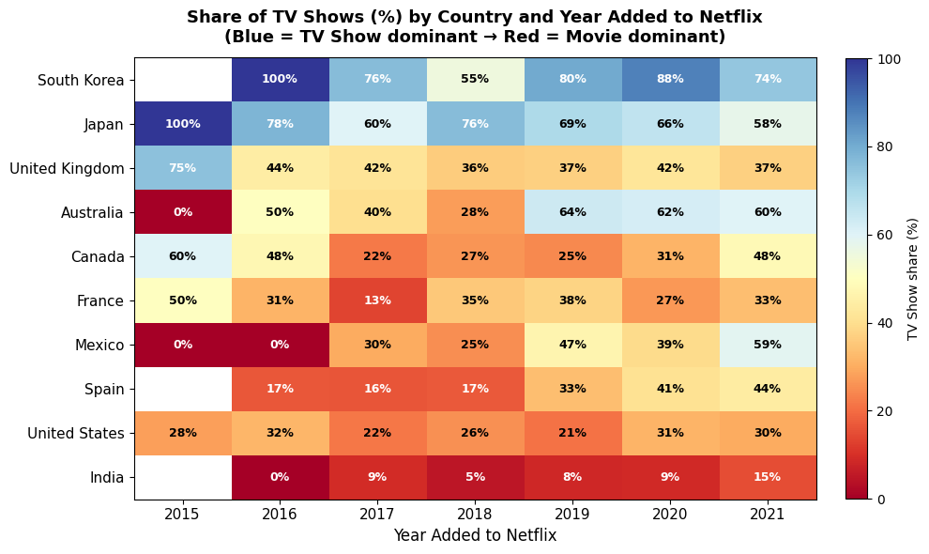
FINDING B.2
Culture & Time Jointly Shape Content Type
South Korea & Japan - 74-100% TV Shows -- strong serial drama cultures
India & USA - Below 32% TV Shows -- large film industries dominate
Global trend 2019+ - Most countries are shifting toward more TV Shows
Notes:
The heatmap shows TV show share percentage per country per year. South Korea and Japan are consistently blue -- over 74% TV. The US and India stay red, under 32%. Most countries trend toward more TV Shows after 2019, confirming that BOTH cultural origin and time period shape the type of content available.

Slide 8
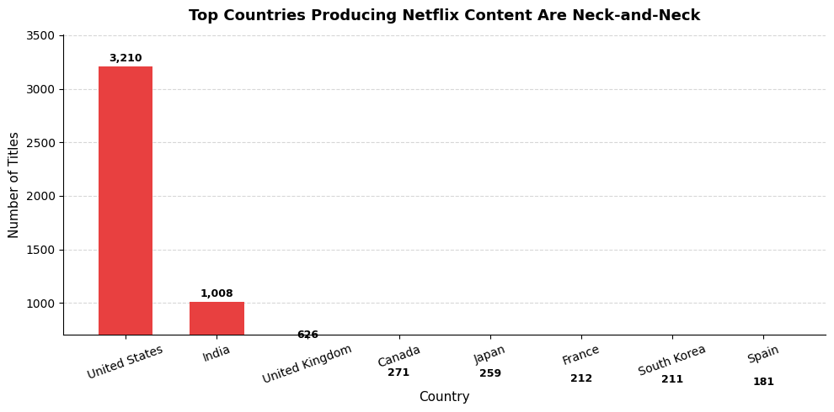
BLACK-HAT VIZ
How to Lie With a Bar Chart
The Trick
Y-axis starts at 700, not 0.
Reality: USA has 3,210 titles -- 3x more than India's 1,008.
Perception: bars look nearly equal in height.
Why it works: viewers judge bars by height. Cutting the baseline hides the true 3:1 ratio.
Fix: start the y-axis at 0.
Notes:
For our black-hat visualization, we used the classic truncated y-axis trick. Starting the axis at 700 makes India look almost as large as the US, hiding the actual 3:1 difference. The misleading title reinforces the deception. The fix is trivial -- just start at zero.

Slide 9
Key Takeaways
01
02
Movies dominate
Rapid 2014-2019 growth
Netflix is 70% movies -- the platform is still primarily a film catalog.
Content additions increased 100x in five years, driven by global expansion.
03
04
Genre follows medium
Geography shapes format
Crime and Reality TV are TV-only; Stand-Up and Horror lean movie-heavy.
South Korea & Japan are TV-dominant; India & USA are movie-dominant -- and both are shifting toward more TV post-2019.
Notes:
To summarise: Netflix is primarily a movie platform but shifting toward TV. Content growth was explosive between 2014 and 2019. Genre and format are strongly linked. And geography is a strong predictor of content type. Thank you for listening.

