Slide 1
Digital Twin of a Smart Room
Release 1
Team 1
Gabriel Mohamed-Hofmayr, Ilker Akceylan, Elma Buljina, Florian Ecker-Eckhofen
Praktikum Software Engineering – WS2022/23

Slide 2
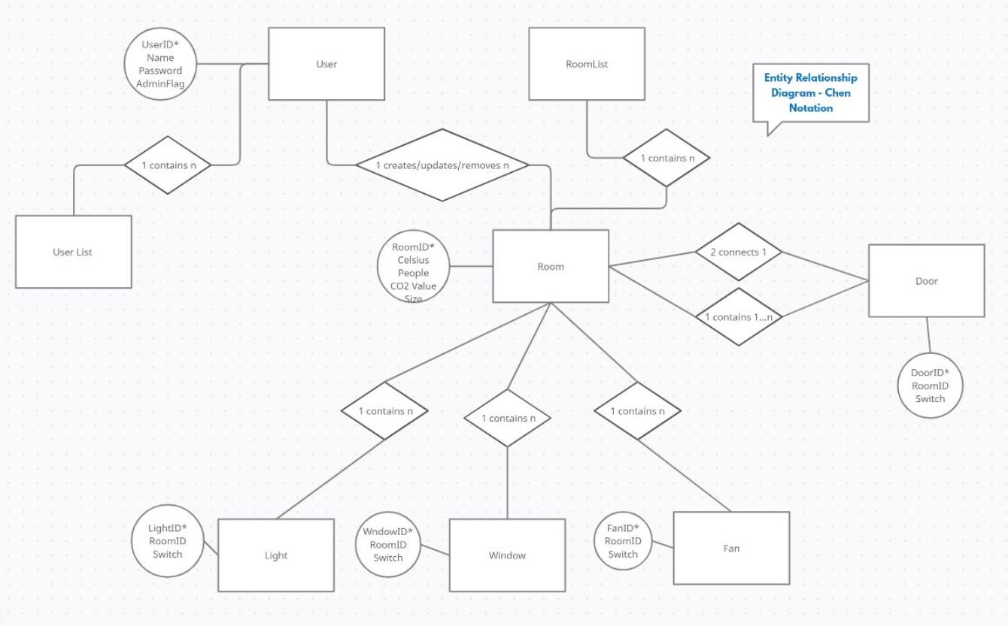
Entity Relationship Model for databas structure

Slide 3
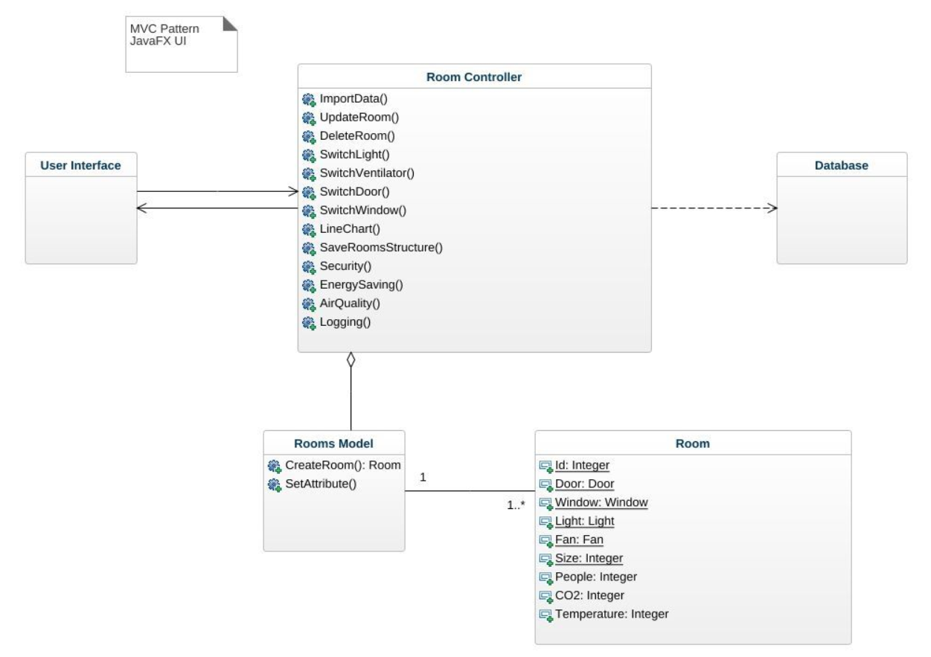
UML

Slide 4
Use case 1
Pre-Conditions
Closed doors, lights off, windows closed, fan off
Post-Conditions
Open doors, ligts on, windows open, fan on
Success end condition
Open doors, lights on, windows open, fan on
Failure end condition
Closed doors, ligts off, windows closed, fan off

Slide 5
Use Case 2
Pre-Conditions
Open doors, lights on, windows open, fan on
Post Conditions
Closed doors, lights off, windows closed, fan off
Success end condition
Closed doors, lights off, windows closed, fan off
Failure end condition
Open doors, lights on, windows open, fan on

Slide 6
Use case 3
Pre-Conditions
User has no information about the room’s temperature, co2 value and if doors are locked, windows closed, and if lights and fans are off. Room data is not downloaded
Post-Conditions
User has information about the room’s temperature, co2 value and if doors are locked, windows closed, and if lights and fans are off. Room data is downloaded
Success end condition
User has information about the room’s temperature, co2 value and if doors are locked, windows closed, and if lights and fans are off. Room data is downloaded
Failure end condition
User has no information about the room’s temperature, co2 value and if doors are locked, windows closed, and if lights and fans are off. Room data is not downloaded

Slide 7
Current Status + Release 2
Verteilung der Aufgaben
Schätzung des Aufwandes
Hauptprobleme
Feedback
Release 2 – Team-Meeting

