Slide 1
Digital Twin of a Smart Room
Release 1
Team 1
Gabriel Mohamed-Hofmayr, Ilker Akceylan, Elma Buljina, Florian Ecker-Eckhofen
Praktikum Software Engineering – WS2022/23

Slide 2
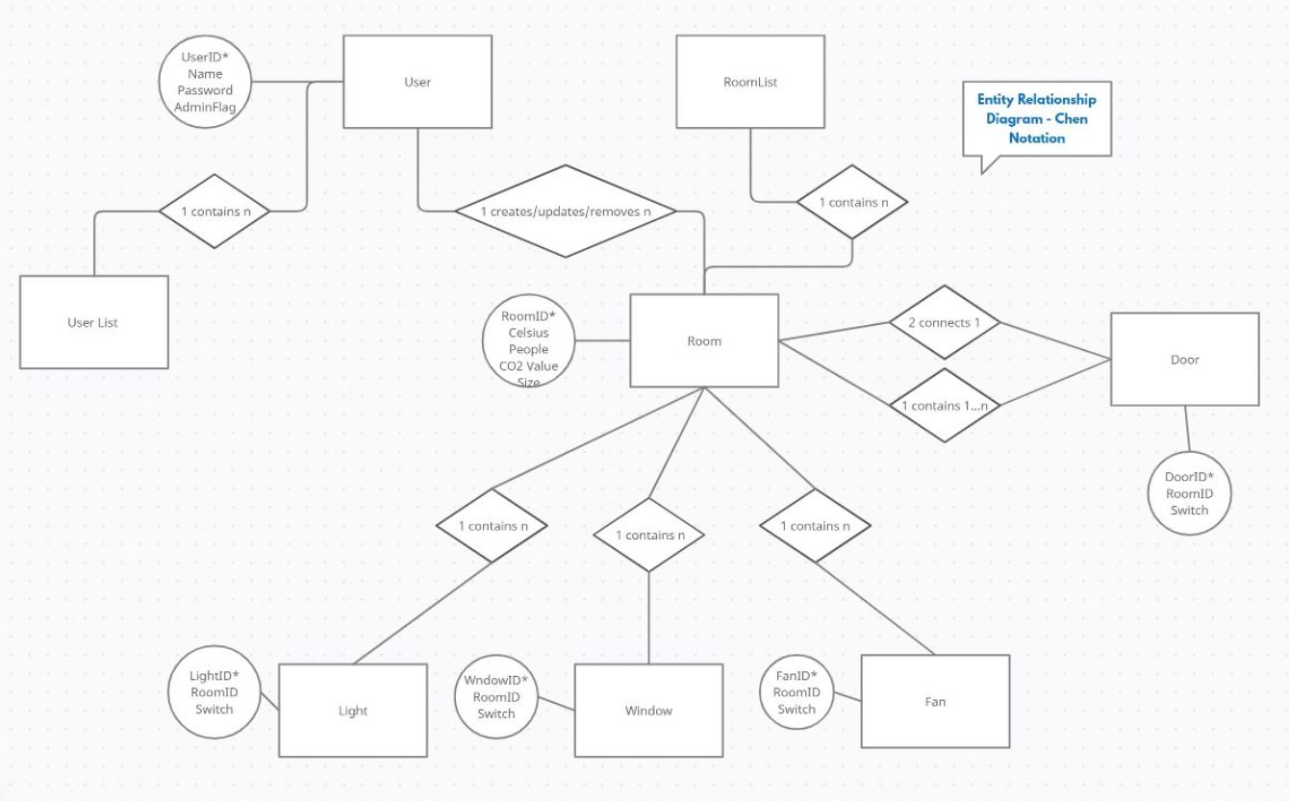
Entity Relationship Model for database structure

Slide 3
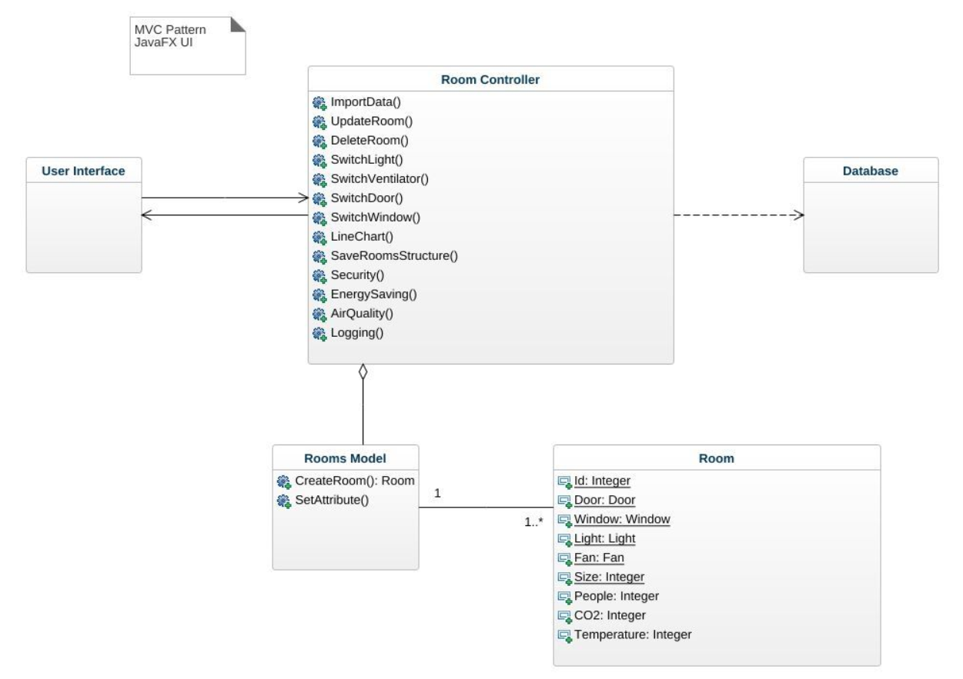
UML

Slide 4
Use case 1
Pre-Conditions
Closed doors, lights off, windows closed, fan off
Post-Conditions
Open doors, ligts on, windows open, fan on

Slide 5
Use case 1
1. Admin opens the web application.
2. Welcome page is shown.
3. Admin logs into the web application with username and password.
4. Admin imports CSV data.
5. Rooms are visualized.
6. Admin selects room. 7. Room structure and data is visualized. 8. Admin uses button “open door 1”. 9. “open door 1” button is now green displayed and door 1 is opened.
10. Admin uses button “lights 1 on”.
11. “lights 1 on” button is now green displayed and lights 1 are on.
12. Admin uses button “open window 1”.
13. “open window 1” button is now green displayed and window 1 is open.
14. Admin uses button “fan 1 on”.
15. “fan 1 on” button is now green displayed and fan 1 is on.

Slide 6
Use Case 2
Pre-Conditions
Open doors, lights on, windows open, fan on
Post Conditions
Closed doors, lights off, windows closed, fan off

Slide 7
Use Case 2
1. Admin opens the web application.
2. Welcome page is shown.
3. Admin logs into the web application with username and password.
4. Admin imports CSV data.
5. Rooms are visualized.
6. Admin selects room. 7. Room data is visualized. 8. Admin uses button “close door 1”. 9. “close door 1” button is now grey displayed and door 1 is closed.
10. Admin uses button “lights 1 off”.
11. “lights 1 off” button is now grey displayed and lights 1 are off.
12. Admin uses button “close window 1”.
13. “close window 1” button is now grey displayed and window 1 is closed.
14. Admin uses button “fan 1 off”.
15. “fan 1 off” button is now grey displayed and fan 1 is off.

Slide 8
Use case 3
Pre-Conditions
User has no information about the room’s temperature, co2 value and if doors are locked, windows closed, and if lights and fans are off. Room data is not downloaded
Post-Conditions
User has information about the room’s temperature, co2 value and if doors are locked, windows closed, and if lights and fans are off. Room data is downloaded

Slide 9
Use case 3
1. User opens the web application.
2. Welcome page is shown.
3. User logs into the web application with username and password.
4. User imports CSV room data.
5. Rooms are visualized.
6. User selects room. 7. Room data is visualized.
8. User selects button “download room”. 9. Room structure and data is downloaded as CSV.

Slide 10
Current Status + Release 2
Verteilung der Aufgaben
Schätzung des Aufwandes
Hauptprobleme
Feedback
Release 2 – Team-Meeting

