Slide 1
Digital Twin of a Smart Room
Release 1
Team 2
Nuray Seker, Abir Sikder, Stefan Pilgerstorfer
Praktikum Software Engineering – WS2022/23

Slide 2
Presentation Release 1 - Agenda
Use Case Description
UI Prototype
UML Class Diagram
Current Status
Planning for Release 2

Slide 3
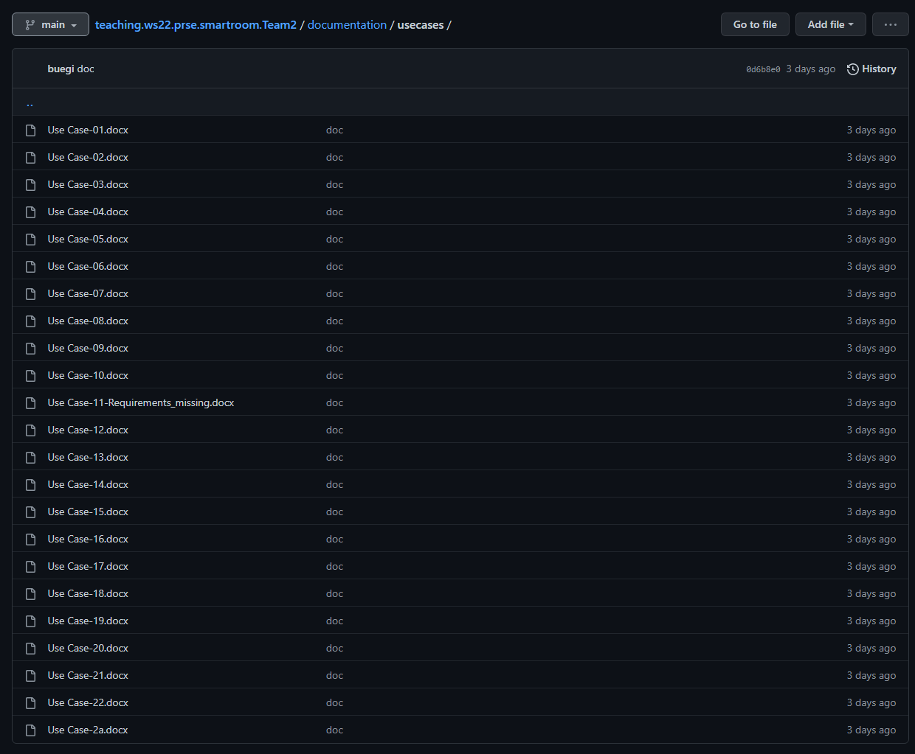
Use Case Description
Overview
Sample Use Case 21

Slide 4
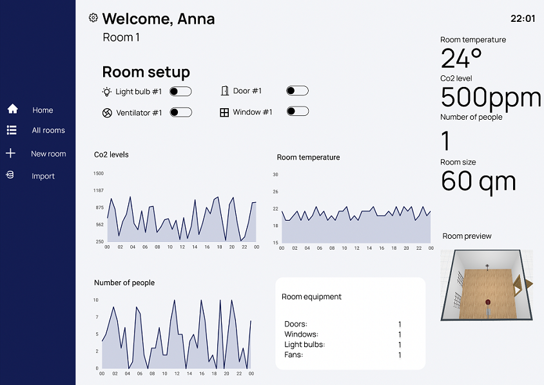
UI Prototype
Tool: Figma
UI Prototype

Slide 5
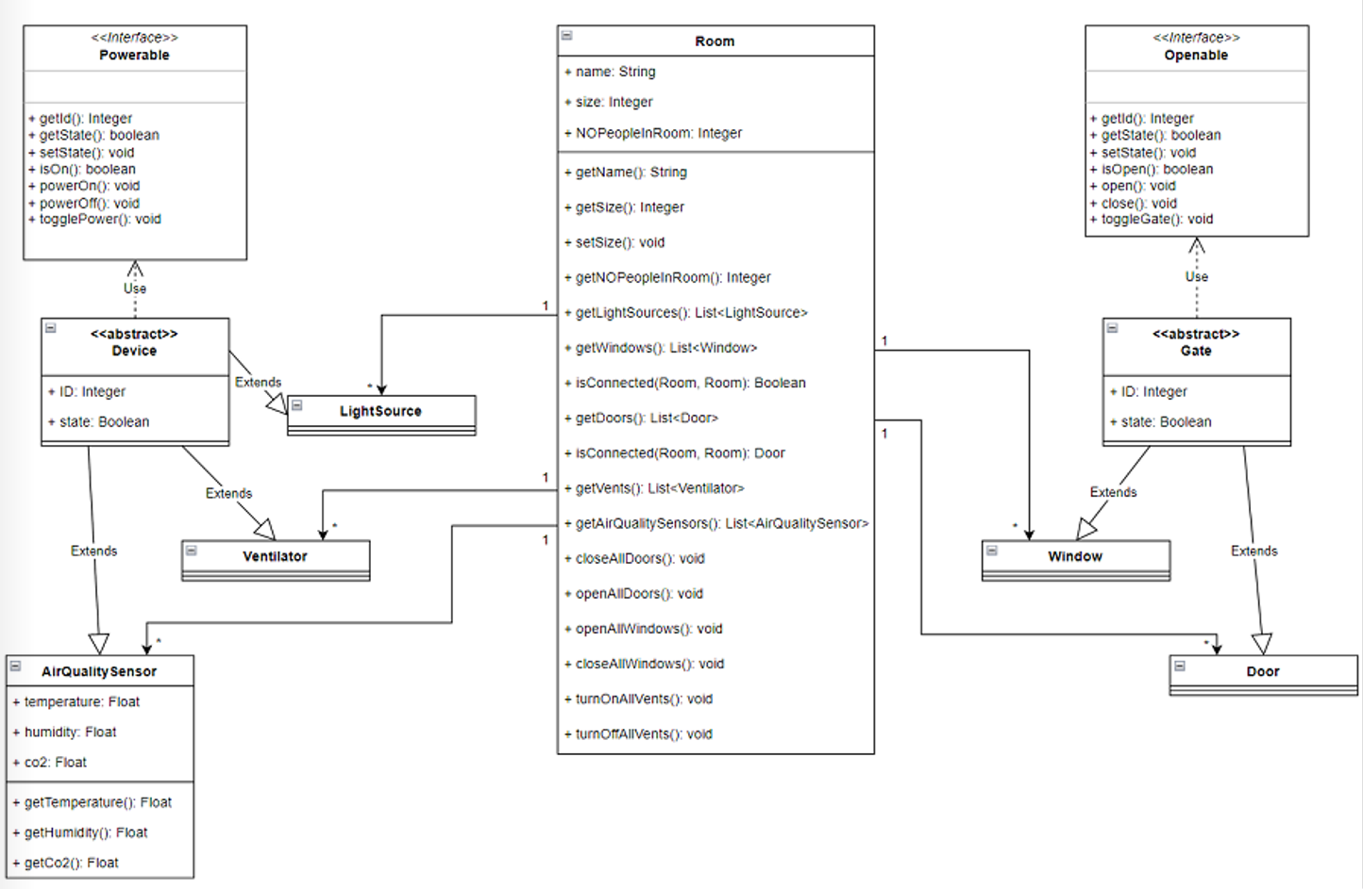
Class Diagram (UML, DrawIO)

Slide 6
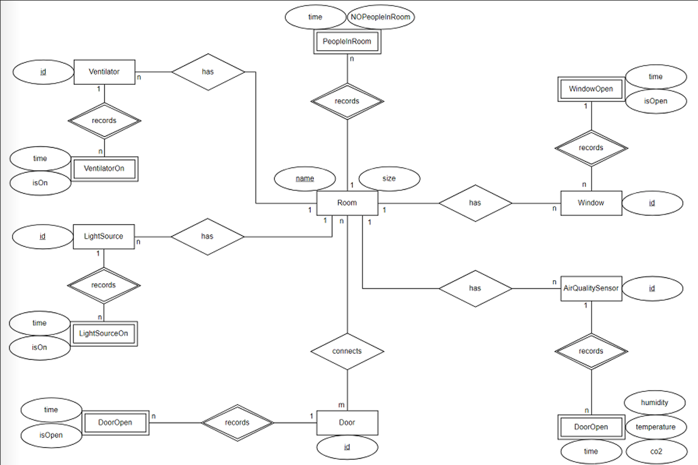
ER Diagram (DrawIO)

Slide 7
What was done, how was the distribution of the tasks?
Configure github (all)
Configure zenhub (all)
Configure circleCI (all)
Concept (Nuray, Abir)
UseCases (all)
Prepare SampleData (LightSource, AirQuality) (Stefan)
UI Protype (Nuray)
UML Diagram (Stefan, Abir)
ER Diagram (Stefan, Abir)

Slide 8
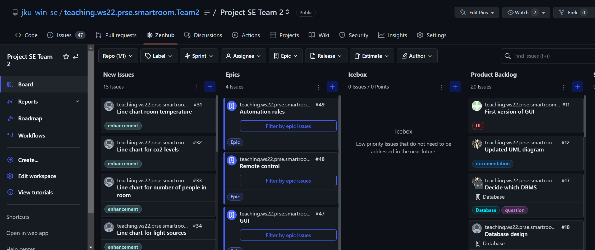
Which tasks were created?
Zenhub

Slide 9
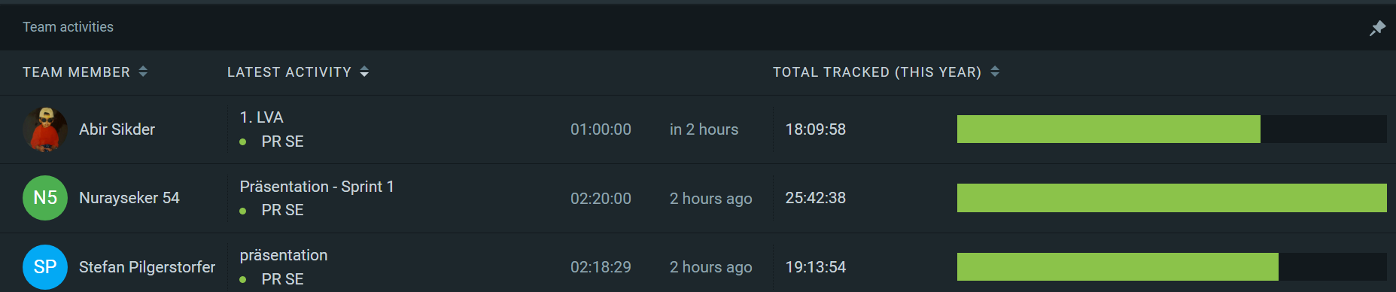
Did the team make a good estimation of the effort?
UI Prototype more effort than expected (mostly performed by Nuray)

Slide 10
Problems & Lessons Learned
CircleCI
Zenhub
Recognizing all requirements and devices (Slides, Requirements document, …)
Basic knowledge about required tools
Estimation problems will stay

Slide 11
Next Steps + Planning Release 2
Prototype
Implementing database
Filling dummy data (database connection)
SceneBuilder UI
Some basic features working
Import csv data
CRUD on basic classes
Unit tests for implemented features
Zenhub

