Slide 1
Digital Twin of a Smart Room
Release 2
Team 2
Elma Buljina, Nuray Seker, Abir Sikder, Stefan Pilgerstorfer
Praktikum Software Engineering – WS2022/23

Slide 2
Agenda
UML
UML (old)
Server-UML, Simulator-UML, Client-UML
Demo
Software Quality
Current Status + progress in Release 2
Problems in Release 2
Next Steps + Planning Release 3

Slide 3
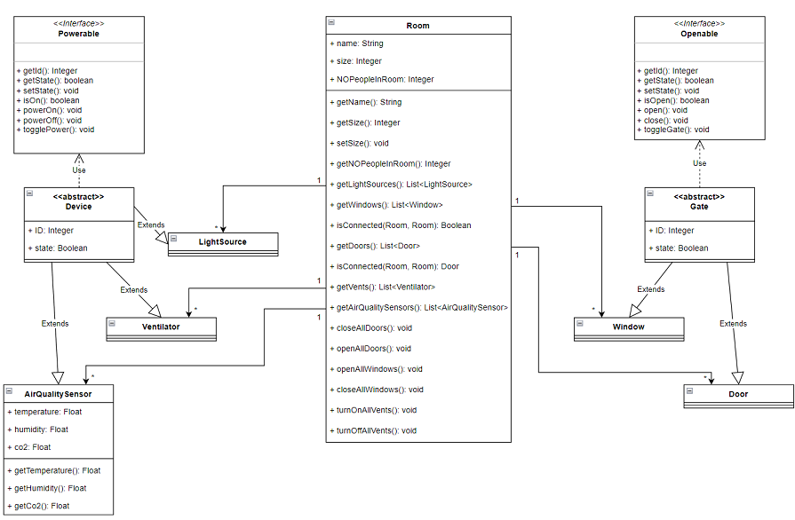
UML (old)

Slide 4
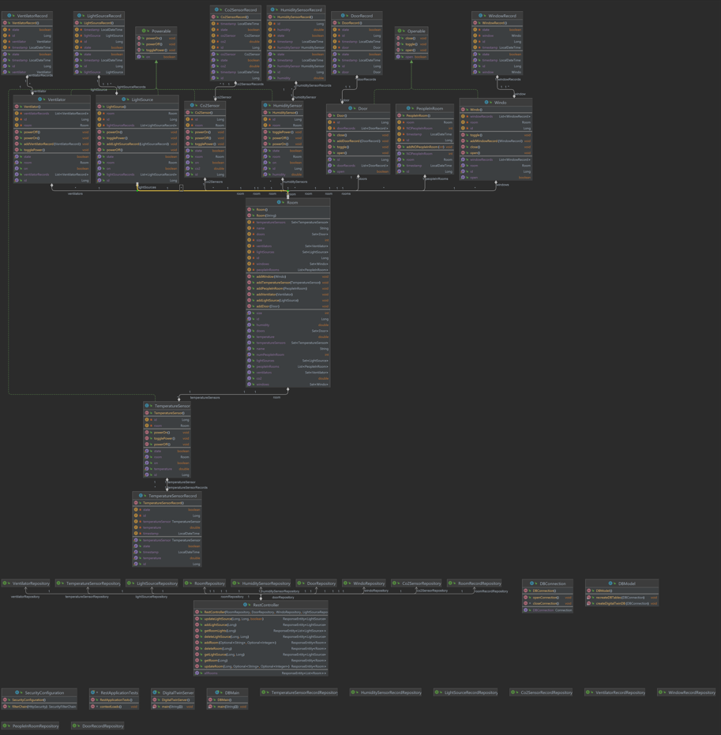
Server - UML

Slide 5
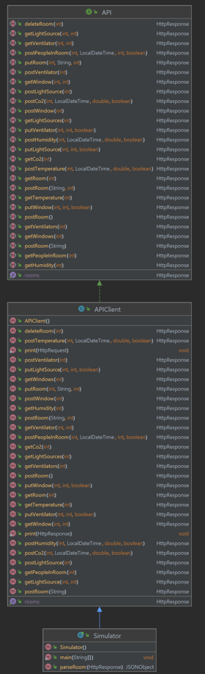
Simulator - UML

Slide 6
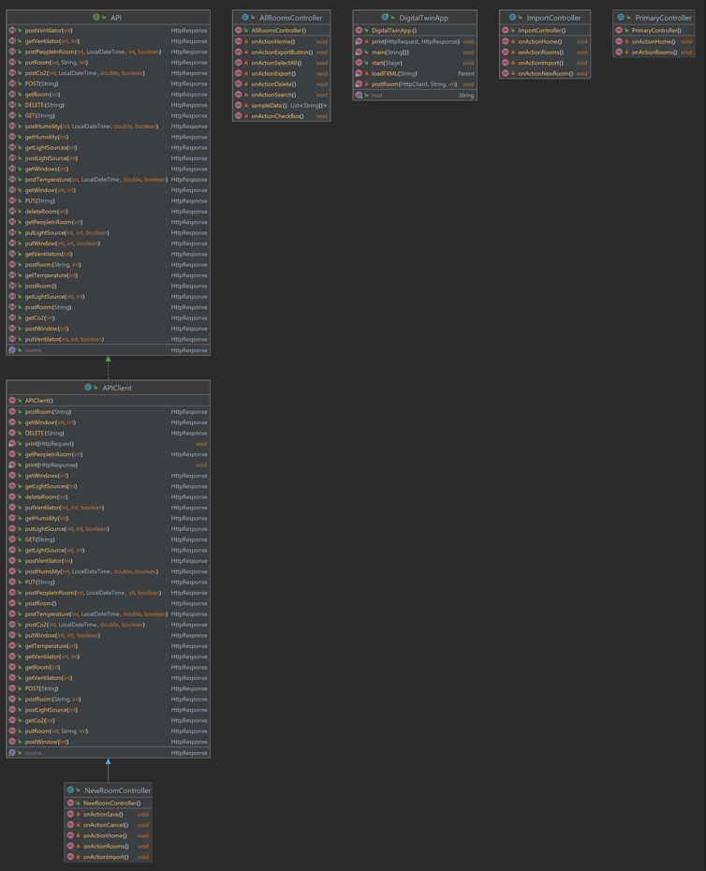
Client - UML

Slide 7
Demo
Give a demo of the functionality that already works in your developed software
Lead the audience through the user interface based on the use cases developed in the first release

Slide 8
Software Quality
Show the current code quality report
Describe 1-2 fixes you have done based on the code quality report
Show the unit test(s) you already have, and present your testing strategy for the next sprint/release

Slide 9
Current Status + progress in Release 2
What was done, how was the distribution of the tasks?
What are tasks that were planned but not finished?
Did the team make a good estimation of the effort (what was the sprint velocity, compared to the estimated velocity, and compared to the previous sprint)?

Slide 10
Task Distribution
Mandatory: Distribution of tasks
Which person was working on which parts, and how much effort was put into these parts?
This is your chance to show us that everyone is contributing to each part of the software (project requirement)

Slide 11
Problems in Release 2
Description of major problems (Planning, Implementation, etc…)
What did the team learn? (Lessons learned to be applied for the next release)

Slide 12
Next Steps + Planning Release 3
Brief overview of the further plan and next steps

