Slide 1
Smart Room Application
Final Release
Team 2
Nuray Seker, Elma Buljina, Abir Sikder, Stefan Pilgerstorfer
Praktikum Sofware Engineering - SS 2022

Slide 2
Präsentation Release 3 - Agenda
Demo
Documentation
Code Quality
Recap Release 3
Recap on Project Management
Course Feedback

Slide 3
Documentation
Briefly go through the documentation on github and the pdf file, if you have something here already
Briefly outline your software architecture

Slide 4
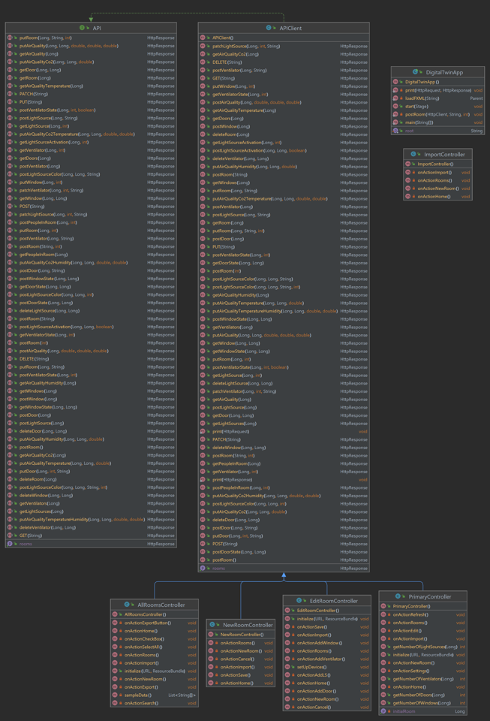
UML – Client
Show final UML class diagram, and discuss how you adapted it over the semester

Slide 5
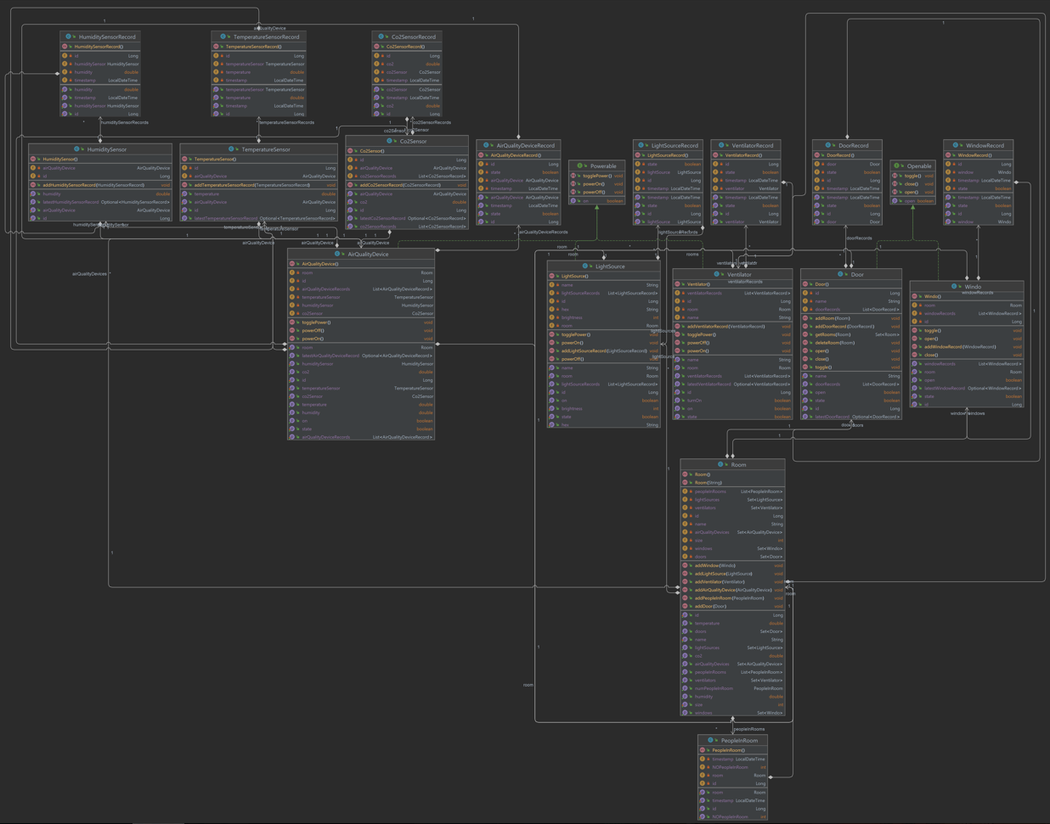
UML - Server

Slide 6
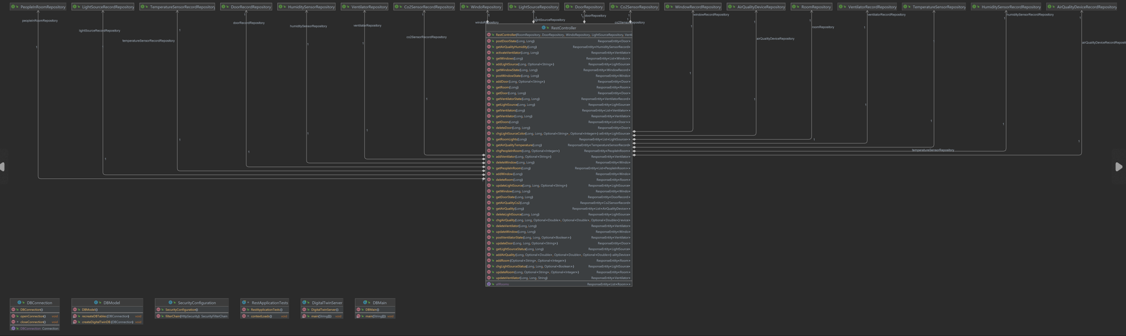
UML – Server (RestController)

Slide 7
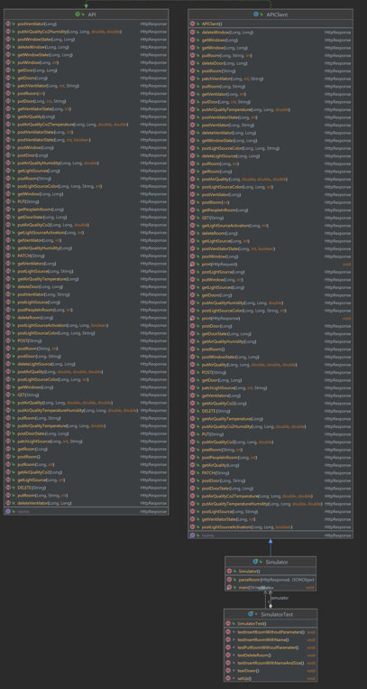
UML - Simulator

Slide 8
Code Quality
Show Coverage + Quality Report
Argue about the quality of your software based on these reports

Slide 9
Recap Release 3
What was your progress in this release?
Are you satisfied with your current status?
Did you finish all planned tickets?
What were problems in this release?

Slide 10
Recap Project Management
How did project management in your team go over the whole semester?
How did you improve project management?
What are your key takeaway messages?

Slide 11
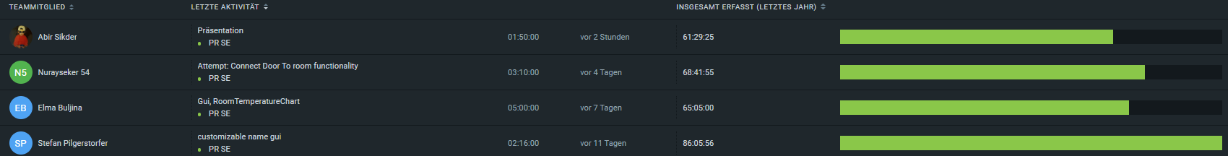
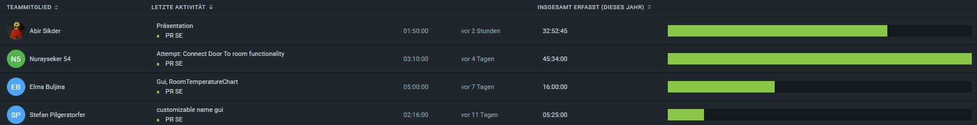
Task + Time Distribution
What was the number of hours spent by each team member?
Last year
This year

Slide 12
Task + Time Distribution
What was the task distribution over the whole semester?

Slide 13
Task + Time Distribution
How does each individual team member rate the fairness of distributed work?

Slide 14
Course Feedback
How did you like the course?
In what way did the course (if at all) help you improve your skills?
What would you do better if you were the LVA lead?

