Slide 1
Digital Twin of a Smart Room
Release 2
Team 2
Elma Buljina, Nuray Seker, Abir Sikder, Stefan Pilgerstorfer
Praktikum Software Engineering – WS2022/23

Slide 2
Agenda
UML
UML (old)
Server-UML, Simulator-UML, Client-UML
Demo
Project Structure
Software Quality
Current Status + progress in Release 2
Problems in Release 2
Next Steps
Release 3 - Strategy

Slide 3
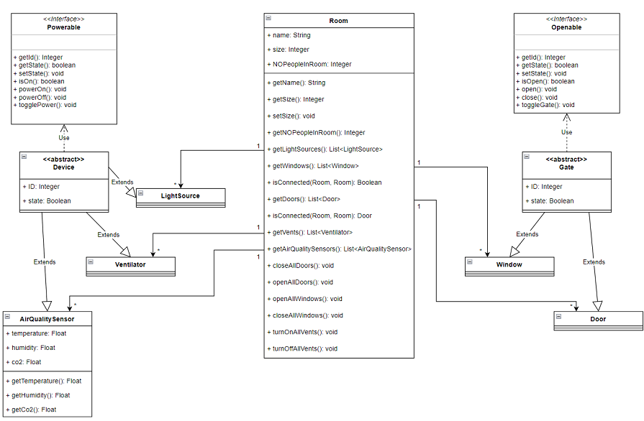
UML (old)

Slide 4
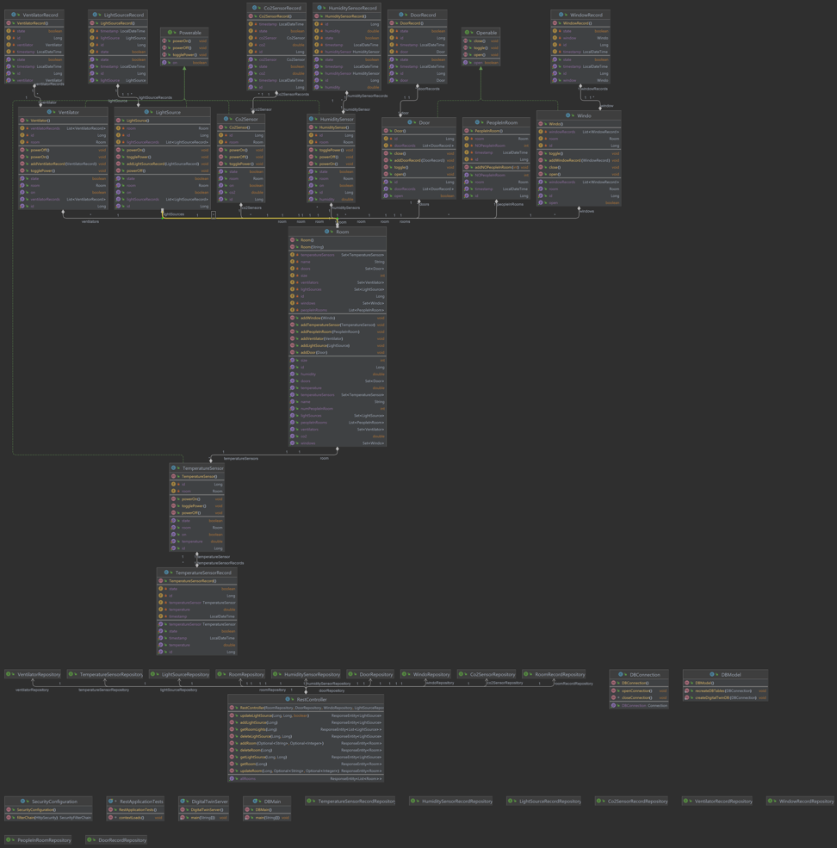
Server - UML

Slide 5
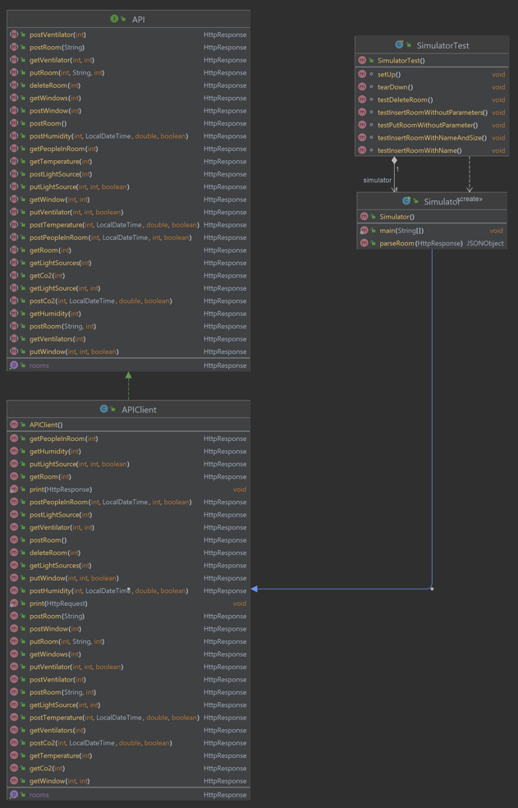
Simulator - UML

Slide 6
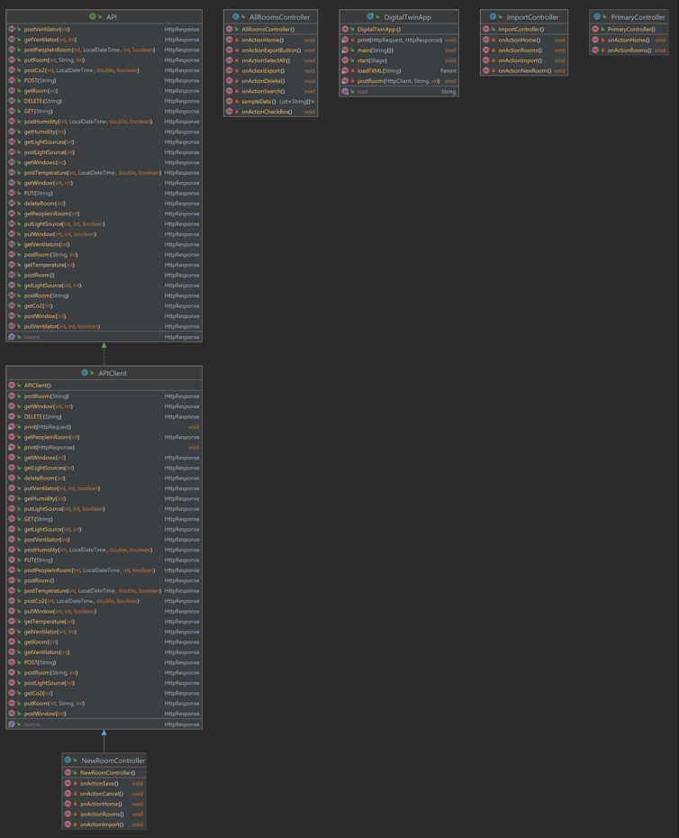
Client - UML

Slide 7
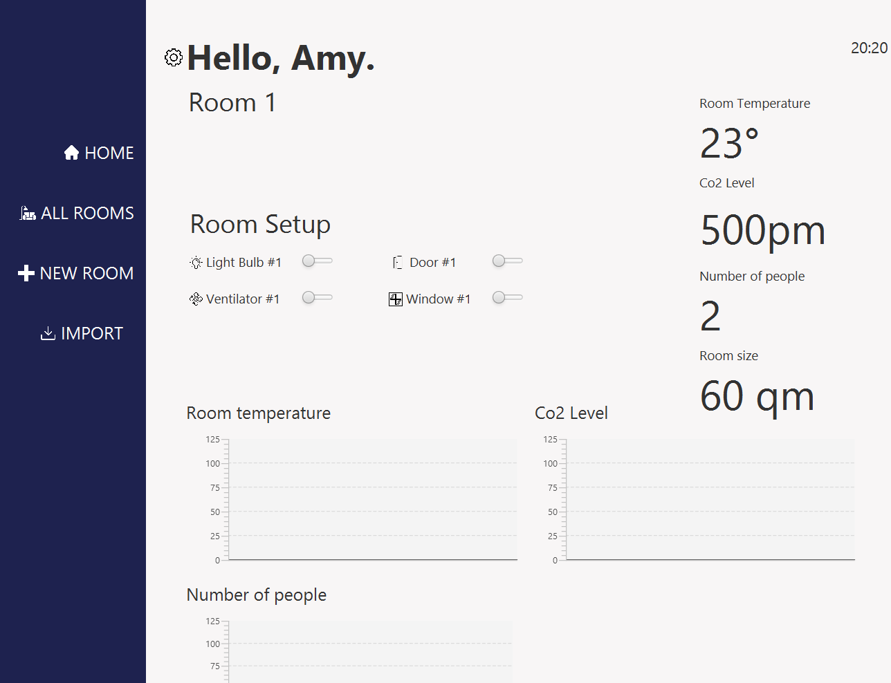
Live-Demo

Slide 8
Code Quality
SonarLint (Live Demo, per Java-Class)

Slide 9
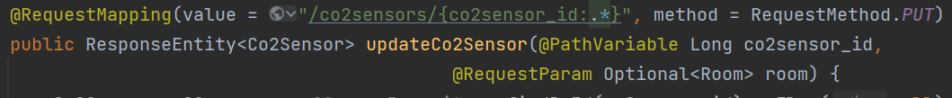
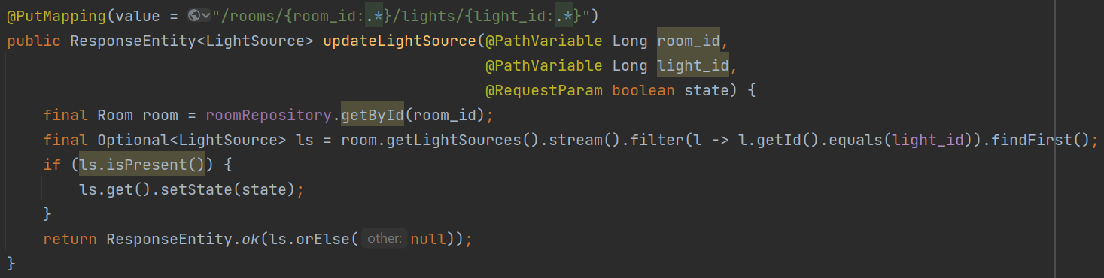
Code Quality Suggestion 1 (SonarLint)

Slide 10

Code Quality Suggestion 2 (SonarLint)

Slide 11
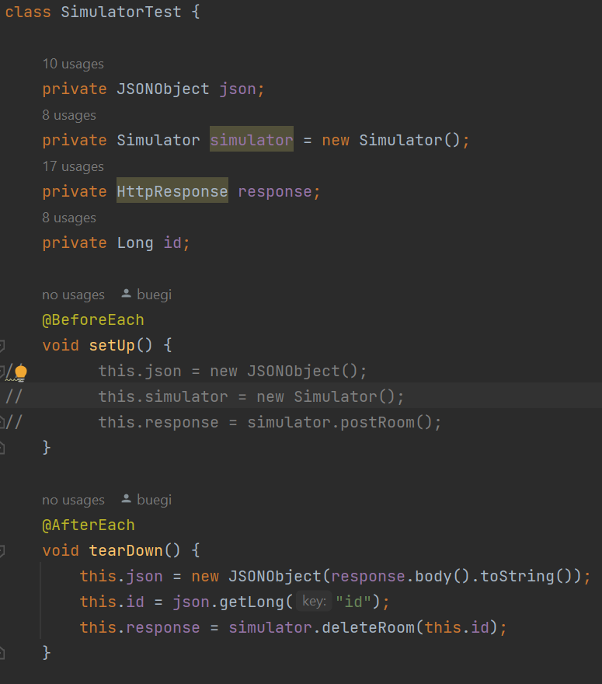
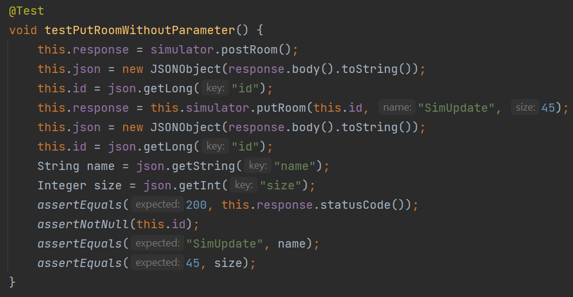
Sample Unit Test

Slide 12
Current Status + progress in Release 2
What was done, how was the distribution of the tasks?
API for Room, Light Source, Ventilator, Window
CRUD Room
Majority of GUI
Export functionality (room only)
(Simulator) HTTP Response for Room, Light Source, Ventilator, Window
UML Diagram (Update)
What are tasks that were planned but not finished?
Remote control
Visualize Static information
Complete API
Unit tests

Slide 13
Task Distribution
Mandatory: Distribution of tasks
Which person was working on which parts, and how much effort was put into these parts?
This is your chance to show us that everyone is contributing to each part of the software (project requirement)

Slide 14
Member | Task | Details
Nuray Seker | Front-End: GUI Back-End: -Action Handles -Calling Rest Methods | Design of Main Pane (Mock Data), Menu Bar, Page: All Rooms Functions: - Export function with chosen name (into a .csv File) Action Handle: - Show existing rooms (currently sample size of 10) - Delete room - Select ALL
Elma Buljina | Front-End: GUI | New room Controller created New files Links Import Edit room function Update Save Cancel button

Slide 15
Member | Task | Details
Stefan Pilgerstorfer | Back-End: -Project Structure -Modules -Database (AWS / MySQL) -DB Model -Hibernate, JPA, Spring-Boot, Spring-Security, Spring-Data -JPA Repositories -API Room -Simulator Client -API Client -Unit Test | API: (GET, POST, PUT, DELETE)
Abir Sikder | Back-End: -API LightSource -API Ventilator -API Window -API Client (LightSource, Ventilator, Window) -Modules -UML Diagram (Update) | API: (GET, POST, PUT, DELETE) API Client: HttpResponse -> Room, LightSource, Ventilator, Window

Slide 16
Problems in Release 2
Major Problems
Implementing Program parts that depend on unfinished other parts
Implementing Unit Tests while classes conceptually change
Effort estimation (high initial effort)
What did the team learn?
Effort estimation (with knowledge comes speed)

Slide 17
Next Steps
CSV Import functionality (Backend)
Complete API (Questions!) (Backend)
Unit Tests (Backend)
Adding/editing devices (GUI)
Line Charts (GUI)
Remote Control (Backend & GUI)
Automation Rules (Backend & GUI)

Slide 18
Release 3 - Strategy
Project conceptually finished
Working on class = finishing it
Correct Code Quality Issues
Implement TODOS
Implement missing functionalities
write Unit Tests
Release 3 = Functionally finished product
After Release 3 only minor bug fixing

