Slide 1
Digital Twin of a Smart Room
Release 2
Team 3
Florian Offenberger, Jakob Hubauer, Fabio Leidwein, Lukas Nömeyer
Praktikum Software Engineering – WS2022/23

Slide 2
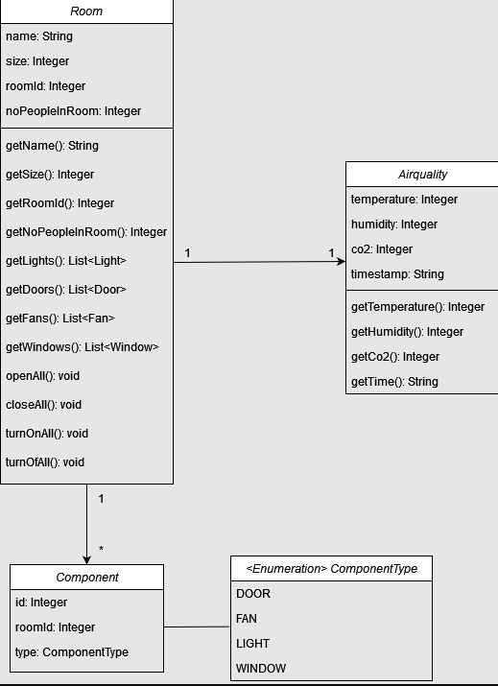
Concepts: UML DIAGRAM

Slide 3
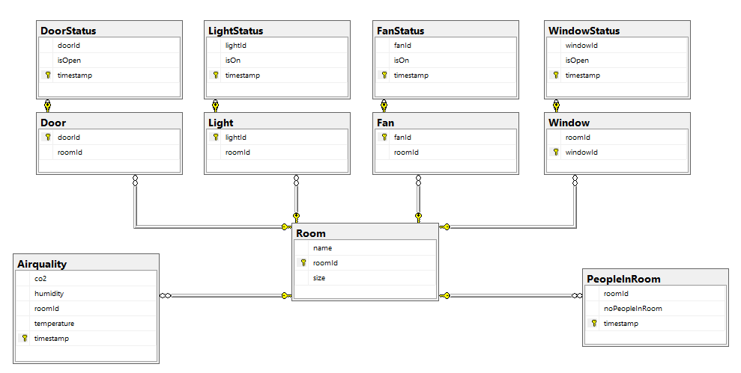
Concepts: ER DIAGRAM

Slide 4
Demo
Basic Functions of CRUDE Operations for Rooms
User interface differs from Prototyp as consequence of missing JavaFX knowledge in the team

Slide 5
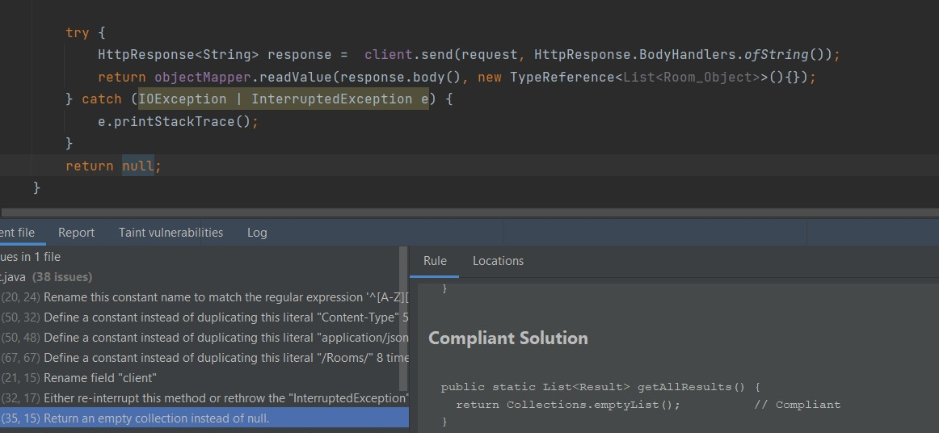
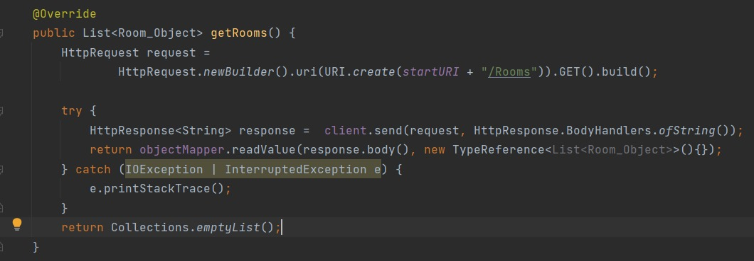
Software Quality
Current code quality report
Unit Tests

Slide 6
Current Status + progress in Release 2
accuracy
In this Sprint :
Basic UI
Client functions
connection to REST API
Unfinished:
Database
RESTful Door and window,
Estimation accuracy varies as there are too many new things we are still learning

Slide 7
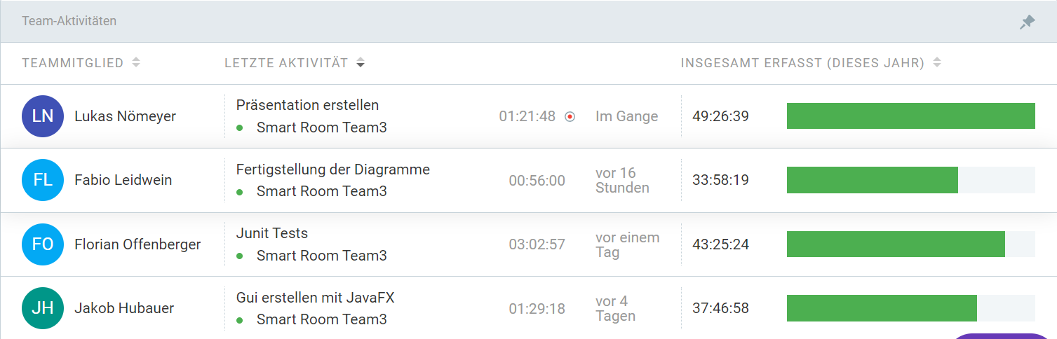
Task Distribution
Lukas
RESTFUL
Connection to RESTFUL
Review, Test and Rework
Florian
Client functions
Team leader
Jakob
User interface
Fabio
Database

Slide 8
Problems in Release 2
Major Problems
Knowledge
Time management
Communication
What did the team learn?
Clearer communication
A single Person is never alone responsible for a component
More short meetings: A wrong approach is faster identified, and less time is waisted

Slide 9
Next Steps + Planning Release 3
Database connection
Further implementation of REST
Get the UI nearer to the Prototyp
Catch errors on Client function (Wrong or empty parameter, no response,…)

