Slide 1


Slide 2
What is Timescale Database?
Is a category-defining relational database for time-series data
Is packaged as a PostgreSQL extension
Designed to be easy to use, easy to get started and easy to maintain

Slide 3
Difference between Timescale and PostgreSQL?
TimescaleDB is approximately 20x faster at inserts at scale than PostgreSQL
TimescaleDB is 1.2x to 14.000x faster for time-based queries
TimescaleDB is 2000x faster at deleting
TimescaleDB also inherits all aspects of PostgreSQL and extends it by new time-centric funtions

Slide 4
Benefit of a Hypertable?
In-memory data (Data is stored in memory, not on disk)
Local indexes (Individual indexes for each chunk* -> latest data and indexes reside in memory -> updating and inserting remain fast)
Easy data retention (Chunks can be deleted based on their time ranges -> users can make this automatic)
Age-based compression, data reordering
Instant multi-node elasticity
Data replication (Chunks can be individually replicated across nodes transactionally)
Data migration (Chunks can be individually migrated transactionally)
* hypertables are actually an abstraction or virtual view of many individual tables that actually store the data, called chunks.

Slide 5
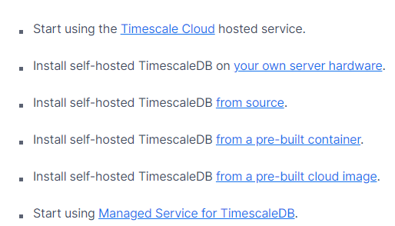
How to set up a Timescale Database?
There are multiple ways of setting up a Timescale Database. To showcase it we decided to choose „Install self-hosted TimescaleDB on your own server hardware“.

Slide 6



How to set up a Timescale Database?
To set up a Timescale Database user need to download and install PostgreSQL and TimescaleDB
After running the setup.exe in the extracted TimescaleDB directory users need to connect to the PostgreSQL by using this command at the command prompt
After a successful connection users can create an empty database →
With \c example (example being the name of the database) users can connect to the database and with users can add the TimescaleDB extension.

Slide 7
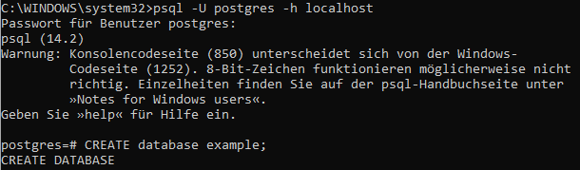
How to set up a Timescale Database?
Previous mentioned steps for setting up a TimescaleDB are showcased in the following screenshots.

Slide 8
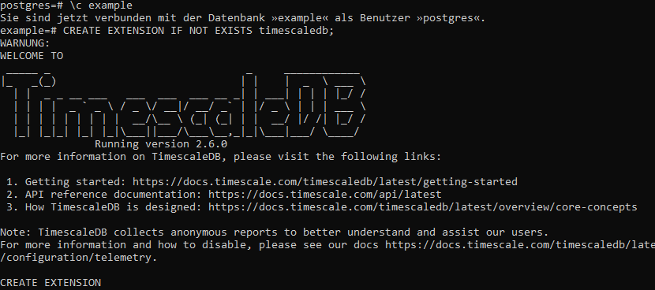
How to set up a Timescale Database?
For further information → https://docs.timescale.com/

Slide 9
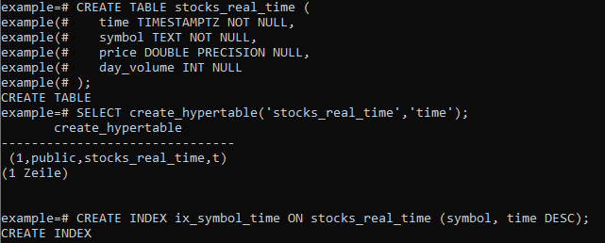
Example of a Hypertable using Timescale and performing a SQL operation
Creating an Index to support efficient queries on the symbol and time columns.

Slide 10

Example of a Hypertable using Timescale and performing a SQL operation
SQL Operation
Selecting everything from the hypertable we created earlier, where the symbol is AMZN and in a descending time and day_volume order
The data output is limited to 10 rows

Slide 11
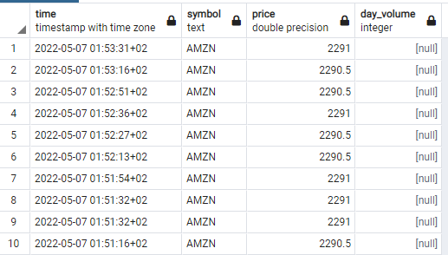
Example of a Hypertable using Timescale and performing a SQL operation

