Slide 1
Health Workforce Density and Health System Performance in Africa
Identifying Workforce Density Thresholds for Universal Health Coverage and Population Health

Slide 2
Objectives
To examine the relationship between health workforce density and key population health outcomes.
To estimate the association between health workforce density and health outcomes (life expectancy and UHC service coverage).
To test for nonlinear and threshold effects in the workforce–health outcome relationship.
To identify workforce density levels associated with diminishing marginal returns to workforce expansion.

Slide 3
Approach
A longitudinal panel data design using annual country-level observations for 47 countries in the WHO African Region over an unbalanced period spanning up to 18 years.
Two indicators were used to measure health system performance:
Life Expectancy at Birth (LE) – measured in years and used as a summary indicator of population health.
Universal Health Coverage Service Coverage Index (UHC_SCI) –measuring coverage of essential health services across several domains.
Explanatory variables
health workforce density-the number of physicians, pharmacists, dentists, and nursing/midwifery personnel per 10,000 population.
Control variables:
Population density, capturing demographic pressures on health systems.
Health financing capacity: government health expenditure per capita (GGHED per capita) to GDP per capita.

Slide 4
Results :UHC
Hausman test : Fixed-effects model preferred
Workforce density positively associated with UHC
An increase in one worker per 10,000 population leads +0.11 increase in UHC-SCI (β = 0.110, p = 0.004)
Strong improvement in UHC after 2006

Slide 5
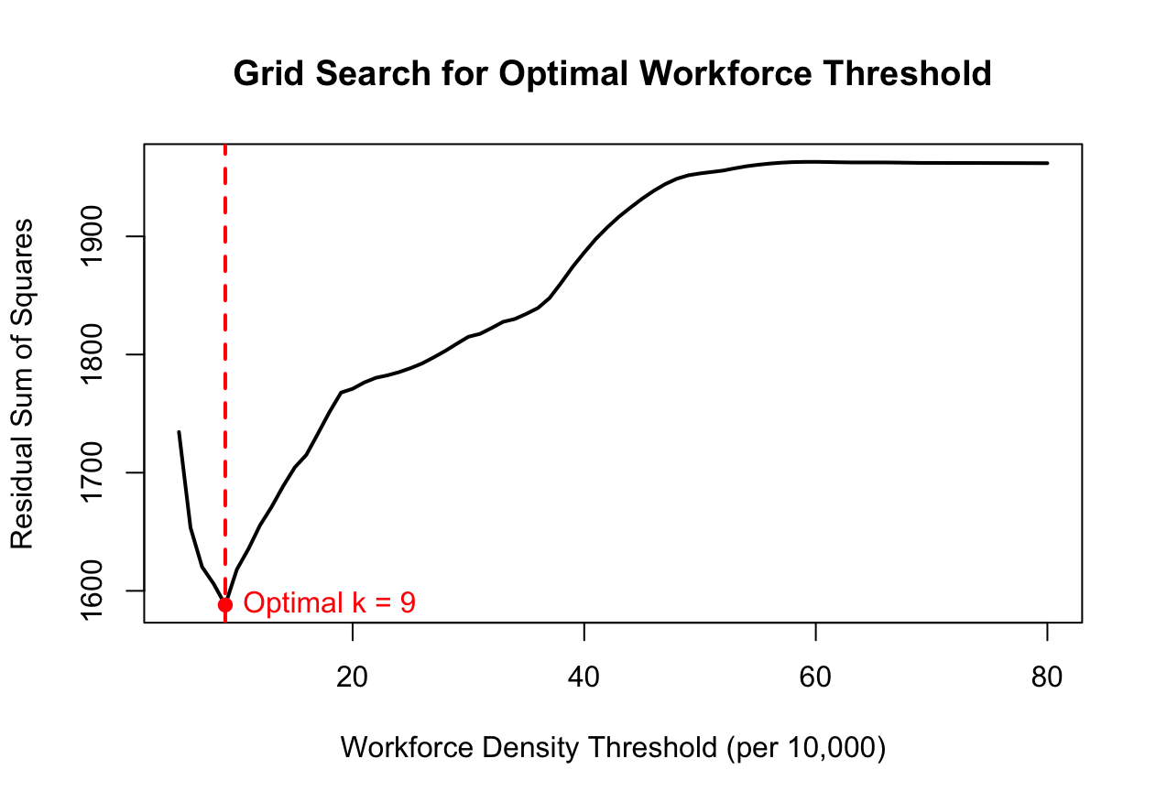
Threshold (UHC)
Optimal workforce threshold:
9 health workers per 10,000 population
Above 9 health workers UHC services begin to stabilize

Slide 6
Life Expectancy (LE)
Hausman test : Random-effects model used
Workforce density was not significantly associated with life expectancy(β = 0.016, p = 0.41)
Strong improvement in UHC was observed after 2014

Slide 7
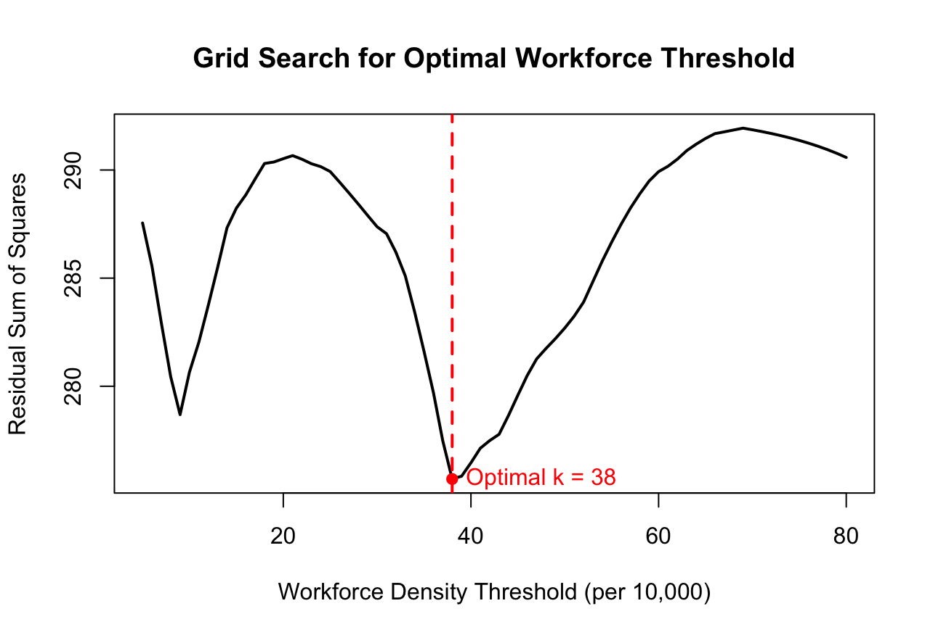
Threshold for LE
Estimated threshold was 38 health workers per 10,000 population

Slide 8
Summary
9 workers per 10,000 for Minimum level for basic service delivery
38 workers per 10,000 for population health improvements
Workforce investments should prioritize countries below 9 workers per 10,000.
Improving life expectancy requires broader health system investments

