Slide 1
Variations Of Quick Hull And Their Effects On Time Complexities
Ioannis Nearchou, Jonah Kubath, Western Michigan University

Slide 2
QuickHull: Introduction
QuickHull is the name for an algorithm developed to draw convex hulls [2].
A convex hull is the polygon formed around the outer points of a graph, generally in R^{n} space [2].
QuickHull is based on the Quicksort algorithm [2].
QuickHull uses recursive calls and partitioning to find points that belong to the hull of a graph [2].
Time-complexity modeled by recurrence relation given in [2]: T(m) = T(m1) + T(m2) + O(m)
m is the number of graph points, m1 and m2 are the sizes of partitioned subarrays. The O(m) term is for finding a partition.

Slide 3
QuickHull: Introduction
In the recurrence relation, if m2 or m1 are close to m, relation behaves similarly to T(m) = T(m-1) + O(m).
m = 2 is base case T(2) = 0, because this means there is no hull point to find. Thus, the complexity is O(m²). For a problem of size n, the order will be O(n²).
If the partitioning is stable, then the recurrence behaves like T(m) = 2*T(m/2) + O(m) → O(m log(m)), or O(n log(n)) for a problem of size n.
Known optimizations in Quicksort partition can reduce time to that above.
We explore if some of these optimizations can be adapted to QuickHull and yield faster times.

Slide 4
QuickHull: Problem
The question exists though, how does QuickHull work?
According to [2], QuickHull takes array of x and y coordinates.
QuickHull finds points p₁ and p₂, with the rightmost and leftmost x-coordinates to form a line segment.
If tie, pick two points from the p₁’s called p₁’ and p₁’’, with smallest and largest y-coordinate values. Two points of the p₂’s are chosen called p₂’ and p₂’’ with the same properties.
Line segments formed by pairing (p₁’, p₂’) and (p₁’’, p₂’’)

Slide 5
QuickHull: Problem
Subarray subproblems X₁ and X₂ made, s.t. X₁ has (p₁, p₂) or (p₁’, p₂’) and all points to the left of them. X₂ has (p₁, p₂) or (p₁’’, p₂’’) and all the points to the right of it.
Hull is called on each subarray and line segment points added to internal hull data structure.

Slide 6
QuickHull: Problem
How are points determined to be left or right of a line segment? Ans: Determinant
In [2], [3] and [4], orientation of point to line segment made by calculating determinant between them.
Formatting for taking the determinant of three points is given by [4] here:
If line has points (x₁, y₁) and (x₂, y₂), [2] states the point being compared is to the left of segment if the determinant is greater than 0. It is to the right if the determinant is negative, and colinear if the determinant is 0.

Slide 7
QuickHull: Problem
With this in mind, we go into the steps of Hull.
Hull executes tasks if more points in input array than line segment points.
Find hull partition [2].
Partition found by taking point with largest triangle area to line. This is done by taking the absolute value of the determinant and dividing by 2 for each point [2].
If points tie for partition, pick a winner. [2] takes point with largest angle largest angle (i.e. comparing determinants), while [3] picks a winner by largest distance of a point to the line. For our project, we decide upon distance.
Taking example coordinates from determinant, distance in [3] is calculated as:
Dist = ((y₃ – y₁)* (x₂ – x₁)) - ((y₂ – y₁)*(x₃ – x₁))

Slide 8
QuickHull: Problem
The partition point partitions current Hull line segment and is added to internal hull structure.
Two subarrays are made, one with all points to the left of segment (p₁,partition) and the other with all points left of (partition, p₂), each also containing the points of the respective line segments too.
Hull is recursively called twice, once for each subarray.
If bad partition, most points will be in one of the two arrays.

Slide 9
QuickHull: Methods
We try to adapt 3 strategies found in [2] and [5]: standard partition function in [2] with random pivot, variation of median-of-medians strategy given in [2] and dual pivot partition given in [5].
The standard partition in [2] has the pseudocode for Quicksort:
partition(a, m, p){
v:= a[m]; i := m; j := p;
repeat
Repeat
i := i + 1;
until (a[i] >= v)
repeat
j := j -1;
until (a[j] <= v)
If(i< j) interchange(a, I, j);
until(I >= j)
a[m] := a[j]; a[j] := v; return j;
}

Slide 10
QuickHull: Methods
Must adapt to compare triangle areas of points to the line segment.
Randomization in the Quicksort case attempts even partitioning by the probability space of picking the right partition.
For median-of-medians in [2], attribute r used to subdivide array and gather medians in each group. The pseudocode can be considered:
partition(a, m, p){
let n be the size of the array
Divide a into n/r groups
Choose median values from each of the n/r groups
Return index of the median of those medians
}

Slide 11
QuickHull: Methods
Must take maximums instead in QuickHull, due to partition requirement.
Final partition variant to adapt found in [5].
Variant applied to Quicksort and integrated into quicksort call in [5]. The pseudocode in the next slide separates the partition functionality of [5].

Slide 12
QuickHull: Methods
Rearranged algorithm of [5]:
partition(a, m, p){
if a[p] is less than a[m] then
interchange(a, m, p);
lt := m+1; gt:= p+1; i:= m+1
while i ≤ gt do
if a[i] < a[m]
interchange(a, i++, lt++);
else if a[p] < a[i]
interchange(a, i, gt--);
else then i++;
interchange(a, m, --lt);
interchange(a, p, ++gt);
return i;
}

Slide 13
QuickHull: Methods
Can adapt dual pivot to break array into three parts, sort points, and order by triangular area.
Here, partition would be found near end of array.
Second ordering to swap partition in the middle and order points by being left of the line segment (m, partition) and (partition, p). This would add unnecessary complexity.

Slide 14
QuickHull: Methods
Note in two of the previous pseudocodes, a method interchange is called.
Interchange in [2] takes array a and integer indices I and j, where body of method swaps values of elements a[i] and a[j].
Also need determinant calculator method based on [3], with 3 1-D integer array parameters, each a point.
The value returned is calculated just as shown in the determinant description.

Slide 15
QuickHull: Design
To test the adaptations, a Java project is written, containing 4 classes:
Application: contains variables for calculating runtimes of QuickHull implementations, creating graphs and outputting results of hulls.
RHullCreator: class that implements functions QuickHull, Hull, determinant and partition, vis random pivot. Methods are quickHull(), rHull(), partition() and determinant().
It also contains internal lists for holding hull points or tracking subproblem points in Hull.

Slide 16
QuickHull: Design
MMHullCreator: class that implements based on the med-of-meds variant with maximums.
contains the same classes except partition and its hull method is called mMHull.
contains the same attributes as RHullCreator and additional attribute r, for its partition.
DPHullCreator: Implements based on dual pivot partition. All methods have the same name as the RHullCreator ones, except the local hull method is called dPHull().
contains the same attributes as RHullCreator.

Slide 17
QuickHull: Implementations
quickHull of each class is identical. They take 2-D integer arrays as arguments and return 2-D integer arrays that represent hulls. The pseudocode is as follows:
quickHull(a){
Find two points, one p1 with leftmost x-coordinate and the second p2 with the rightmost x-coordinate
if more than one extreme point on either side of the graph exists then
choose points with lowest and highest y-coordinates from each list of extremes. For the leftmost x-coordinate list, call these points p1 and p11. For the right list, call them 2 and p22.
create an array x1 for all points to the left of the line segment formed by p1 and p2, including those points.
create an array x2 for all points to the right of the line segment formed by p11 and p22, including those points.
Call local hull method on x1
Call local hull method on x2
Else
create array x1 of points to the left of the line segment p1 to p2, including those points.
create array x2 containing points to the right of segment p1 to p2, including those point.
Call local hull method on x1
Call local hull method on x2
}
Return computed hull from recursive hull steps
}

Slide 18
QuickHull: Implementation
a is 2-D integer array of point tuples of an n x n graph.
The expected time-complexity will depend on the recursive local hull calls. If no additional complexities added, the quickHull() execution may be O(n²) at asymptotic worst-case and O(n log(n)) at average case.
The local hulls mMHull() and dPHull() are identical pseudocode, having parameters a (2-D integer array) and integers p and q. Their method interiors read:
If q – p +1 > 2
Find partition point and add it to the internal hull list
Create subarrays with all points left of segment (p,partition) and left of (partition, q)
Call local hull on first subarray
Call local hull on second subarray

Slide 19
QuickHull: Implementation
rHull differs with swapping random element between p and 1 with the element at p+1.
Time-complexity of each Hull could be O(n²) at asymptotic worst-case and O(n log(n)) at average case.
Each partition modified to compare triangle areas. Ties are handled by point with the greatest distance to the line through calculation in [3].

Slide 20
QuickHull: Implementation
RHullCreator partition replaces swaps in algorithm from Methods with adding points left of the two new line segments into internal lists to create subproblem arrays.
Due to all loops resulting in all elements of the point array passed to it, the worst case time is O(n) for n points.

Slide 21
QuickHull: Implementation
The partition of DPHullCreator keeps the swaps found in the loop of its source [5], but the final swaps at the end are not used.
Additional loop checks if correct partition and handles ties overlooked.
O(n) loop is used to keep track of points to the left of each new line segment formed with the partition.
The worst-case of partition is O(n) for n points, because the most costly operations are in this order.

Slide 22
QuickHull: Implementation
The partition of MMHullCreator uses a different for loop if array a can be broken into n/r subgroups of its n elements.
If n > r, a for loop iterates through each group and an inner loop is used for groups of size r, to find the maximum areas.
Despite nested loops, the structure ensures all elements are examined once.
Overall worst-case is O(n) for n elements. Even with additional loop to track subproblem points, sum of the O(n) operations still expected O(n) worst-case.

Slide 23
QuickHull: Implementation
The determinant methods in each class are identical to each other.
They calculate the determinant of 3 points as described in the determinant description.
The only additional functionality is the creation of a 3x3 array that is of the form described in graphic shown previously from [4]. Sum of assignments leads to worst case time complexity of O(1).
For the case of DPHullCreator and RHullCreator, interchange is implemented as in the Methods section.
Since there are only a few constant-time assignment statements in the body of the method, the total-complexity is at worst case O(1).

Slide 24
QuickHull: Implementation
Application Class performs the main tasks of the project in its main method.
If-else separates code for measuring quickHull() and code for giving a demonstration. It is controlled by a Boolean value called test.
If false, quickHull() times are measured and hulls printed
If true, test array hull is computed and printed
Three levels of loops in project part used to generate random graphs, time quickHull() calls and print hulls.
The overall application performance will be O(n³) at worst case due to these loops.

Slide 25
QuickHull: Testing/Example
9x9 test array made with points at (0,0), (0,8) and (4,8), representing a triangle. The expected result of the hull computation should be this same triangle.
The resulting test computations are displayed next to each other to compare their hulls to the original graph.
The next slide displays the result of the test. As will be seen, the computed hulls are the same as the original graph as expected.
With additional time, a more rigorous test could be developed for a demonstration.

Slide 26
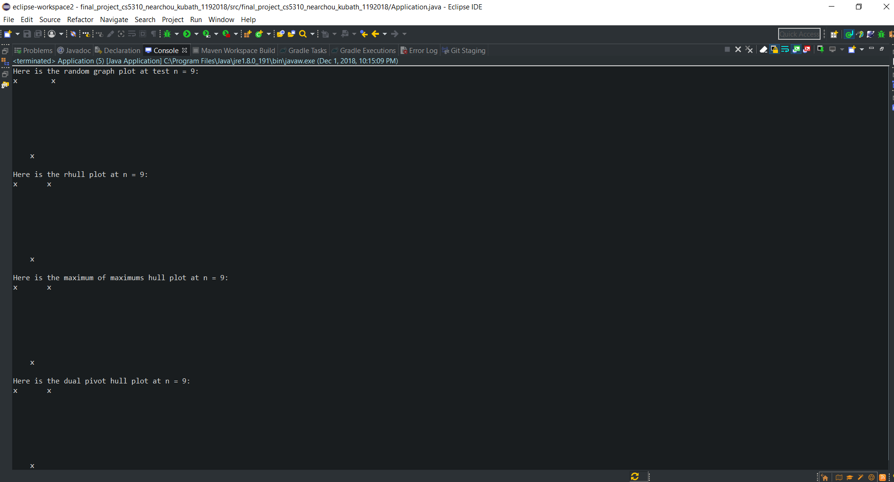
QuickHull: Testing/Example
Resulting hull computations from the three partition adaptations:

Slide 27
QuickHull: Results
Analysis on random n x n graphs.
Range value of n from 10 <= n <= 500 in steps of 10.
quickHull() executions averaged over five runs.
Theoretical times normalized by 1x10⁶/(2.5GHz) processor speed and taken as n*log(n) equivalent time operations
The theoretical calculations and experimental measurements plotted for the performance of the three quickHull() methods on n x n graphs of increasing n.

Slide 28
QuickHull: Results
In the figure below, we see the comparison of measured time complexities compared to the theoretical calculations:

Slide 29
QuickHull: Results
Overall growth of the implementations exceeds that of the theoretical calculations at some point after n = 100. The appearance seems to agree with worst-case behavior of O(n²).
We can conclude that the adaptations applied are ineffective at reducing time.
Objective of project to find partition adaptations to reduce QuickHull complexity was not achieved.

Slide 30
QuickHull: Results
Difficulties and errors in adaptation due to design of the adaptations.
Due to the triangular area being the means of partitioning sub arrays in a Hull() call, the element swapping in dual pivot and randomized pivot have no effect.
Additional errors may occur with partition selection.
During debugging, ties of partitions had proper partitions overlooked when calculating distances.
This is because some points were too close with integer precision.
This could be resolved with double precision angles calculated from triangle face lengths and use of an arccosine.

Slide 31
QuickHull: User’s Guide
The program file requires any of the recent versions of Java to exist on the user's computer.
With this requirement met, the program itself may be run by using an IDE like Eclipse or can be run from the console through Java.
For IDE, user needs to import the project into their file explorer.
Next, open imported project folder at the src level and click on the application.java file.
Once the class file appears in the main window, click on the green triangle execute button on the top toolbar of the IDE screen.

Slide 32
QuickHull: User’s Guide
The program will compile, then run. .
If the user wishes to engage in a demonstration, set the boolean test flag at the top of the main method to true before running.
In the case of command-line execution, enter the file path of the class file to execute and type run.
The program will compile, then run according to current value of the test flag in the source code.
To change the flag, go to the source code of the project file and replace "true" with "false" or vice versa.

Slide 33
References
Convex Hull. Wikipedia contributors. (16 September 2018). Retrieved November 30, 2018, from https://en.wikipedia.org/wiki/Convex_hull
Horowitz, E., Sahni, S., Rajasekeran, S., Computer Algorithms, 2nd Edition, Silicon Press, Summit, NJ 07901, 2008.
GeeksForGeeks Contributors. (n.d.) - GeeksForGeeks. Retrieved November 30, 2018, from https://www.geeksforgeeks.org/quickhull-algorithm-convex-hull/
Geometric Algorithms. João Comba. (n.d.). Retrieved November 30, 2018, from. cse.unl.edu/~ylu/raik283/notes/quickhull.ppt
QuickDualPivot.java from §2.3 Quicksort. (Fri Oct 20 12:50:46 EDT 2017). Retrieved November 30, 2018, from https://algs4.cs.princeton.edu/23quicksort/QuickDualPivot.java.html
Quicksort. Wikipedia contributors. (27 November 2018). Retrieved November 30, 2018, from https://en.wikipedia.org/wiki/Quicksort

