Slide 1
FLEX / Bison Calculator Implementation
Ioannis Nearchou & Jonah Kubath

Slide 2
Problem Description
Implement a calculator
Use a lexical analyzer to read input
Tokenize user input
Use a parser to match series of tokens to defined rules

Slide 3
Problem Description
Define rules to handle basic arithmetic operations
Addition, subtraction, multiplication, division, etc.
Trigonometric functions
Sine, Cosine, and tangent
Define rules to handle the derivation of polynomials and functions
dx( x^2 )
dx( cos(2x) )

Slide 4
Possible Methods
Lexical Analyzer Generators
LEX – First implemented in 1975 [1]
Standard on most Unix Systems
FLEX
Very similar to LEX
Faster run time and compressed table compared to LEX [2]
QUEX [3]
Modern lexical analyzer
Default general purpose token class

Slide 5
Possible Methods
Parser Generators
YACC
Standard on BSD and AT&T Unix systems
Produces a parser for recognizing defined grammars
Bison
Standard on GNU-based Linux systems
Forward-compatible YACC replacement
Well supported, last stable release was Nov 21, 2018

Slide 6
Implementation
Lexical Analyzer Generator
FLEX
Generates input analyzer in C code
Typically generated in O(n) time for length of the input [4]
Parser Generator
Bison
Generates LALR Parser in C code
Look Ahead Left to Right Parser
Works well with FLEX
Included with GNU-Linux

Slide 7
Implementation
Lexical Analyzer
Define how the data will be passed to the Parser
struct data_s {
char * s;
double num;
};
extern YYSTYPE yylval

Slide 8
Implementation
Define the regular expressions to break input into tokens
[ \t\r] - Removes any whitespaces
“+” return PLUS; – When a plus sign is read, return the PLUS token
“-” return MINUS;
“%” return MODULO;
“cos” return COS;
“(“ return LEFT_B;

Slide 9
Implementation
Read numbers and return the token NUMBER
[0-9.]+ { sscanf( yytext, “%lf”, &(yylval.num) ); return NUMBER; }
Read strings and copy the data
[a-zA-Z0-9.^-]+ { allocate memory, copy string, return STRING }
Read a derivative and the character to derive
“d”[a-z] { copy the character, return DERIV }

Slide 10
Examples
1 + 1
NUMBER PLUS NUMBER
( 1 + 1 ) * 6
LEFT_B NUMBER PLUS RIGHT_B MULTIPLY NUMBER
cos(2)
COS LEFT_B NUMBER RIGHT_B
X^2 + 2x + 4a
STRING PLUS STRING PLUS STRING
dx(x^2 – 2x)
DERIV LEFT_B STRING MINUS STRING RIGHT_B

Slide 11
Implementation
Parser
Define how data will be received
struct data_s {
char * s;
double num;
char ref;
};
Create character array to hold data
Char resultString[1024]

Slide 12
Implementation
Define tokens
%token NUMBER EOLN STRING
%token POWER MODULO
%token SIN COS TAN CSC SEC COT
%token DERIV
%token LEFT_B RIGHT_B
Tokens can also give precedence to tokens near them
%left PLUS MINUS
%left MULTIPLY DIVIDE

Slide 13
Implementation
Create context-free grammars
Read the tokens
commands:
/* Empty */
|
commands EOLN
|
commands exp EOLN
|
commands error EOLN

Slide 14
Implementation
Create context-free grammars for calculator operations
add_sub: mult_div
| add_sub PLUS mult_div { $$.num = $1.num + $3.num; }
| add_sub MINUS mult_div { $$.num = $1.num - $3.num; }
mult_div: power
| mult_div MULTIPLY power { $$.num = $1.num * $3.num; }
| mult_div DIVIDE power { $$.num = $1.num / $3.num; }
| mult_div MODULO power { $$.num = calcMod($1.num, $3.num); }

Slide 15
Implementation
Create context-free grammars for trigonometric functions
function:
SIN LEFT_B NUMBER RIGHT_B { $$.num = sinf($3.num); }
|
COS LEFT_B NUMBER RIGHT_B { $$.num = cosf($3.num); }
|
TAN LEFT_B NUMBER RIGHT_B { $$.num = tanf($3.num); }

Slide 16
Implementation
Create context-free grammars for derivatives
DERIV LEFT_B SIN LEFT_B polynomial RIGHT_B RIGHT_B { functionDeriv($5.s, "sin", $1.s[0]); $$.s = resultString; }
|
DERIV LEFT_B polynomial RIGHT_B { derivative($3.s, $1.s[0]); $$.s = resultString; }
|
DERIV LEFT_B NUMBER RIGHT_B { $$.s = "0"; }

Slide 17
Implementation
Create context-free grammars for saving numbers and strings
primary:
NUMBER { $$.num = $1.num; $$.s = NULL; }
|
STRING { $$.s = calloc(strlen($1.s), sizeof(char)); strcpy($$.s, $1.s); }
|
LEFT_B add_sub RIGHT_B { $$.num = $2.num; }
;

Slide 18
Implementation
Create C code to calculate derivatives of polynomials
Input – char * string, char reference
Receive a string and the variable to be derived in respect of
Output
A string with all sections derived in respect of the given reference variable

Slide 19
Implementation
Derivation Pseudo code
Split the input string into segments S1, S2, S3 by spaces
x^2 + 2x + 2a = x^2, +, 2x, +, 2a
Split the segments into five sections
dx( 3ax^2b )
Coefficient = 3
Variables in front of x = a
Reference variable = x
Reference variable exponent = 2
Variables after x = b

Slide 20
Implementation
Derive the sections dx( 3ax^2b )
Multiply the coefficient by the exponent of the reference variable
3 * 2
Reduce the reference variable’s exponent by one
2 – 1 = 1
Combine the sections to one string
Special printing instructions
Exponents with a power of 1 and double negatives change to ‘+’
6abx
Combine the derived sections to one result string

Slide 21
Implementation
Derivatives of trigonometric functions dx( cos(2x) )
Calculus defines the rule for the function
Take derivative of the inner polynomial
Combine to one string
1. Derivative of cos(a) = -sin(a)
2. Call polynomial derivative function on (2x) = 2
3. combine = -(2)(sin(2x))

Slide 22
Testing
Testing is attempting to cover the possible states that user input can put the application in.
Testing arithmetic problems
1 + 1 = 2
2 * 9 = 18
2 * 8 * 5 = 80
2 + (5 * 2) = 12
(1 + 2) * (4 + 5) = 27

Slide 23
Testing
Testing Derivatives of polynomials and functions
dx(1) = 0
dx(x) = 1
dx(x^2) = 2x
dx(a) = 0
dx(cos(2x)) = -(2)(sin(2x))
dx(2x + 3x^2 + x^-4) = 2 + 6x – 4x^-5

Slide 24
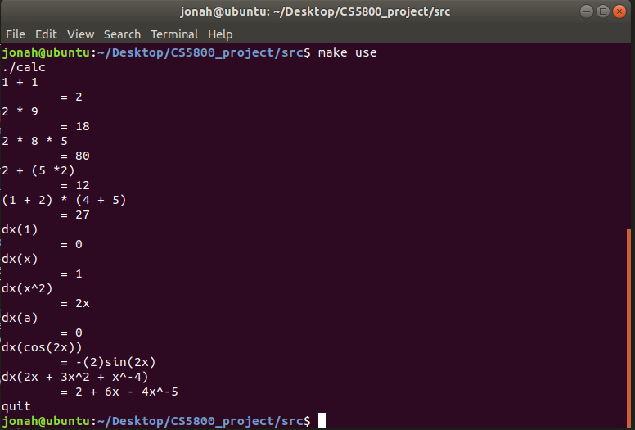

Slide 25
Results
Lexical Analyzer
Definite Finite Automata assist in character parsing and tokenizing
Quickly build regular expressions and allow FLEX to generate C code
Token Parser
Bison can quickly recognize series of tokens
Execute code when grammars are matched
Generates needed C code

Slide 26
User Guide
Compilation
Automated with makefile
Compile the executable - ~$ make
~$ flex calc.l
~$ bison –d –t parse.y
~$ gcc –o calc lex.yy.c parse.tab.c –lfl -lm
Run the executable - ~$ make run
~$ ./calc

Slide 27
Input
User Input
As show in the testing, any arithmetic, polynomial, or trigonometric expressions can be entered.
1 + 1
(2 * 3)
4 % 5
2^5
X^2 + 3x – 4a
Cos(2)
Derivatives start with “d” and the variable to derive
dx(x^2)
dv(v^2 + a^3 + 2v^-2)

Slide 28
References
[1] Wikipedia contributors. (2018a, November 25). Lex (software) - Wikipedia. Retrieved December 1, 2018, from https://en.wikipedia.org/wiki/Lex_(software)
[2] Srivastava, A. (1991). LEX VS. FLEX. Retrieved from http://digitalcollections.library.cmu.edu/awweb/awarchive?type=file&item=350072
[3] Introduction — Quex Lexical Analyzer Generator 0.64.8 documentation. (n.d.). Retrieved December 1, 2018, from http://quex.sourceforge.net/doc/html/intro/intro.html
[4] Wikipedia contributors. (n.d.). Flex (lexical analyzer generator) - Wikipedia. Retrieved December 1, 2018, from https://en.wikipedia.org/wiki/Flex_(lexical_analyzer_generator)

