Slide 1
FLEX / Bison Calculator Implementation
Ioannis Nearchou & Jonah Kubath

Slide 2
Problem Description
Implement a calculator
Use a lexical analyzer to read input
Tokenize user input
Use a parser to match series of tokens to defined rules

Slide 3
Problem Description
Define rules to handle basic arithmetic operations
Addition, subtraction, multiplication, division, etc.
Trigonometric functions
Sine, Cosine, and tangent
Define rules to handle the derivation of polynomials
dx( x^2 )
dx( cos(2x) )

Slide 4
Possible Methods
Lexical Analyzer Generators
LEX – First implemented in 1975 [1]
Standard on most Unix Systems
FLEX
Very similar to LEX
Faster run time and compressed table compared to LEX [2]
QUEX [3]
Modern lexical analyzer
Default general purpose token class

Slide 5
Possible Methods
Parser Generators
YACC
Standard on BSD and AT&T Unix systems
Produces a parser for recognizing defined grammars
Bison
Standard on GNU-based Linux systems
Forward-compatible YACC replacement
Well supported, last stable release was Nov 21, 2018

Slide 6
Implementation
Lexical Analyzer Generator
FLEX
Generates input analyzer in C code
Typically generated in O(n) time for length of the input [4]
Parser Generator
Bison
Generates LALR Parser in C code
Look Ahead Left to Right Parser
Works well with FLEX
Included with GNU-Linux

Slide 7
Implementation
Lexical Analyzer
Define how the data will be passed to the Parser
struct data_s {
char * s;
double num;
};
extern YYSTYPE yylval

Slide 8
Implementation
Define the regular expressions to break input into tokens
[ \t\r] - Removes any whitespaces
“+” return PLUS; – When a plus sign is read, return the PLUS token
“-” return MINUS;
“%” return MODULO;
“cos” return COS;
“(“ return LEFT_B;

Slide 9
Implementation
Read numbers and return the token NUMBER
[0-9.]+ { sscanf( yytext, “%lf”, &(yylval.num) ); return NUMBER; }
Read strings and copy the data
[a-zA-Z0-9.^-]+ { allocate memory, copy string, return STRING }
Read a derivative and the character to derive
“d”[a-z] { copy the character, return DERIV }

Slide 10
Examples
1 + 1
NUMBER PLUS NUMBER
( 1 + 1 ) * 6
LEFT_B NUMBER PLUS RIGHT_B MULTIPLY NUMBER
cos(2)
COS LEFT_B NUMBER RIGHT_B
X^2 + 2x + 4a
STRING PLUS STRING PLUS STRING
dx(x^2 – 2x)
DERIV LEFT_B STRING MINUS STRING RIGHT_B

Slide 11
Implementation
Parser
Define how data will be received
struct data_s {
char * s;
double num;
char ref;
};
Create character array to hold data
Char resultString[1024]

Slide 12
Implementation
Define tokens
%token NUMBER EOLN STRING
%token POWER MODULO
%token SIN COS TAN CSC SEC COT
%token DERIV
%token LEFT_B RIGHT_B
Tokens can also give precedence to tokens near them
%left PLUS MINUS
%left MULTIPLY DIVIDE

Slide 13
Implementation
Create context-free grammars
Read the tokens
commands:
/* Empty */
|
commands EOLN
|
commands exp EOLN
|
commands error EOLN

Slide 14
Implementation
Create context-free grammars for calculator operations
add_sub: mult_div
| add_sub PLUS mult_div { $$.num = $1.num + $3.num; }
| add_sub MINUS mult_div { $$.num = $1.num - $3.num; }
mult_div: power
| mult_div MULTIPLY power { $$.num = $1.num * $3.num; }
| mult_div DIVIDE power { $$.num = $1.num / $3.num; }
| mult_div MODULO power { $$.num = calcMod($1.num, $3.num); }

Slide 15
Implementation
Create context-free grammars for trigonometric functions
function:
SIN LEFT_B NUMBER RIGHT_B { $$.num = sinf($3.num); }
|
COS LEFT_B NUMBER RIGHT_B { $$.num = cosf($3.num); }
|
TAN LEFT_B NUMBER RIGHT_B { $$.num = tanf($3.num); }

Slide 16
Implementation
Create context-free grammars for derivatives
DERIV LEFT_B SIN LEFT_B polynomial RIGHT_B RIGHT_B { functionDeriv($5.s, "sin", $1.s[0]); $$.s = resultString; }
|
DERIV LEFT_B polynomial RIGHT_B { derivative($3.s, $1.s[0]); $$.s = resultString; }
|
DERIV LEFT_B NUMBER RIGHT_B { $$.s = "0"; }

Slide 17
Implementation
Create context-free grammars for saving numbers and strings
primary:
NUMBER { $$.num = $1.num; $$.s = NULL; }
|
STRING { $$.s = calloc(strlen($1.s), sizeof(char)); strcpy($$.s, $1.s); }
|
LEFT_B add_sub RIGHT_B { $$.num = $2.num; }
;

Slide 18
Implementation
Create C code to calculate derivatives of polynomials
Input – char * string, char reference
Receive a string and the variable to be derived in respect of
Output
A string with all sections derived in respect of the given reference variable

Slide 19
Implementation
Derivation Pseudo code
Split the input string into segments S1, S2, S3 by spaces
x^2 + 2x + 2a = x^2, +, 2x, +, 2a
Split the segments into five sections
dx( 3ax^2b )
Coefficient = 3
Variables in front of x = a
Reference variable = x
Reference variable exponent = 2
Variables after x = b

Slide 20
Implementation
Derive the sections dx( 3ax^2b )
Multiply the coefficient by the exponent of the reference variable
3 * 2
Reduce the reference variable’s exponent by one
2 – 1 = 1
Combine the sections to one string
Special printing instructions
Exponents with a power of 1 and double negatives change to ‘+’
6abx
Combine the derived sections to one result string

Slide 21
Implementation
Derivatives of trigonometric functions dx( cos(2x) )
Calculus defines the rule for the function
Take derivative of the inner polynomial
Combine to one string
1. Derivative of cos(a) = -sin(a)
2. Call polynomial derivative function on (2x) = 2
3. combine = -(2)(sin(2x))

Slide 22
Testing
Testing is attempting to cover the possible states that user input can put the application in.
Testing arithmetic problems
1 + 1 = 2
2 * 9 = 18
2 * 8 * 5 = 80
2 + (5 * 2) = 12
(1 + 2) * (4 + 5) = 27

Slide 23
Testing
Testing Derivatives of polynomials and functions
dx(1) = 0
dx(x) = 1
dx(x^2) = 2x
dx(a) = 0
dx(cos(2x)) = -(2)(sin(2x))
dx(2x + 3x^2 + x^-4) = 2 + 6x – 4x^-5

Slide 24
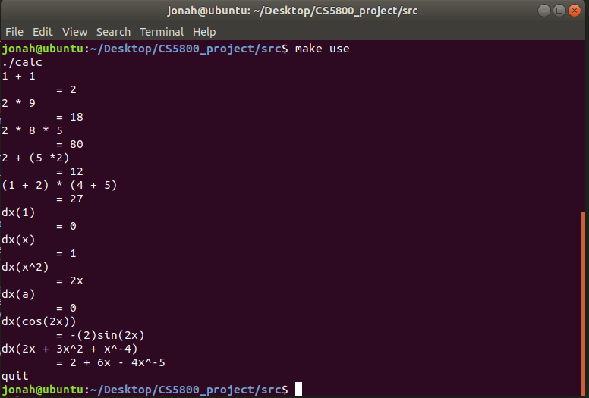

Slide 25
Results
Lexical Analyzer
Definite Finite Automata assist in character parsing and tokenizing
Quickly build regular expressions and allow FLEX to generate C code
Token Parser
Bison can quickly recognize series of tokens
Execute code when grammars are matched
Generates needed C code

Slide 26
User Guide
Compilation
Automated with makefile
Compile the executable - ~$ make
~$ flex calc.l
~$ bison –d –t parse.y
~$ gcc –o calc lex.yy.c parse.tab.c –lfl -lm
Run the executable - ~$ make run
~$ ./calc

Slide 27
Input
User Input
As show in the testing, any arithmetic, polynomial, or trigonometric expressions can be entered.
1 + 1
(2 * 3)
4 % 5
2^5
X^2 + 3x – 4a
Cos(2)
Derivatives start with “d” and the variable to derive
dx(x^2)
dv(v^2 + a^3 + 2v^-2)

Slide 28
References
[1] Wikipedia contributors. (2018a, November 25). Lex (software) - Wikipedia. Retrieved December 1, 2018, from https://en.wikipedia.org/wiki/Lex_(software)
[2] Srivastava, A. (1991). LEX VS. FLEX. Retrieved from http://digitalcollections.library.cmu.edu/awweb/awarchive?type=file&item=350072
[3] Introduction — Quex Lexical Analyzer Generator 0.64.8 documentation. (n.d.). Retrieved December 1, 2018, from http://quex.sourceforge.net/doc/html/intro/intro.html
[4] Wikipedia contributors. (n.d.). Flex (lexical analyzer generator) - Wikipedia. Retrieved December 1, 2018, from https://en.wikipedia.org/wiki/Flex_(lexical_analyzer_generator)

