Slide 1
Mass Spectrum Protein Matching with Neural Networks
Matt Peter
Jonah Kubath

Slide 2

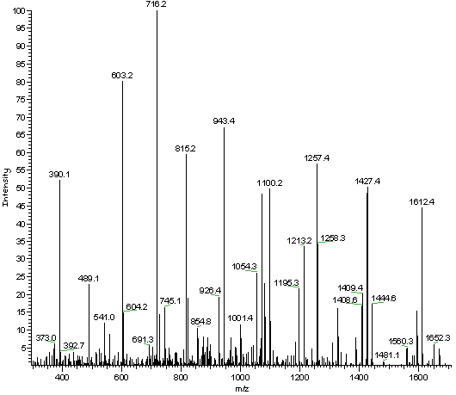
Proteomics
Mass Spectrometry
Proteins are broken into Peptide Sequences
Peptide are broken down into ions
Ions are then fragmented, separated, and detected

Slide 3
Data Augmentation
Yeast protein database was chosen
Protein sequences broken into peptide sequences with protein labels
Generate MS2 data for each peptide
LABEL Theoretical MS2
sp|P38149|DUG2_YEAST “27,44,71,72,84,88,93,101,102, …”

Slide 4
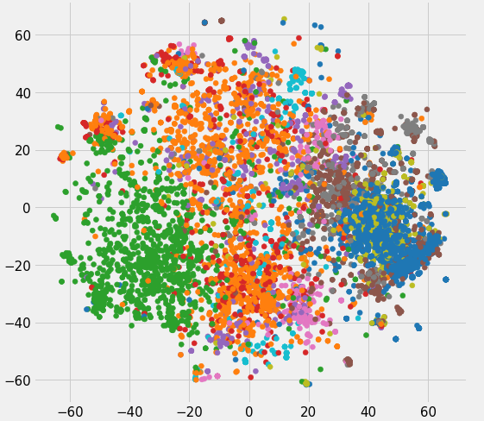
Embeddings
Represent ”words” in a multi-dimensional space
Similar words are grouped
In text, ”king” and “queen” are often used similarly
Input: “27,44,71,72,84,88,…”

Slide 5
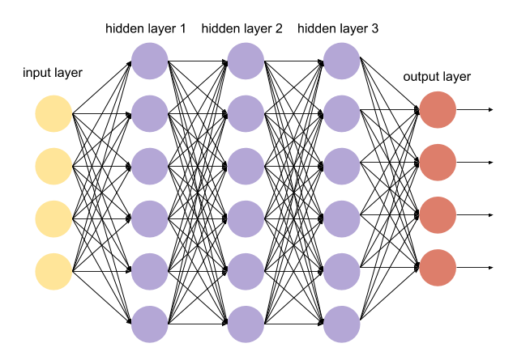
Design 1: Dense Network
Input Embedding layer
Multiple densely connected layers
50 nodes – 5000 nodes
Dense output layer
Each output neuron is protein label

Slide 6

Design 2: Convolutional Network
Input Embedding layer
Multiple convolutional 1D layers
Filters: 256
Kernel size: 8
Pooling layer
Pooling size: 2
Dense output layer
Each output neuron is protein label

Slide 7
Results
Convolutional 1D network worked the best
Dense network had higher learning capacity
Slower learning rate
With MS2 test data, %26 accuracy for predicted protein label

Slide 8
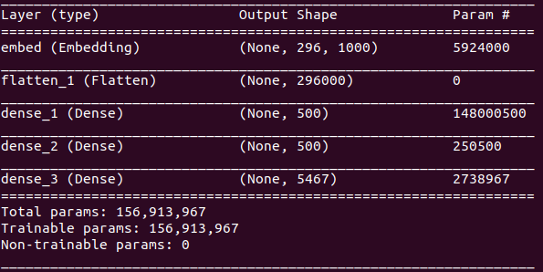
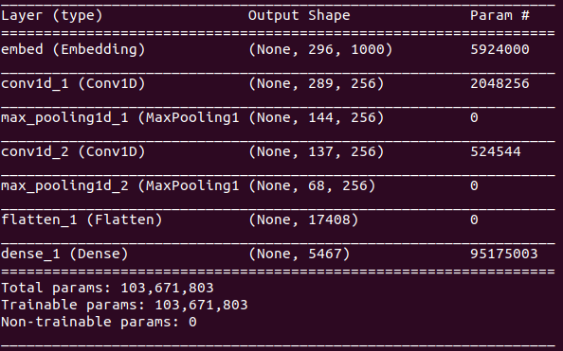
Results
Dense Network
Convolutional Network

Slide 9
Future Research
Train with larger data sets
2.7 million peptides were generated from the yeast database
Increase convolutional layers
Add noise to training data
Train for more epochs

Slide 10
Mass Spectrum Protein Matching with Neural Networks
Matt Peter
Jonah Kubath

